Slide 1




STM Reads 2014
Thanks to our Sponsors!

Slide 2


Slide 3
Click TO VIEW THE BOOK Trailer

Slide 4
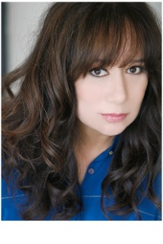
Tweet from Lissa
Hi, St. Malachy's Memorial High School!
STARTERS is a futuristic thriller where desperate teens rent out their bodies to seniors, so they can enjoy being young again temporarily.
See you April 29th!
Follow me at @Lissa_Price
and send questions with #STMReads
www.LissaPrice.com

Slide 5
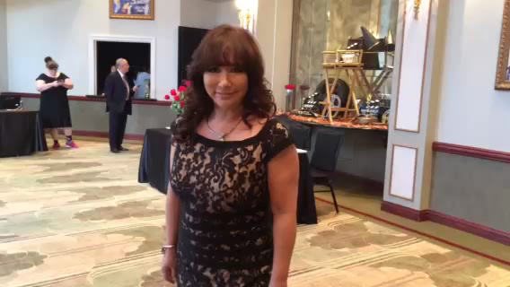

Slide 6
Author’s Visit – April 29
Highlights of Lissa’s visit will include;
ASSEMBLY: Lissa will answer some of her favorite questions about the book and will also speak about her sequel novel -ENDERS.
WORKSHOPS: Submit your questions to the author on Twitter using #STMReads OR submit them in writing to the prize box in the Learning Commons and you could win a spot in a workshop with the author.
PRIZES: Submit pictures of you and your friends reading STARTERS to @STM_Super_Saint , #STMReads for random prize draws!
BOOK SIGNING: Visit the Learning Commons at lunch to get your copy of STARTERS signed by the author.

