Slide 1
Entrepreneurship 110 Presents:
Our 1st Virtual Christmas Market

Slide 2
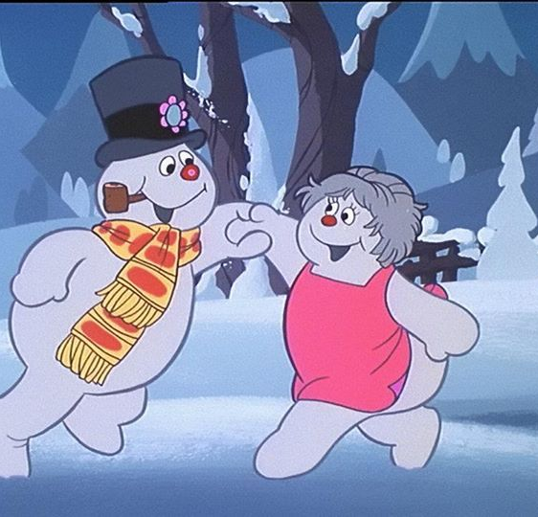
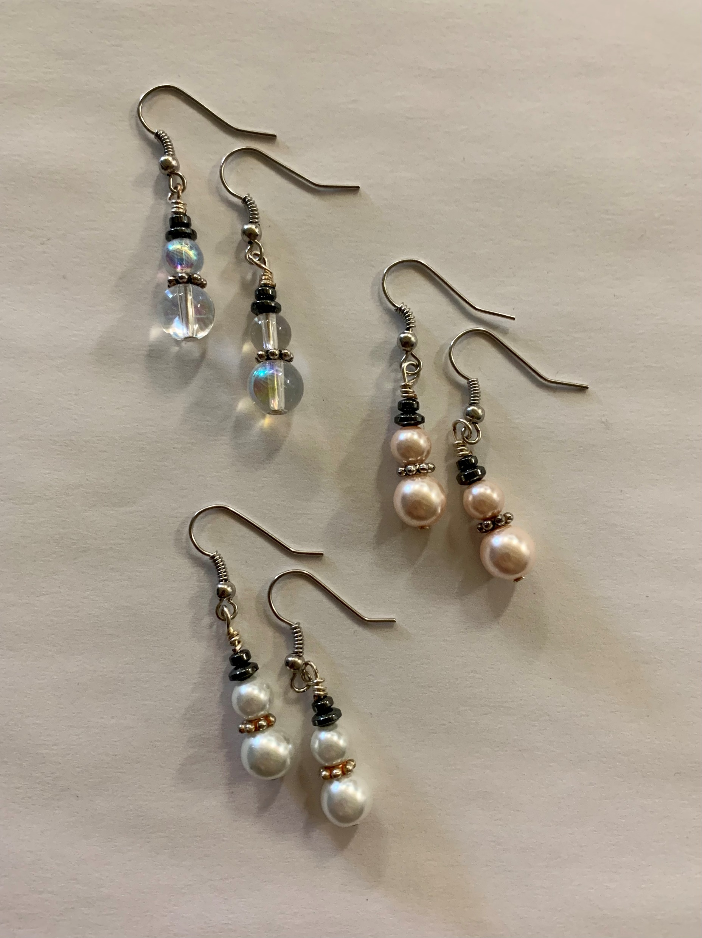
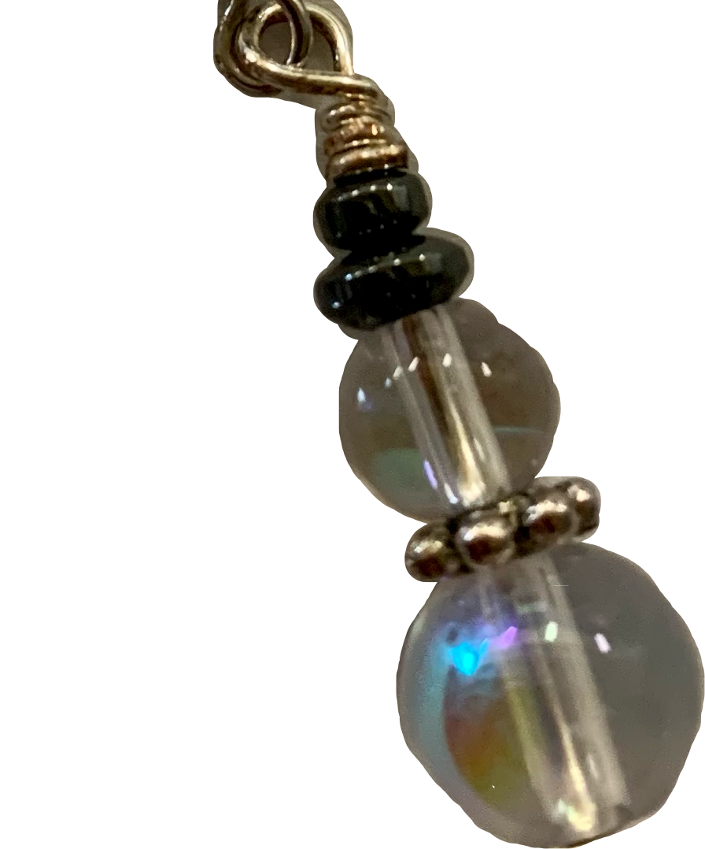
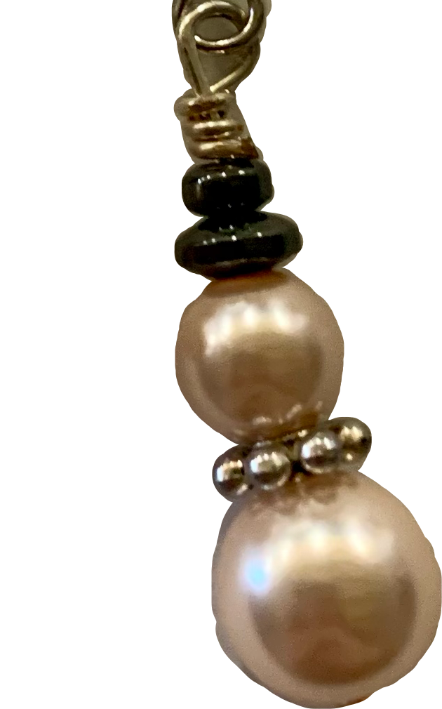
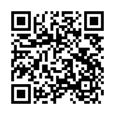
FROSTY DROPS
Handmade Snowman Earrings
ORDER NOW!
Scan with your phone.
Frosty Drops on Facebook
$5 A Pair
3 Colours
Clear Crystal
White Pearl
Rose Gold Pearl

Slide 3
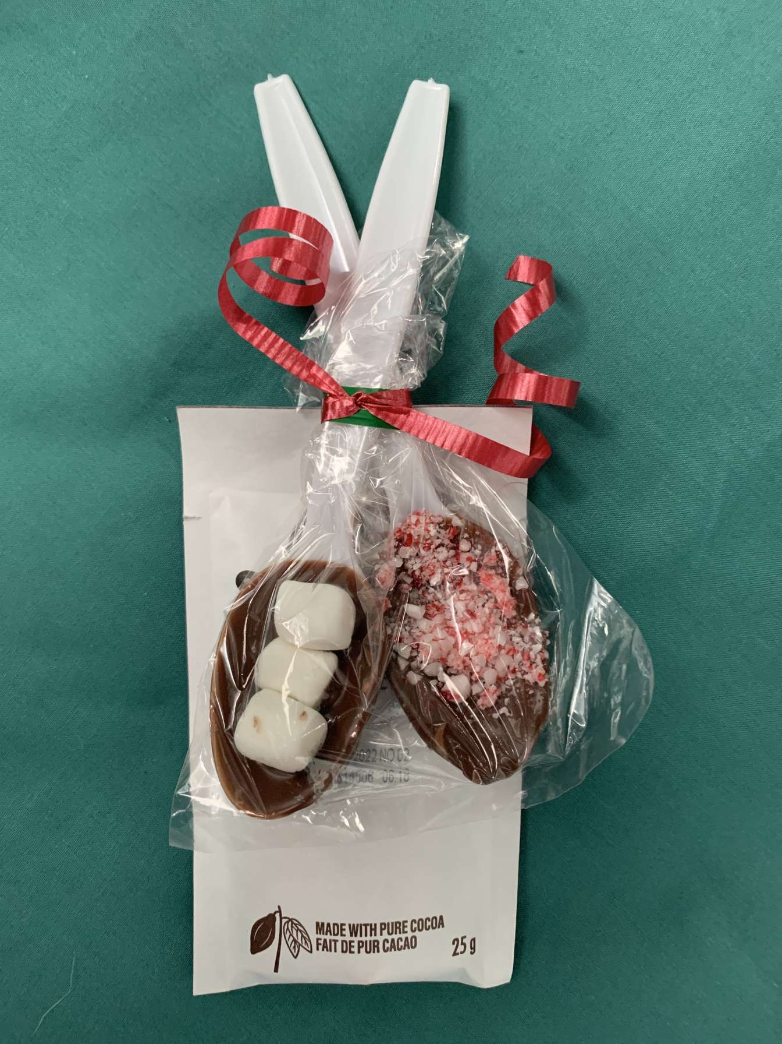
3$ for 2 dipsticks and a pack of hot chocolate
Order now at https://m.facebook.com/thedipsticksfromsimonds/

Slide 4
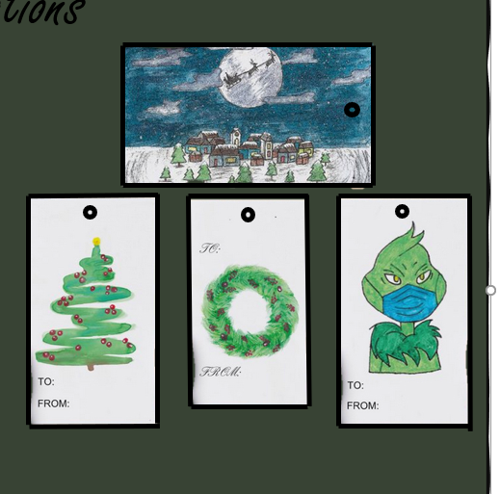
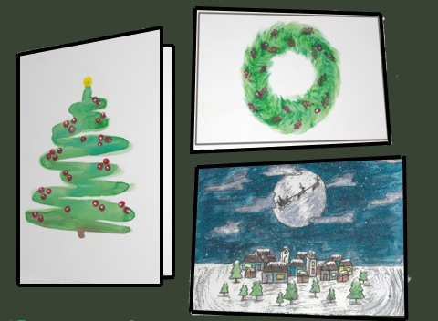
Carly’s Christmas Creations
Christmas cards & Christmas tags
with handmade art
BUNDLES
14$ for 10 tags & 3 cards
8$ for 5 tags & 2 cards
PRICE
0.50$ per tag
3.50$ per card
December 7th- 11th
Bringing Christmas cheer, despite the year

Slide 5
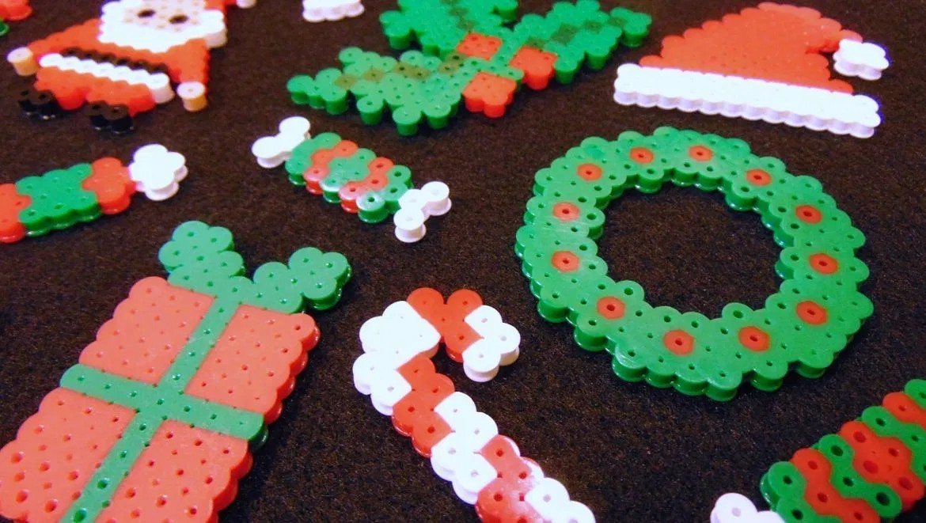
Perler Bead Shapes, usable for ornaments on your tree! 1 for $3.00 or 2 for $5.00

Slide 6
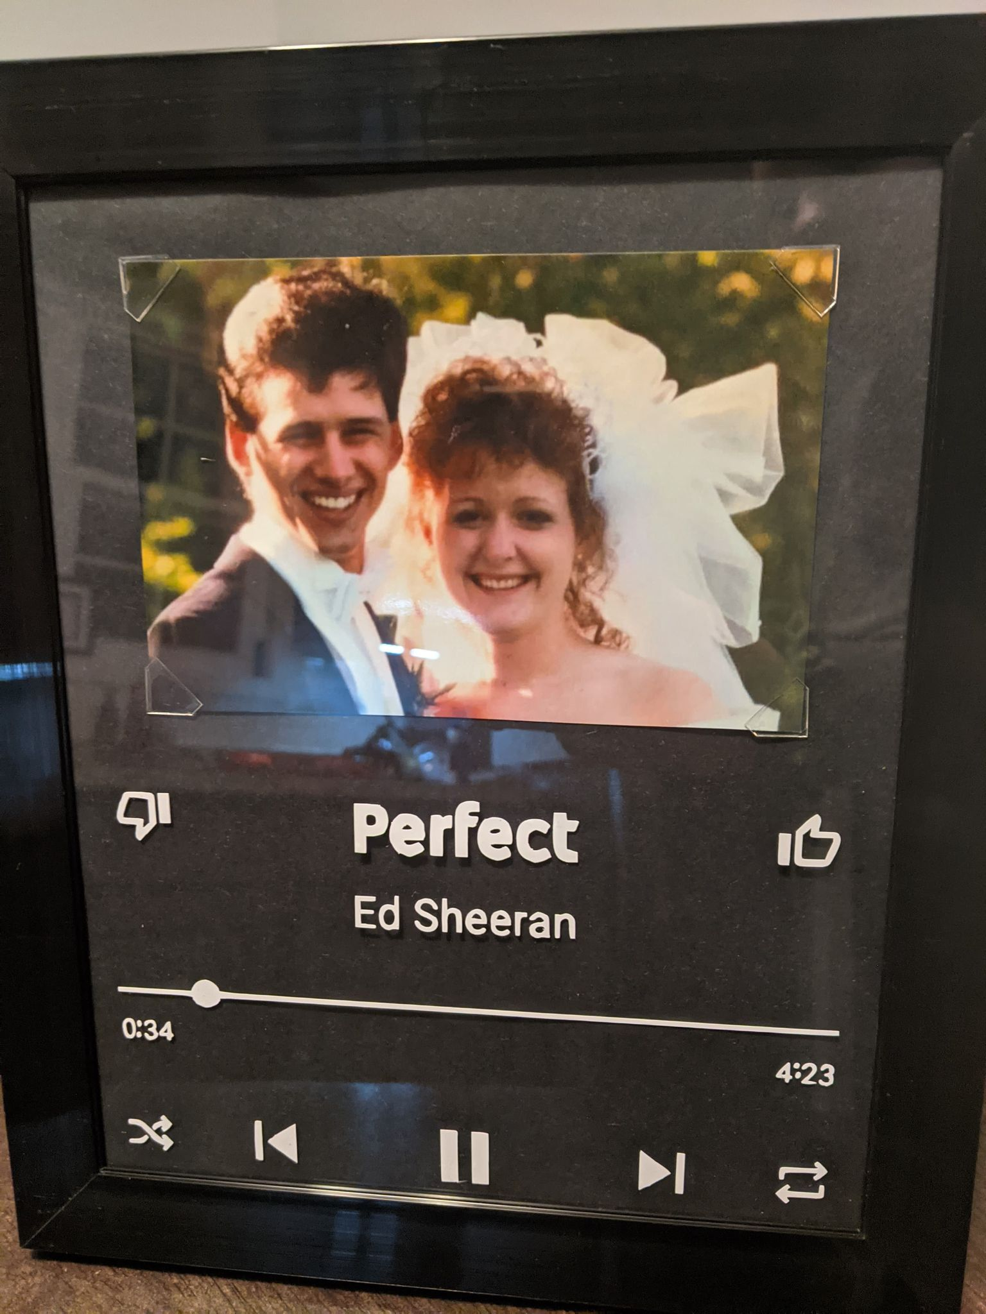
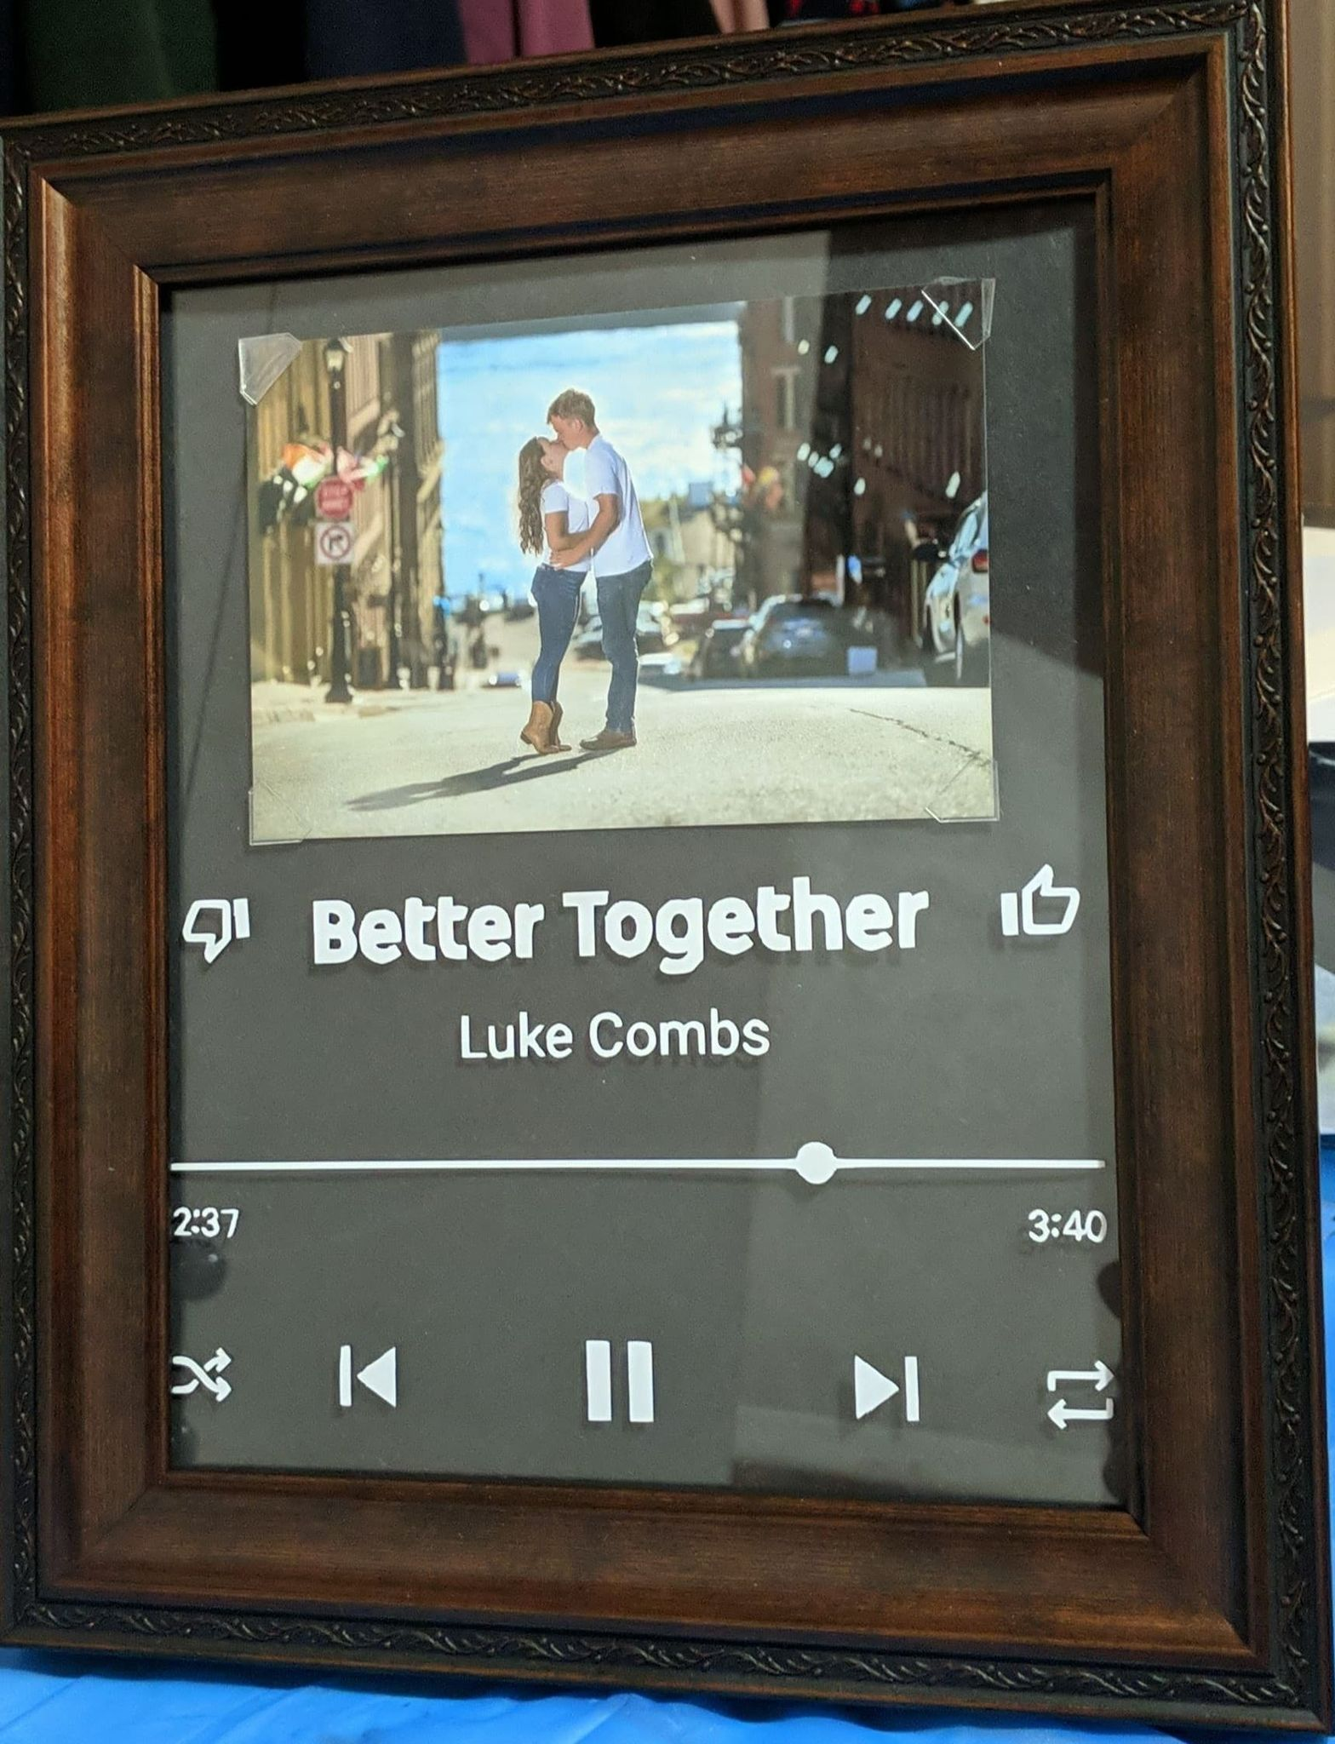
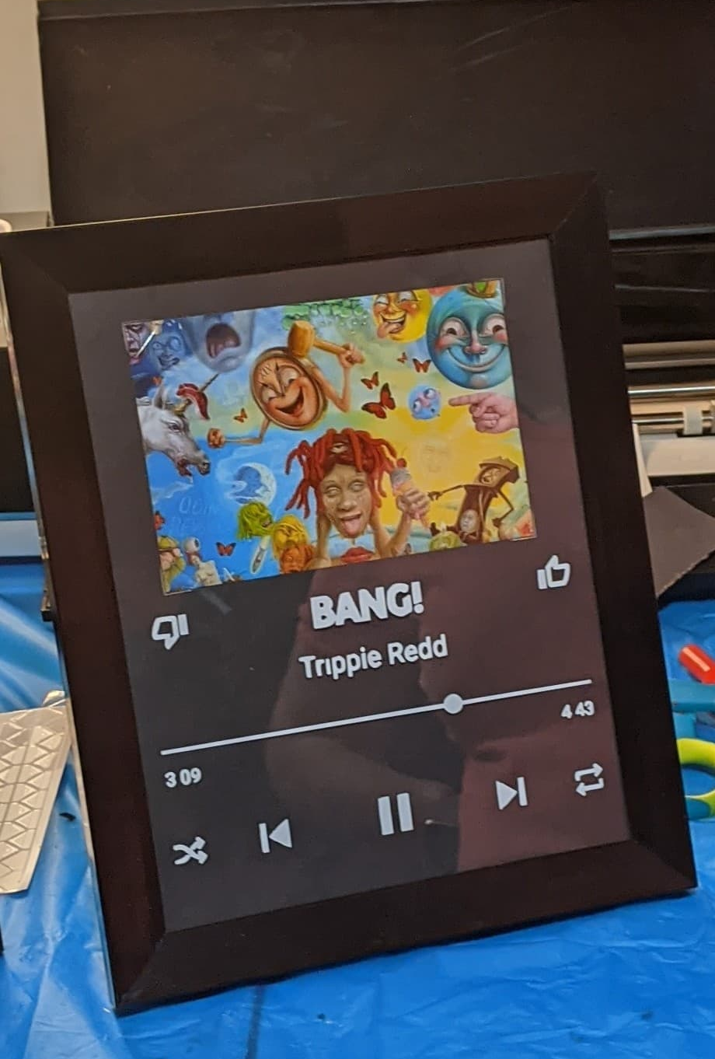
Pick a song for your friends and lovers to sing along!
1 for 20$
Frame-Us
(Glass Album Covers)
It even comes with a chip, that when you scan your phone over it, it plays the song!

Slide 7
Painted Christmas Ornaments
Bringing some glee to you and your tree!
Where?
Facebook Market Place
4$
Hand Painted
Christmas ornaments
https://www.facebook.com/Cardboard-Christmas-Ornaments-101058435201197

Slide 8
Custom T-Shirt Designs
We specialize in custom screened printed t-shirts for events such as birthday parties, corporate functions and sporting events.
We are only limited by your imagination!!
Part of the proceeds from every shirt sold with be donated to local charities to help those in need in our community
Please contact us for a quote as rates differ depending on your quantity. 506-639-4030

Slide 9
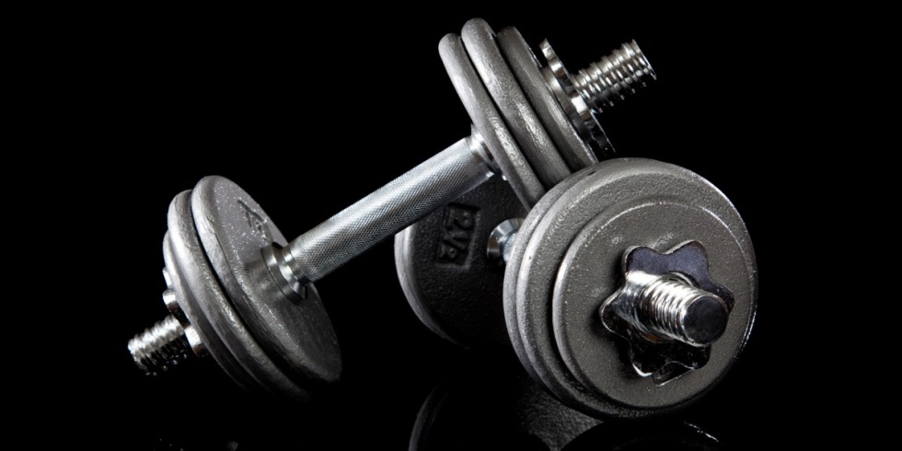
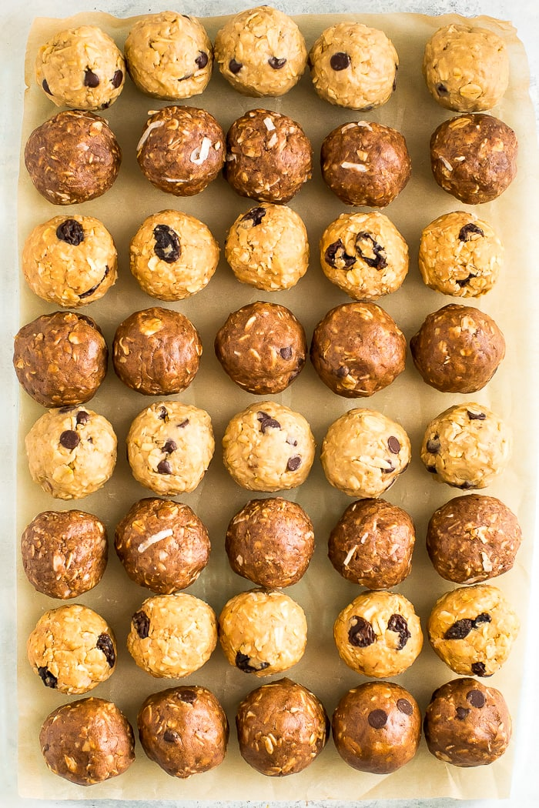
Pumped Up Protein Balls
4 for 4$
For when your too fit to quit!!!
By Ethan Barbour

Slide 10
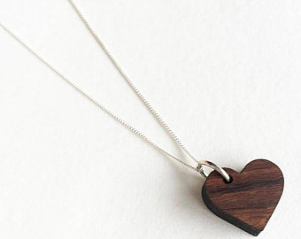
Master Medallions
Everyone’s got one, why don’t you?!
Small: $7.50
Regular: $10.00

Slide 11
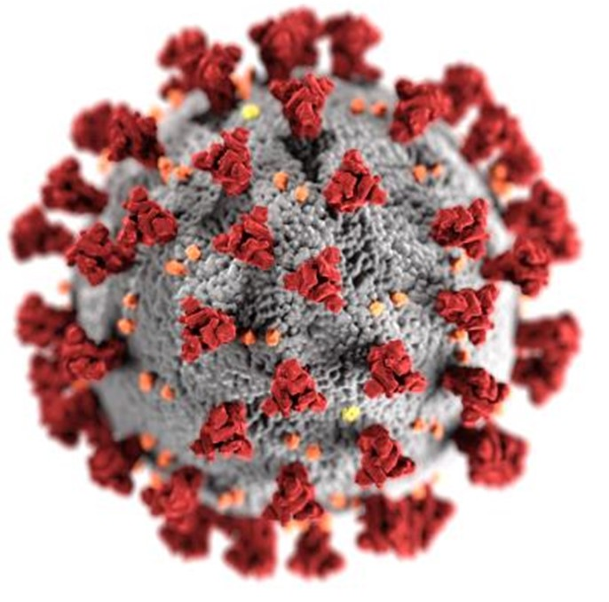
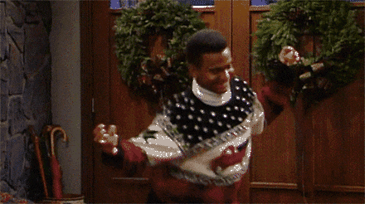
Need a little help getting into the Christmas spirit?
Get your Christmas cheer
for this Year!
T-shirts
$13 for students $15 for the rest

Slide 12
Glossy Lip Co.
Miracle Moisturizer!!
4$ Each or 2 for 7$!!!

Slide 13
Ultimate Gaming Guides
You’re better than you think.
https://www.facebook.com/ultimategaming.guides.1
All guiders are $5

Slide 14
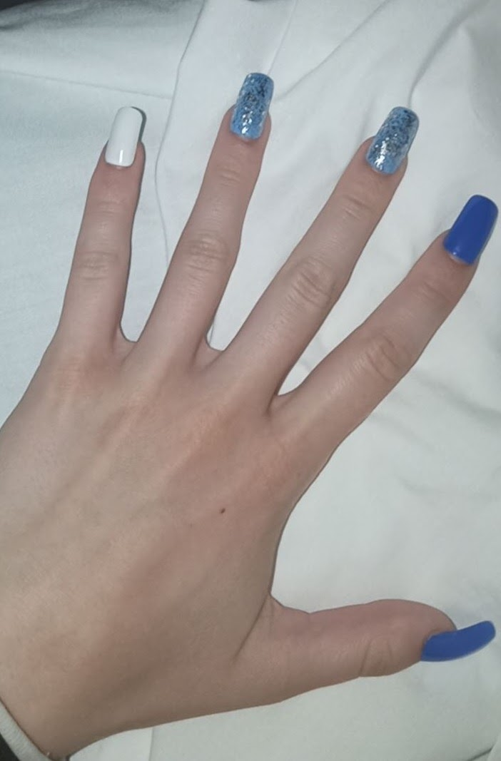
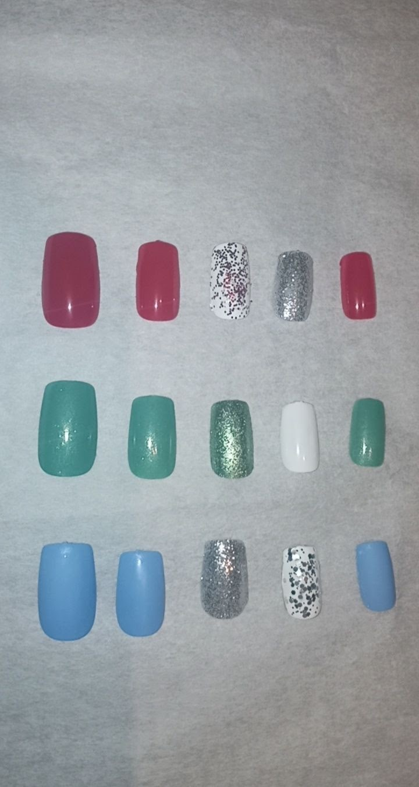
Festive Fingernails
10 custom nails!!
For only $12
Buy now on our Simonds online market or our Facebook page @Festivefingernails. Pick up dates are the 17th and 18th in Ms. Hayes classroom!

Slide 15
Visit Happenings in the Hive from Monday December 7th to Friday December 11th for the Links to
Each Student’s Business Page
Order your product, make your payment (preferably E-Transfer) and pick up your products on: Wed. Dec. 16th and Thurs. Dec. 17th
Thank you so much for supporting our Entrepreneurs!

