Slide 1
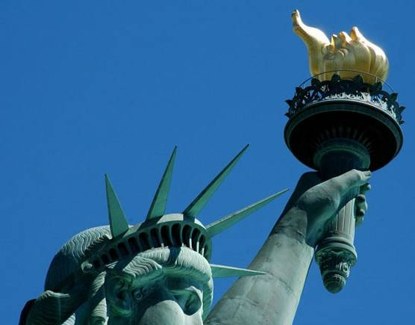

Simonds High School
Experiences Manhattan !
May 4-8, 2016
Travel Changes Lives

Slide 2

Agenda
Why Educational Travel
Why Travel On An EF Tour
Your Tour Details
Your Program Fee
What’s Included,
What’s Not
Payment Options
How To Enroll
Questions & Answers

Slide 3
Educational Travel…
why is it important ?
Make a lasting impact
  Travel encourages independence and opens our eyes to new points of view. Participants return home more curious about the world around them and more aware of themselves.
Prepare them for success
  Students who travel abroad gain a new appreciation for education and everything the world has to offer them.
Bring classroom lessons to life
  Teach history where it happened, languages where they are spoken and cultures where they are lived.

Slide 4
Benefits of Group Travel
More FUN than on your own.
Groups given preferential treatment from waiting
in lines or to see things such as behind the
scenes tours not available to individuals.
Get to see & do more things in a shorter time
period (itinerary & bookings done in advance &
guide provided).
Eliminates hassle of deciding, organizing and scheduling once arriving at destination.
Friends are with you to share the experience.
If problems arise, trouble-shoot them together,
not alone.

Slide 5
Why thousands choose EF ?
THE EF EXPERIENCE
EF - “Education First”
50 Years Educating Students
World’s Largest Education Company
Certified through TICO, and a member
of Student and Youth Travel Association of North America, and the Ontario Motor Coach Association
Best Support
The in-house Customer Service Department and full-time Tour
Directors provide around the clock support.
EF Safety First Initiative
EF SAFETY FIRST
Offices across North America
Toronto, Montreal, New York City, Washington and Boston
24-hour Service
Emergency on-call service 24 hours a day, 7 days a week
Tour Directors
Bilingual, professionally trained EF Tour Director accompanies your group 24 hours a day.
Free Peace of Mind Program
EF’s Peace of Mind Program allows you to change your tour and/or departure date should your school board not allow you to travel for safety reasons.

Slide 6
New York City – March 2016
The Simonds High trip to New York City is
- school sponsored
- ASD-S approved
- supervised by
Mme Cormier and Miss Downey
We have years of experience teaching students, organizing and chaperoning student travel.

Slide 7
DAY 1 – Tentative Itinerary
Board your motor coach for New York at
Simonds High School
Arrival at your hotel in New Jersey
Pizza Party upon arrival at your hotel
Overnight at the same hotel for the next four nights

Slide 8
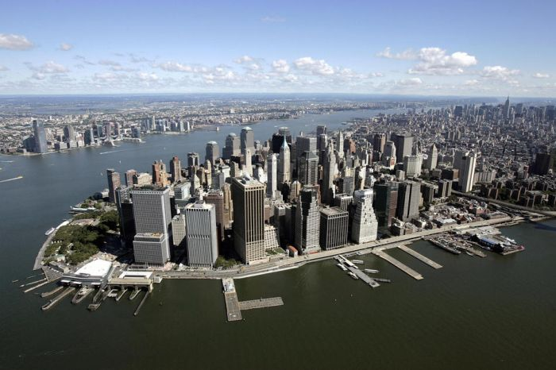
Welcome to New York City!

Slide 9
DAY 2 – Tentative Itinerary
Breakfast at your hotel in New Jersey
Guided Sightseeing of New York City: Wall Street, St.Paul’s Church, SoHo, Greenwich Village, Chinatown, Little Italy…
World Trade Center Memorial
Brooklyn Bridge Walking Tour
Free Time for Shopping on Canal Street (Chinatown)
Dinner in Midtown
Broadway Show
Overnight at hotel in New Jersey

Slide 10
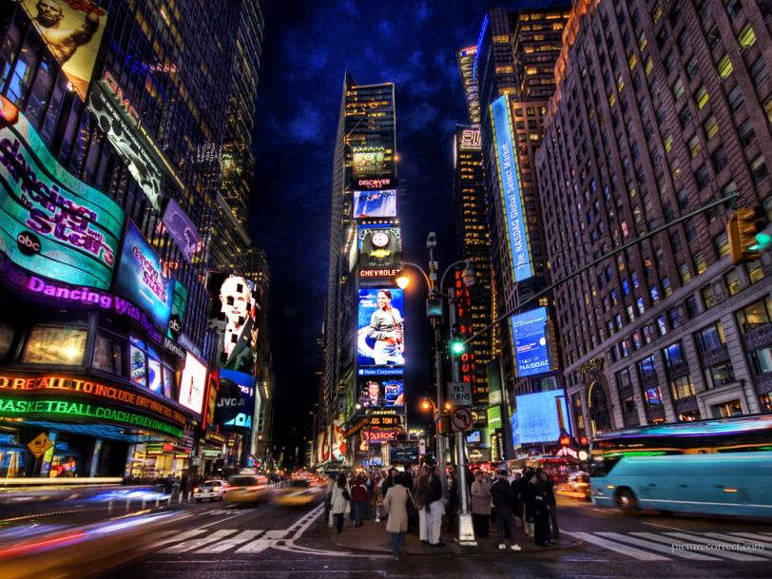
Times Square

Slide 11





Madame Tussaud’s Wax Museum

Slide 12
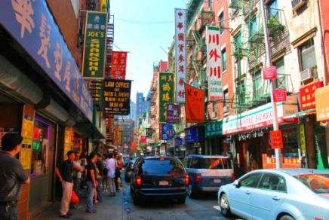
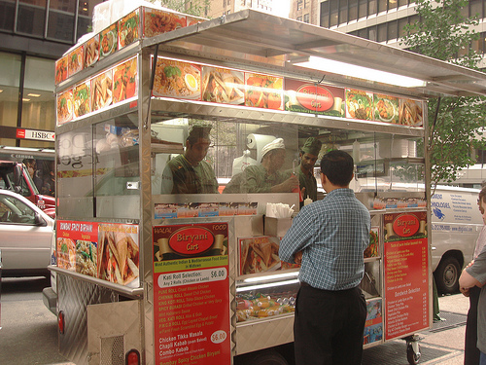
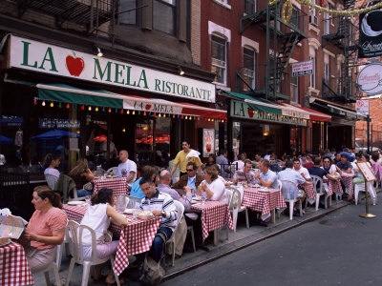
Neighborhood Exploration

Slide 13
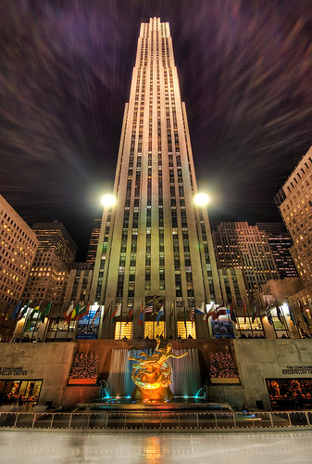

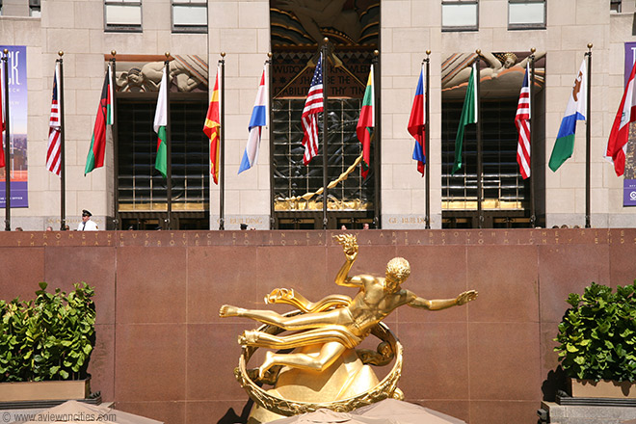
Rockefeller Center

Slide 14
DAY 3 – Tentative Itinerary
Breakfast at your hotel
Walking Tour of Central Park: Strawberry Fields, Fountain, Lake, Bridge, Merry-Go-Round, statue of Alice in Wonderland, etc
American Museum of Natural History
Lunch Midtown Manhattan at your own expense
Madame Tussaud’s Wax Museum
Baseball Game
- students receive $15 each for dinner
Overnight at hotel in New Jersey

Slide 15

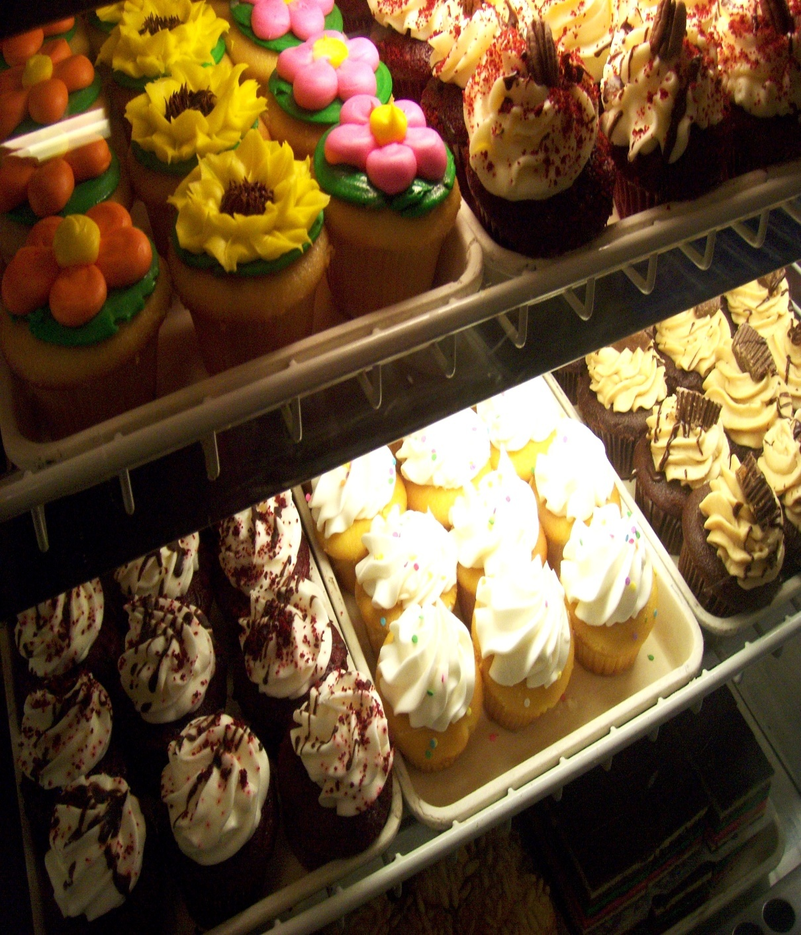
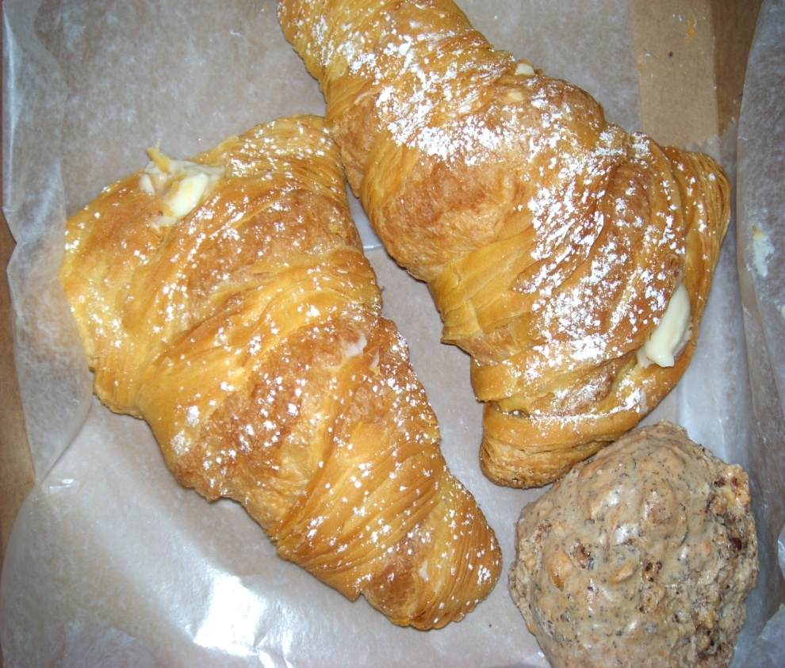
Carlo’s Bakery of Cake Boss

Slide 16
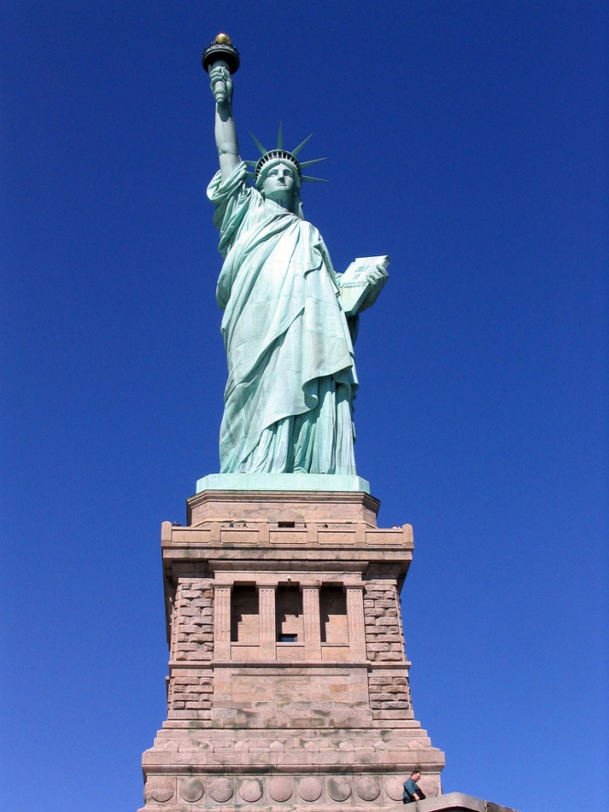
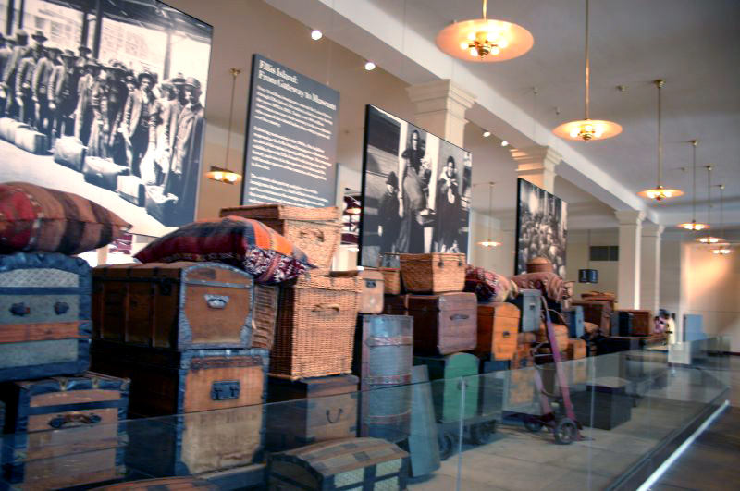
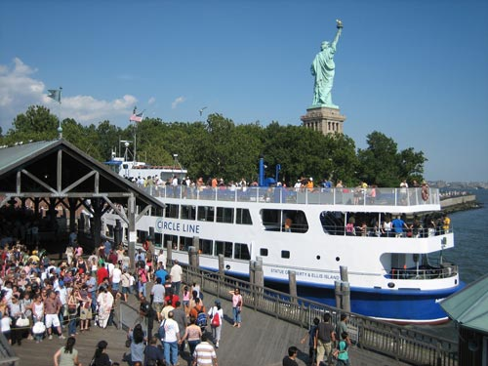
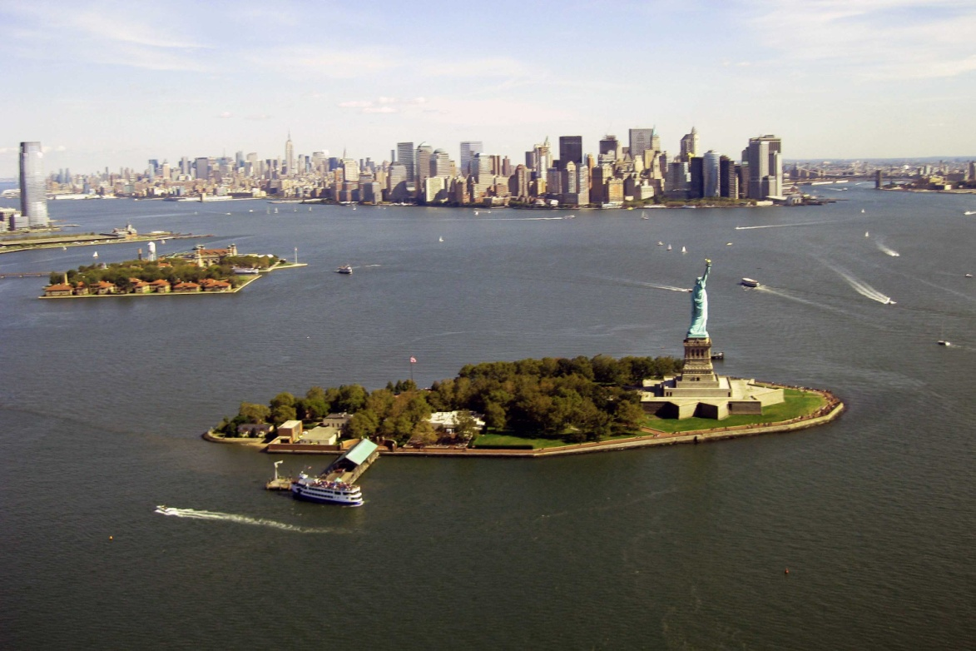
Statue of Liberty / Ellis Island

Slide 17

South Street Seaport

Slide 18
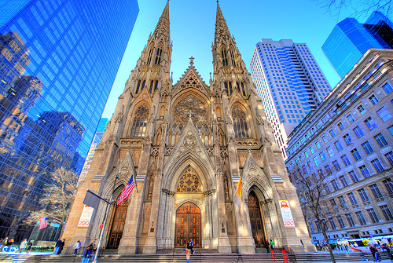
St. Patrick’s Cathedral

Slide 19
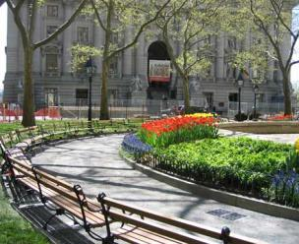
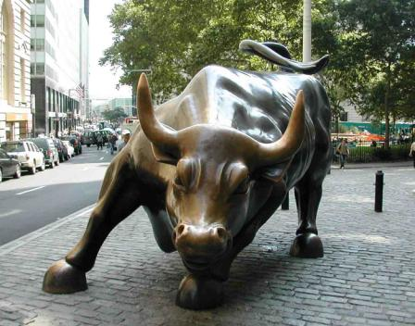
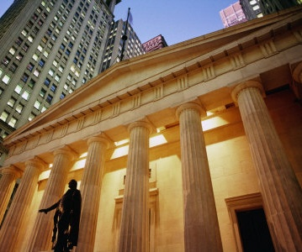

Financial District

Slide 20
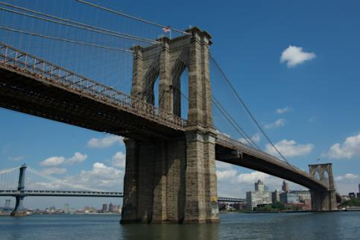
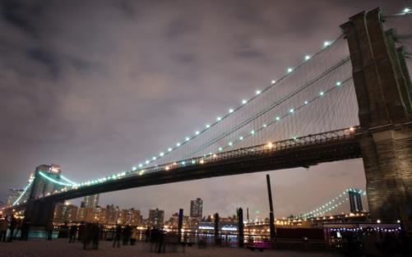
Brooklyn Bridge

Slide 21

Broadway Show

Slide 22


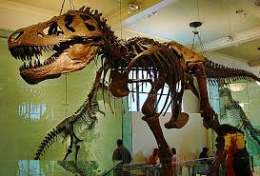
American Museum of Natural History

Slide 23
DAY 4 – Tentative Itinerary
Breakfast at your hotel
Statue of Liberty and Ellis Island
Lunch at South Street Seaport
Top of the Rock Observatory at Rockefeller Centre
Dinner in New York City
Free Time in Times Squares
Overnight at hotel in New Jersey

Slide 24
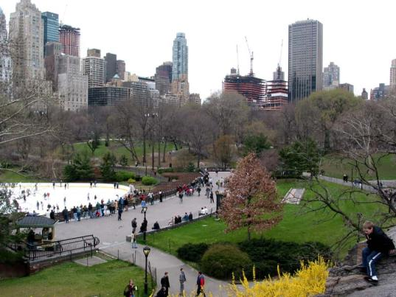
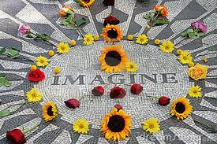
Central Park

Slide 25
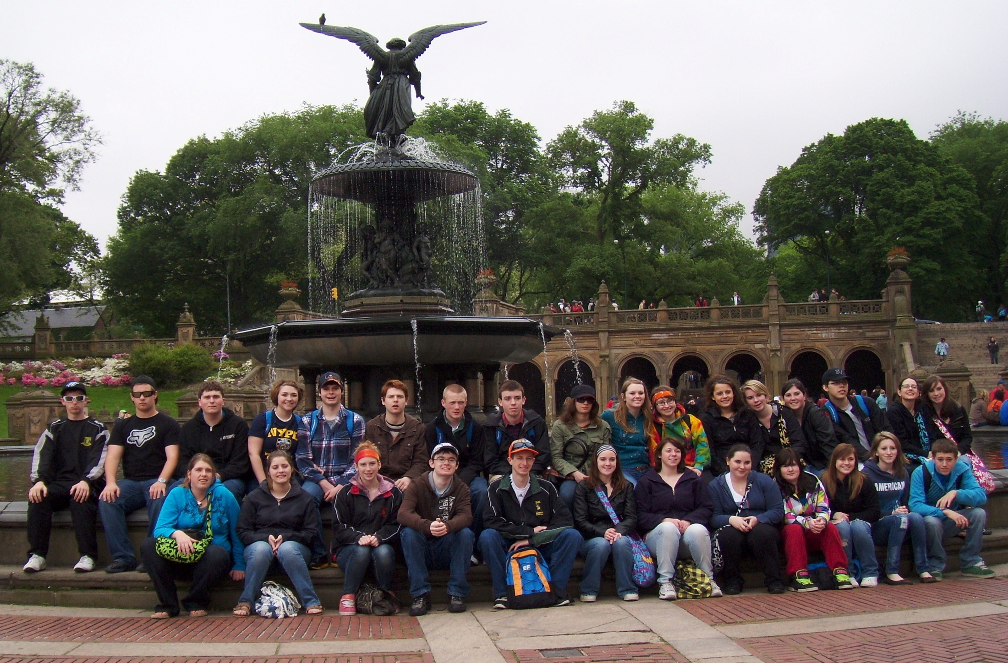
Simonds at Central Park

Slide 26
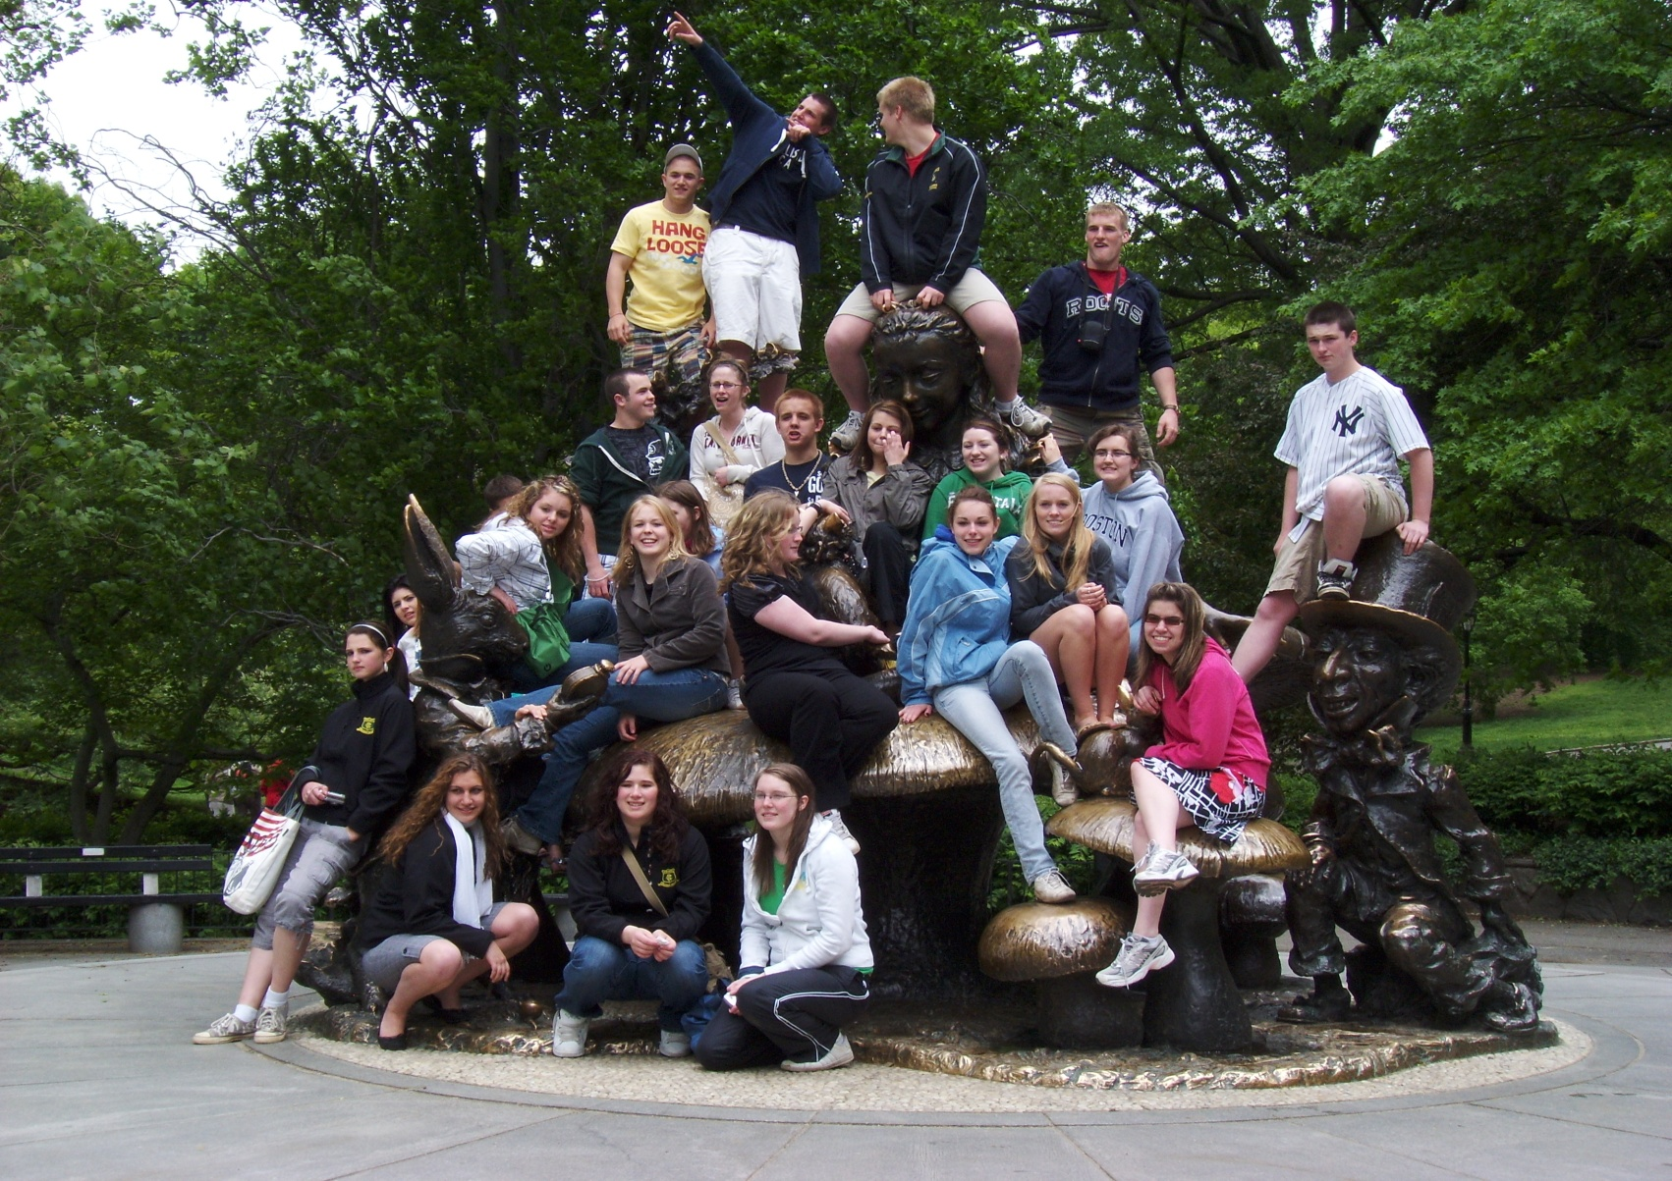
Simonds at Central Park

Slide 27
DAY 5 – Tentative Itinerary
Breakfast at your hotel
Board your motor coach for journey home
Arrive at Simonds early evening

Slide 28
What’s included and what’s not ?
Round-trip deluxe motor coach transportation
Superior tourist-class hotel accommodations
Breakfasts (4)
Dinners (4)
24/7 EF Tour Director
Night Security
Entrance fees to ALL included activities and attractions
Lunches
Personal spending money
Optional insurance
Applicable Passport Fee
Notes:
Lunches (unless specified)
Lunch time is your time to go explore and taste something new!
Personal spending money
Bring some extra money so you can pick up a few souvenirs for friends and family!
$25 per person/per day (in local currency)
Potentially
Optional insurance
Passport/visa fees

Slide 29
Cost of the Trip
The program fees for this trip are variable, depending upon the number of students participating.
# of Participants Program Fee
30 – 34 $1025
35 – 39 $975
40 + $945
* $99 upon enrollment by October 15th 2015
_________________________________________
Additional Fees:
All-inclusive Insurance (optional) $60

Slide 30
How to Enrol
Option 1:
Enrol online by entering your tour number 1666428UM at www.eftours.ca/enrol
Option 2:
Call EF’s Customer Service number at
1-800-263-2806 and mention your tour number 1666428UM
Option 3:
Fill out the 2016 Traveller Application in booklet. Mail or fax to EF with your payment.

Slide 31
Payment Options
Most popular method is Auto Pay Plan
-Your payments are automatically deducted from you bank account
-Smaller, more manageable payments
-Convenient choice of dates for monthly payment
-Extend your final payment deadline by more than one month

Slide 32
Payment Options
If you DO NOT choose Auto Pay Plan, how may you make payments to EF ?
- Pay by credit card
Visa or Mastercard
- Pay by cheque
Payable to EF Educational Tours
- Pay by phone
Customer Service at 1-800-263-2806

Slide 33

What is the All Inclusive Insurance Plan ?
  Tour Cancellation and Interruption Coverage
  Medical and Accident Coverage
  Baggage and Property Coverage
  24-hour Emergency Assistance
$12 per day All-Inclusive Insurance
For more information, call EF’s Customer Service Department at 1-800-263-2806
Notes:
Lunches (unless specified)
Lunch time is your time to go explore and taste something new!
Personal spending money
Bring some extra money so you can pick up a few souvenirs for friends and family!
$25 per person/per day (in local currency)
Potentially
Optional insurance
Passport/visa fees

Slide 34
Crossing the Border
To cross the US Border by coach bus, you will need:
A VALID Passport
This passport must be valid for six (6) months from your date of return.
Notes:
Lunches (unless specified)
Lunch time is your time to go explore and taste something new!
Personal spending money
Bring some extra money so you can pick up a few souvenirs for friends and family!
$25 per person/per day (in local currency)
Potentially
Optional insurance
Passport/visa fees

Slide 35
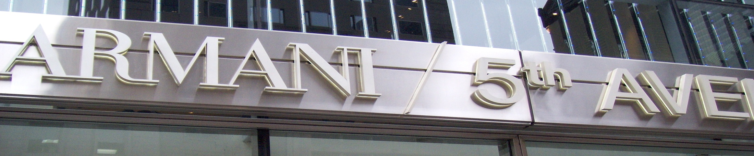


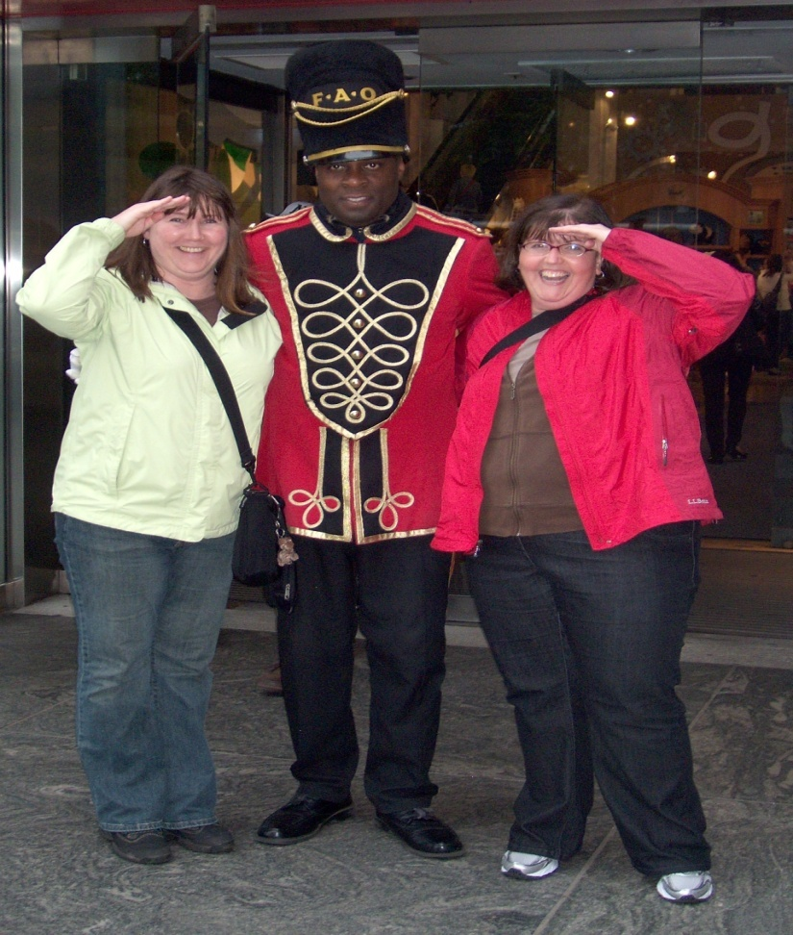
5th Avenue in New York
Famous People

Slide 36
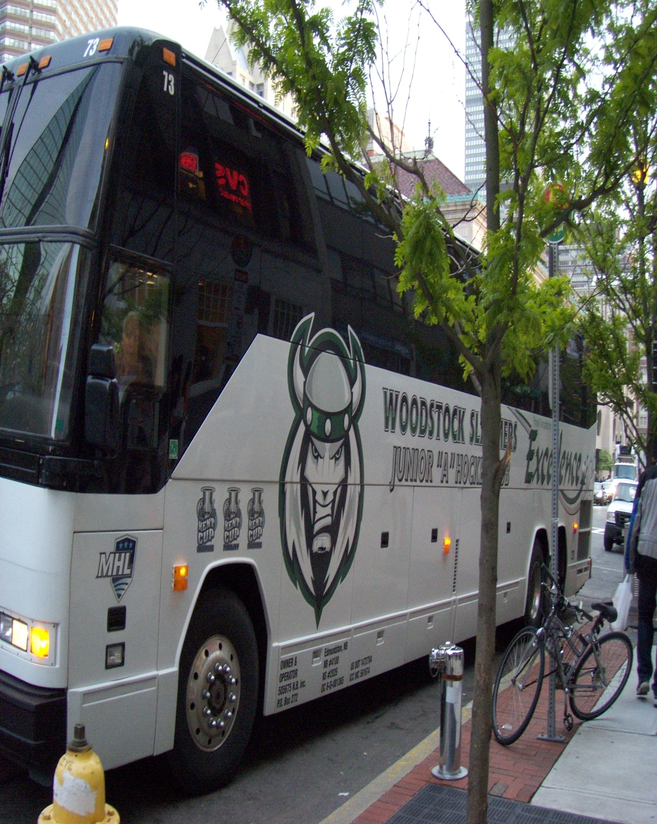
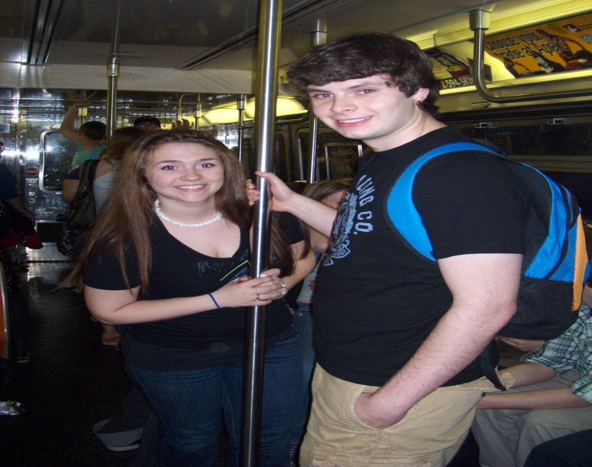
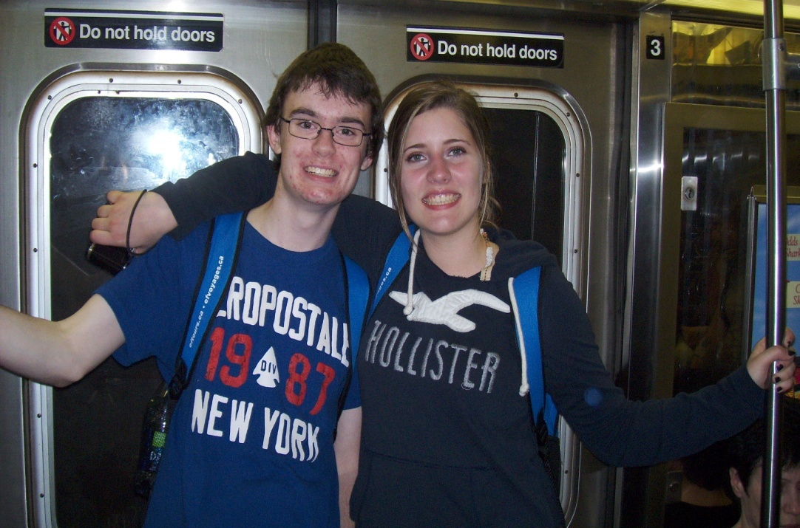
How Do We Travel Around On Tour ?

Slide 37
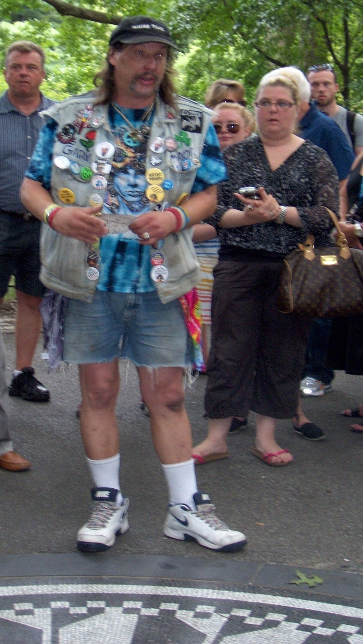
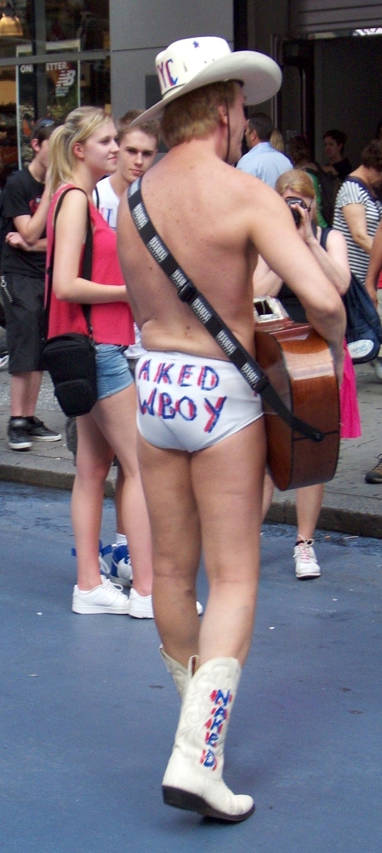
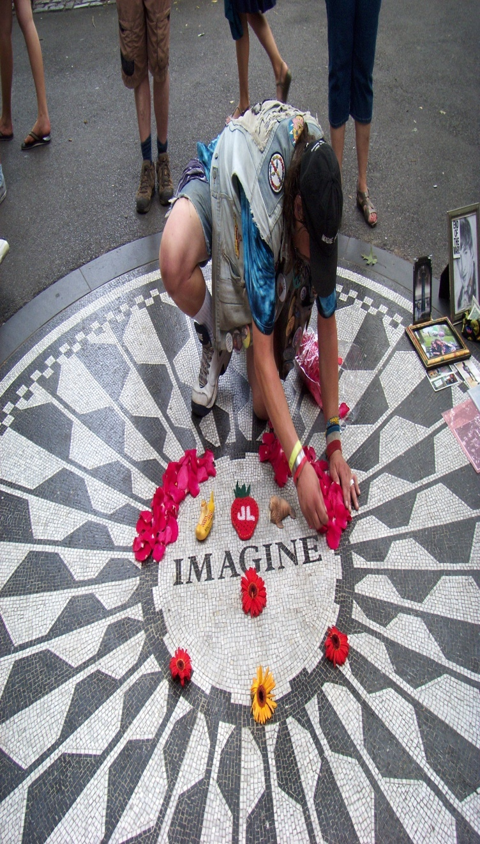
New York Oddities (Attractions)

Slide 38
Contact Information
Mme. Cormier
edmonde.cormier@nbed.nb.ca
Tel: 333-7130 or C-201
Miss Downey
stacey.downey@nbed.nb.ca
Tel: 658-2470 or C-307

Slide 39
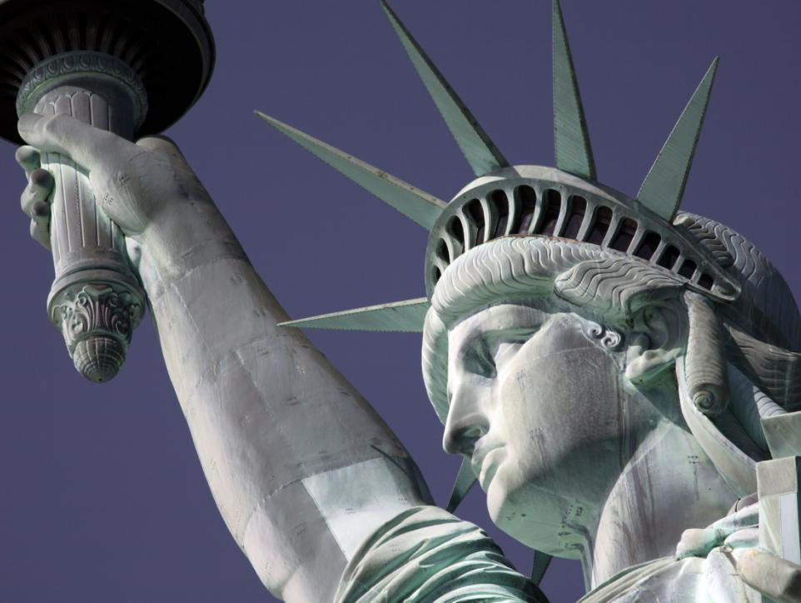
Thank You!
Any Questions?

