Slide 1
Notes:
As students are arriving, the “Did you Know” presentation can be running. Once everyone is situated, proceed to slide 1 (this slide). The Intro video does not have to run in it’s entirety.
This format of the presentation runs one class period (under 60 minutes) without the interview video in slide # 22. That would add an additional 7-8 minutes to the presentation running time.
Rough Timing Guidelines:
15 minutes: Career Planning Steps and discussion of how Job Fest supports each one (slides 1-10)
10 minutes: Cover Letters (slides 11-13)
20 minutes: Resumes (slides 14-21)
8 minutes: Interview Techniques (slides 22-24)
2 minutes: Wrap up (slide 25)

Slide 2
Job Fest is a career planning activity that provides grade 11 students in the Anglophone South School District with information to help them to successfully apply their education, interests and skills to opportunities in the workforce.
It is an online, virtual environment where you can speak to business and training school representatives in real time, download resources that will help you in your job search and career decision-making and watch career and professional instructional videos.
Selected grade 11 students can participate in a practice job interview with an actual employer so they can hone their skills for their actual job search.
Notes:
Introduce presenters
Explanation of Job Fest
Time: 1 minute

Slide 3
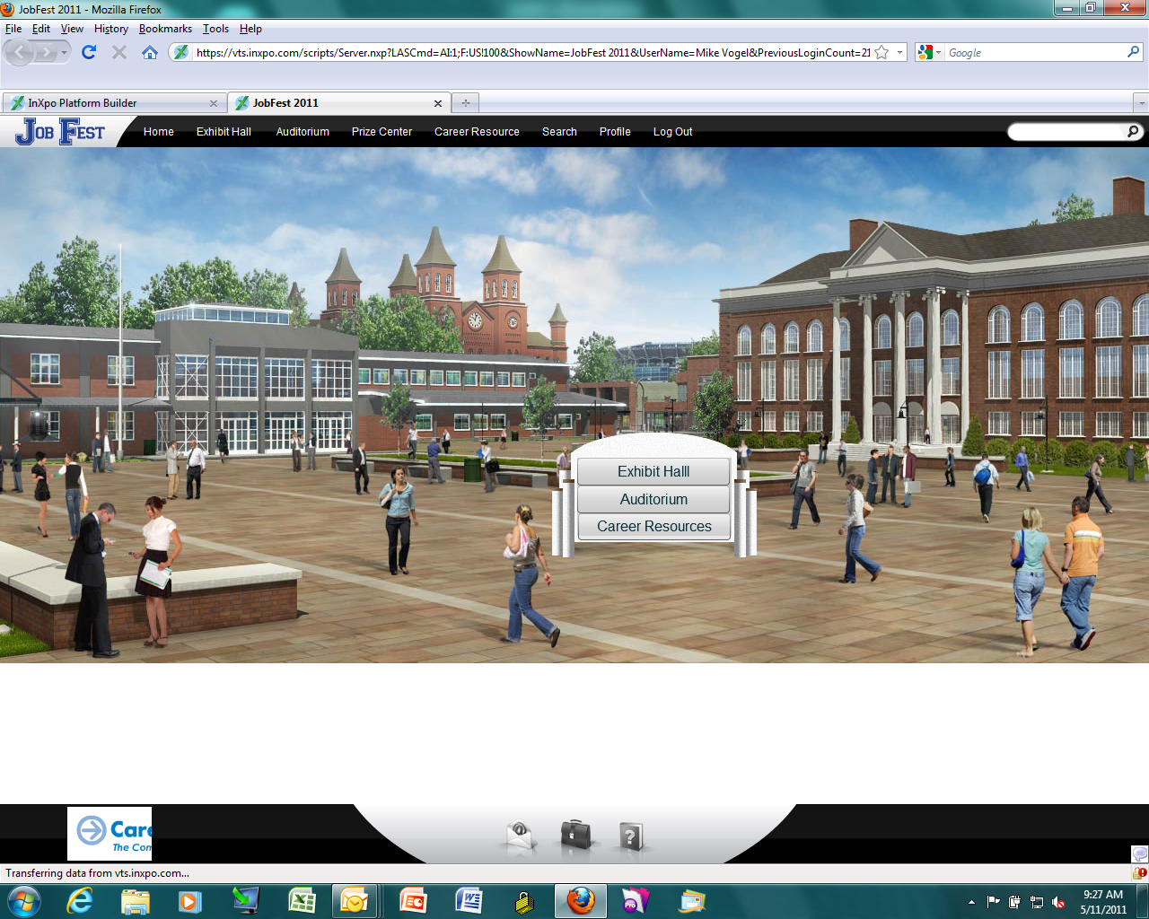
There are 3 main areas to explore:
Exhibit Hall Auditorium Career Resource Lounge
Notes:
Introduce presenters
Explanation of Job Fest
Time: 1 minute

Slide 4
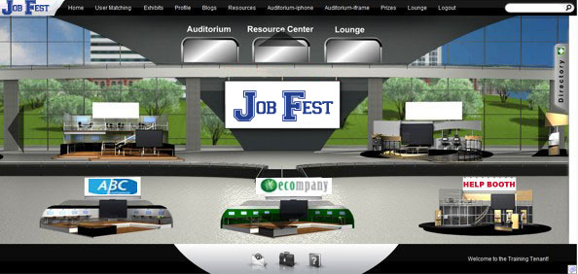
In the Exhibit Hall you can chat with the exhibitors in real time and explore information they provide at their booths. There are multiple floors to explore!
Notes:
Introduce presenters
Explanation of Job Fest
Time: 1 minute

Slide 5
..WELCOME TO JOB FEST 2013
Booth Overview
Job Fest Video
Download
Resources
Prize Draw!
FAQs
ABC INDUSTRY
In the Exhibitor Booths you may find videos, career descriptions, and industry info. You may be lucky enough to have a conversation with someone from the industry and gain valuable tips and insight!
Notes:
Introduce presenters
Explanation of Job Fest
Time: 1 minute

Slide 6
What kinds of exhibitors will be at Job Fest?
Over 30 booths representing the following industry sectors and training institutions:
Did you know?
Value Added Food
Value Added Wood
Industrial Fabrication
BioScience
Aerospace
Information and Communication Technology
Beside the more traditional industries of agriculture and forestry are emerging technical fields in Engineering/Steel Fabrication, BioScience (“green” technologies), Aerospace and ICT (gaming, social media, mobile apps).
The Provincial Government has identified these 6 areas as growth sectors that could lead to many opportunities for employment and careers here in our province!
Notes:
Introduce presenters
Explanation of Job Fest
Time: 1 minute

Slide 7
What kinds of exhibitors will be at Job Fest?
Supply Chain and Logistics
Arts, Culture, Tourism and Recreation
Mining
Energy
Apparel and Textiles
Public Safety and Justice
Contact Centres
If you are looking for interesting careers at Job Fest, you can talk to graphic and tattoo artists, musicians, broadcasters, film makers, video games designers and entrepreneurs.
Maybe adrenaline-based jobs are more your style. Check out firefighting, policing, military or emergency medicine.
Notes:
Introduce presenters
Explanation of Job Fest
Time: 1 minute

Slide 8
What kinds of exhibitors will be at Job Fest?
Transportation
Trades and Technology
Business and Finance
Plastics
Printing
Social Sciences
Medical and Health Care
How would you like to make lots of money?
Job Fest is about opening your mind to all the possibilities that exist in the local and global marketplaces.
Discover how entrepreneurs and large companies alike have found ways to combine industry sectors to take traditional industries in exciting new areas.
Notes:
Introduce presenters
Explanation of Job Fest
Time: 1 minute

Slide 9
What kinds of exhibitors will be at Job Fest?
Government
Retail and Service Industries
Community Colleges
Universities
Private Training Schools
Finance and Saving for Your Future
Career Planning Tools
Within each of these exhibitor booths are a wide assortment of companies, government agencies, and/or training institutions that are volunteering their time to give you information to help kick start your career.
This is an opportunity that is available exclusively to students in the Anglophone South School District!
Talk about getting a competitive advantage!
Notes:
Introduce presenters
Explanation of Job Fest
Time: 1 minute

Slide 10
There are 3 main areas to explore:
Exhibit Hall Auditorium Career Resource Lounge
Notes:
Introduce presenters
Explanation of Job Fest
Time: 1 minute

Slide 11
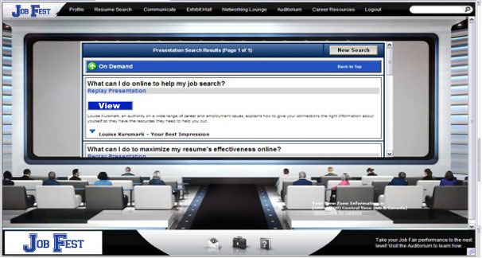
The Auditorium features pre-recorded presentation/videos that are available on demand during the event.
Notes:
Introduce presenters
Explanation of Job Fest
Time: 1 minute

Slide 12
There are 3 main areas to explore:
Exhibit Hall Auditorium Career Resource Lounge
Notes:
Introduce presenters
Explanation of Job Fest
Time: 1 minute

Slide 13
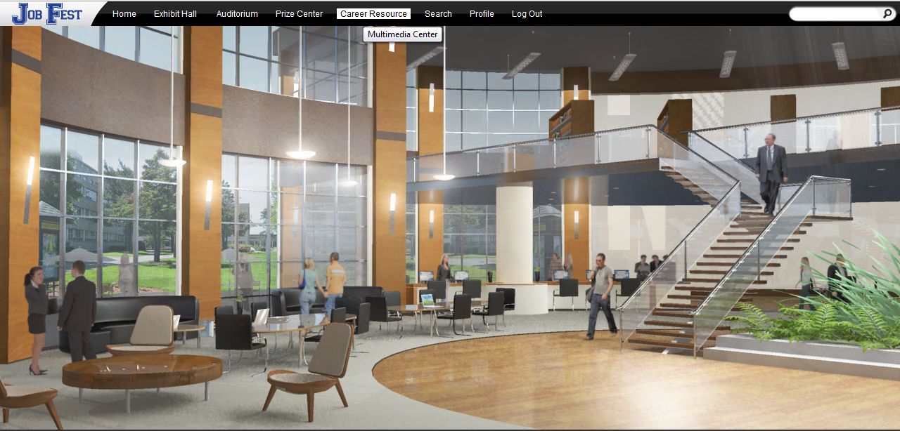
The information found in the Career Resource Lounge are especially helpful for your summer job search and deciding on your career options once you graduate from high school.
Notes:
Introduce presenters
Explanation of Job Fest
Time: 1 minute

Slide 14
OK, so how do you participate in Job Fest?
Visit during your scheduled class time on April 3rd or 4th
Visit as often as you wish from your home computer from April 6th to 30th.
Hone your job search skills by
applying to have a practice interview
with an HR professional.
This will get your résumé ready for your summer job search and provide you with valuable coaching tips!
Notes:
Introduce presenters
Explanation of Job Fest
Time: 1 minute

Slide 15
March 1st
Deadline for students to submit résumés/cover letters to Guidance Office.
March 11th – March 15th
Résumés short-listed by each school.
March 20th – March 22nd
If your résumé is selected, you will be notified that you have a chance to participate in a practice interview.
April 3rd and April 4th
JOB FEST 2013 (LIVE EVENT)
April 15th – April 18th
PRACTICE INTERVIEWS for selected students.
The interviews will be in person and take place in your high school.
Notes:
Introduce presenters
Explanation of Job Fest
Time: 1 minute

Slide 16
LET’S REVIEW THE BENEFITS:
Learn how to use new recruitment tools that employers and training schools are currently using.
Talk to employers about career
opportunities.
Talk to schools about admission requirements.
Get coaching advice to ace your next interview.
Notes:
Introduce presenters
Explanation of Job Fest
Time: 1 minute

Slide 17
EVEN MORE BENEFITS:
Collect information and resources to give you a competitive advantage in job seeking and your career.
Discover opportunities that can provide you with money for your post secondary training.
Have some fun trying some cool technology and who knows, you may be able to find a few prizes along the way!
Notes:
Introduce presenters
Explanation of Job Fest
Time: 1 minute

Slide 18
STILL NOT SURE? CONSIDER THIS…
Less than 20% of the available jobs are actually advertised!
(We know how you can access the hidden job market!)
Most employers take about 5-7 seconds to scan only
a small portion of your resume!
(We know the tricks to get them to read
your whole resume!)

Slide 19
MORE TO THINK ABOUT…
Most students settle for a lousy job with low pay instead of getting a job that will really benefit them.
(We know how to help you find a better job!)
Some students don’t have any idea about what
they are going to do after graduating
from high school.
(Yeah, we can help you with that too!)

Slide 20
So, no matter your career
destination…
The information at
Job Fest can help
get you where you
want to go!

Slide 21
Find out more!
Here is the link to
Job Fest!

Slide 22
Thanks for your time
&
see you at Job Fest!

