Slide 1
Welcome to Course Registration
2022 -2023!!!!
A student’s guide to a successful course selection

Slide 2
Course registration is the opportunity for students to select which courses they would like to study in the 2022-2023 year.
We do our best to ensure that students receive their first choices, but that is not always the case and, particularly when students are looking for a course that has only one section offered.
If you don't receive your first choice, your alternates are used. It is important to carefully consider your alternates when selecting courses.
Good Luck!!

Slide 3
Courses required for Graduation
English 11 (2 credits, one each semester)
English 12 (one semester)
2 Maths
1 Modern History
1 Science
1 Fine Arts/Life Role
______________
8 COMPULSORY CREDITS
+10 OPTIONS
_____________
18 TOTAL
• 5 Credits must be at the Grade 12 Level
• Must Pass English Language Proficiency Assessment
• Students may only count 2 Local Option courses toward graduation.

Slide 4
Course Levels
English 112
Year
Level

Slide 5
Course Levels
Level 1 = University Prep
Level 2 = University/College Prep
Level 3 = College Prep

Slide 6
Level 0 = One level only
Writing 110
Everyone can take this course
Some 120 courses can count as university admissions electives
AP English 120
Special course. AP means ‘Advanced
Placement’ and a university level course

Slide 7
Course Pre-Requisites
Keep in mind that you need to successfully complete some courses before you are able to take other…
Examples:
You need courses in Grade 10 to take some courses in Grade 11
You need Science 10, GMF 10 and NRF 10 to take Chemistry 11 or Physics 11.
You need Social Studies 10 to take Modern History 11.
Other Grade 11 and 12 courses have prerequisites
You need Chemistry 112 to take Chemistry 122
You need Modern History 11 to take World Issues 120.

Slide 8
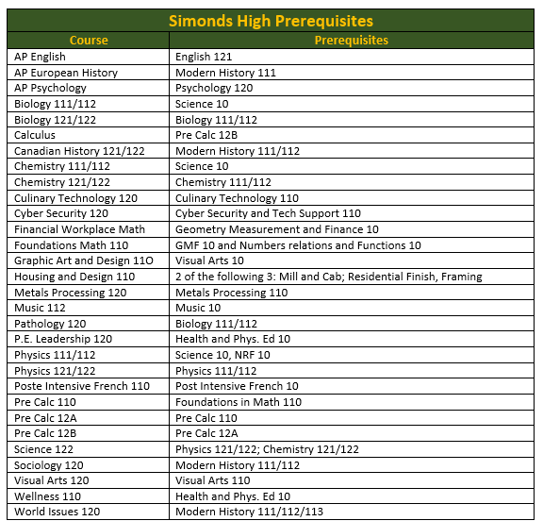
Here is a list of prerequisites to help in your course selections.
In order to take a level one/AP course, students need a 75% or better in the course prerequisite.

Slide 9
Students in Grade 11 may take courses that begin with the number 12 – provided they have the pre-requisites for them.

Slide 10
YOU NEED TO REQUEST
10 COURSES + 2 ALTERNATES

Slide 11
YOU MUST REQUEST …
GRADE 11:
2 English Credits
English 111 - Lit. Text & Info Text or
English 112 - Lit. Text & Info Text or
English 113 – Lit. Text & Info Text
GRADE 12:
1 English Credit
121, 122, or 123

Slide 12
STUDENTS REQUIRE 2 MATH CREDITS TO GRADUATE
Numbers Relations and Functions Gr. 10 &
Foundations Math 110 or Financial and Workplace Math 110
--OR—
Financial and Workplace Math 110 &
Financial and Workplace Math 120 or NBCC Work Math…120

Slide 13
Mathematics Pathways
FI/FSL Pre-Calculus or Pre-Calculus Math 110, Pre-Calculus 120 A and 120 B and Calculus 120 are for students who want to pursue university studies in business, engineering, or science.
Foundations Math 110 and 120 are for students who want to pursue other university or college programs.
Workplace and Financial Math 110, 120 and NBCC Work Math 120 are for students who want to enter the workforce after graduation, go into an apprenticeship, or enroll in most one-year college programs.

Slide 14
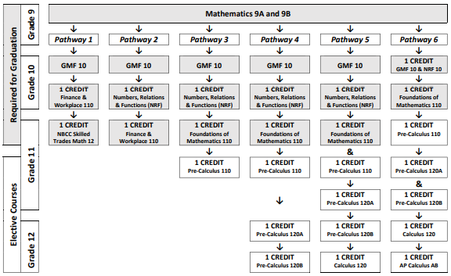

Slide 15
YOU MUST REGISTER FOR
1 semester of History:
Modern History112 or 113 or
FI Modern History 112 (French Immersion Program Only)

Slide 16
Sciences
ONE science credit is required for graduation:
Automotive Electrical Systems 120
Biology 111 or 112
Chemistry 111 or 112
Human Physiology 110
Physics 111 or 112
Intro to Environmental Science 120
Intro to Electronics 110
Micro Electronics 120
Physical Geography 110

Slide 17
Students must have one Fine Arts/Life Role credit to graduate:

Slide 18
ELECTIVES
THE REMAINDER OF YOUR COURSES ARE YOUR ELECTIVES…
PLAN YOUR ELECTIVES CAREFULLY TO MAKE SURE THAT YOU HAVE THE COURSES YOU NEED WHEN YOU GRADUATE IN ORDER TO CONTINUE YOUR STUDIES
YOUR ELECTIVES ARE NOT GUARANTEED. KEEP IN MIND THAT YOU MIGHT NOT GET ALL THE ELECTIVES THAT YOU WANT.

Slide 19
French Immersion Certificate
French Immersion Students must successfully complete five credits in French during Grade 11/12 to obtain a FI Certificate in Grade 12.
To be eligible for the oral proficiency interview in Grade 12, a Grade 12 French course must be taken during your Grade 12 year.

Slide 20
ADVANCED PLACEMENT (AP)
https://www.youtube.com/watch?v=mNnWgl8pLB8

Slide 21
ESSENTIAL SKILLS -
The Essential Skills Achievement Pathway (ESAP) Program is an opportunity for students to earn a high school diploma that prepares them for a post-secondary education, apprenticeship or the world of work.
The program consists of personalized learning opportunities that allow students to explore their skills, talents, abilities and interests while intentionally attaining the 9 federally identified Essential Skills.

Slide 22
CO-OP
Cooperative Education 120 is a course in which selected high school (usually grade 12) students combine studies at school with a work placement in the community.
These students learn through participation in the day-to-day operation of an organization.
Learning and experience are combined in an educationally beneficial way.

Slide 24
FLEXIBLE OPTIONS
CHALLENGE FOR CREDIT
Get credit for learning that occurred outside of the classroom
PERSONAL INTEREST 1&2
INDEPENDENT STUDY
Develop your own course outcomes and dig deeper into a topic of interest.
DUAL CREDIT COURSES
Earn both a high school credit and a post secondary credit
ie: NBCC Skill Trades Math
EARLY START CREDITS
Students on track to graduate can earn early start credits from some Post-Secondary Institutions online.

Slide 25
PERSONAL INTEREST COURSES
Personal Interest Courses are elective courses designed to offer more flexibility within the current credit system.
This course provides students with the time, opportunity and resources to develop or pursue individual interests.
The course is designed by the student with the support of the teacher and/or other mentors in the school community (local/global)

Slide 26
Important Information for Students entering Grade 12
Students interested in taking the IDEA Centre Coop with Mr. Van Beek must contact Mr. Langille
Students signing up for Coop 120 are not guaranteed acceptance. An application process, based on attendance marks and behaviour, will take place once course selection has ended.

Slide 27
Course Selection Process
1. Students will fill out a registration form with their homeroom teacher.
2. Parents/Guardians will sign off on the form and it is to be returned to the homeroom teacher.
3. Students use this form to self register online.
4. Guidance will meet with each student and review their form and online registration.

Slide 28
COURSE REQUEST TIMELINE
Week of March 21st – Grade 9, 10 & 11 Presentations
Friday April 8th – Forms due back to your Homeroom Teacher
Monday April 11th – Homeroom Teachers hand in forms to Mrs. Carhart.
April/May – Guidance will meet with all current Grade 9, 10 and 11 students to review.

Slide 29
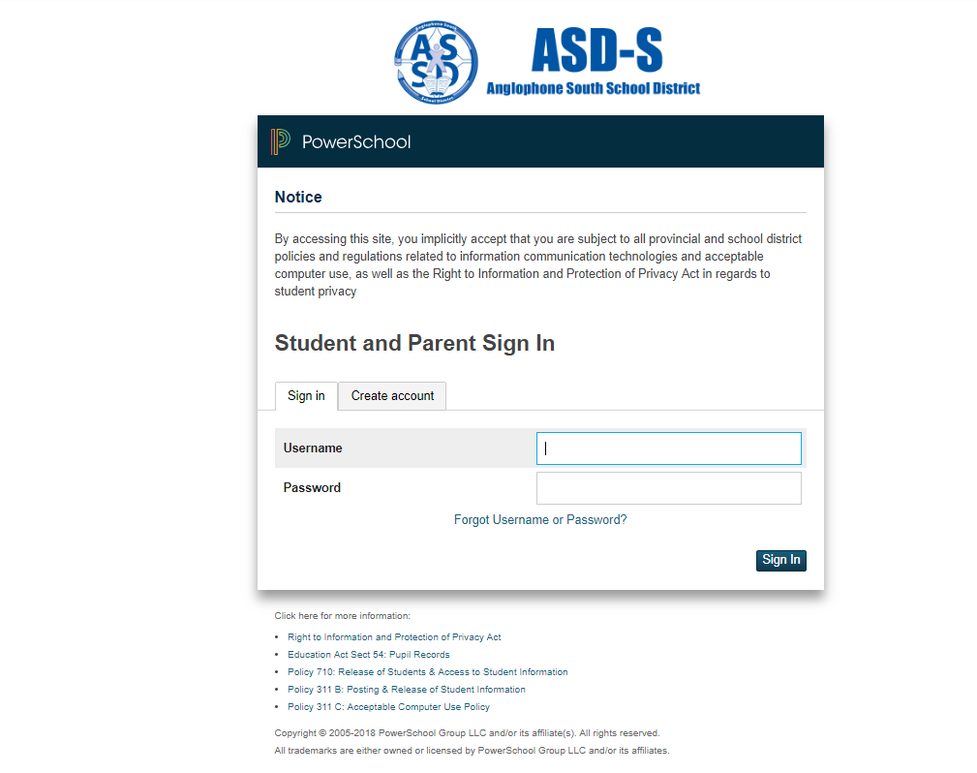
Step 1
Sign into PowerSchool with your student’s username and password.
https://sisasds.nbed.nb.ca/public/home.html

Slide 30
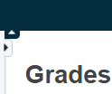
Step 2
Click on ARROW on the top left side to access the menu.

Slide 31
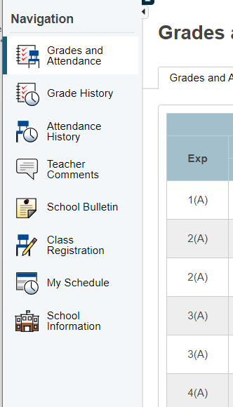
Step 3
Choose
Class Registration

Slide 32
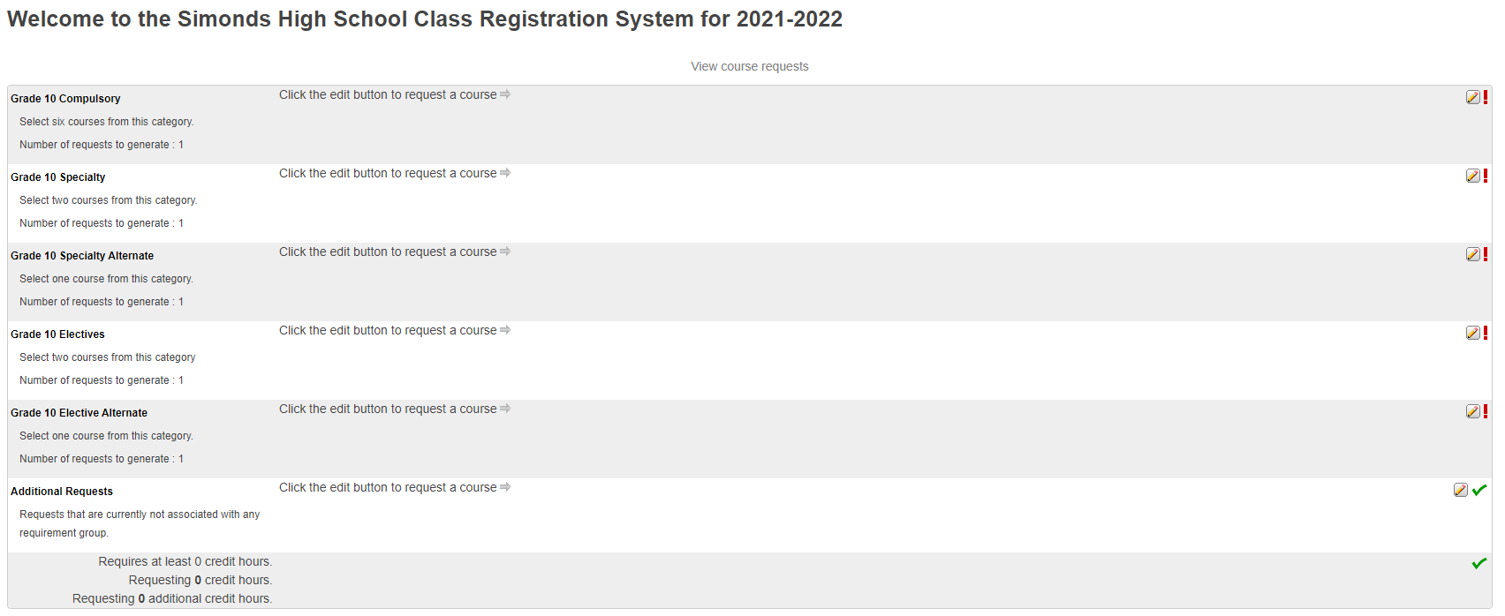
A menu will
appear.
It will be grouped similar to what is on the course registration sheet.

Slide 33
Step 4 ---- Click on the Pencil (edit button). It will bring up the selection screen.

Slide 34
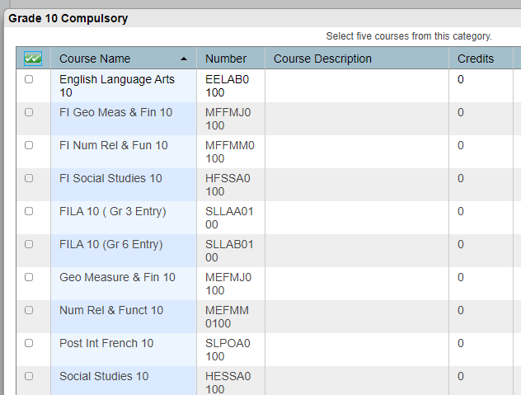
Step 5
Students will
select courses.
Follow instructions at the top of each category.

Slide 35
Step 6
As you finish each grouping, click okay at the end for the course to be listed as a choice.
(You MUST hit Okay)

Slide 36
A box will then appear with the selected choice.
Students should work through each grouping as required/desired.

Slide 37
Step 7
Students MUST choose 2 alternates!!! (Used all the time)!!!

Slide 38
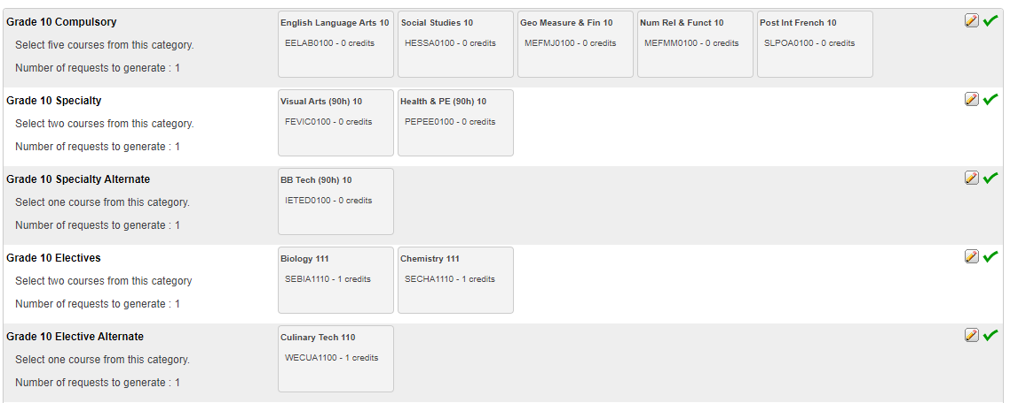
When finished, your selections will
look something
like this.

Slide 39
It is important to note***
Total Credit hours for Grade 10 students should be 2, unless they are repeating a course at the grade 9 level.
Total Credit hours for Grade 11 students should be 10, unless they are repeating a course at the grade 10 level.
Total Credit hours requested for Grade 12 students should be 10.
When you have finished your course selection, you MUST hit the Submit button

Slide 40
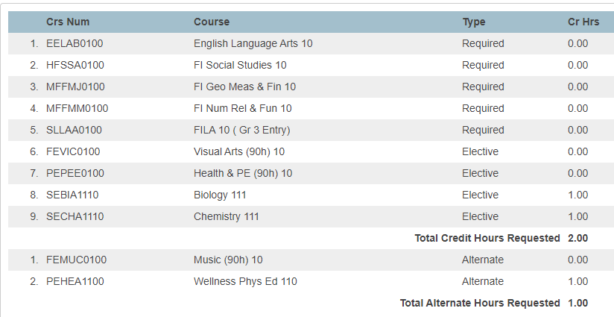
A successful course selection will look like this.

Slide 41
Congratulations Seabee!!
Your Course Selection is now complete

