Slide 1
Coronavirus – COVID-19
Loch Lomond School

Slide 2

Learning Goals:
By the end of this lesson, we will be able to:
Describe COVID-19
Identify how to protect ourselves and others.
Explain how we do things at school now.
Feel more confident about coming to school
This Photo by Unknown Author is licensed under CC BY-SA
Notes:
We have not been together in school for a long time. It is exciting to be all together again in one building! We stayed safe at home for a long time because of Coronavirus, or COVID 19. Things are better now, so we can come back to school . But this means we need to do things differently, so let’s talk about what school day will look like now.

Slide 3




NEW!
New kind of coronavirus
COVID-19
  ‘CO’ corona
  ‘VI’ virus
  ‘D’ disease
  19 discovered in 2019
Viruses can make people sick
Most people get a bit sick
A few people get very sick
Notes:
New is often associated with improved BUT for COVID-19 it means a virus we have never seen before. We have to learn more about it like how it lives, how we can live with it, does it make us sick, is there medication we can take to protect us from it or medication that makes us better?

Slide 4
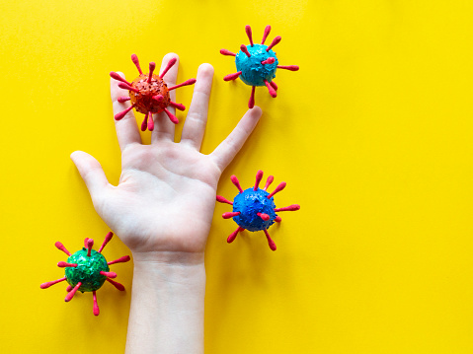
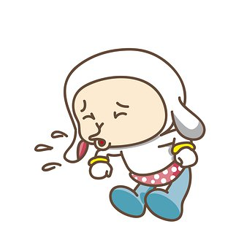

How Does COVID-19 Spread?
Notes:
When a person is sick with a cold, they often sneeze, cough, or have a runny nose. This is the same idea. When a person has the Coronavirus, it is in the tiny droplets that come out of their mouths and noses when they cough, sneeze, laugh, sing, and talk.
In order for the virus to get into someone else’s body, they need to be close by for a little while. A close contacts is someone who was within 6 feet, or 2 metres, for longer than 15 minutes. This is why we tell people to physically distance themselves, so that they can stay away from the droplets.
If someone coughed into their hand, the tiny invisible virus droplets would be on their hands. Then, if they turned on the light switch, it would be on the switch. If I come along and turn off the switch, then I will pick it up onto my fingers. If I touched my mouth, nose, or eyes before washing my hands, I would let the virus get inside my body. This is why we wash our hands more frequently, and avoid touching our faces.

Slide 5

How to Protect Ourselves and Others:
Keep Your Distance
Clean Your Hands
Cover Your Cough & Sneeze
Wear Your Mask
Notes:
These are the four super powers to stay healthy. Let’s look at each one individually.

Slide 6

Grover tells How to Cover Your Cough and Sneeze
Notes:
Okay friends, Grover will tell us how to cover your cough and sneeze with your elbow.
Step 1- realize that you are about to cough or sneeze
Step 2- raise your elbow to your nose
Step 3- cover your cough and sneeze
Say, “Excuse me”
Great work!
Click picture 30 second video https://www.youtube.com/watch?v=dp9z3yaxkSI

Slide 7
Be a Handwashing Hero
Notes:
Colouring page link https://www.canada.ca/content/dam/phac-aspc/documents/services/diseases-maladies/coronavirus-disease-covid-19/resources-parents-children/colouring-pages/colour-hand-eng.pdf
Hey kids, wash your hands for 20 seconds to stop germs from spreading.
20 seconds is the same time it takes to sing the Happy Birthday song two times in a row!
On your mark, get set, wash!
(A voice hums the happy birthday song.)
Wet your hands with warm water.
Now use soap and make lots of bubbles.
Wash the front and back of your hands, and around your nails. Great job!
Don’t forget to wash between your fingers. You can do it!
Now rinse and dry your hands really, really well.
(The humming stops and the stopwatch dings.)
Hooray! Now you’re hand-washing heroes!

Slide 8
If You Do Not Have Soap and Water Available,
Use Hand Sanitizer
Notes:
Reinforce:
Soap and water are always the best, especially if your hands are visibly dirty.
If your hands aren’t visibly dirty, but do need to be cleaned, we can use hand sanitizer that contains at least 60% alcohol. Children with small hands need only a ½ teaspoon or 3 mls of hand sanitizer to clean their hands. This would be the size of a dime in their palm. Rub hands together until all sides of the hands have been covered. Pay attention to between the fingers, around the nails, the backs and palms of each hand, and around the wrist. Rub until it has dried into the hands.
There will be a hand sanitizing station per classroom and one station ____________ (common area) in our school.
Younger students are to be supervised when using these sanitizers.
Hand sanitizer products must not be ingested and must always be kept out of reach of younger students.

Slide 9
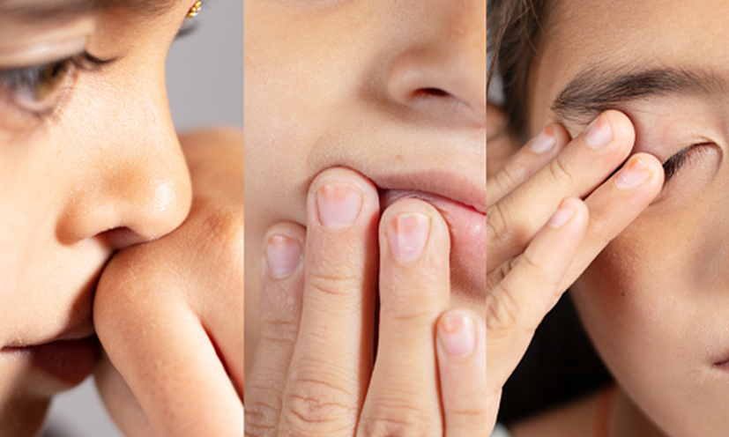
If you do this…wash your hands before and after
Notes:
Our hands are often in contact with surfaces, and can pick up germs. If we touch our nose, eyes, or mouth with unclean hands, germs can enter our bodies.
Based upon what we just discussed in the earlier slides, what can we do to protect ourselves before touching our faces?
Yes, we protect ourselves by cleaning our hands before touching our faces.

Slide 10


When should you clean your hands?
When you arrive at school
Before and after meals
After using the bathroom
After blowing your nose or coughing
After playing with shared toys or school supplies
After playing outside
Before and after taking medications
Before and after handling a mask
After handling animals
Whenever you can see dirt on your hands

Slide 11
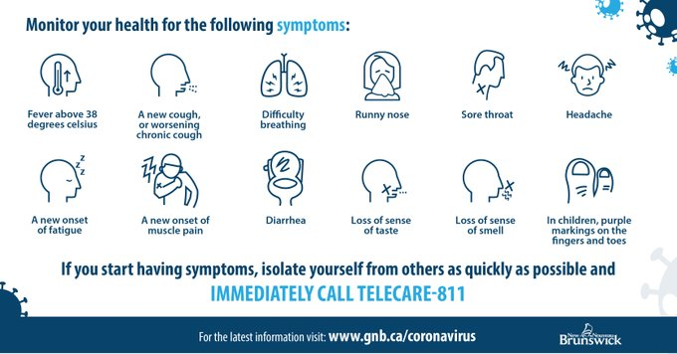
Before Coming to School
Tell an adult if you have any of these:
Purple marks on children’s fingers or toes
Stay home from school if 2 or more of these symptoms and have an adult call Telecare 811 or their primary healthcare provider
Notes:
Every day, we will review these questions with our families. When we are not feeling well with any of these symptoms, it doesn’t mean that you definitely have COVID-19; but it does mean that you need to stay home from school until you get some more advise. Your parents will call 811 or your primary care provider (family doctor or nurse practitioner) for answers.

Slide 12


Do Your Part,
Keep at Least a Pool
Noodle Apart

Slide 13

Bus Instructions K-5
Try to stay 2 meters apart waiting for your bus
One student only per seat, except if you live in the same home.
You are allowed to wear a mask, but you do not have to wear a mask.
Your bus driver may wear a mask, or have a special barrier (curtain) around them.
Notes:
You might notice that the students in grades 6-12 will be wearing a community face mask when entering and exiting the bus. They can remove their mask if sitting alone, or with someone from their household.

Slide 14

Arrival at School
Teacher, please fill in your details here:
Where is my bubble or group meeting spot?
Where can I play?
Who can I play with?
Notes:
When you arrive on the school grounds, go to ________________________ area and wait with your class. You can talk to or play with the other students in your class.
Please stay 2 meters apart from the other classes.

Slide 15
How to
Enter Our School
Teacher, please Insert essentials from your school plan here
Notes:
While outside, you will be with your class group/pod/bubble.
A teacher will call your class to come into the building. As you come in, try to remain 2 meters apart (2 pool noodles apart) from adults or other students who are not in your class.

Slide 16

Things to Remember
When
Inside Our School
Greet friends with a big smile!
When outside of our classroom keep more than a pool noodle apart from other groups
Bathroom
Lunch
Recess
Teacher: Change these items to suit your needs
Notes:
Add your school’s bathroom, lunch and recess protocols

Slide 17
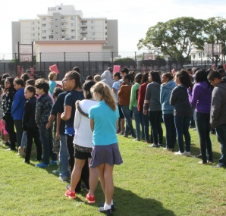

Emergency Practices
If there is time, put on a community mask.
We leave the building quickly. It’s okay if we are a bit closer until we get outside.
Once outside, we will have 2 meters space between classes.
Returning inside, we have lots of time to stay 2 meters apart from other groups.
Notes:
Emergency evacuation drills and lockdown drills will take place without physical distancing. Once the evacuation and lockdown drill are complete, physical distancing will recommence and will be maintained during the re-entry of the school. Masks should be worn for all emergency drills but not to the detriment of the response to the drill.

Slide 18


If You Feel Sick at School…
Tell an adult
We will call home for you. Home is the best place to be when you are not feeling well.
Our school has a special spot for you to wait for your parent
(insert your school plan for isolation area)
Let’s cover your mouth and nose with a mask while waiting for someone to pick you up
Notes:
In particular, tell a grown up if you have the following symptoms: fever/chills, new or worsening cough, difficulty breathing, runny nose, sore throat, headache, feeling tired, achy muscles, diarrhea, loss of sense of taste or smell, and purple markings on fingers or toes.
Insert your school’s isolation plan

Slide 19

How to Leave the School:
This Photo by Unknown Author is licensed under CC BY-NC
Teacher add your school info
Give directions for how to leave the school here
Perhaps there will be two lines in their class: walkers and bus line?
They wait until their class is called
Walkers go out ____door, and the bus riders go out the ____ door?
Remember to keep your distance from other classes

Slide 20
How Can We Help Others When They/Their Family are at Home Feeling Unwell:
Send a card
Call them
Draw a picture
Welcome them back to school when they feel better
Invite them to play with you when they return to school

Slide 21

This Photo by Unknown Author is licensed under CC BY-NC

Slide 22
Other Resources for Educators

Slide 23
Sick Kids TVO
https://youtu.be/fBkA2ZTUnyI Dr Cheddar - some questions would need to be edited but it is well done. ~9-10 minutes
Notes:
Alternate resource

Slide 24
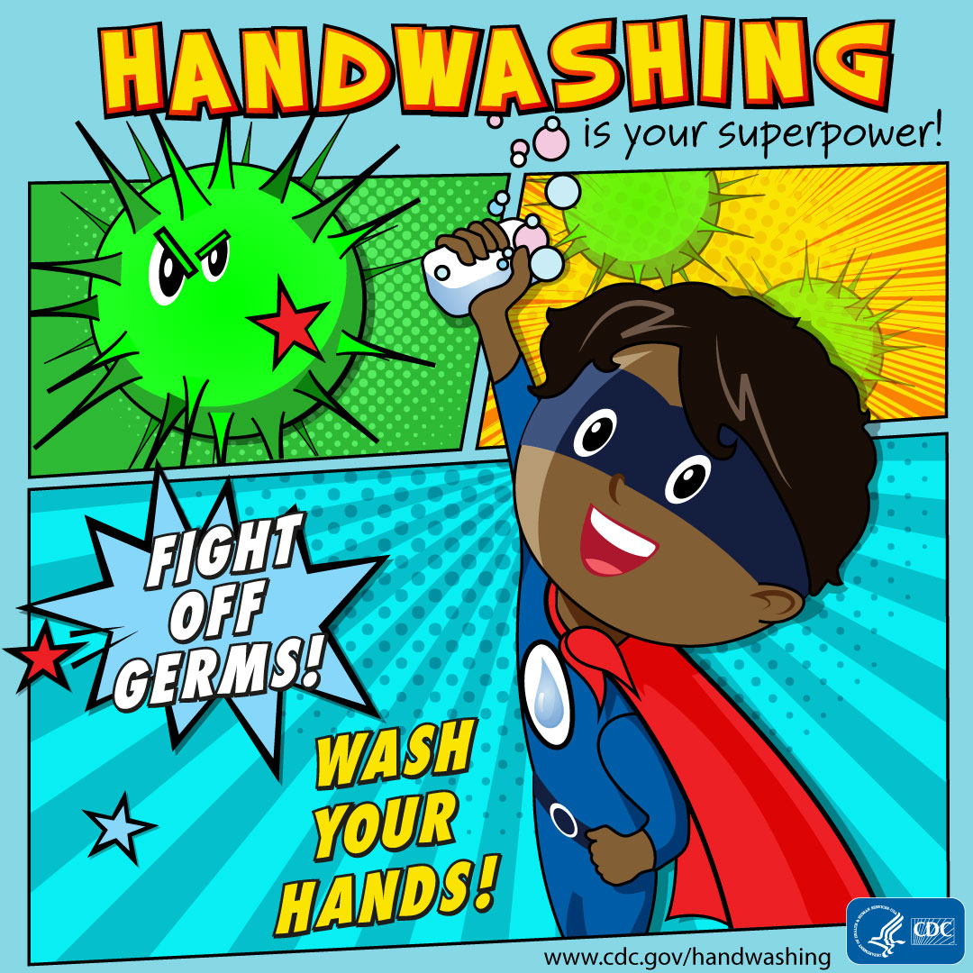

Slide 25
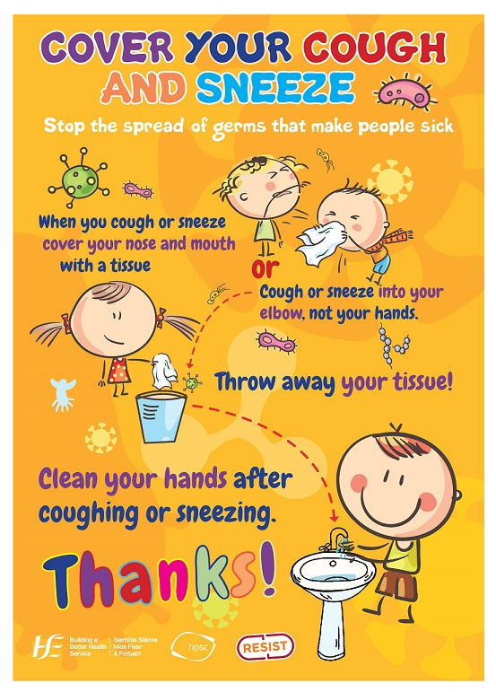
Notes:
To recap after the video. Re-inforce this messaging.

Slide 26
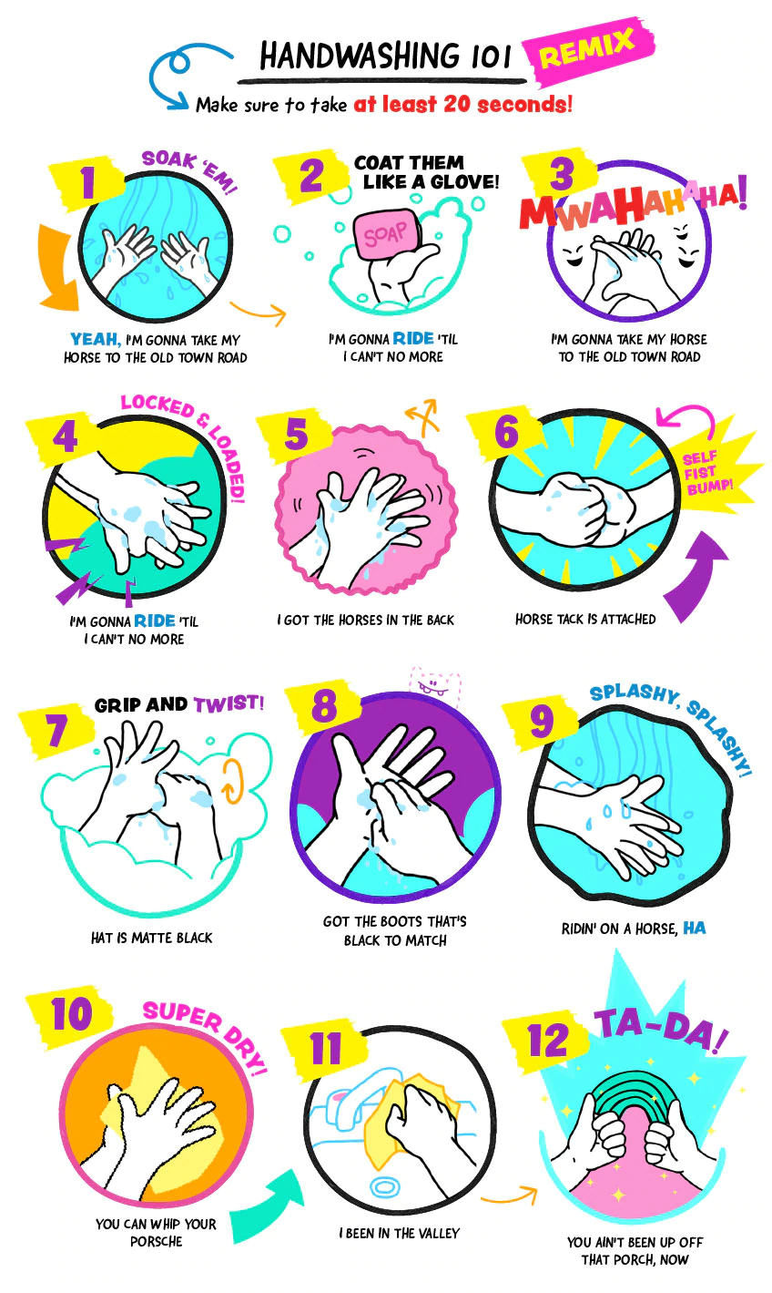

https://www.cbc.ca/kidscbc2/the-feed/handwashing-101-how-to-become-a-handwashing-artist
Notes:
Alternate

Slide 27
My Hero is You https://static1.squarespace.com/static/58cc13fd37c5817a683e8bd7/t/5e95d2b6bf791f4fb83245a5/1586877127126/My+Hero+is+You%2C+Storybook+for+Children+on+COVID-19%5B1%5D.pdf
Notes:
Alternate resource – grade 3-5

Slide 28
Last page needs to be deleted
https://www.surreyplace.ca/wp-content/uploads/2020/03/Social-Story-COVID.pdf
Notes:
K-2 alternate resource

