Slide 1
Welcome to Course Registration
for 2022 - 2023
A student’s guide to a successful course selection
https://sisasds.nbed.nb.ca/public/home.html

Slide 2
Course Registration
Course registration is the opportunity for students to select which courses they would like to study in the 2022-2023 year. We do our best to ensure that students receive their first choices, but that is not always the case and, particularly when students are looking for a course that has only one section offered. If they don't receive their first choice, their alternates are used. It is important to carefully consider your alternates when selecting courses.

Slide 3
Important Information for Students entering Grade 10
Students entering Grade 10 now require 2 Math Credits to Graduate. Numbers, Relations and Functions (NRF) is now considered a credit course.
18 credits are needed to graduate.
Students in grade 10, must select 2 Specialties
( Art, BBT, HPE, Music, AP Computer Science Principles or PDCP).
Please Note: If you choose to sign up for the following courses, you will need to select the designated course when completing your registration online. This is to ensure you will be grouped for these courses.
Enriched English 10 (sign up for Electrical Wiring 110)
AP Track FI NRF (sign up for FI/FSL Economics)
AP Track NRF (sign up for Spanish 110)
HPE 10 Basketball Academy (sign up for Fashion Design 120)
Instrumental Music 10 (sign up for Music 113)

Slide 4
Important Information for Students entering Grade 11
All English are now two separate courses. Students must choose English Lit Text and English Info Text for all grade levels except 12.
18 credits are needed to graduate.
French Immersion students require 5 courses in French Immersion for graduation purposes.
If you plan on taking Outdoor Education, you must pick up form from Guidance and return to HR teacher with your registration form.
If you plan on taking an AP course and are interested in having a Study Hall, please see Mrs. Brown for an application.
Please Note: If you choose to sign up for the following courses, you will need to select the designated course when completing your registration online. This is to ensure you will be grouped for these courses.
- Culinary Technology 110/120 Double period (sign up for Fashion Tech 110)

Slide 5
Important Information for Students entering Grade 12
18 credits are needed to graduate.
French Immersion students require 5 courses in French Immersion for graduation purposes.
If you plan on taking Outdoor Education, you must pick up form from Guidance and return to HR teacher with your registration form.
If you plan on taking an AP course and are interested in having a Study Hall, please see Mrs. Brown for an application.
Students signing up for Coop 120 are not guaranteed acceptance. A selection process, based on attendance and behaviour, will take place once course selection has ended.
If you plan on taking Coop, you must pick up forms from Guidance and return to HR
teacher with your registration form.
Please Note: If you choose to sign up for the following courses, you will need to select the designated course when completing your registration online. This is to ensure you will be grouped for these courses.
- Culinary Technology 110/120 Double period (sign up for Fashion Tech 110)

Slide 6
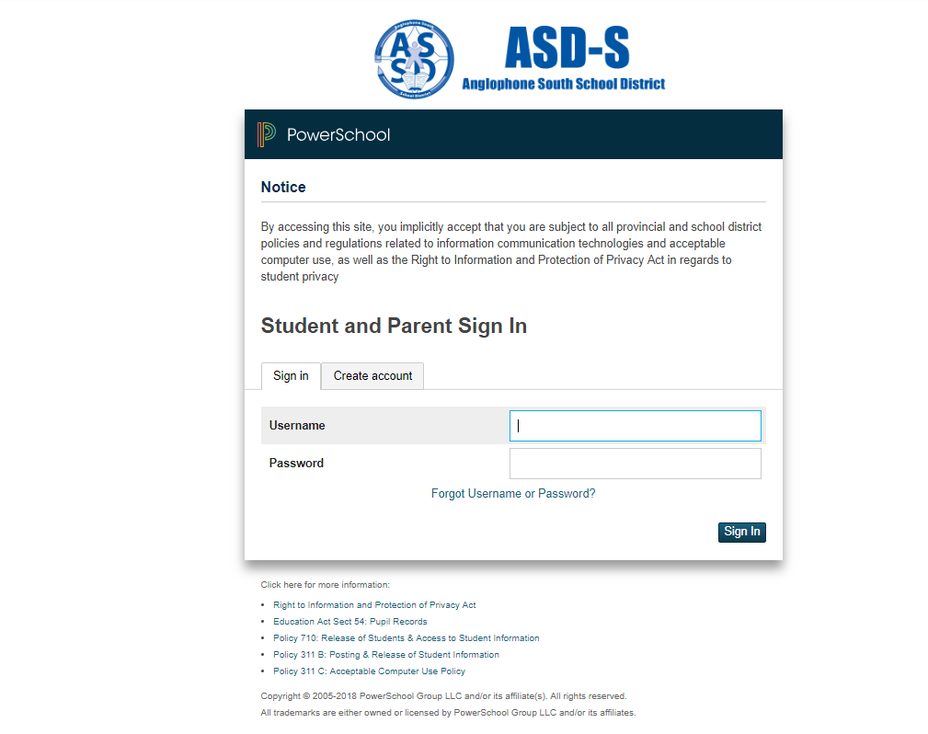
Step 1
Sign into PowerSchool with your student’s username and password.
https://sisasds.nbed.nb.ca/public/home.html

Slide 7
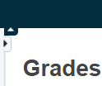
Step 2
Click on ARROW on the top left side to access the menu

Slide 8
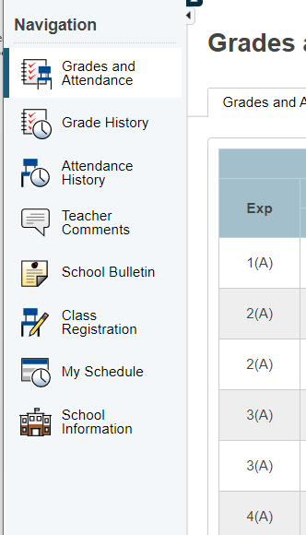
Step 3
Choose Class Registration

Slide 9
Step 4
Click on the Pencil (edit button). It will bring up the selection screen.

Slide 10
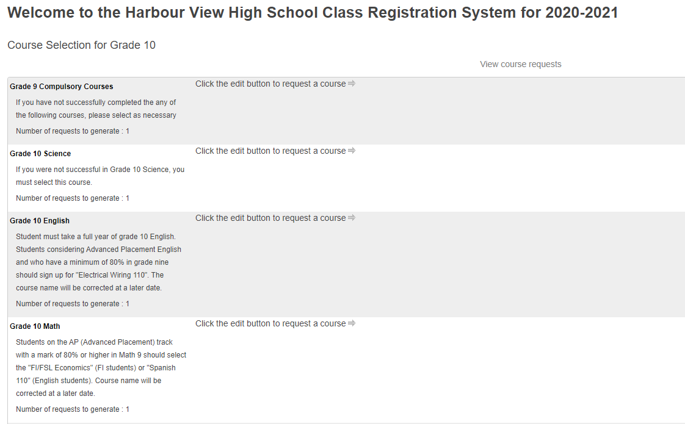
A menu will
appear.
It will be grouped similar to what is on the course registration sheet.
Put in new one!

Slide 11
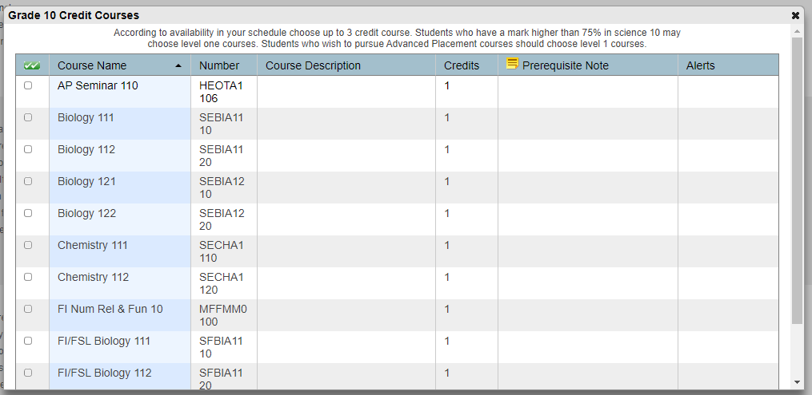
Step 5
Students will select courses.
Follow instructions at the top of each category.
Be sure to scroll through the pages!

Slide 12
Step 6
As you finish each grouping, click okay at the end for the course to be listed as a choice.
(You MUST hit Okay)

Slide 13
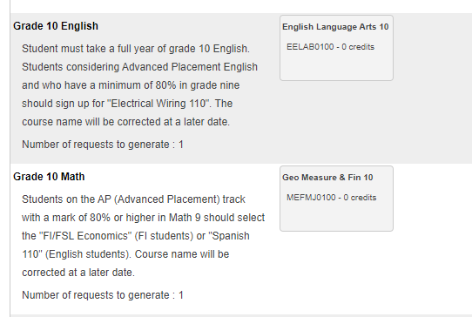
A box will then appear with the selected choice.
Students should work through each grouping as required/desired.

Slide 14
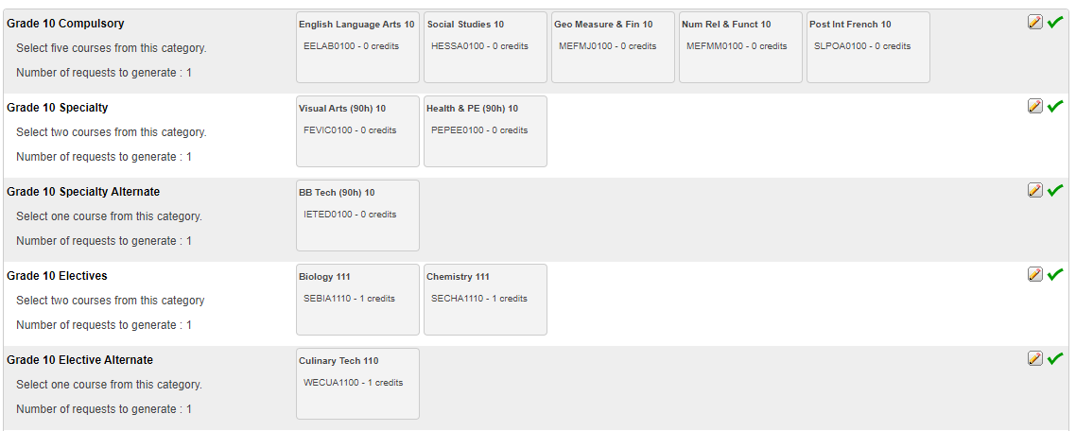
When finished, your selections will look something like this.

Slide 15
It is important to note***
Total Credit hours for Grade 10 students can choose up to 3 (plus one alternate), unless they are repeating a course at the grade 9 level or if they are taking AP Computer Science Principals as a specialty.
Total Credit hours for Grade 11 students should be 10 (plus two alternates), unless they are repeating a course at the grade 10 level.
Total Credit hours requested for Grade 12 students should be 10 (plus two alternates).
When you have finished your course selection, you MUST hit the Submit button

Slide 16
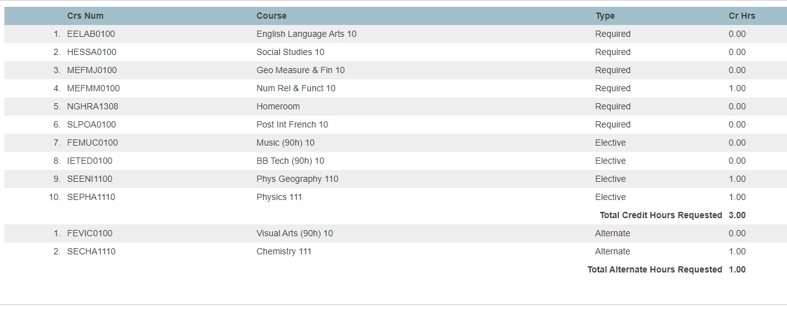
A successful course selection will look like this.

Slide 17
Congratulations Vikings!!
Your Course Selection is now complete

