Slide 1
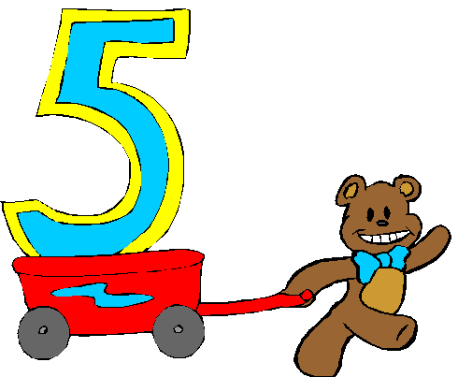
The Daily Five™
Read to Self
Read to Others
Listen to Reading
Writing
Word Work

