Slide 1


Kick Off to Kindergarten
Notes:
Have registration package with you to refer to throughout the presentation.

Slide 2

"Forest Hills School students will become successful, productive citizens fulfilling their passions in life as part of an ever-changing world."
  Forest Hills School
  1. Mission Statement - We build Inclusion, Capacity and Learning Communities
  2. Vision Statement- Forest Hills School students will become successful, productive citizens fulfilling their passions in life as part of an ever-changing world.
  3. Falcon Code of Conduct – Be Respectful, Be Responsible, Be Safe.
  4. Student Population – 675 students
  5. Grades – Kindergarten – Grade 8
Notes:
Things you may want to talk about:
Daily Schedule
How many childen registered for Kindergarten to date?
How many classes for next year?
Refer to the school handbook or website.
How information on bussing will be shared.
Health concerns or learning needs. Let us know.
Idea: Use Grade 5 school leaders to talk about their schools.

Slide 3
Calendar of Events
1. Registration
2. Kick Off
3. EYE-DA
4. Welcome to Kindergarten
5. Transition Programs
6. Orientation Day
Notes:
Discuss the transition events that will happen during the school year and mention that we will be discussing each event this evening.
Mention the ‘Kindergarten Events’ handout that was given to them at registration that has the dates for each event happening during the year. Bring the handout with you and show it to them. You may want extra copies on hand in case they have been lost.

Slide 4

A child’s formal education begins in kindergarten, but learning begins at birth. You have been your child’s first and best teacher during those critical first five years of life. You will continue to support your child through this transition year and in the years to come.
Notes:
Talking points after reading the slide:
The importance of the parents’ role in a child’s education and encourage them to remain involved throughout their child’s education.
It is natural to have some level of anxiety and concern during this time of transition to school (for both parents and children). Participating in the transition activities throughout the year will help to lessen this anxiety so your child’s transition is a positive experience.

Slide 5
Developmental Growth of Your Four Year-old
These developmental domains are key to your child’s transition to school:
  Social Development
  Emotional Development
  Motor Development
  Language/Intellectual Development
Notes:
There are key developmental domains that we can support to help ensure a smooth transition to school for your child.
What do these domains mean?
Social development: sharing, taking turns, playing with others, level of independence, making decisions.
Emotional Development: understanding feelings, taking responsibility, taking risks, ability to solve problems
Motor development: running, jumping, climbing (gross motor) holding scissors and pencils, using zippers and buttons etc. (fine motor)
Language/Intellectual Development: conversation/oral language, knows rhymes and songs, knowing about books, awareness of numbers and letters
We will now have a closer look at each of these domains and what you can do with your child to support them.

Slide 6

Social Development
Play simple games with your child.
Talk about how it feels to share and take turns.
Help your child wait to have a turn playing
with a toy.
Encourage your child to do things independently (e.g., getting dressed,
brushing teeth).
Notes:
Here are some examples of activities that you can do with your child to support social development.

Slide 7
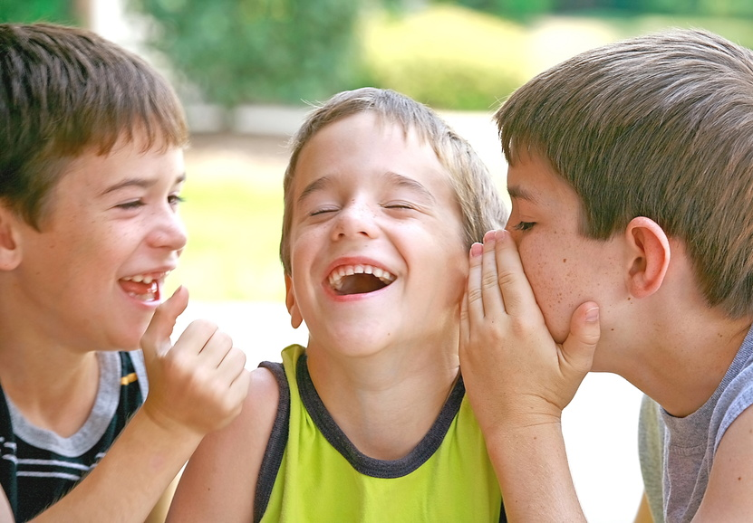
Emotional Development
Help your child develop ways to work out a solution to a problem.
Talk to your child about feelings (e.g., happiness, sadness, anger) so he or she can make good choices about how to act when he or she has these feelings.
Notes:
Examples of activities (2 slides that look the same but have different content).

Slide 8
Emotional Development
Help your child feel more secure by having regular routines such as bedtime, mealtimes, etc.
Encourage your child to take responsibility by assigning simple chores (put away toys), etc.
Encourage your child to try new activities.
Notes:
Examples of activities

Slide 9

Language & Intellectual Development
Having conversations/oral language
Being familiar with rhymes and songs
Knowing about books
Awareness of numbers and letters
Notes:
The following four slides may be delivered by Talk With Me staff. If they are not available you may wish to paraphase or read the slides. Encourage parents to contact Talk With ME if they have concerns or are unsure if you child is developing these skills appropriately. Emphasize that early detection of difficulties is important.
Handouts for Talk With Me are in the registration package – you can show it at this time.

Slide 10

Language Development
Talk with your child; allow time for him/her to respond.
Sing songs and recite nursery rhymes; encourage your child to repeat parts of them.
Encourage your child to help you around the house. Teach him/her to categorize and organize by size, shape,
colour, etc….
Read to your child as often as you can and encourage him/her to read along with you.
Notes:
Talking points:
Encourage your child to use proper grammar and speech sounds when he/she speaks. Re-phrase and repeat if he/she is not.
Talk about the book you read (the people, animals and events in the story). Introduce new words and concepts to your child when you read. Talk about the meaning of words. Show the video (next slide) which illustrates the interaction between reader/child when reading.

Slide 11
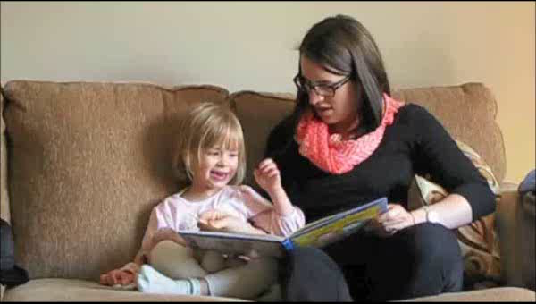
Reading With Your Child
Notes:
After video plays you can point out how the reader encourages the child to participate in the story telling, to complete rhymes and draws attention to letters in the book.

Slide 12

Encourage your child to count things and look for numbers in the environment.
Give your child three-step directions to follow without help from you.
Find ways to display your child’s name.
Ask your child to talk about his/her drawings and writings.
Ask your child to tell you about specific events in their day.
Notes:
Model reading and writing for your child as often as possible. It can be as simple as reading a message on a sign or making a grocery list together.
Help your child create stories that have a beginning, middle and end that are connected and make logical sense.
3 step direction example: get your jammies on, brush your teeth, and pick out a story.

Slide 13
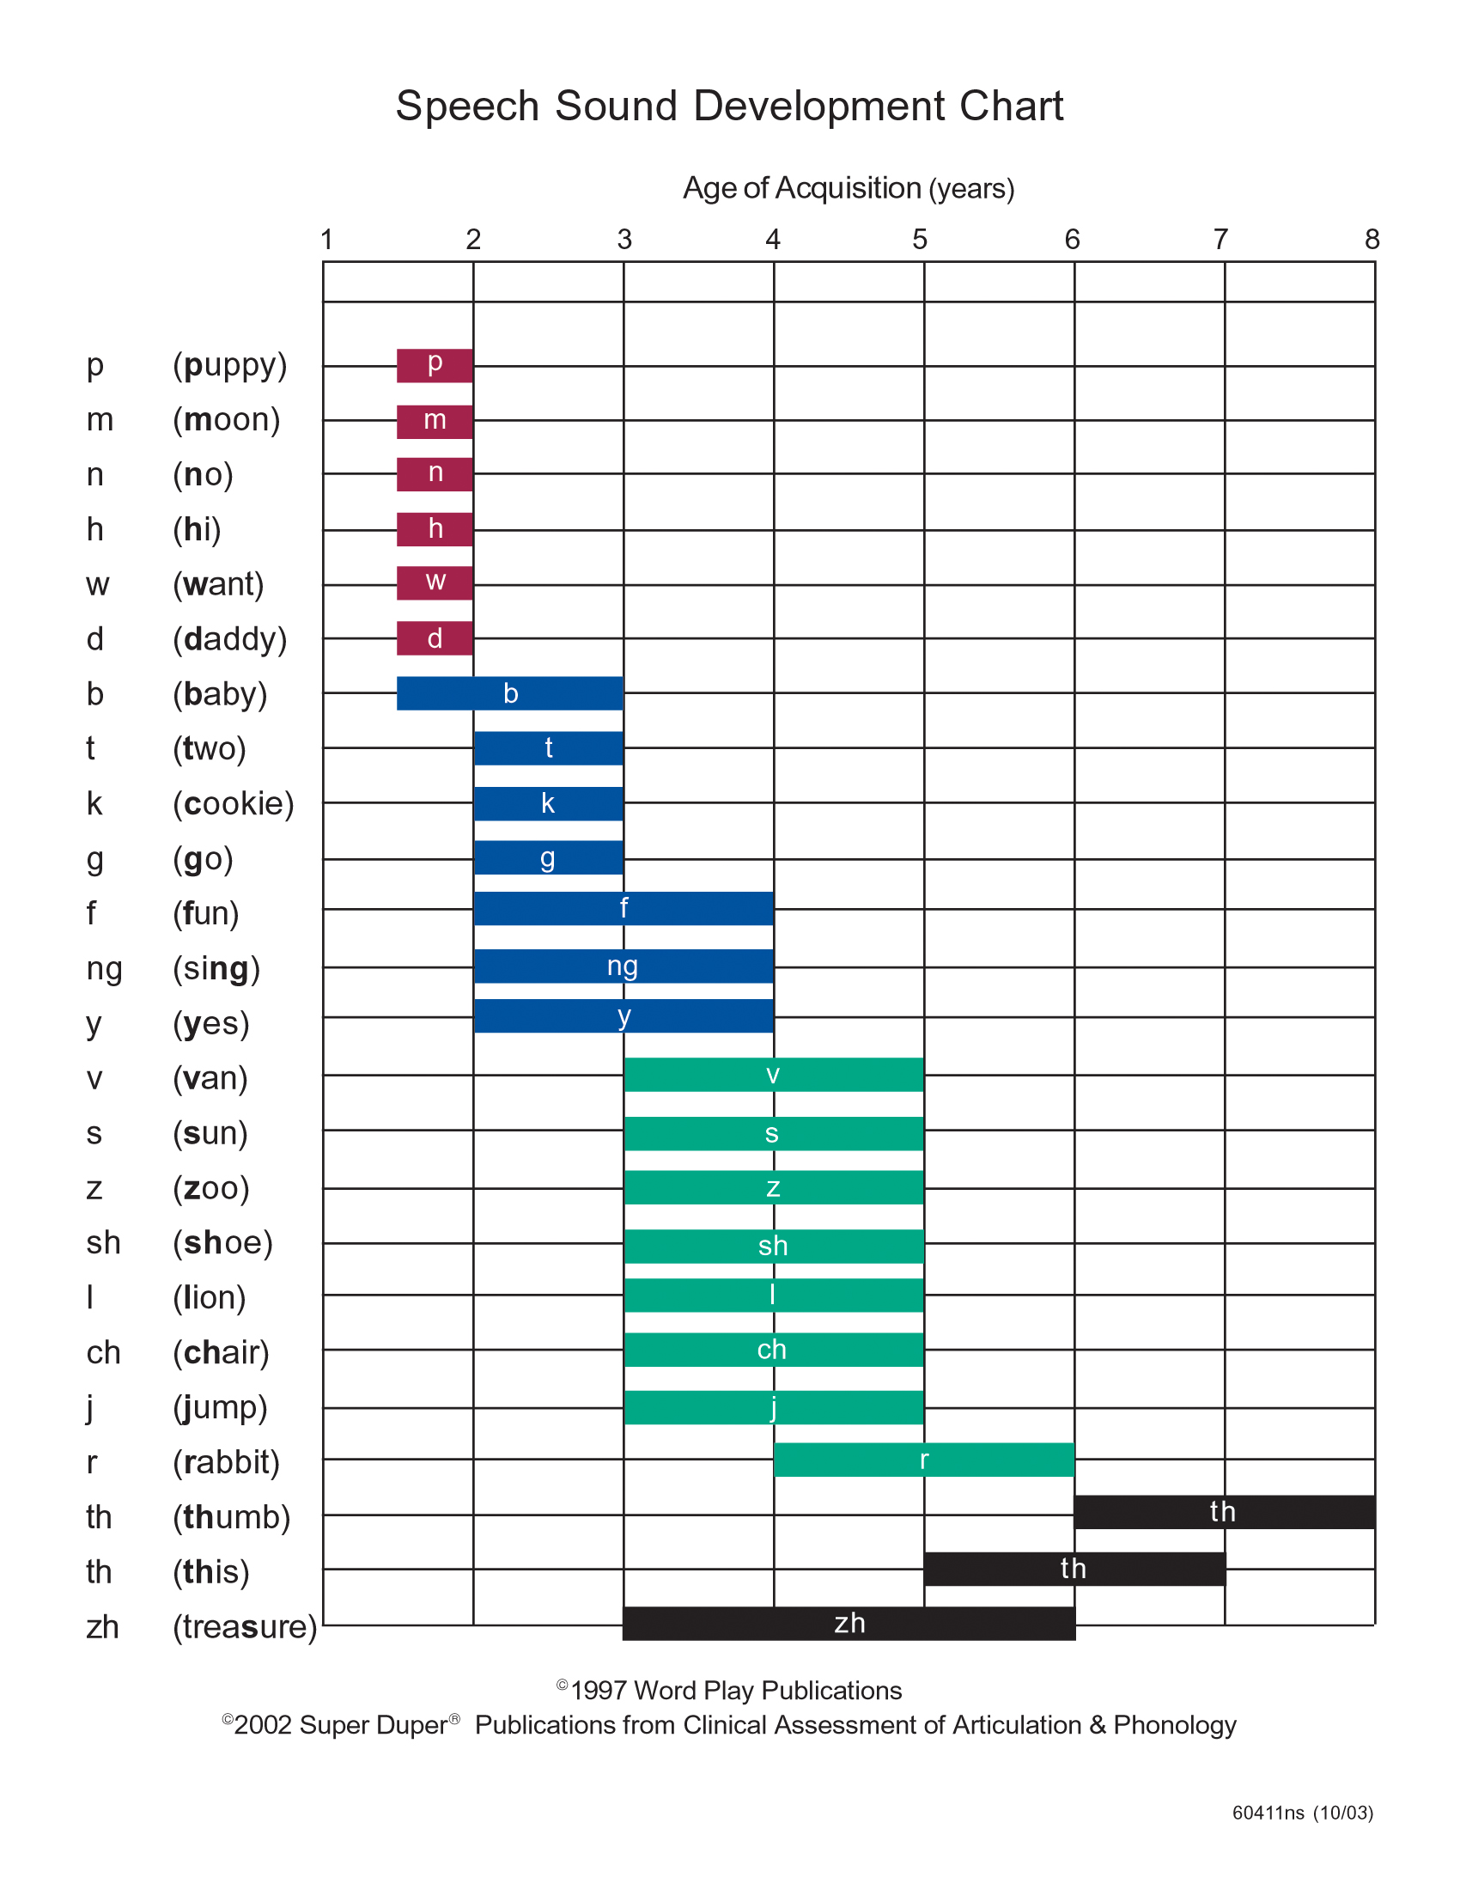
Notes:
Note to principal: If TWM staff are not available to deliver this portion of the presentation, and you are not comfortable to discuss this slide, you may wish to delete the slide or simply mention that this chart represents the development of speech sounds in the early years.
Again, mention that parents should contact TWM if they have questions about their child’

Slide 14

Fine Motor Development
Encourage your child to draw, colour, cut and glue things.
Provide your child with play-doh or clay to use
Encourage stringing things like beads and macaroni to make necklaces to wear.
Encourage your child to button shirts and
pants, and zipper jackets.
Notes:
Examples of activities

Slide 15
Gross Motor Development
Provide opportunities for your child to run, jump and play outdoors.
Set an example of an active lifestyle by spending time playing catch, walking
skating, biking, etc.
Visit the school playground so your child can become familiar with the playground.
Dance with your child to music.
Notes:
Examples of activities to support gross motor development.
Next we are going to look at the EYE-DA, which stands for: Early Years Evaluation – Direct Assessment. The EYE-DA is designed to give both parents and school information about their child’s skills in all of the domains we just looked at.

Slide 16

Notes:
Next we are going to look at the EYE-DA, which stands for: Early Years Evaluation – Direct Assessment. The EYE-DA is designed to give both parents and school information about their child’s skills in all of the domains we just looked at.

Slide 17


What is the EYE-DA?
The Early Years Evaluation-Direct Assessment (EYE-DA)
is an assessment administered individually with
pre-kindergarten children.
Family and Child Education (FACE) – Anglophone South
administers the EYE-DA and provides support to parents and children.
Notes:
This part of the Transition to Kindergarten often causes the most anxiety for parents. We all worry about our children and receiving a ‘report’ on their development can feel like our child is being judged or that we are being judged as parents. That is NOT the intent. The EYE-DA is a TOOL for parents and schools that provides us with information on how we can support children to ensure their school entry is positive and smooth. Look at the EYE-DA as an opportunity to access support and/services your child may benefit from before they start school.

Slide 18
EYE-DA FYIs
The EYE-DA is a ‘snap-shot’ of a child’s skills at a particular time.
Occasionally that snap shot will not accurately reflect a child’s skills (a very shy child or a child who does not feel well, for example).
The evaluator will make note of anything that may affect the child’s results.

Slide 19

What does the EYE-DA assess?
The EYE-DA assesses your child’s developmental strengths and areas that may require some support prior to school entry.
The EYE-DA assesses four key areas of early childhood development: Awareness of Self and Environment, Cognitive Skills, Language and Communication, and Physical Development.
These key areas are linked to children's readiness to learn at school.
Notes:
The key areas assessed by the EYE-DA are linked to children's readiness to learn at school. Social and emotional development is NOT assessed by the EYE-DA but is an equally important area of development.
Refer to the EYE-DA pamphlet (with you in the registration package) for further explanations of each area assessed by the EYE-DA. Mention that a copy of the pamphlet came in the registration package.
For parents of children with additional needs, the EYE-DA may not be a comprehensive assessment. However, the process of coming to the school, meeting with FACE staff and participating in the parts of the assessment may be worthwhile. Feel free to discuss this with FACE before your scheduled EYE-DA appointment.

Slide 20
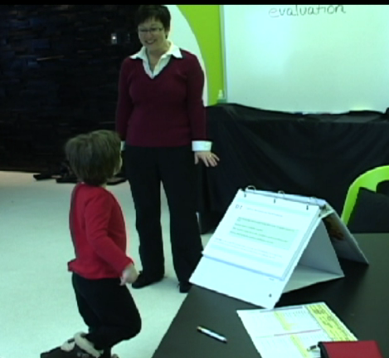
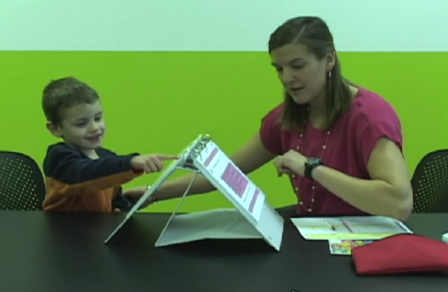
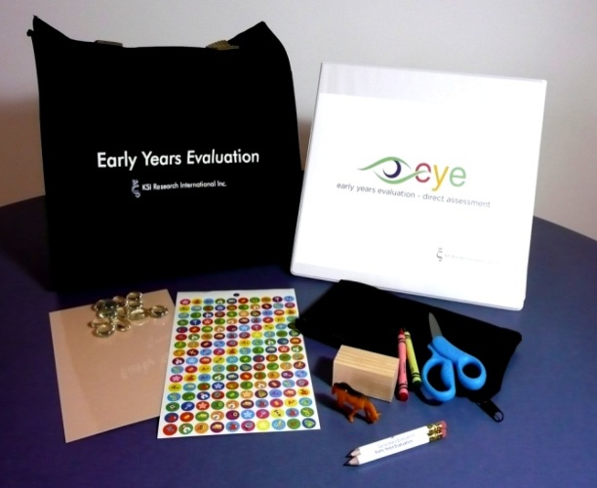
EYE-Direct Assessment
The EYE-DA takes approximately 45 minutes per child.
Colourful pictures and physical activities make the EYE-DA fun for children.
Most children enjoy doing the EYE-DA
Notes:
If a child is anxious and is resistant to separate from his/her parent or guardian, the parent/guardian is welcome to accompany the child in to the area where the EYE-DA will be administered. (Parents will be directed not to participate with their child during the EYE-DA, however).

Slide 21
What is the EYE-DA used for?
The EYE-DA is used to:
Assess areas of strength
Identify areas where children may benefit from additional support
Help facilitate a positive transition to school.
Parents will receive information about their child’s development that will guide them to support their child at home, daycare or, if needed, additional supports in the community.
Notes:
Parents may wonder if the school uses the EYE-DA information to ‘group’ or label children, but the primary support of this evaluation is to provide support for children PRIOR to coming to school.

Slide 22
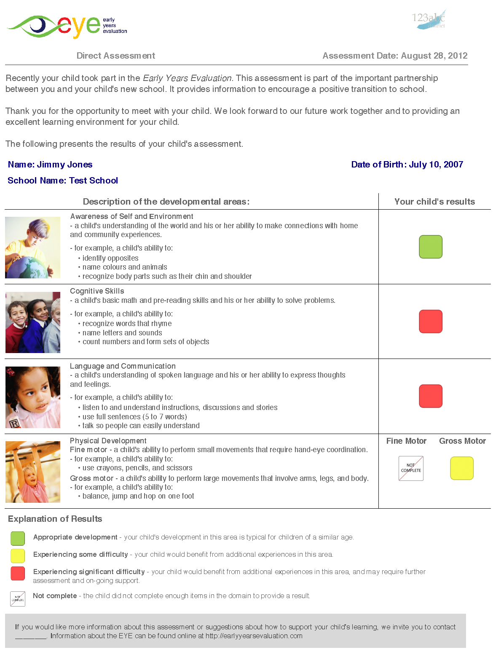
EYE-DA Child Report
This report lists each of the developmental areas, along with examples describing each area, and a colour coded box showing the child’s results.
Notes:
EYE-DA Child Report
If your child’s results show one red or two or more yellow results, a FACE educator will contact you to discuss the results and answer any questions you may have and give you some guidance on how to support your child’s development. Additional supports may be discussed at this time or opportunities in the community that may assist you in supporting your child.

Slide 23
I have the EYE-DA report, what do I do now?
Continue to engage in activities with your child that support his/her development.
If your child’s EYE-DA results concern you and you would like to discuss them with FACE, you are encouraged to contact them.
A ‘red’ or ‘yellow’ does not mean that there is something wrong with your child.
For some children, individual support will be offered by FACE:
  Home programming
  Play, Learn, and Go program
  Referral to Talk with Me or other community
  agencies
Notes:
Remind parents that they are their child’s first and best teacher. Most ‘issues’ that come up from the EYE-DA can and should be addressed by continued engagement in activities that will enrich your child. For example, if your child’s fine motor results were ‘yellow’, provide them with the chance to play with materials that support these skills such as play-doh, lacing beads, and cutting activities.
We would encourage you to share and celebrate the results with your child’s caregivers. Should your child attend a licensed child care facility the early childhood educators would welcome the opportunity to discuss the results and to celebrate and assist as needed.
Emphasize that this is a snap shot from a particular day. If the results do not seem like an accurate representation of our child’s skills, you can use the information you have to take a closer look at those areas of development.

Slide 24

Notes:
Remind parent of the date of your event.

Slide 25
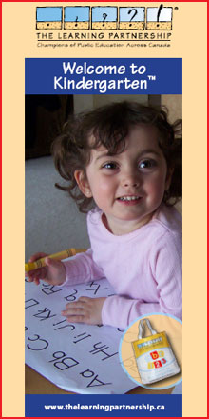
Welcome to Kindergarten Event
The Welcome to Kindergarten™ program has been developed to provide pre-school children (and their families) with resources and experiences to begin their formal education with a foundation in early learning nurtured in their homes. The program was developed by The Learning Partnership, a national not-for-profit organization.

Slide 26
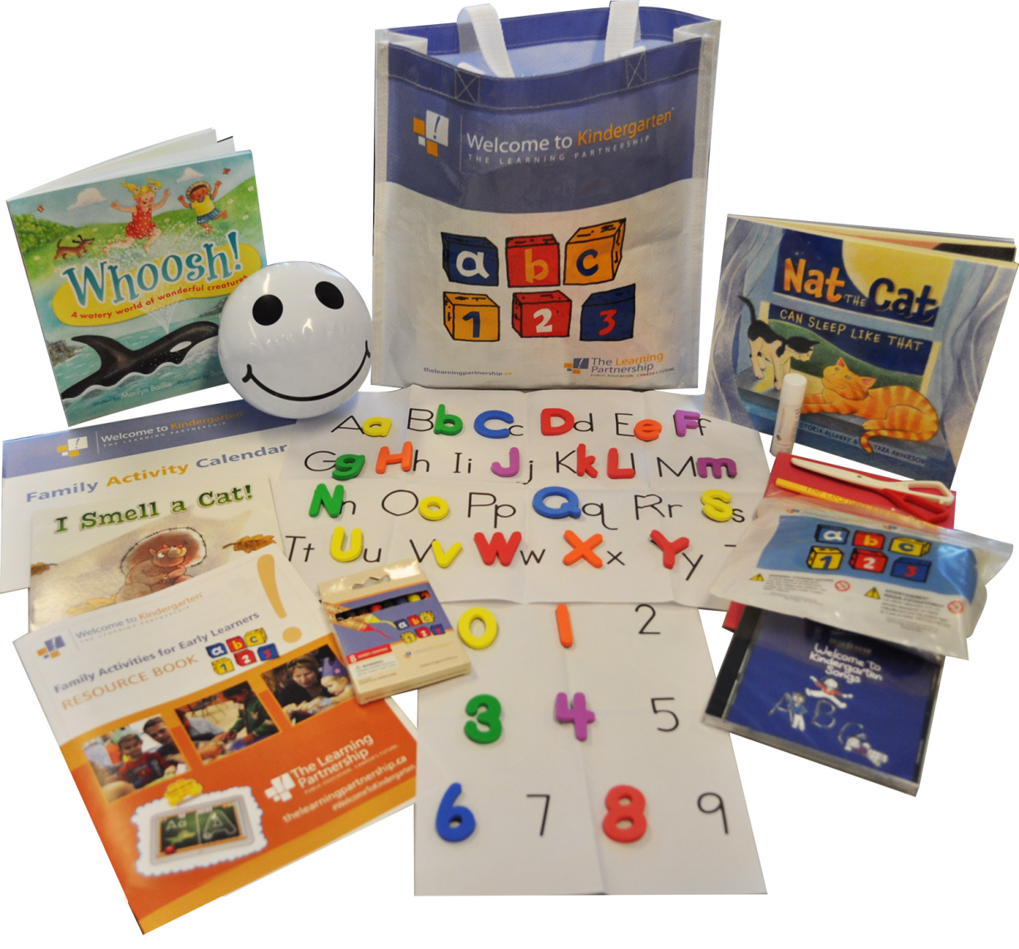
Welcome to Kindergarten
Notes:
Parents/ caregivers and their children attend Welcome to Kindergarten orientation sessions at their neighborhood school, where they receive early learning and literacy resources, and learn how to use them at home. The orientation helps create the foundation for positive relationships between parents, educators and community agencies that sets the stage for future success.
The materials in the bag and the activities that you will do at the Welcome to Kindergarten event will help you support the skills evaluated by the EYE-DA.

Slide 27

Orientation Day
Date
Format
Bus information
Notes:
Orientation Day is a ‘mini’ kindergarten day that will give your child the opportunity to spend time in a kindergarten classroom with a kindergarten teacher doing activities typical of a day at kindergarten. Children will also have a snack and have time to play on the playground (weather permitting). The highlight of this day is usually the school bus orientation where children will learn how to ride the bus safely and then go for a short ride. You will receive more information about this event as the date approaches.

Slide 28
Questions?
Event Dates:
  EYE-DA (week of)
  Welcome to Kindergarten (date)
  Orientation Day (date if scheduled)
FACE: 1-855-383-5437
Talk With Me: 1-877-492-8255
Notes:
Add in your dates.

