Slide 1
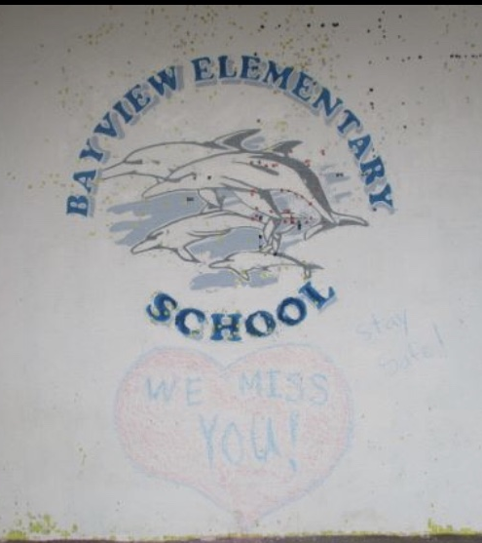

Bayview Families …
We hope you enjoy a few pictures and messages from the staff at your school.

Slide 2

Hello Bayview Bucketfillers!

Slide 3
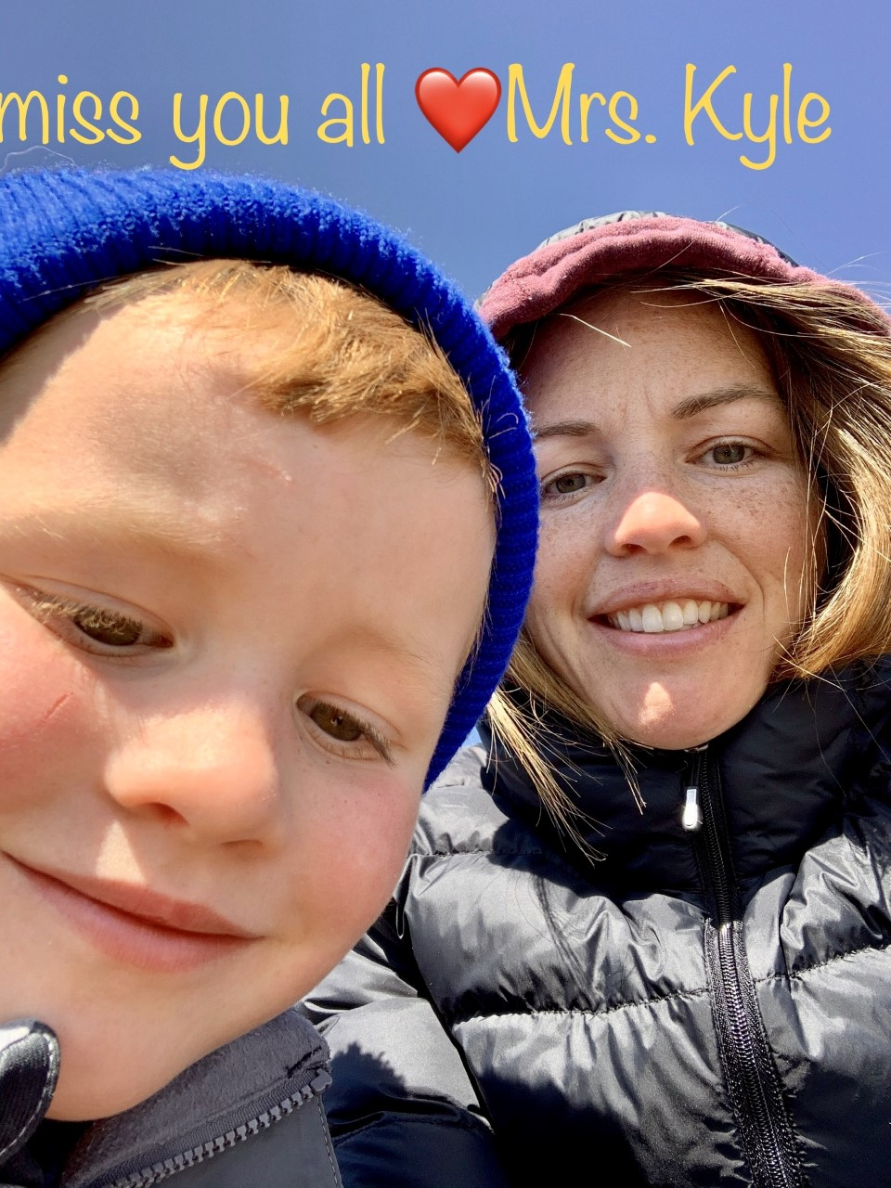
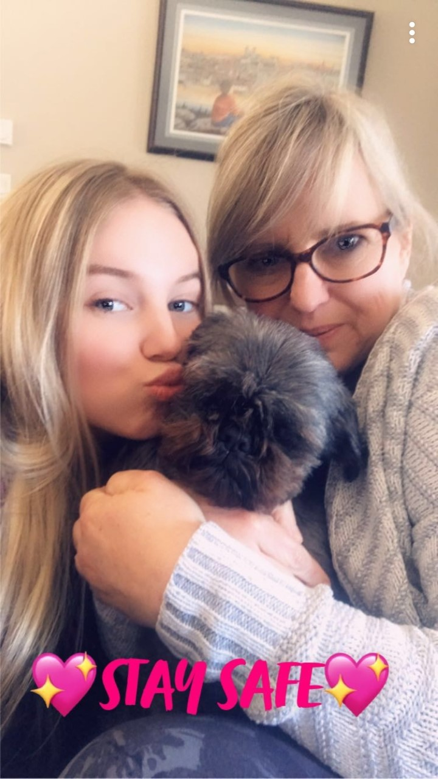
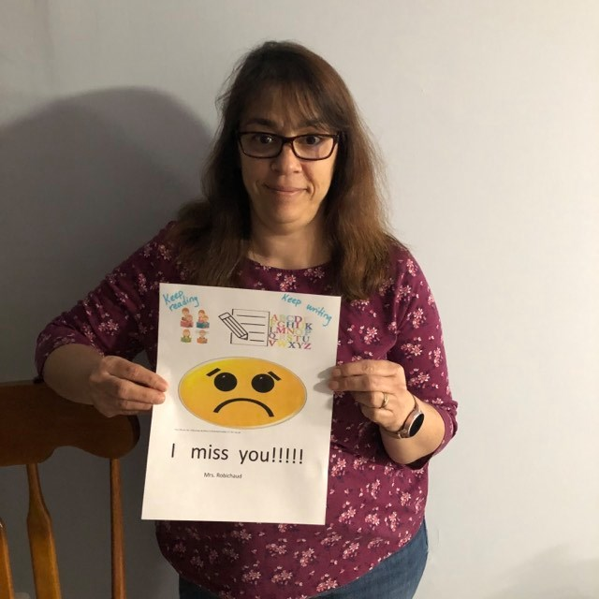
Mrs. Kyle’s Kindergarten Class.
Mrs. Kyle, Mrs. Langlais and Mrs. Robichaud are missing everyone and hoping the entire Bayview Community is staying safe.

Slide 4
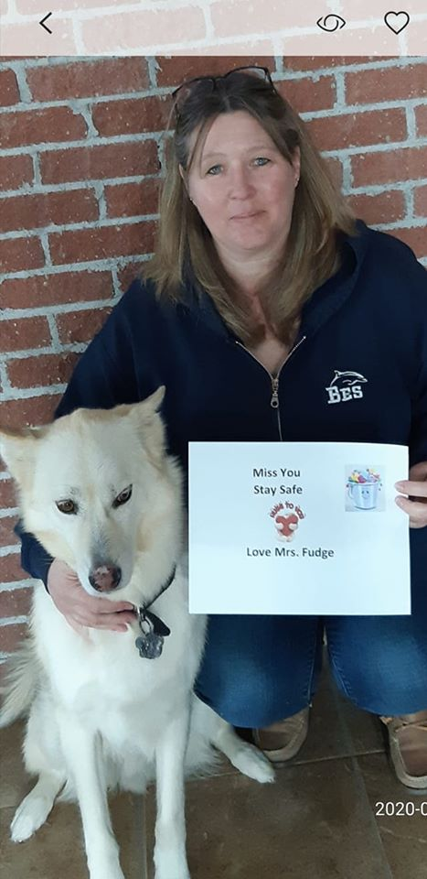
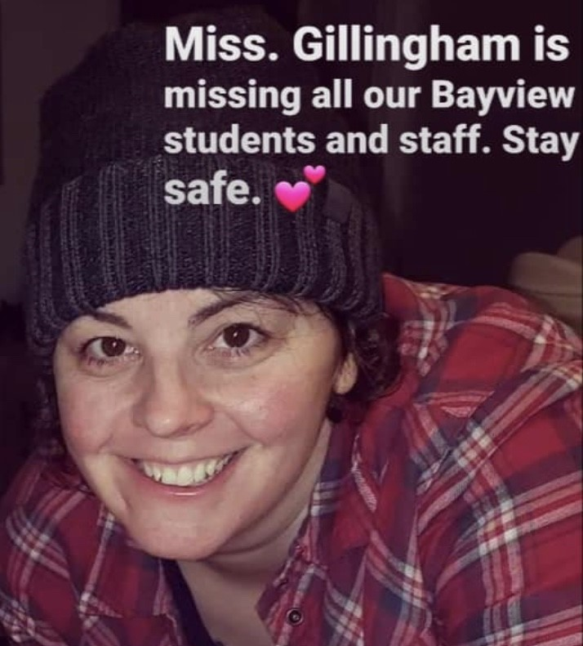

Slide 5
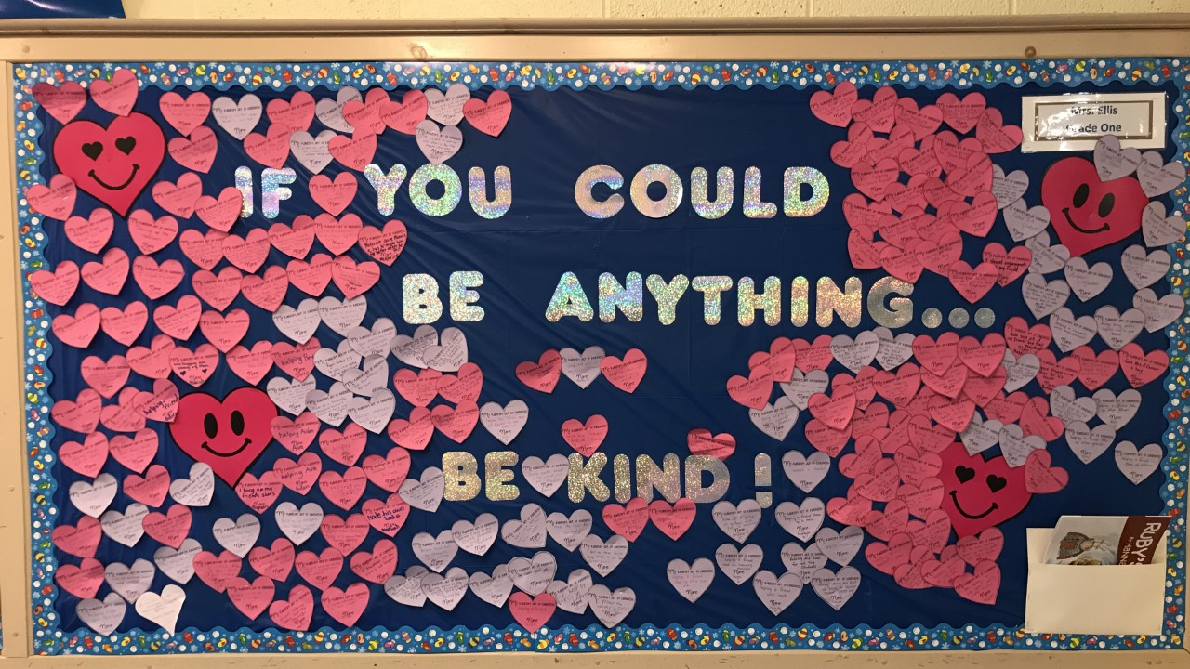

Slide 6
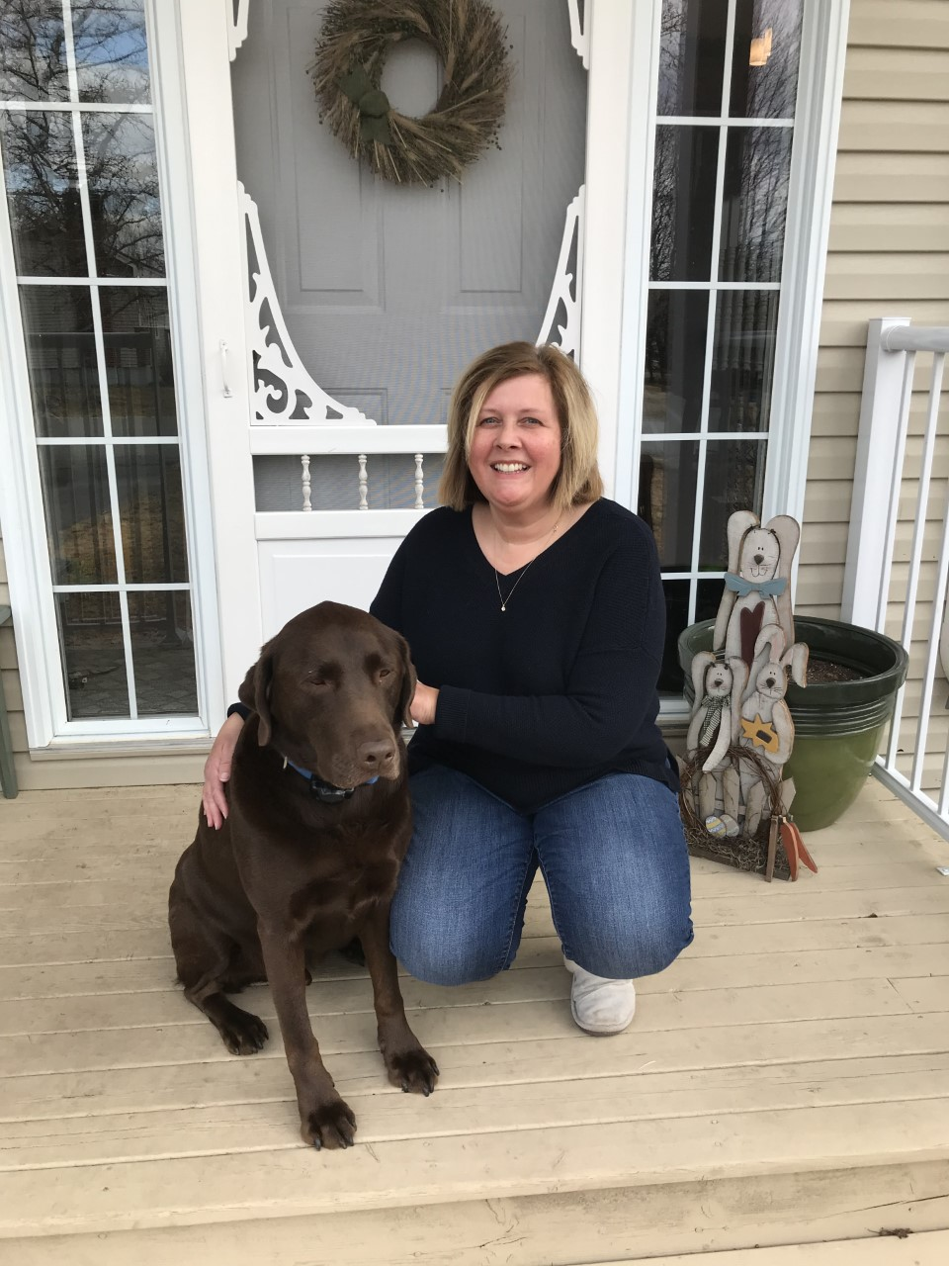
Mrs. Ellis is enjoying time outside and going for walks with her dog. Do you get outside to play?

Slide 7
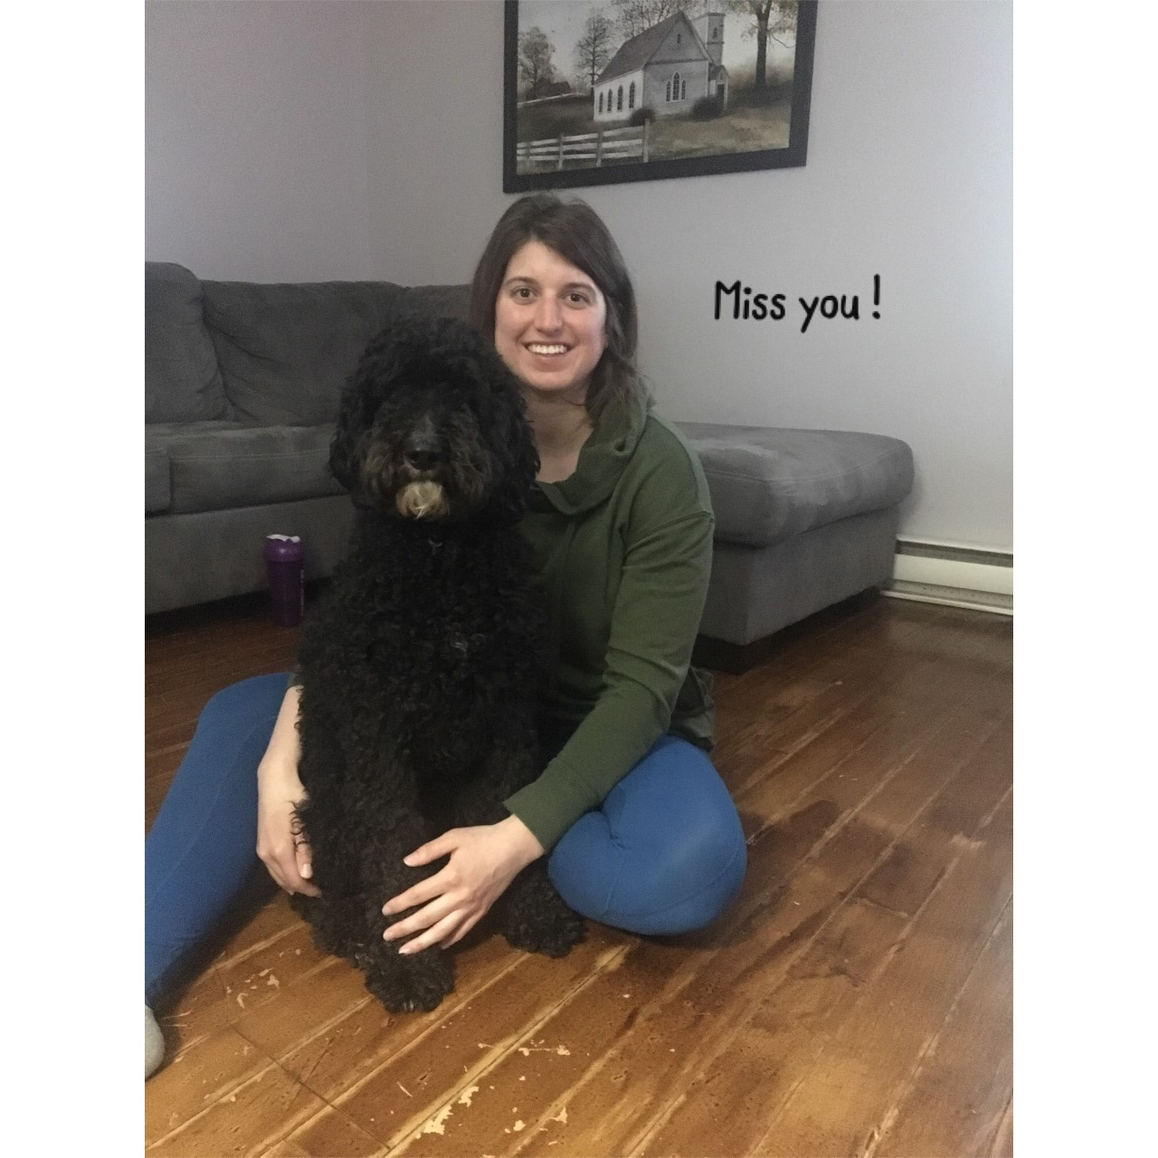
Take Care,
Love
Ms. Furlong

Slide 8
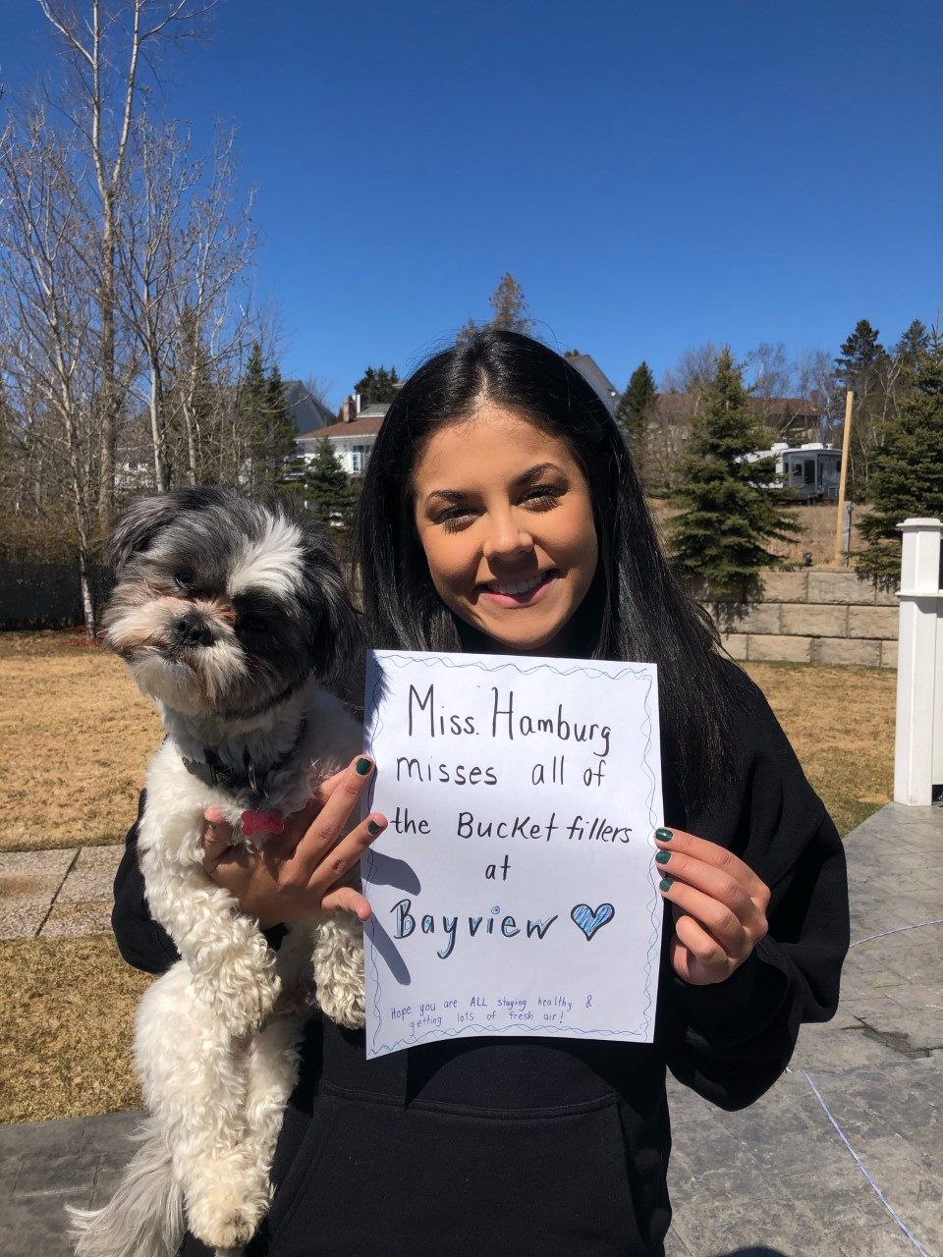
Ms. Hamburg is wishing she could be with you all and is hoping everyone is washing their hands often and staying safe.

Slide 9
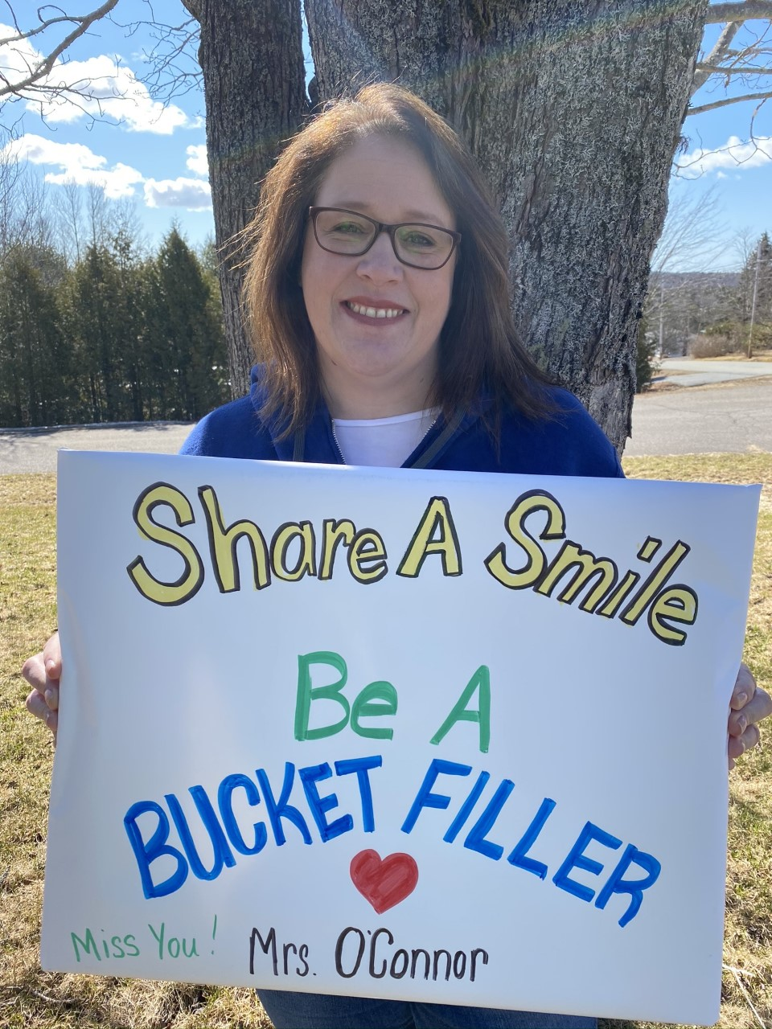

Slide 10
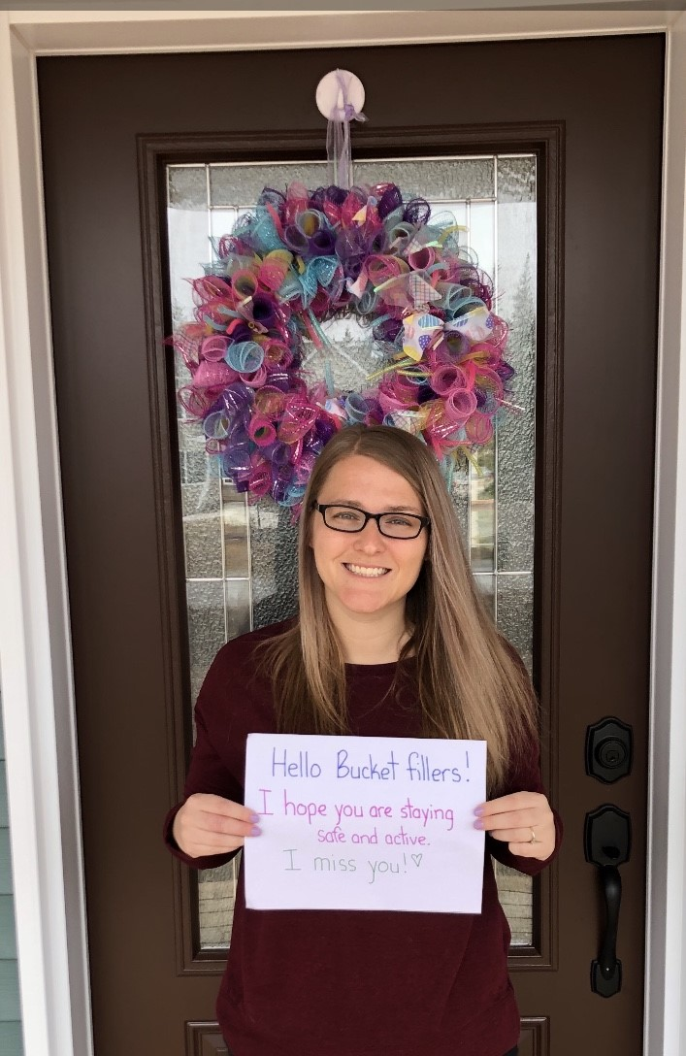
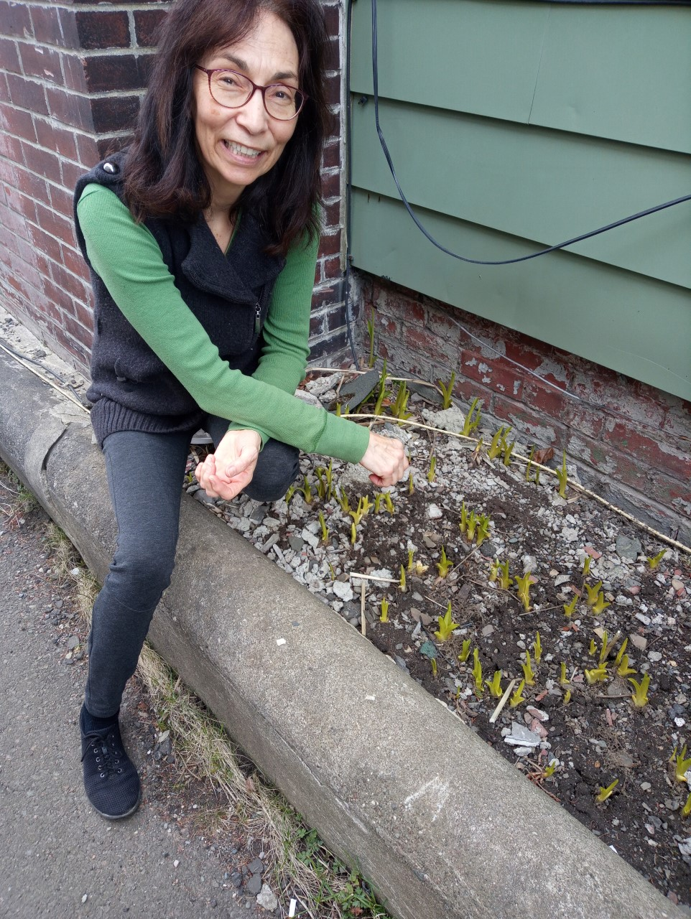
Mrs. Roberts is excited to see some of her plants starting to grow in her garden. Have you seen things growing outside?
Ms. Gallant is enjoying some time outside too! She wants to know what you have been doing to stay active during your time of self isolation.

Slide 11
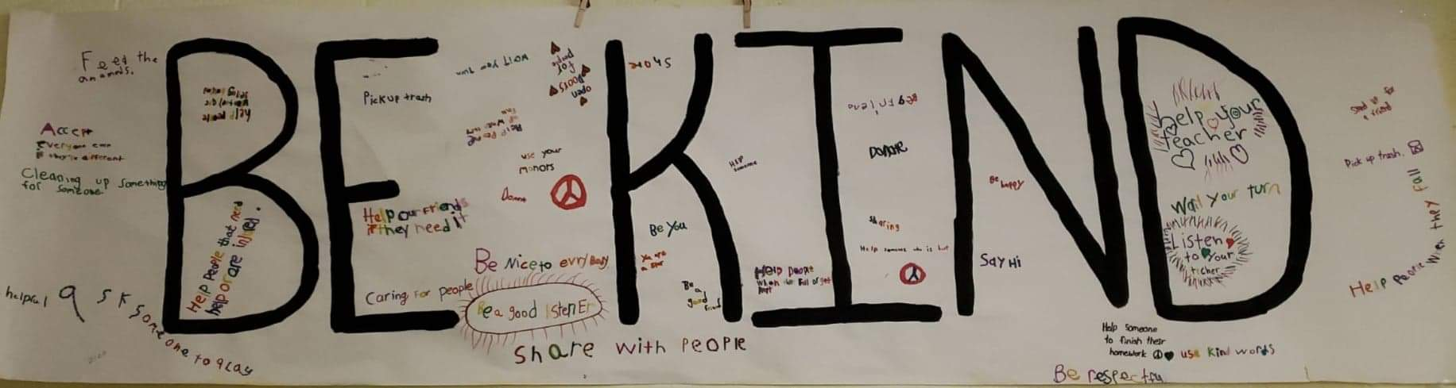

Slide 12
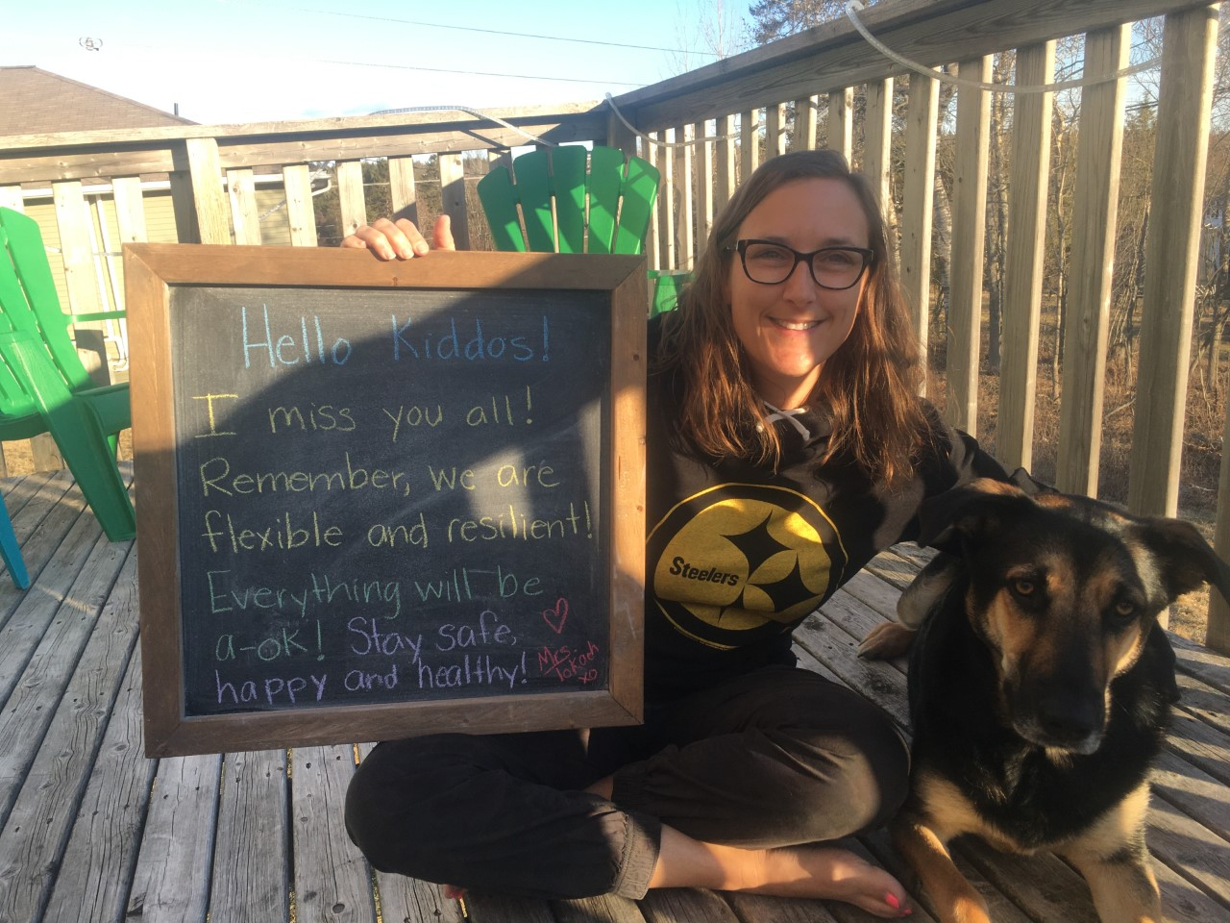
Check out this fun message from Mrs. Tokach.

Slide 13
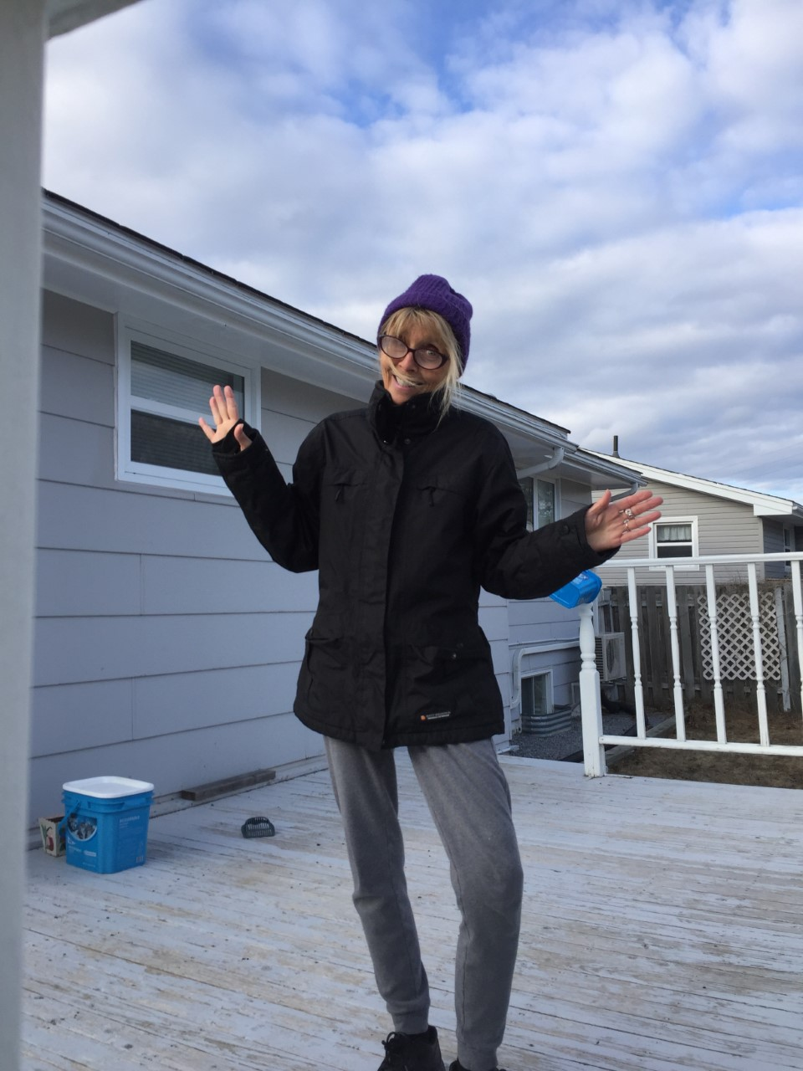
Ms. Langstroth misses everyone and is hoping all Bayview families and students are staying safe and healthy. Remember to keep a safe distance from people that do not live in your house with you ☺

Slide 14
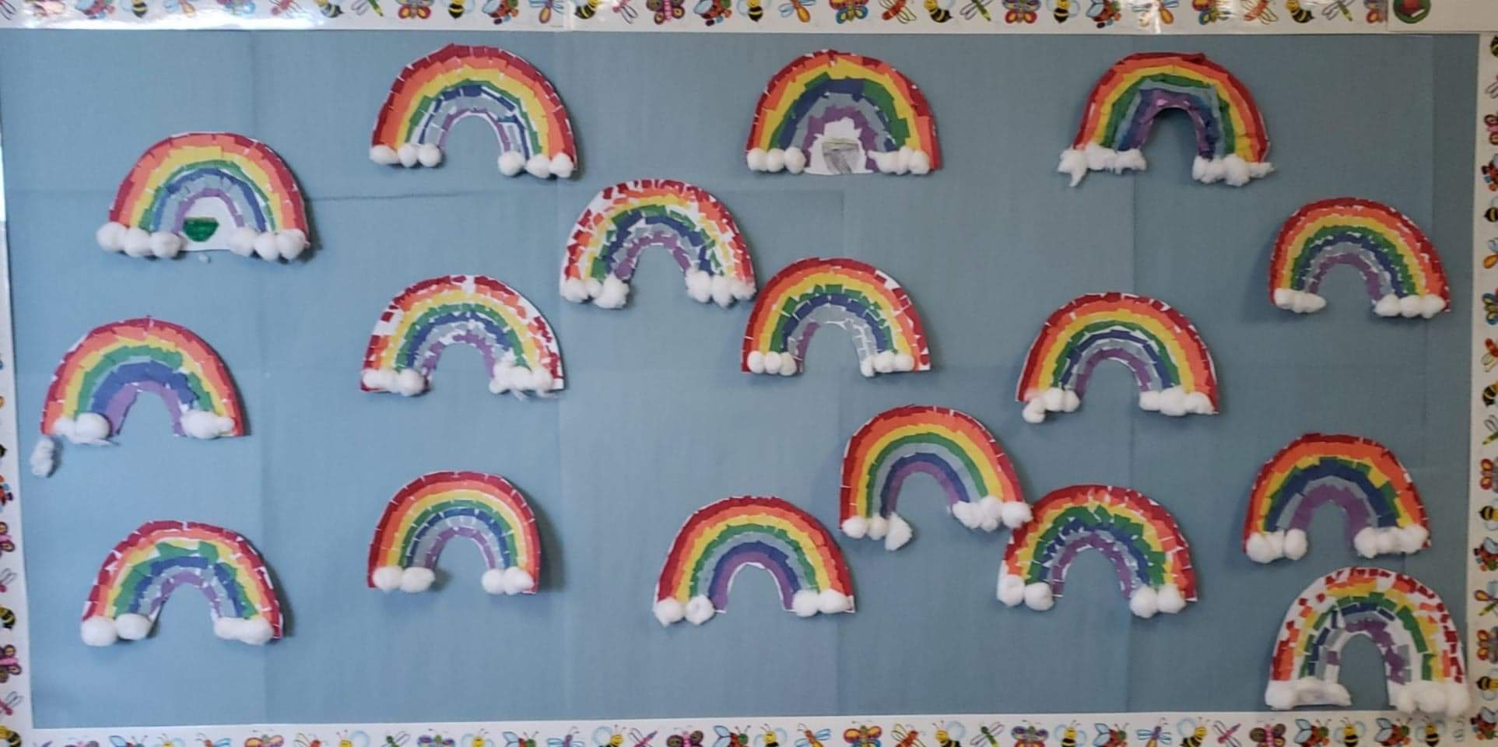

Slide 15
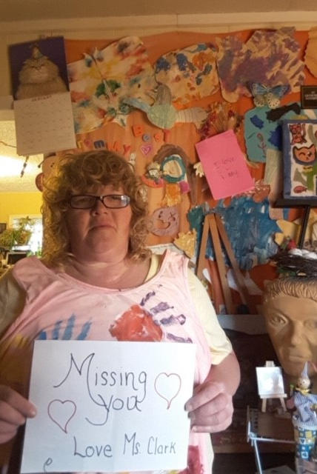
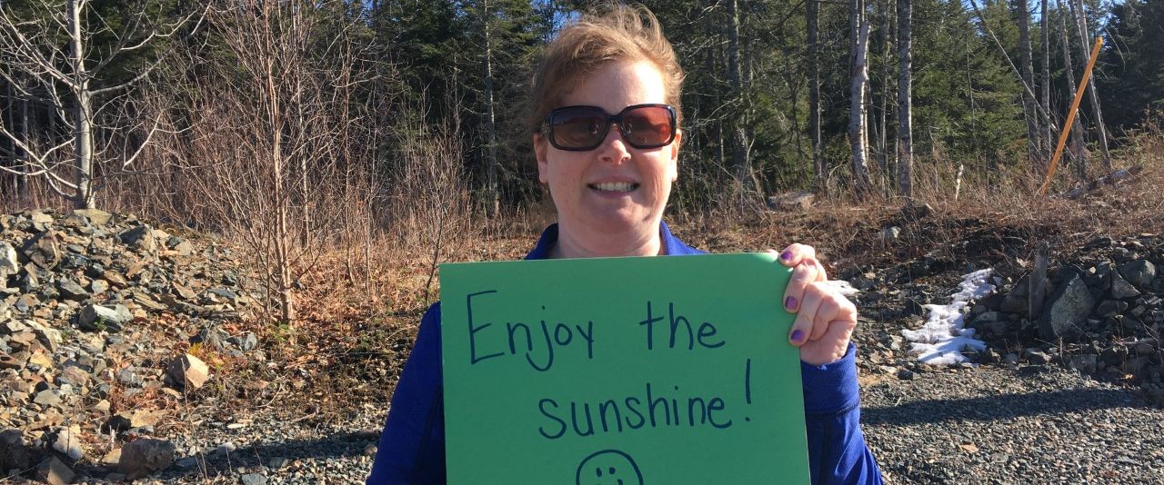
Loving messages from Mrs. Blakely’s Grade One Class.

Slide 16
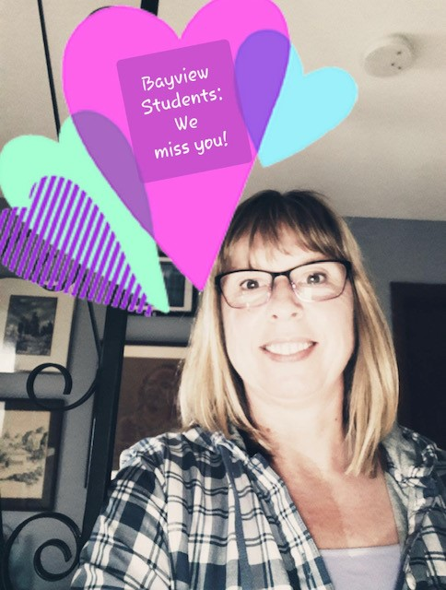
Ms. Groves-Reynold’s is having fun learning new things with her computer. What new things have you learned during your time at home?

Slide 17
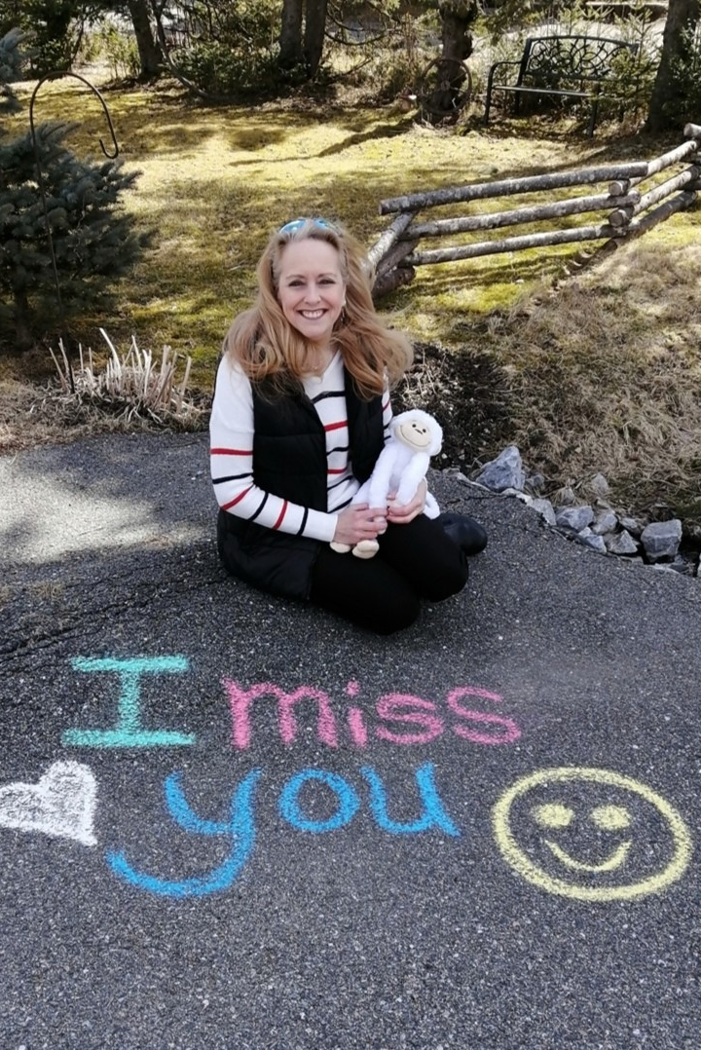
Ms. Connolly is missing you and hoping that everyone is remembering all the breathing exercises that she does with some of our students. She is cuddling with her favorite stuffy. What do you do with your favorite stuffy?

Slide 18
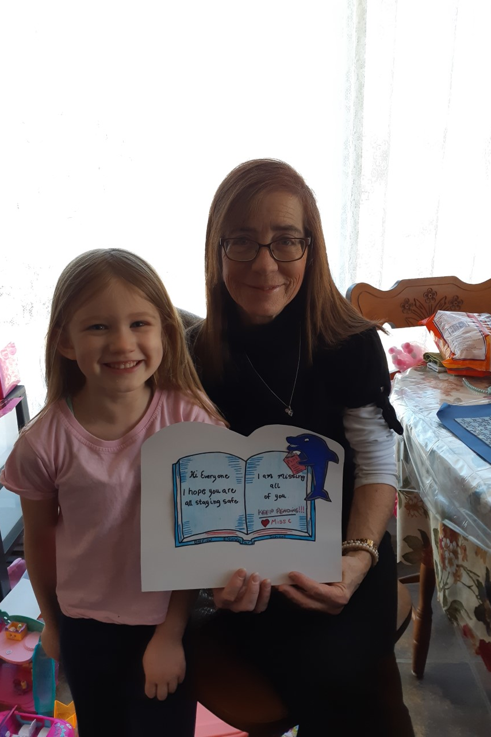
Mrs. Capriotti is doing lots of reading and hoping all Bayview Students are reading lots too.

Slide 19
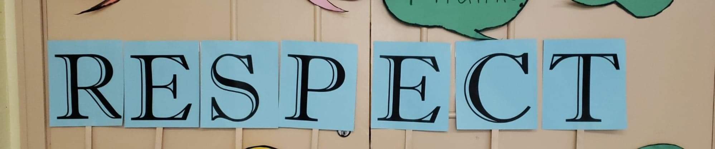

Slide 20
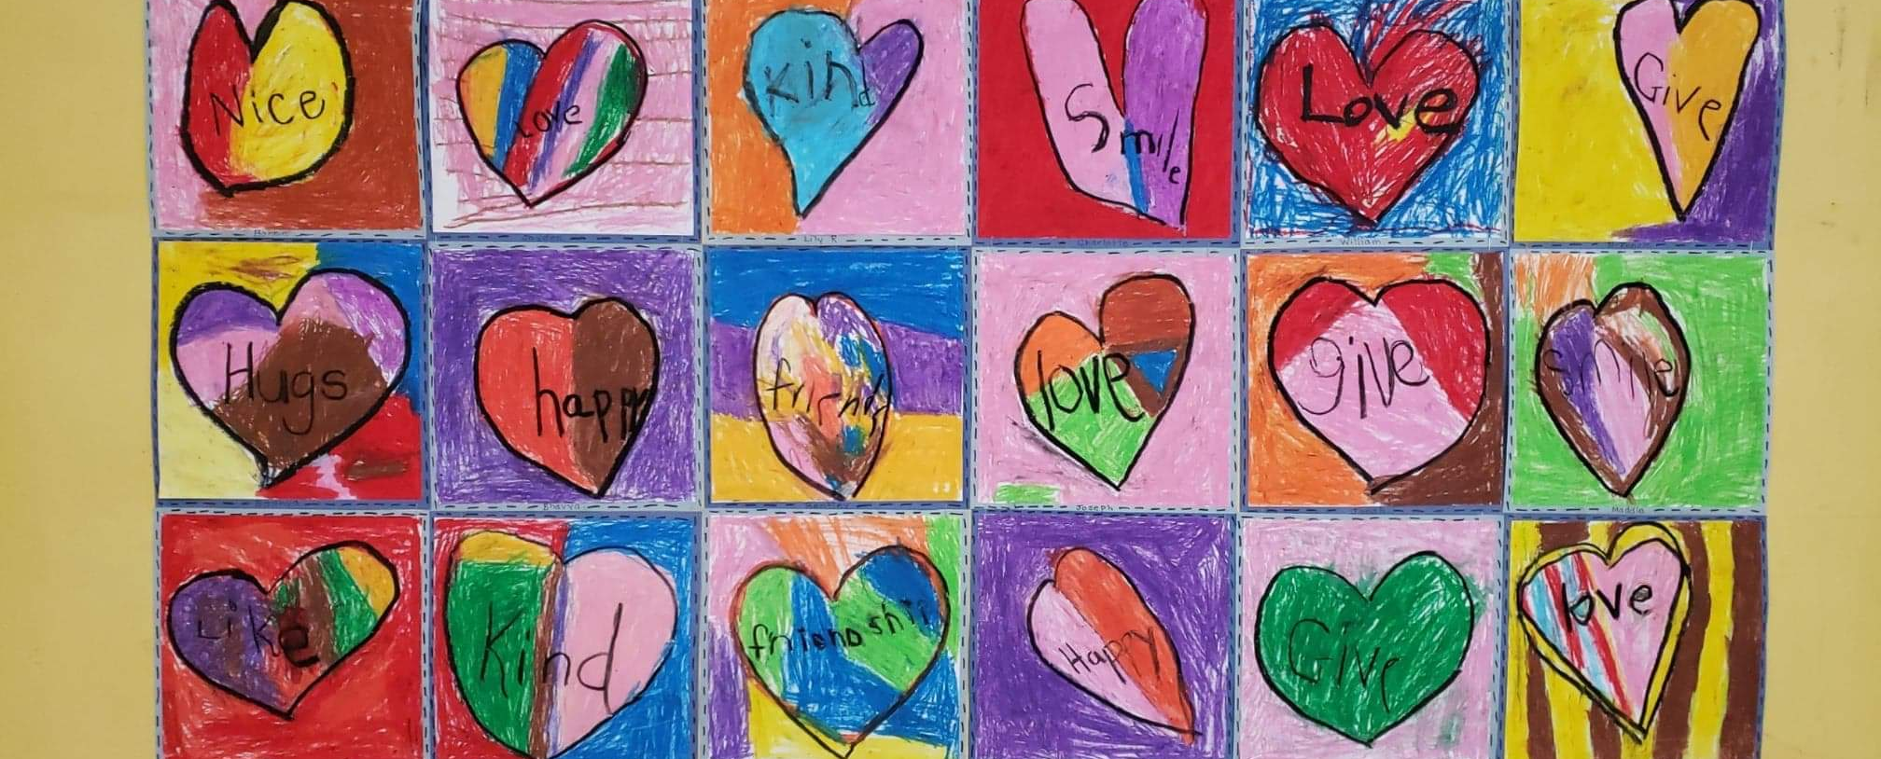

Slide 21
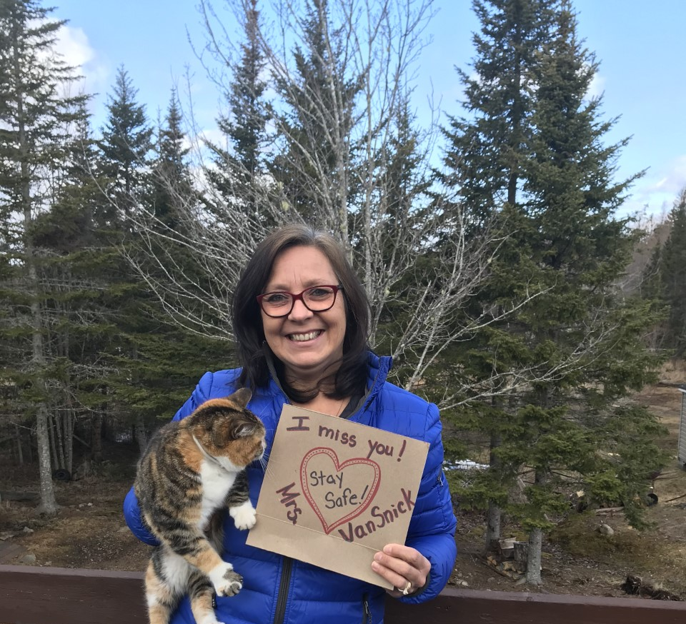
Mrs. Vansnick wants all Bayview Bucketfillers to stay safe and remember to stay home as much as possible. We miss you all very much!

Slide 22
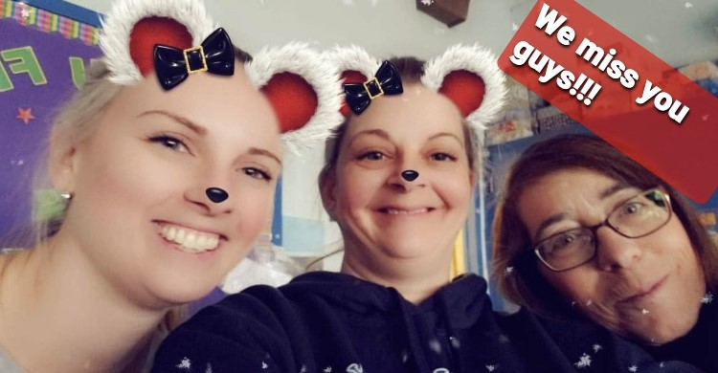
The fun never stops in Mrs. MacLeod’s Grade 4 Class …

Slide 23
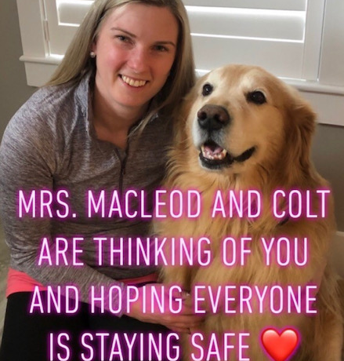
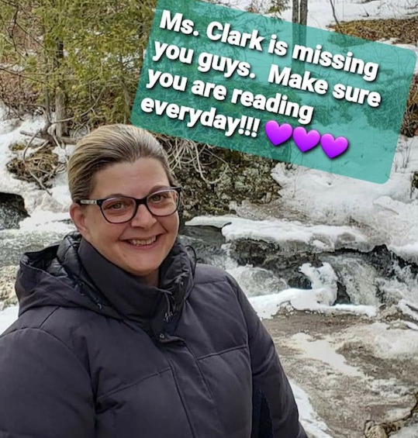

Slide 24
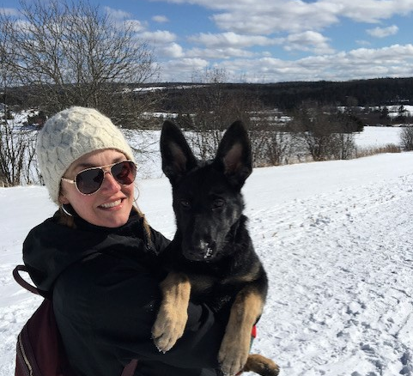
Mme. Grandy et Berlin dit …
…. Bonjour mes amis! Vous me manquez. Restez en sécurité et en bonne santé.

Slide 25
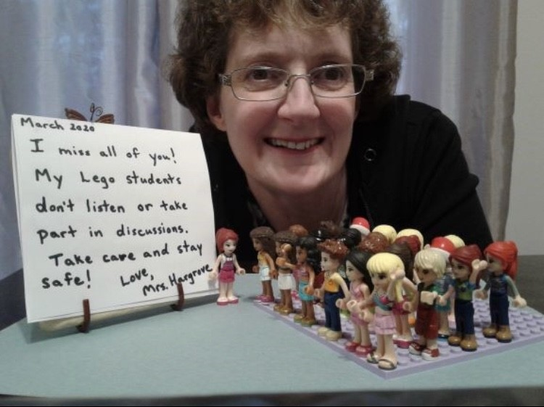
Mrs. Hargrove is finding lots of fun ways to stay busy. How are you staying busy?

Slide 26
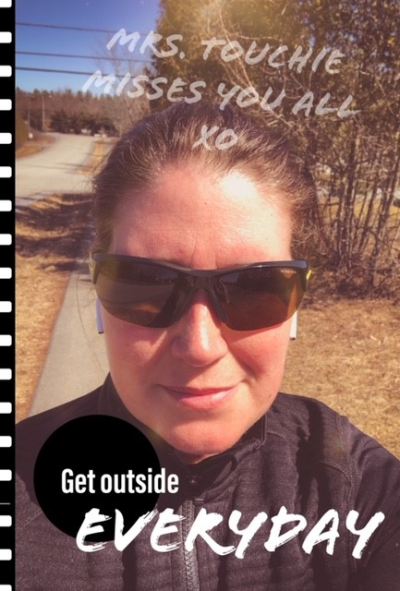
Mrs. Touchie exercises almost every day. Do you exercise?

Slide 27
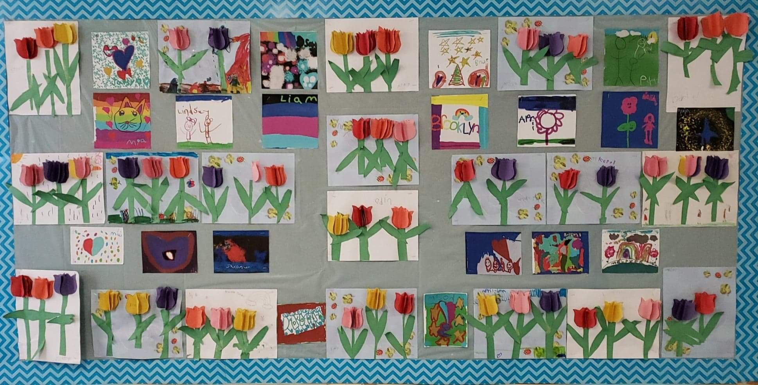

Slide 28

Have you filled someone’s bucket today?

Slide 29

Remember to always:
BE KIND,
BE SAFE &
BE YOUR BEST
BUCKETFILLERS

Slide 30

WE MISS YOU!!
Stay Safe & Help Flatten the Curve

