Slide 1
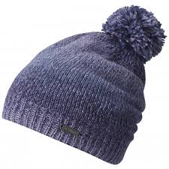
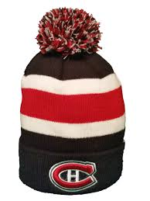
Tuque Tuesday
February 6th
In Support Of
Outflow Men’s Shelter
Tuque Tuesday
For
Outflow

