Slide 1
Welcome to Barnhill Memorial School

Slide 2
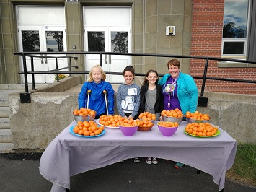
Agenda/Topics to be Covered
Introduction
Vision Statement
Mission Statement
Who’s Who
Student Behaviour
Barnhill Supports & Activities
Parent-Teacher Communication
Closed Campus
Daily Schedule
How To
Enter the school in the morning
Exit the school in the afternoon
Clementines on Terry Fox Day!

Slide 3
Agenda/Topics to be Covered Continued…
Nutrition Breaks & Lunch
Nut Free Policy
Scent Reduced Policy
Electronic Device Policy
Missed Work
Lost & Found Items
Procedures & Routines
Going from class to class
Entering and leaving classrooms
Using the washroom
Transportation

Slide 4
Vision Statement
Barnhill does
their
BEST!
Better Every Single Time!

Slide 5
Mission Statement
The Community of Barnhill Memorial School provides a variety of quality learning experiences to support students in reaching their potential and to become contributing members of society.

Slide 6
Who’s Who
Ms. Jill Ferguson – Principal
Mrs. Liza Muise – Vice Principal
Ms. Kristen Sloat, Mrs. Liza Muise and Mr. MacDonald (EST-Resource)
Mr. Bruce Savoie – Guidance Counsellor
PSSC – Parent School Support Committee
Grade 6, 7 & 8 – English Prime & French Immersion
15 homerooms

Slide 7
Student Behaviour We are a Restorative Practice School
All students have the right to a safe and healthy learning environment.
To achieve this, students are asked to develop and demonstrate a sense of responsibility and accountability for their actions.

Slide 8
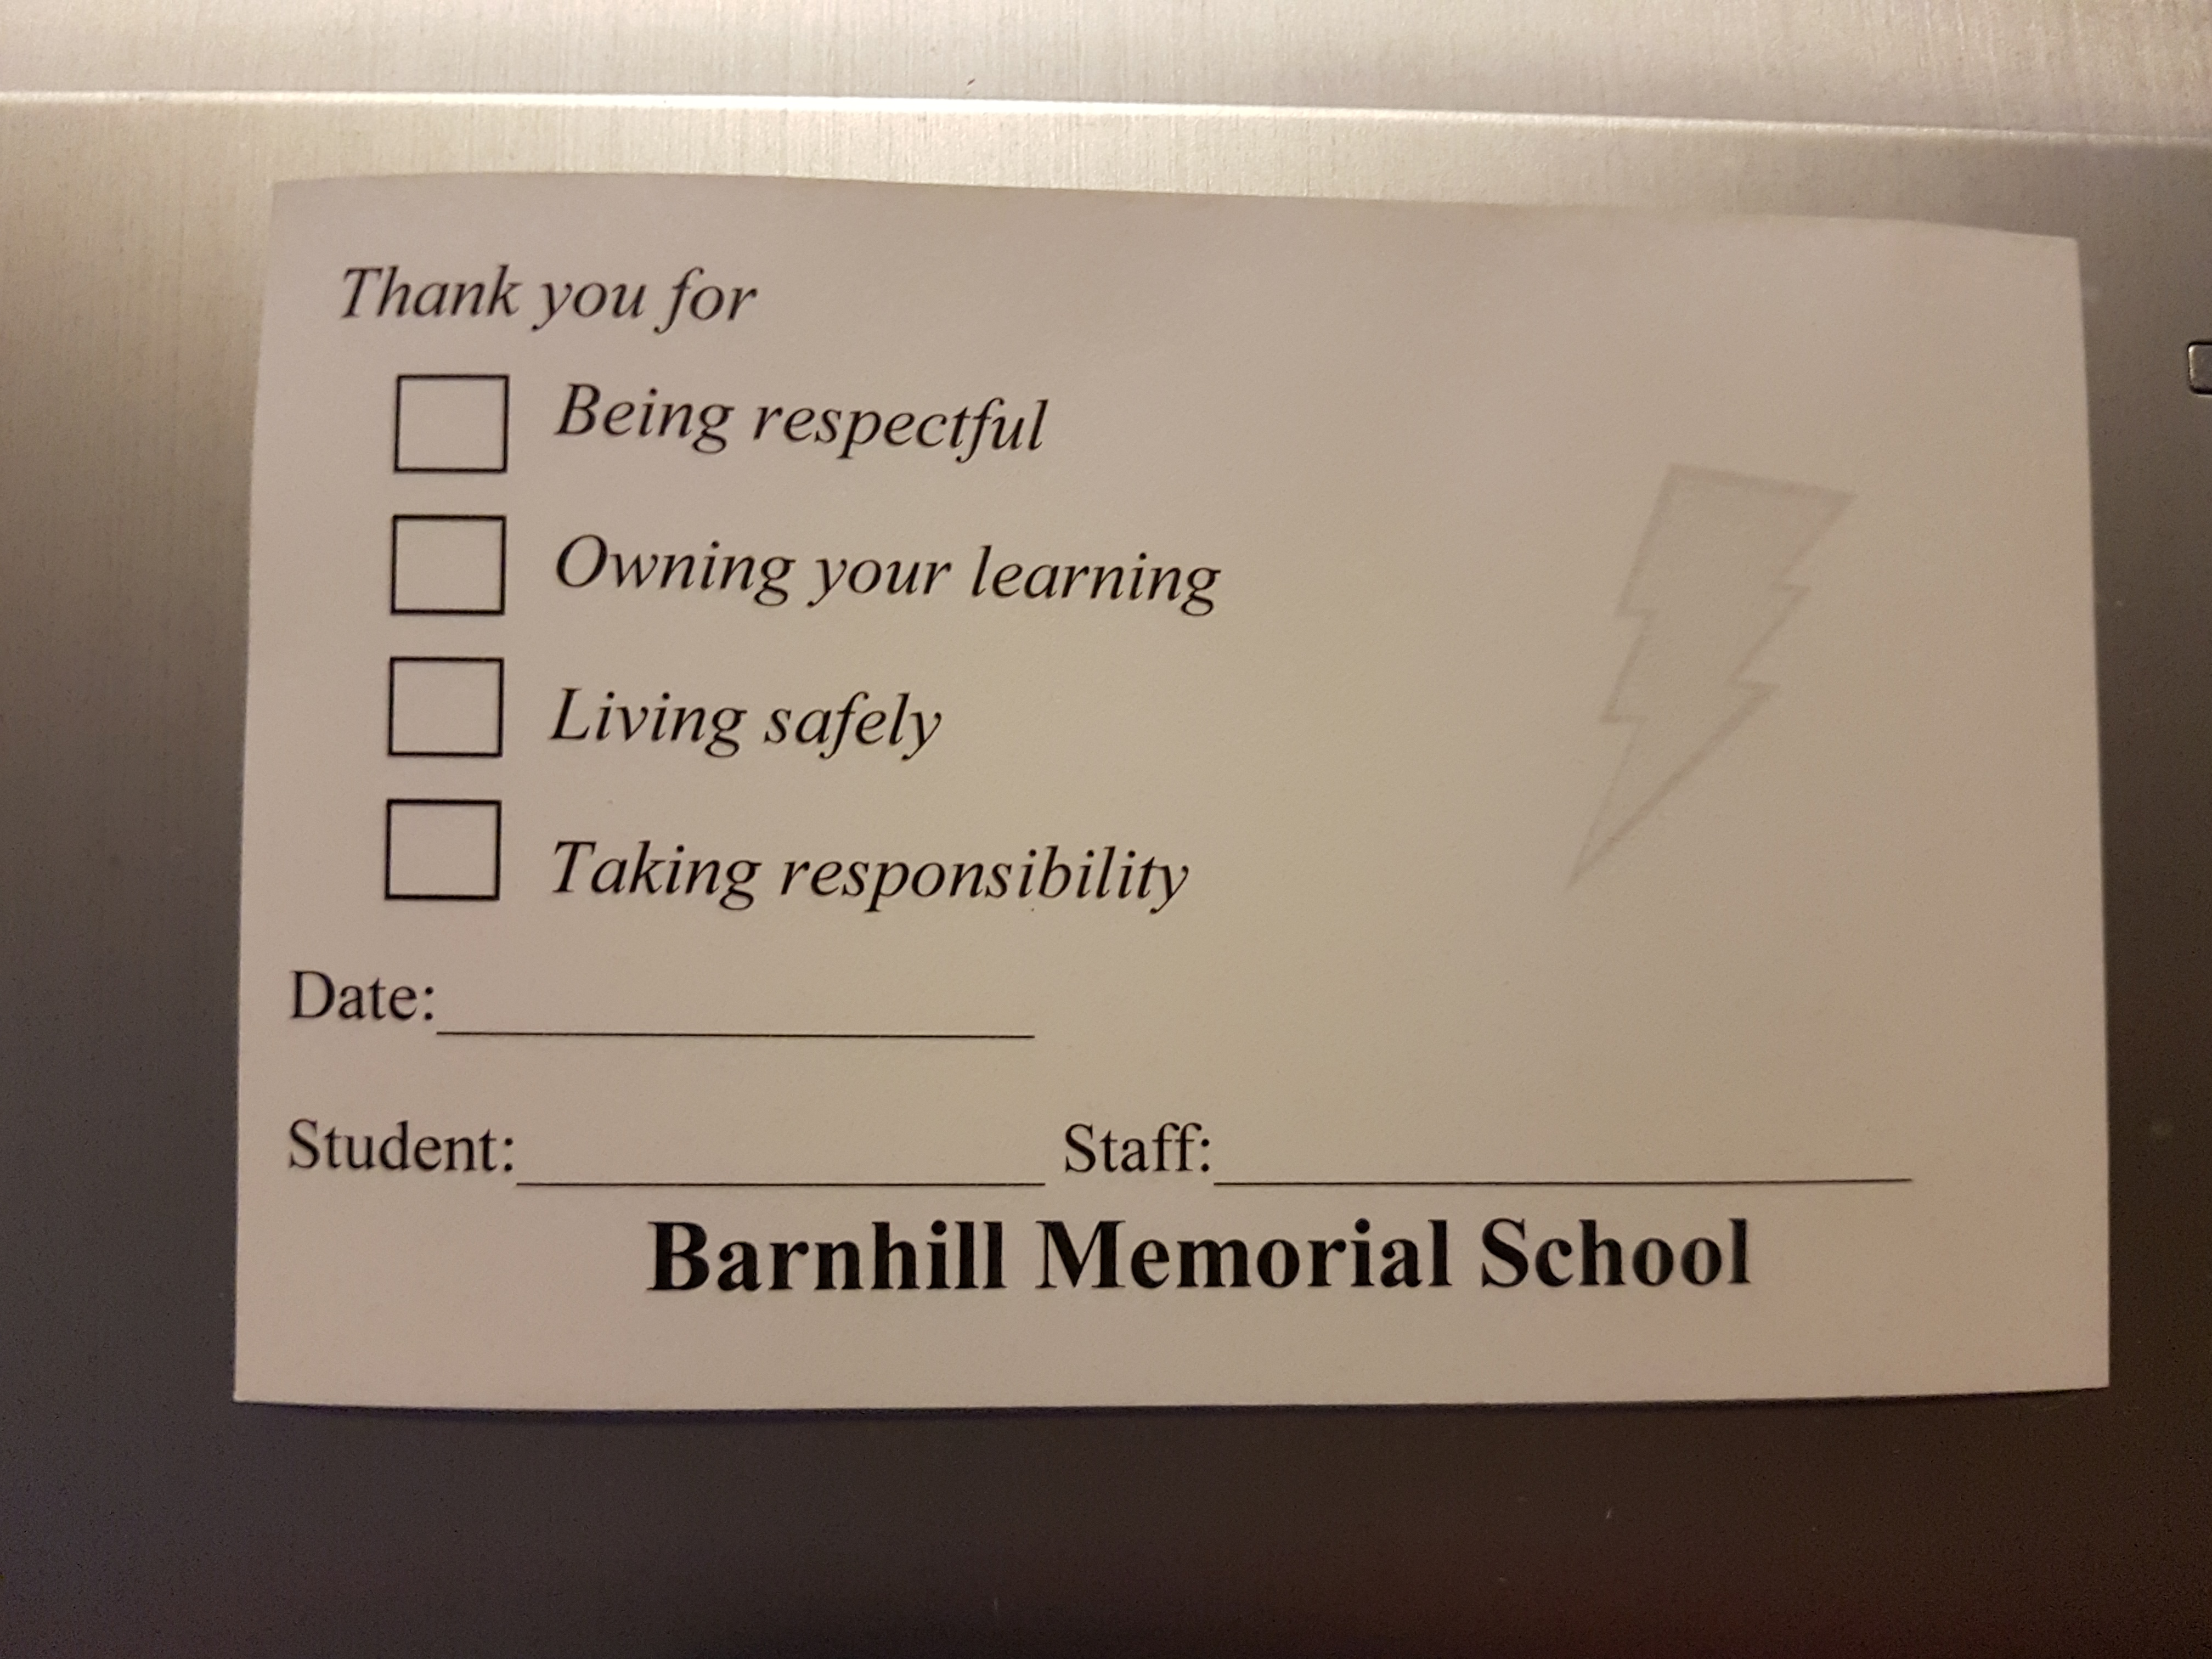
Barnhill BOLT
Be Respectful
Own Your Learning
Live Safely
Take Responsibility
You can receive a BOLT ballot from a Barnhill staff member for displaying one of the traits. There will be weekly prizes that will be announced on Fridays, from the office.

Slide 9
Classes
English Prime & French Immerson
PRIME ONLY:
FILA – 3 times a week
English Language Arts – 5 times a week
FRENCH IMMERSION ONLY:
English Language Arts – 3 times a week
French Immersion Language Arts:
5 times a week
Specialties – same for both Prime and FI
Math – 5 times a week
Science - 3 times a week
Social Studies – 3 times a week
Personal Wellness every morning.
Physical Education – twice a week
Exploratory once a week.
Each student at Barnhill has three speciality classes throughout the year. They are:
Art
Music
Technology

Slide 10
Parent-Teacher Communication
Agenda
Phone/Email
An agenda will be provided to all students.
An agenda is an excellent form of communication for parents and teachers to stay connected.
Homeroom teachers will have made initial contact with families before the first week of school
We will be connecting throughout the school year by email or phone calls.

Slide 11
Closed Campus
Barnhill Memorial School is a closed campus for the safety of our students.
Students are to remain on-site when they arrive in the morning until they are dismissed at the end of the day.
A parent/guardian must sign their child out in the office if they must leave for any reason prior to dismissal. Parents are asked to not enter the building when picking up students, please call the office when you arrive.
Drop-off and pick-up area in the morning and after school is
at the Cenotaph, between Barnhill and St. Rose School.

Slide 12
Your Daily Schedule
8:20 am Enter School – Begin Day
8:20 – 8:35 Homeroom
8:35 - 9:00 Personal Wellness - 1
9:00 – 10:00 Period 2
10:00 – 10:05 Break
10:05 -11:05 Period 3
11:05 - 11:10 Break
11:10 - 12:10 Period 4
12:10 - 12:50 Lunch
12:50 - 1:50 Period 5
1:50 - 1:55 Break
1:55 - 2:55 Period 6 ~ Every Wednesday there is Exploratory.
2:55 pm Dismissal

Slide 13
Morning Routine
Morning supervision begins at 7:50 AM. When students arrive, they can go to the outdoor classroom or the yard. Students enter the school at 8:20 Each student then goes immediately to their locker in a calm and orderly manner. While in the hallway, students must walk and be respectful. If a student arrives after 8:20, they are to go in the front door and sign in at the office before going to their locker.
Organize all necessary materials for your first class and use the washroom/get a drink.
Upon arriving in class, take a seat and prepare for homeroom and Personal Wellness.

Slide 14
How to Properly Exit the School
1. Go to your locker.
2. Gather your belongings.
3. -Bus students walk to the bus loading zone.
- Walkers leave school grounds immediately.
- Pick-ups are to walk directly to guardian's vehicle.

Slide 15
Nutrition Breaks
There are two breaks in the morning. One between 2nd and 3rd period and another between 3rd and 4th period. They are each 5 minutes.
In the afternoon, between 5th and 6th period, you have a third break. This break is also 5 minutes in length.
During these times you may:
Get a snack;
Go to the washroom; and
Prepare materials for next class.

Slide 16
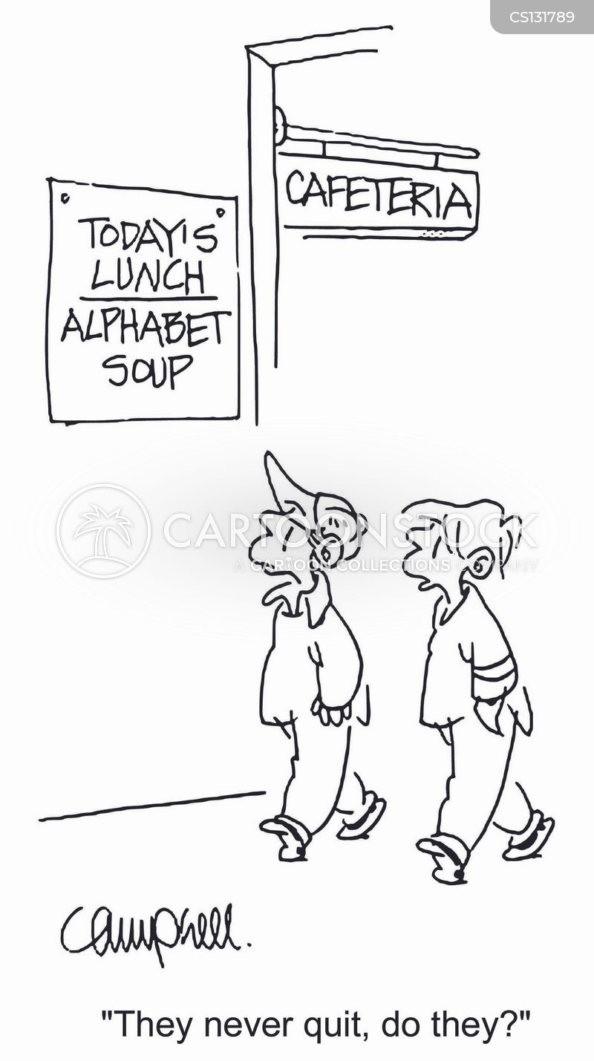
Lunch
Lunch is from12:10 to 12:50;
The first 20 minutes are for eating; and
The second 20 minutes is for activity.

Slide 17
Nut Free/Scent Reduced Policy
ASD-S is nut and scent reduced. We at Barnhill, wish to create a healthy environment for all students and staff.

Slide 18
Phone Use and Electronic Device Policy
The office phone is available for use. Details are outlined in your Agenda.
The Electronic Device Policy is also available on our website.
Texting: Students can receive texts before 8:20 AM, at lunch, and after 2:55 PM.

Slide 19
Missed Work
It is your responsibility to catch up on missed work when you are absent. Please talk to your teachers if you are uncertain.

Slide 20
Lost and Found Items
We are not responsible for lost items, however there is a bin located in the hallway outside of the gymnasium.

Slide 21
Going From Class to Class
Use an indoor voice (with this many people, it gets noisy VERY QUICKLY)
please WALK from class to class AND be respectful of your school environment.

Slide 22
Entering and Leaving Classrooms
Students are required to ask permission of their teacher before leaving the classroom, and they must sign out before leaving , and sign in when they return.

Slide 23
Using the Washroom
* Always sign IN and sign out in the class.
Go to the washroom on the same floor as the classroom you are currently in.

Slide 24
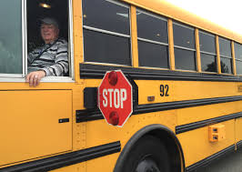
Transportation
Travelling on a school bus is a privilege.
Follow the rules, be respectful to your bus driver, and enjoy your ride!

Slide 25
Sports, Clubs and Activities
Here are some of our extracurricular activities:
- Music club - Intramurals
- Badminton - Art club
- Cross country - Christian Fellowship
- Basketball - Mandela Coloring
- Volleyball - Student Council
- GSA - Flag Football

Slide 26
Communication
If you have any questions, please feel free to contact:
Principal – Ms. Jill Ferguson at Jill.Ferguson@nbed.nb.ca
Vice Principal - Mrs. Liza Muise at Liza.Muise@nbed.nb.ca

