Slide 1
You can win an Oscar!
Barnhill Memorial School
PBIS Initiative November 2020

Slide 2
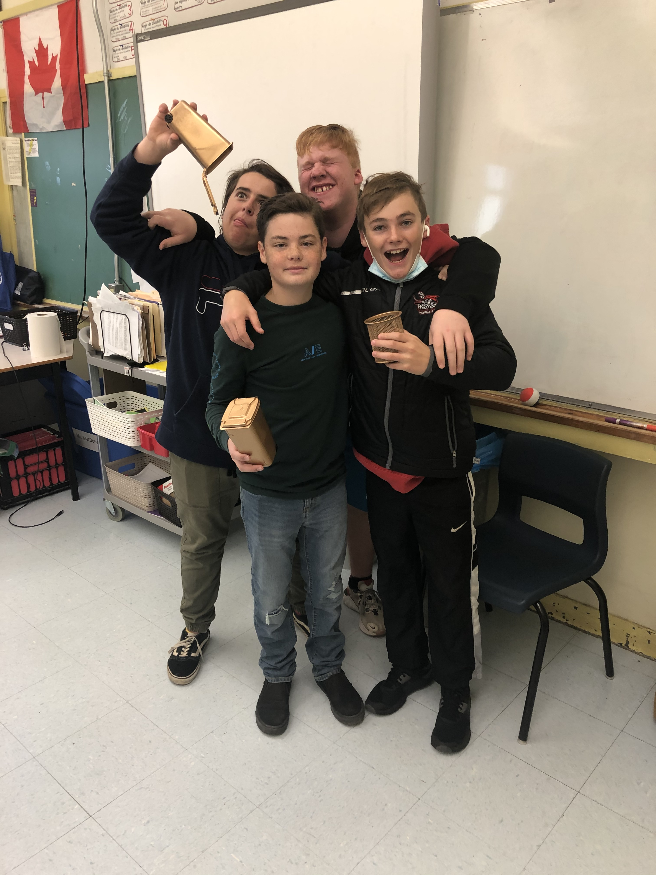

Slide 3
How do you win?

Slide 4
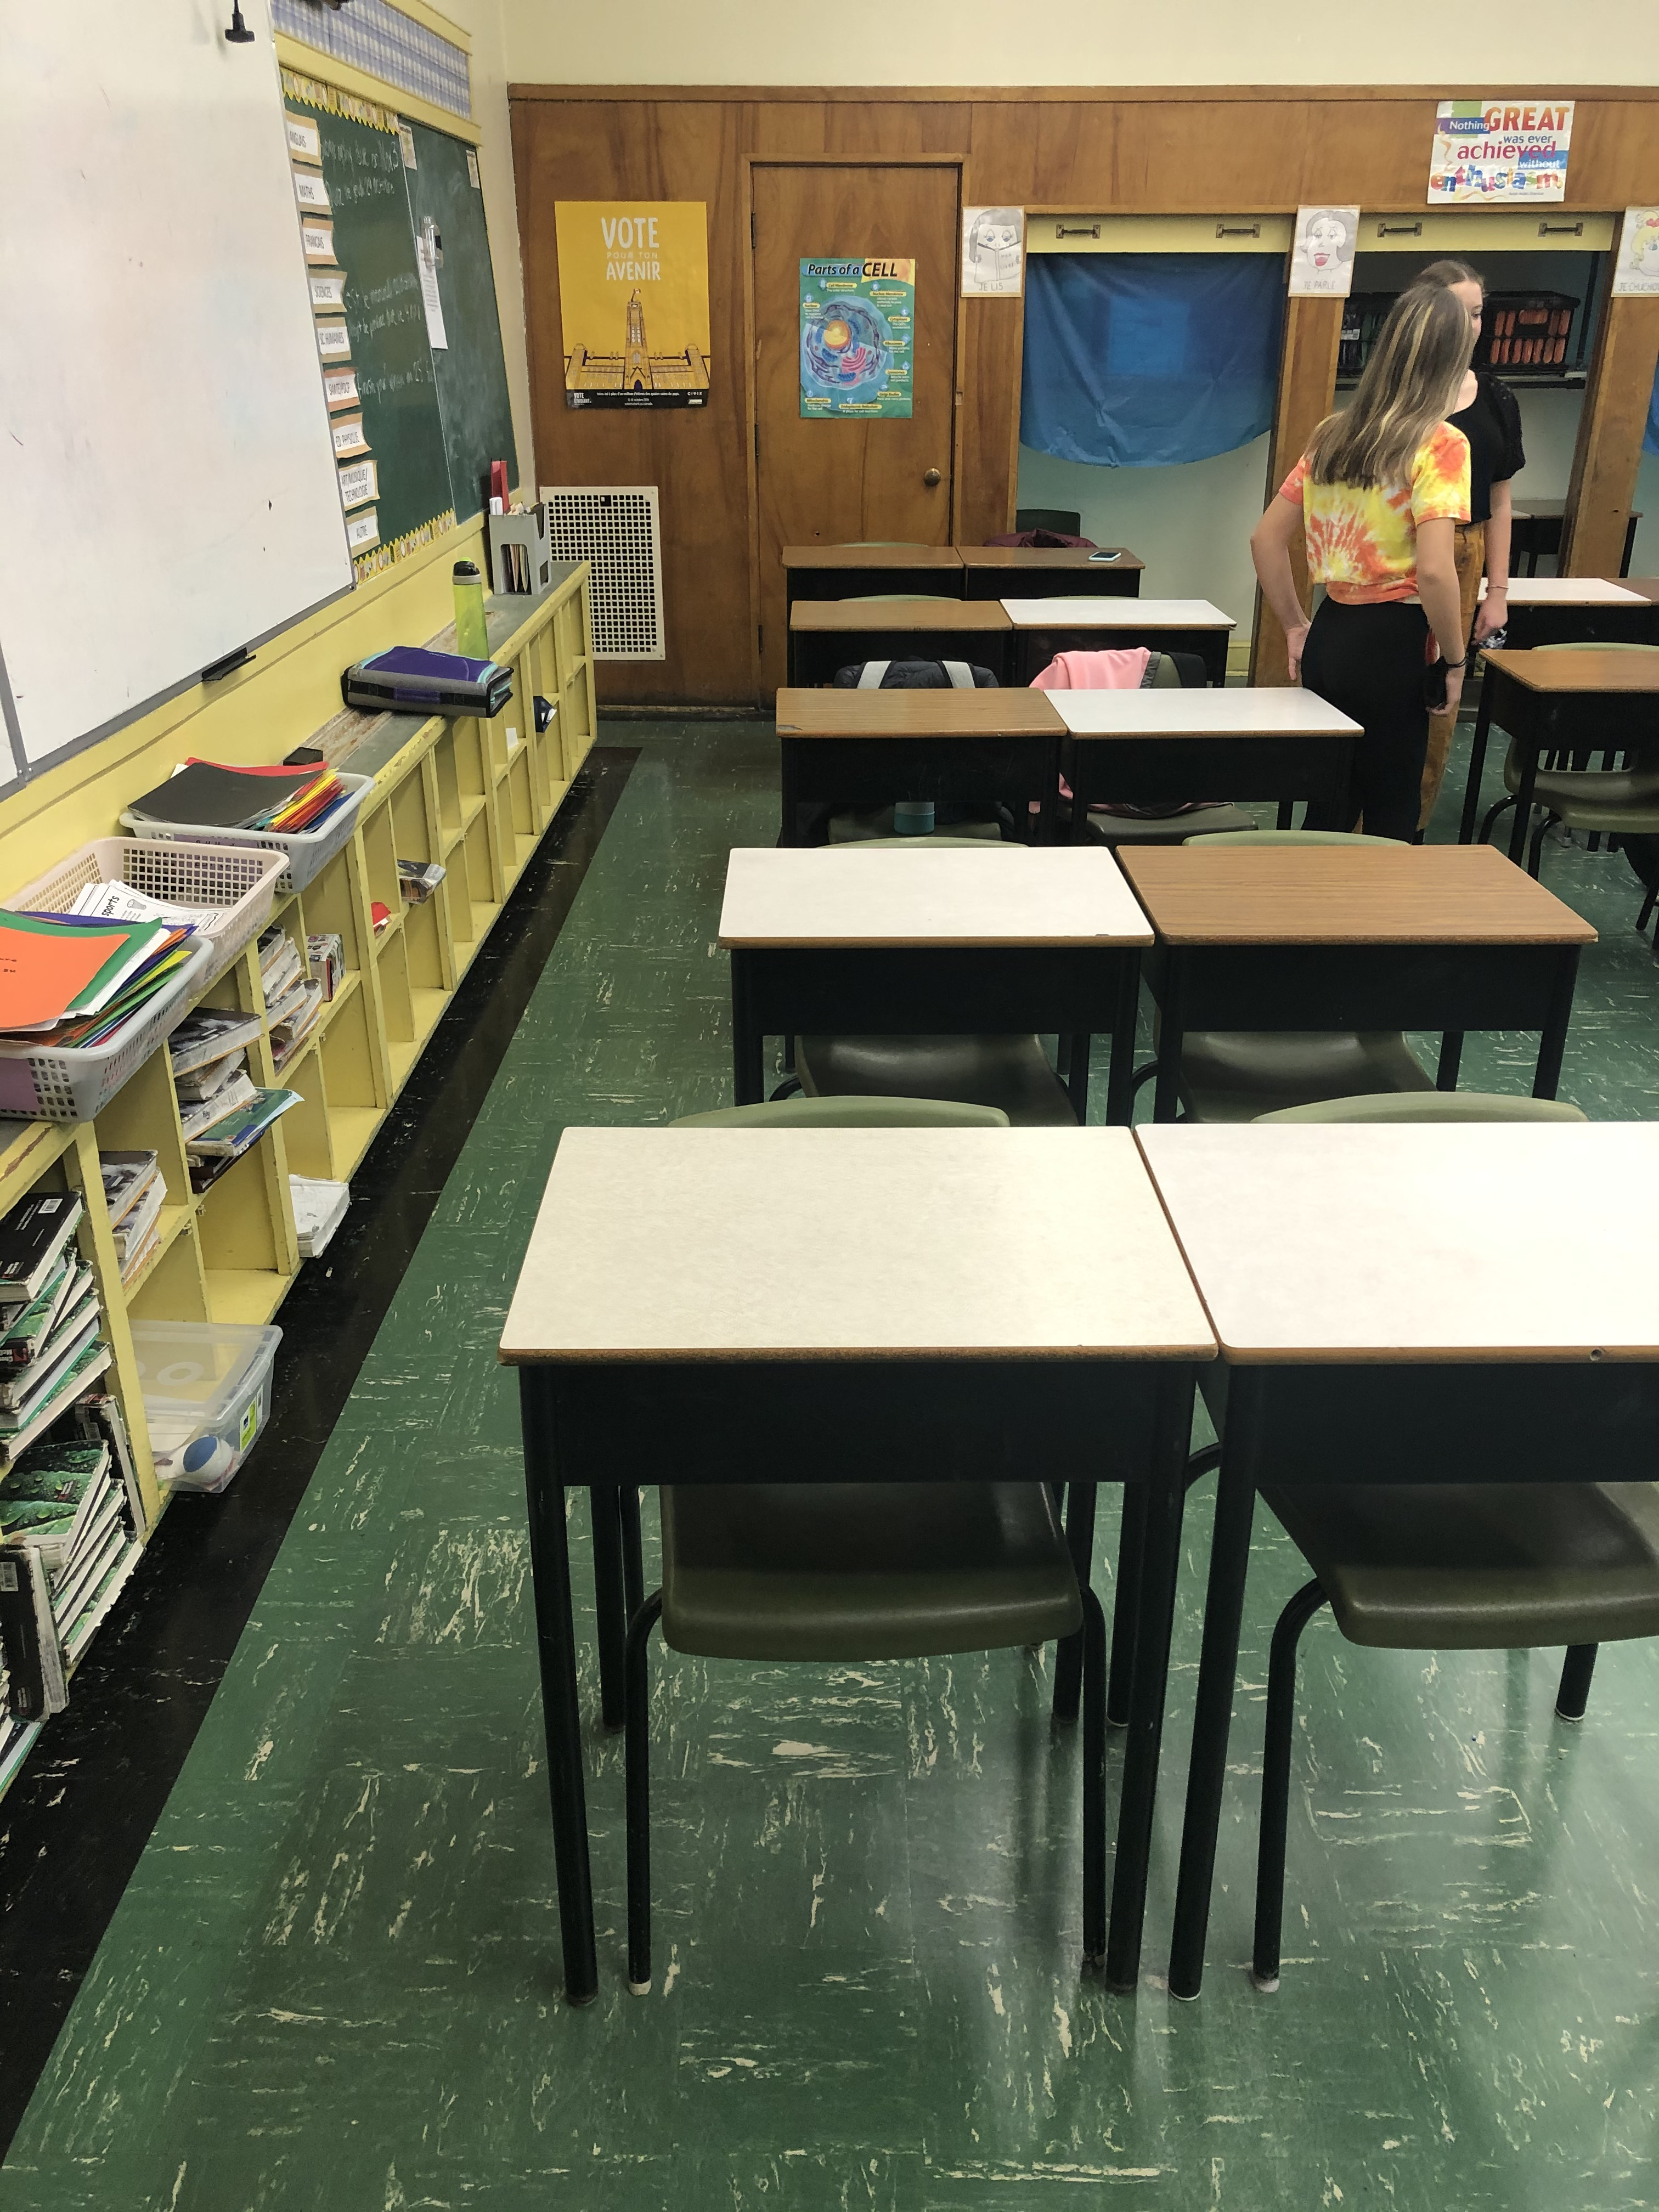
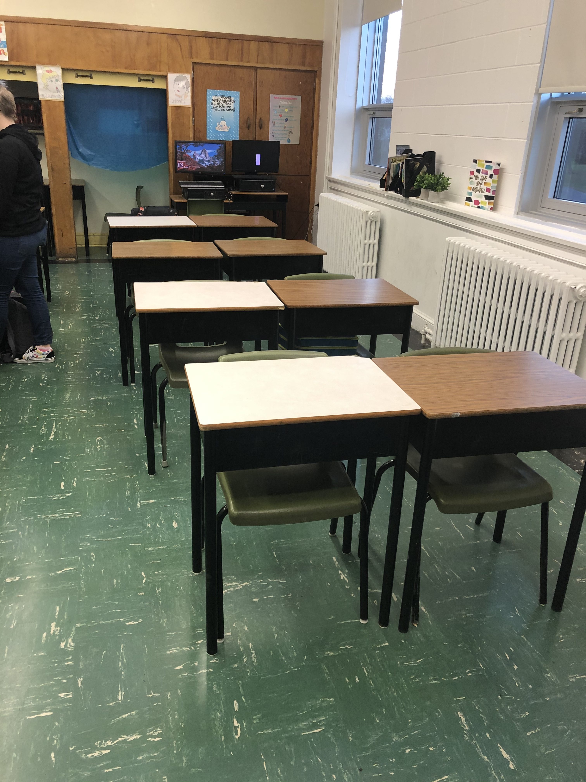
Make your classroom look more like this:

Slide 5
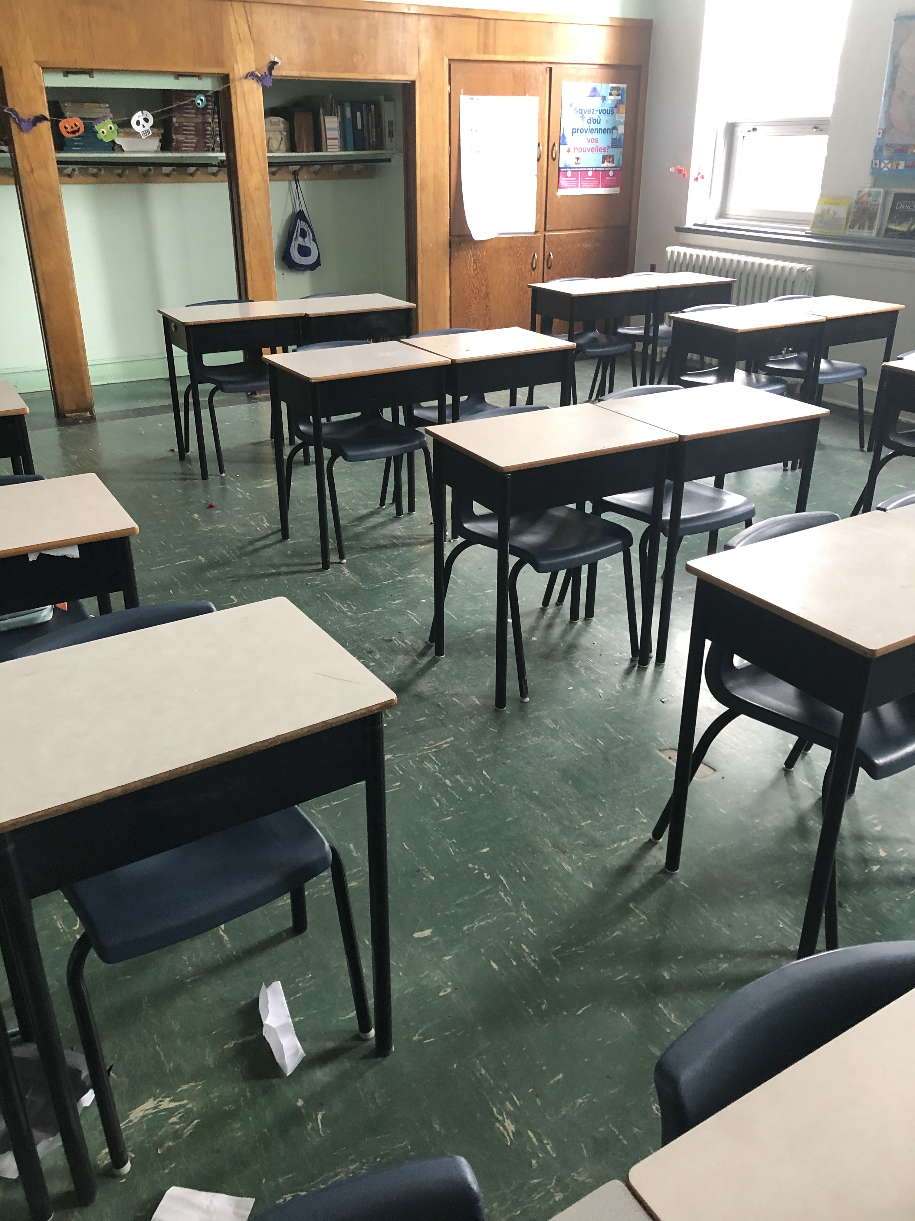
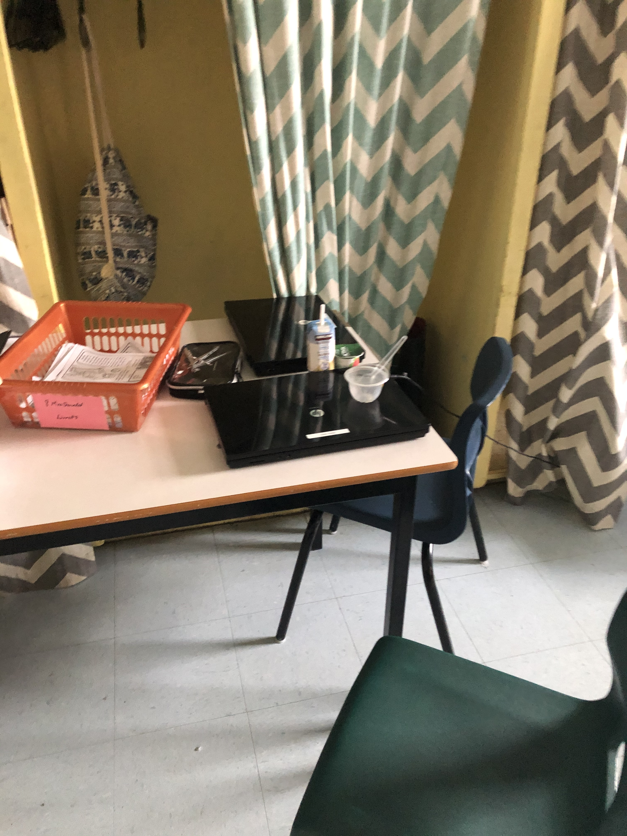
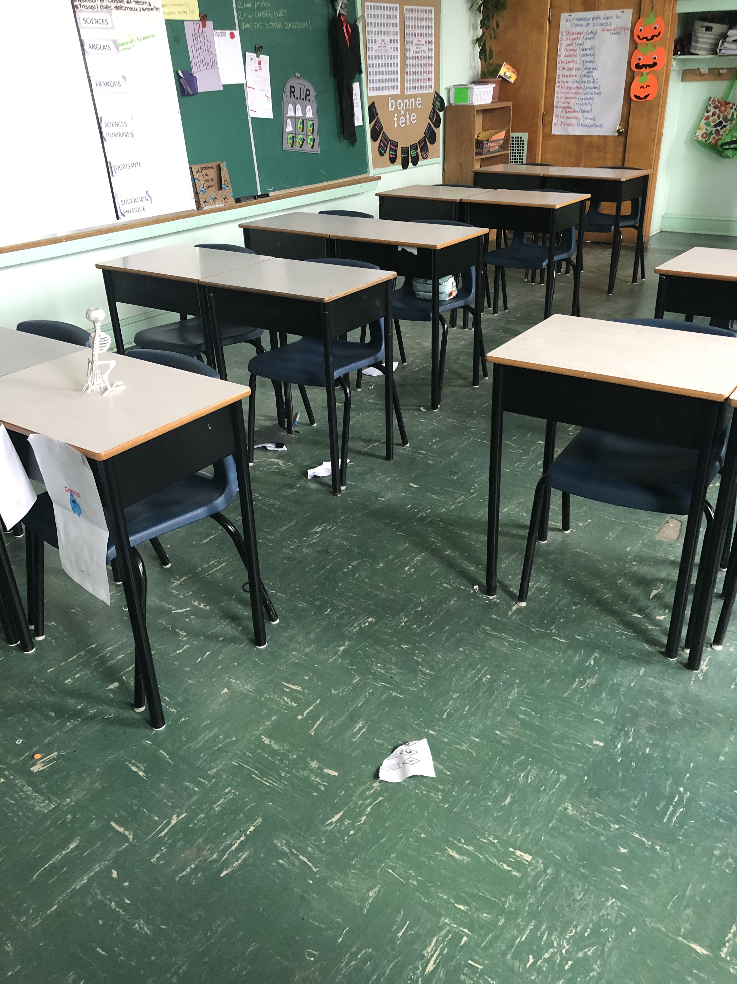
And less like this:

Slide 6
How does it work?
Each evening, our awesome custodians will choose the classroom that was left the neatest and most clean.
The Oscar will be placed in that selected classroom.
The class that gets the Oscar Trophy the most on that level this month wins!

Slide 7
The Prize!
A movie during class time!
This Photo by Unknown Author is licensed under CC BY-SA
This Photo by Unknown Author is licensed under CC BY-NC

