Slide 1
SRC presents…
Barnhill Memorial school
Will be collecting new pairs of socks and nonperishable goods for our food bank.
We are encouraging all students to participate. Please spread the word throughout your community and let’s help those: Because Barnhill Does Their Best BETTER EVERY SINGLE TIME.
i

Slide 2
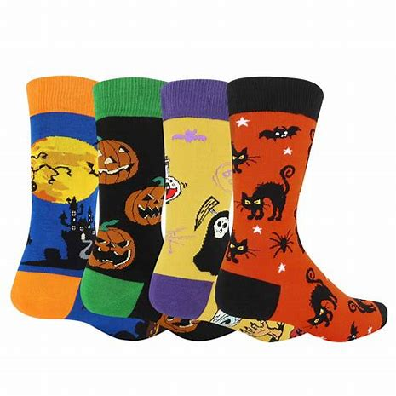
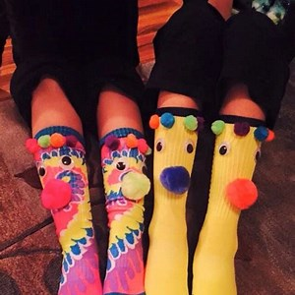
October Fest October 24th-28th Monday
Colouring Contest
Door Decoration Contest
Begins
Tuesday
Halloween Sock Day

Slide 3
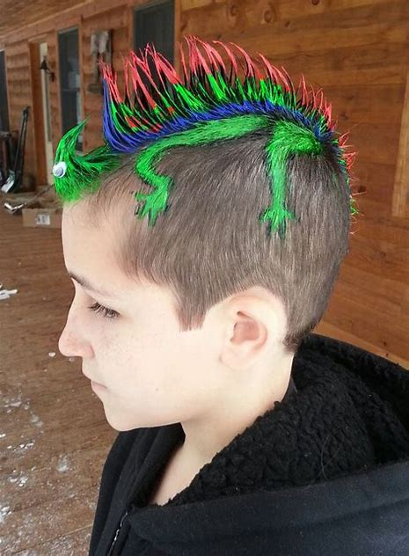
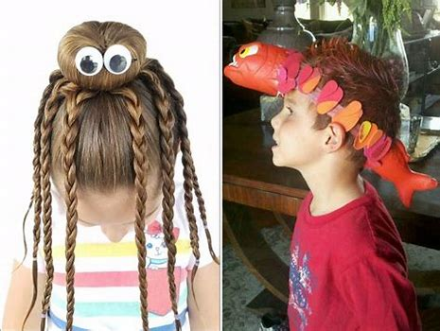
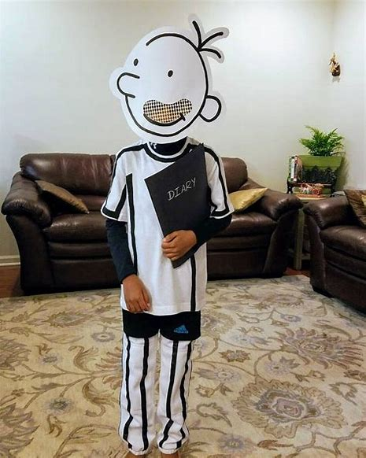
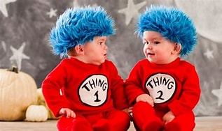
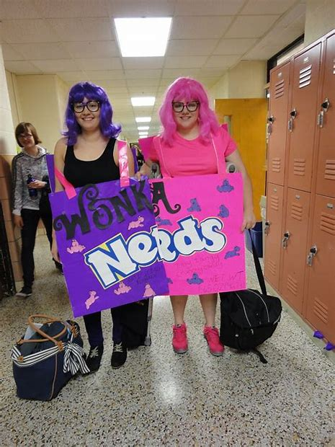
Wednesday Wacky Hair Contest
Thursday
Twin Day
Door Decorating Competition continues
Voting Begins for Colouring Contest

Slide 4
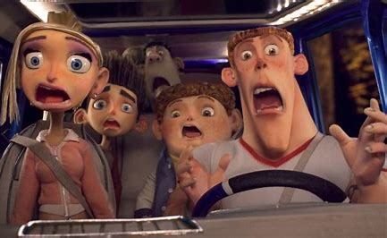
Thursday Night Dance!
Bring Five Cans of non-perishables or $5 Dollar to get into the dance
doors open at 6:30- over at 8:30
Friday
Costume & Scary Movie Day
Voting finished for Colouring and Decoration Contest
Winners will be announced!

