Slide 1
Lightning News
October 16th – 20th.

Slide 2
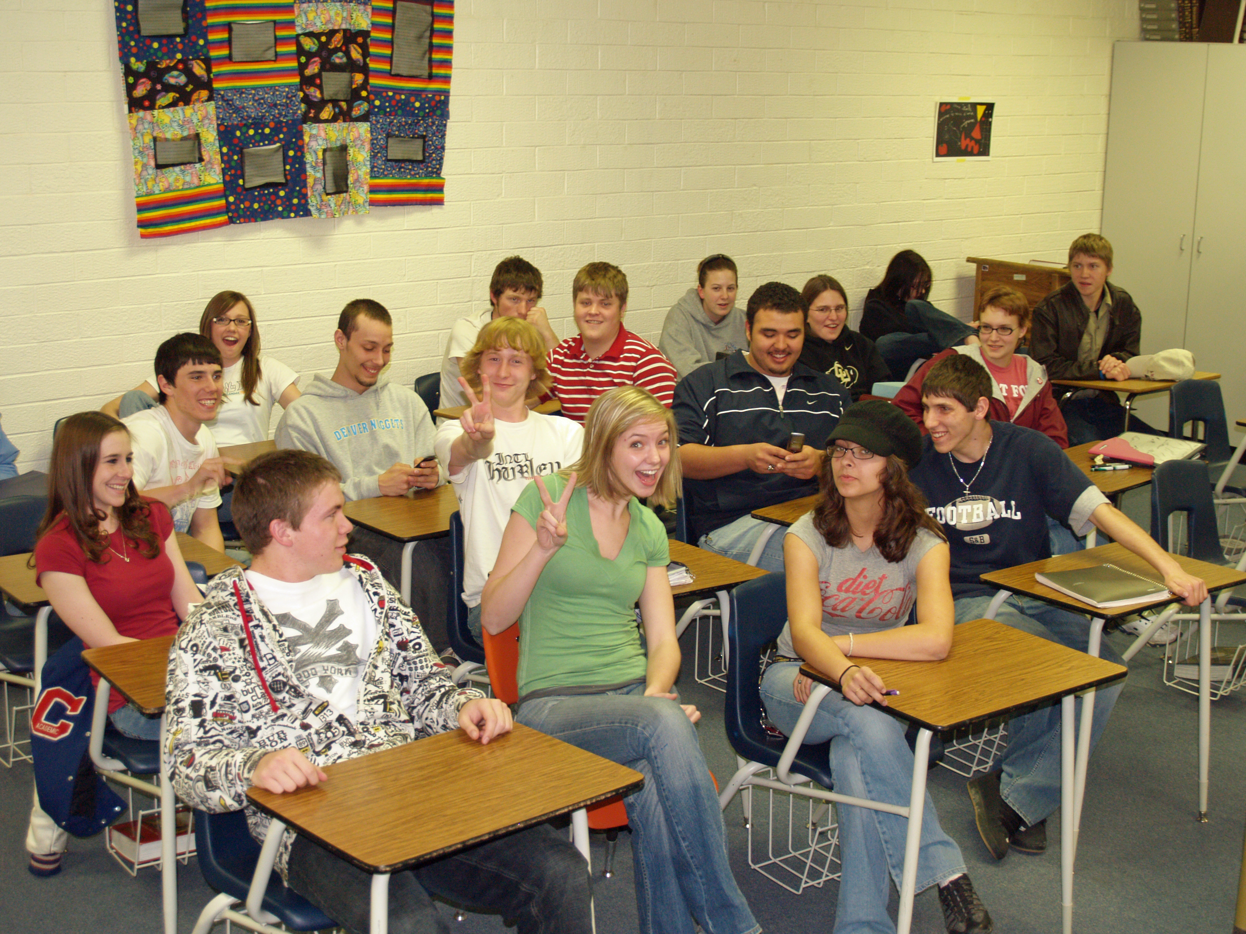
It is a full 5-day week!
Attendance matters; you need to be here to learn!
Student fees are now due. Please pay $35 on Cashless Schools.
https://asd-s.schoolcashonline.com/
This fee is used to support extra-curricular events throughout the year. If the fee is not paid, students will have to pay for individual events to patriciate.
This Photo by Unknown Author is licensed under CC BY-SA

Slide 3
Staffing Update
Congratulations to Daniel Staples for moving into the full-time homeroom position for the 7/8 FI Class. Mr. Staples is now teaching 7, 8 PIF, 6, 7 Personal Wellness, 7/8 Science.
Welcome and congratulations to Jillian Roy who will be taking over the 6, 7, 8 English Science position for the remainder of the school year. Welcome to Barnhill, Mrs. Roy!

Slide 4
Kiwanis Calendars – Grade 8 Fundraiser
Contact Mrs. Sloat to get your calendars
A great fundraising opportunity to
raise money for your trip.
All calendars and money is due November 17th.
You can bring your money and calendar stubs in when they are sold.
Each student can take 5 at a time, then come back for more!

Slide 5
World Food Day!
This is a day that is celebrated widely by many organizations concerned with hunger and food security.
This Photo by Unknown Author is licensed under CC BY

Slide 6
SMILE! Picture Day is coming up!
Picture Day is on Tuesday, October 17th.
Photos will be available to view online https://harveystudios.fotosource.com/ five business days after photo day.
This Photo by Unknown Author is licensed under CC BY-NC
This Photo by Unknown Author is licensed under CC BY

Slide 7
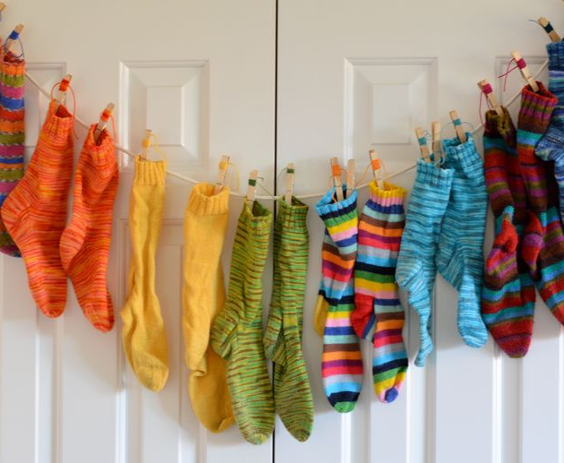
Socktober
Thank you for your support! Already many socks have been donated to the school. We will continue to collect socks throughout the month of October, and we want to thank everyone for making a difference in our community. The shelters always appreciate receiving the socks before the weather becomes colder!
This Photo by Unknown Author is licensed under CC BY-NC

Slide 8
October is for Outdoor Learning
We have an awesome outdoor classroom called “The Lightning Dome” for all students to learn in the fresh outdoors. We encourage all classes to go outside with their teacher to learn while the weather is still nice!
This Photo by Unknown Author is licensed under CC BY

Slide 9
Athletics
Please check the board outside of the gym for weekly sports updates and the intramural schedule.
Exhibition Soccer for girls and boys will continue Wednesday and Thursday from 3:00-4:00 pm. Please see Ms. Dennis or Mr. Staples with questions.

Slide 10
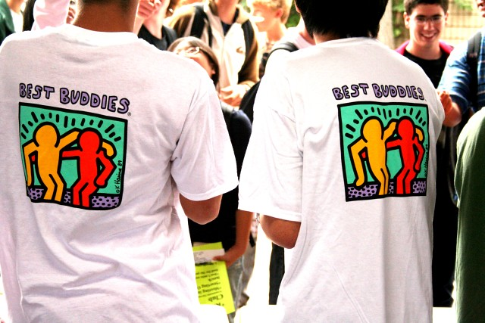
Clubs
SRC: The SRC meets every Monday at the beginning of Lunch in the SRC Room.
GSA: The Gender and Sexuality Alliance will meet every Thursday in Room 30 at Lunch. All are welcome!
Guinea Pig club with Mrs. Muise is every Thursday at lunch. Please go to the Bolt Center at the beginning of Lunch.
Best Buddies with Ms. Vanderbeck is up and running.
This Photo by Unknown Author is licensed under CC BY

Slide 11
Lunch and Canteen
Breakfast Program
We want our students to start their day in the right way, therefore, we have healthy breakfast options available in the front lobby every morning for all students. Ms. Galbraith, and Daniel will be in the lobby every morning until 8:45 a.m.
Students are to continue to bring a packed lunch every day.
The canteen and Hot Lunch will resume on October 20.
Canteen items are $1-2
Hot Lunch is cheese pizza for $2.50 per slice. Please pay in advance on Cashless Schools.

Slide 13
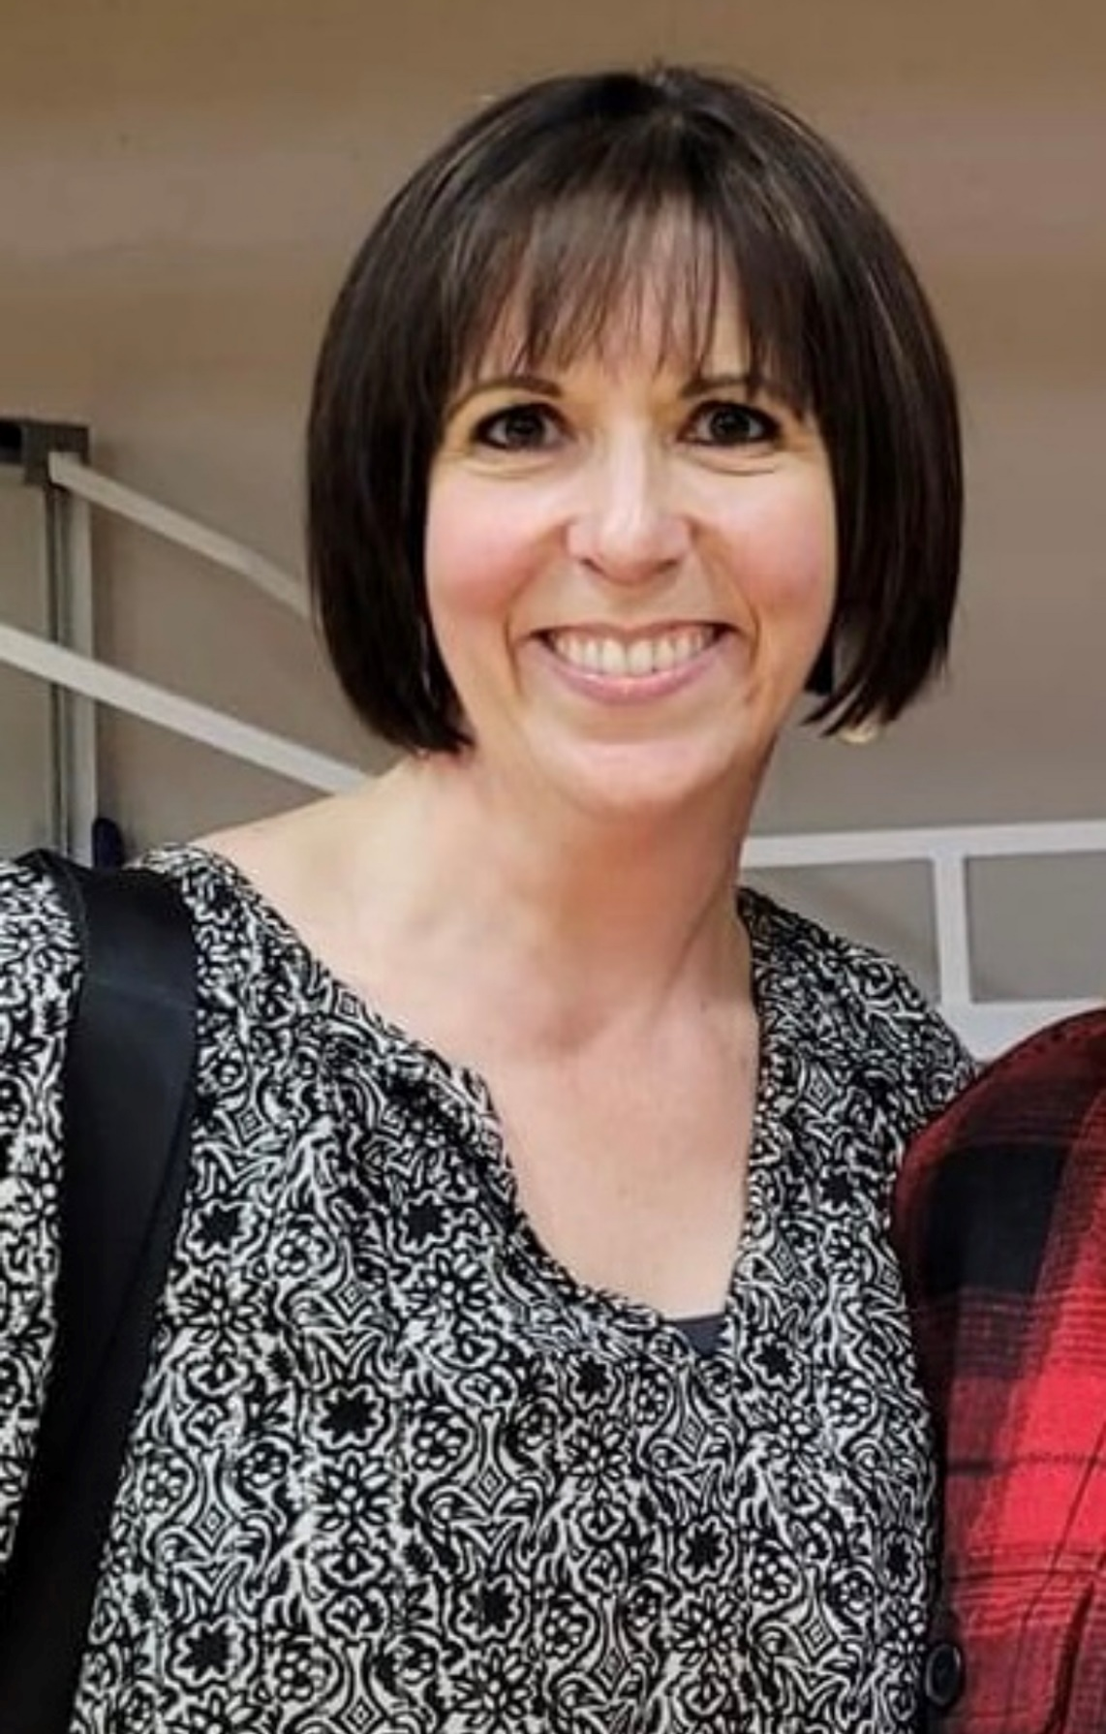
Mrs. Krista Graham
BARNHILL STAFF SPOTLIGHT
Teaches Phys. Ed for Grades 6-8
Teaching Experience: 22 years
Years at Barnhill: 21
What do you love about teaching? “Making connections with students.”
Interest/Activities: Working out, reading and enjoying Starbucks!
Interesting Fact: Has broken 6 bones in her body

Slide 14
On the Horizon…
This Photo by Unknown Author is licensed under CC BY-SA

Slide 15
Halloween Dance
SRC is hosting a Halloween Dance for students on October 26th from 6:30-8:30 p.m.
The cost is $5 per student. We encourage students to dress up, however weapons (real or fake) and face coverings are not allowed.
Sign-Ins are available. To sign-in a student from another school, please see Ms. Ferguson in the morning, at lunch or on break.
In addition to the dance, there will also be a Haunted Hallway experience. This is an additional cost of $2 and is completely optional.

Slide 16
Remembrance Day Events
The Legion’s Annual Remembrance Day contest to open to all students! For detailed information, please visit www.remembrancecontests.ca/ Entries are due on November 10th.
Our Remembrance Day Ceremony will be on November 10th at 10:15 a.m. Community members are welcome.
This Photo by Unknown Author is licensed under CC BY-NC-ND

Slide 17
Barnhill Remembers…
We would like your help with a special project for Remembrance Day.
We are asking families to submit a photo of a family member who has served in any capacity in the Canadian military. These photos will be used in our Remembrance Day Ceremony on November 10.
We ask that photos be submitted via email to andrea.dennis@nbed.nb.ca. In your submission, please specify which student is connected to the person in the photo and how that person served.
Thank you for your support!

