Slide 1


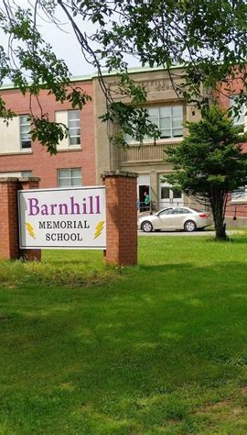
Lightning News
March 27th – 31st,
2023

Slide 2

March Theme Honesty
“Honesty is the fastest way to prevent a mistake from turning into a failure.”
~ James Altucher ~
This week is the final week of March, and it is a full 5day, week of school.
Attendance does matter; so, make every effort to attend everyday.

Slide 3
Honesty
What is honesty? Honesty is when you speak the truth and act truthfully.
Many people think honesty means you “don’t tell a lie” … and speaking the truth is a big part of being honest. It is more than that, it is acting truthfully as well.
Just do not be sneaky!
Be truthful in both the way you speak and the way you act with others.

Slide 4

It’s Finally Spring!!
Please come to school dressed for the weather. It is getting sunnier out and we certainly want everyone outside enjoying the weather as much as possible.

Slide 5

Specialty Classes change on Monday, March 27th.
With the beginning of term #3 on March 27th students will begin a new specialty class! It will be either Music, Art or Technology.

Slide 6
The second report card will be issued on April 6th.
Booking information will be shared the week of April 3rd – 6th. Our hope is that parents/guardians of children who are struggling academically will take advantage of this time to be part of the intervention plan for their child’s success at school.
The scheduled dates for Parent/Teacher interviews are Thursday, April 13th, from 4:00 p.m. – 7:00 p.m. These interviews will be in person at the school. On Friday, April 14th, from 9:00 a.m. – 11:00 a.m. These interviews will be virtual on Microsoft Teams.

Slide 7
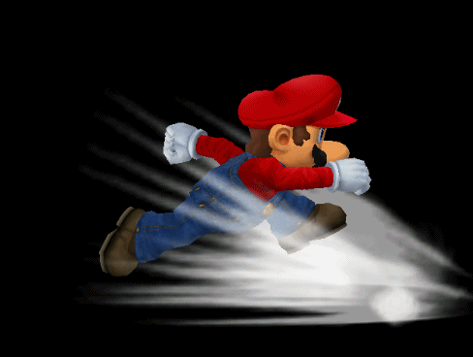

Athletics
Monday, March 27th – boys’ practice.
Tuesday, March 28th – boys’ game, starts at 4:00 p.m. here vs RVMS.
Wednesday, March 29th – girls’ practice.
Thursday, March 30th – girls’ practice.
Volleyball practices are from 3:00 p.m. – 4:30 p.m.

Slide 8
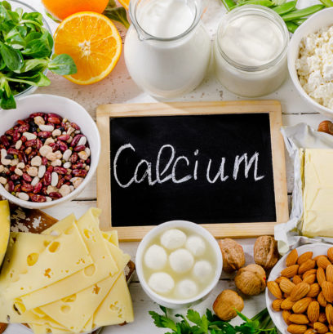
March is Nutrition Month!
We want to share a recipe with you. Ham, Turkey or Chicken, Cheese, Cucumber, and Carrot Pinwheel, made with Tortilla.
Ingredients: ^{1 package of medium Tortillas}
½ cup of cream cheese, ¼ cup of Italian Dressing, ½ cup of Roasted Red Peppers, finely chopped, 400g of sliced Deli Ham/Turkey/Chicken, ½ Cucumber, ribboned and 1 large carrot, shredded.
Directions: In a small bowl, lightly whisk together the cream cheese, Italian Dressing and Red Peppers until combined. On a work surface, lay out the Tortillas and spread the mixture evenly on each Tortilla. Layer each with Cucumber Ribbons, & Shredded Carrot.
Tightly Roll each Tortilla and cut into 1” thick slices.
ENJOY!

Slide 9

Barnhill does their BEST EVERY SINGLE TIME!
HAVE A GREAT WEEK!! Talk with your teachers and get all your assignments in so they can mark them for your Report Card.

