Slide 1

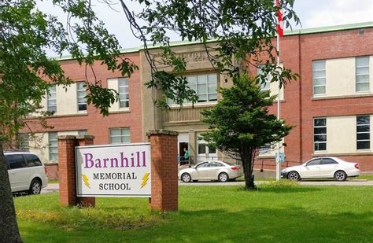
Welcome to
Barnhill Memorial School
Home of The Lightning

Slide 2
Vision Statement
Better
Every
Single
Time
Barnhill does their Best

Slide 3

Mission Statement
The Community of Barnhill Memorial School provides a variety of quality learning experiences to support students in reaching their potential and to become contributing members of society.

Slide 4
Welcome to 2023 - 2024
This is a brand-new school year, which means all of us have a fresh start.
The Lightning News is sent out every Friday. It is a great way to stay informed of events and activities for the upcoming week.

Slide 5

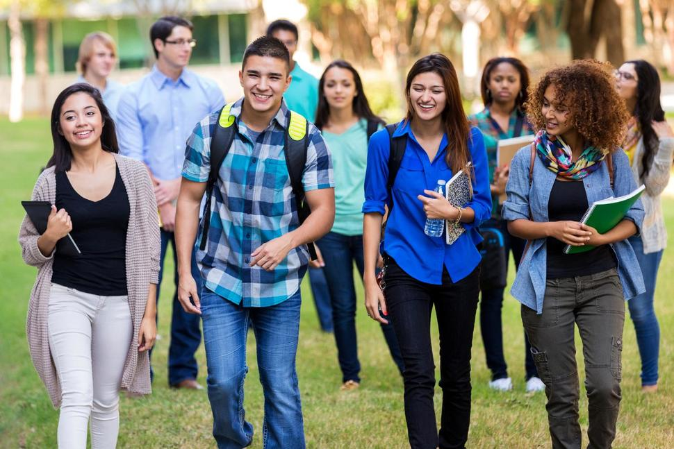
Grade 6 students start on Tuesday
We look forward to having all our students here at school.
The grade 6 students have their own special day on Tuesday, September 5th. Starting with an assembly for the students and their families.
All grade 6 students will enjoy a Pizza Party at lunch.
Grades 7 and 8 come on Wednesday, September 6^{th .}
This Photo by Unknown Author is licensed under CC BY-SA-NC

Slide 6

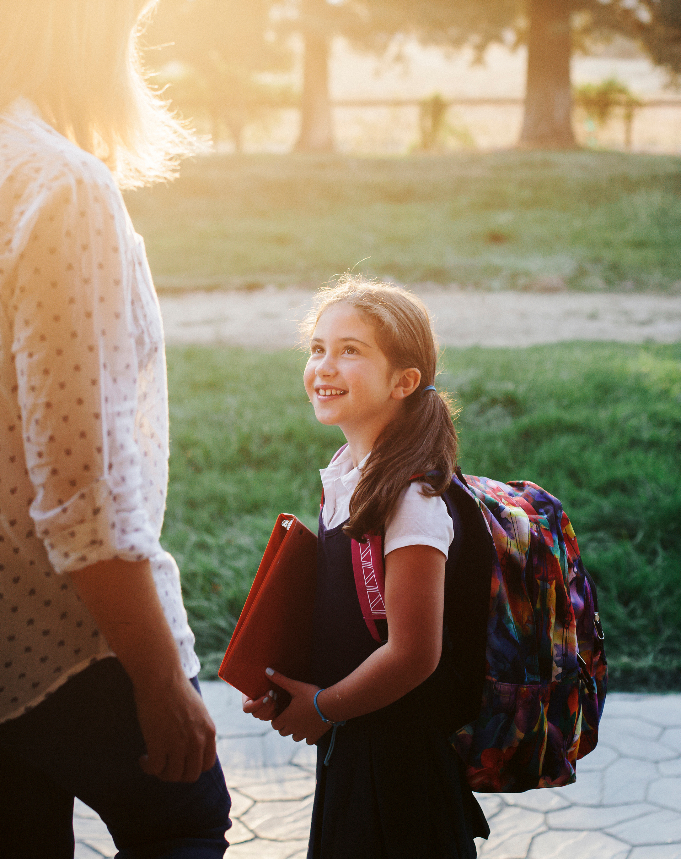
The school day starts at 8:20 a.m.
Supervision in the yard begins at 7:50 a.m.
Dismissal is 2:50 p.m.
Please remember we are a closed campus. Students are not permitted to go to stores and fast-food establishments unless they are signed out in the office and accompanied by a parent or guardian.

Slide 7
Paperwork to be returned the first week of school
Please ensure you take the opportunity to review your data sheet. It is very important that we have all the up-to-date information. Any changes can be made on the sheet. Sign and return to your child’s homeroom teacher.
Right to Information and Protection of Privacy Act (RTIPPA) – All students will have a copy of this form in their welcome package, please ensure you return this consent form with your signature to the homeroom teacher.
  All forms are due, Friday September 8th.

Slide 8
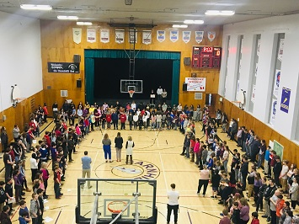
Barnhill Activities and Athletics
In the welcome package is a “Pursuit of Excellence” please read with your child and sign. We want all students to be involved in athletics and activities.
  Intramurals
  Sports
  Learning Commons
  Student Representative Council
  Tech Crew
School Musical
Reading Buddies
Best Buddies
GSA

Slide 9

Barnhill Supports
Guidance
Resource
Academic Intervention
Student Representative Council
Foundation Support

Slide 10

On the Horizon:
The Terry Fox Walk will take place on Monday, September 18th.
The first PSSC Parent School Support Committee meeting will be on Monday, September 25th.

Slide 11

Barnhill Memorial School Trivia
This Photo by Unknown Author is licensed under CC BY-SA

Slide 12
Barnhill Memorial School Trivia
What year was Barnhill Memorial School Built?

Slide 13
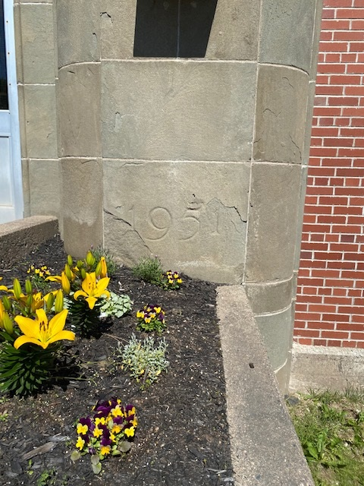
1951

Slide 14
Barnhill Memorial School Trivia
What are Barnhill’s Mascot and School Colours?

Slide 15
Lightning
Purple and Yellow

Slide 16
Barnhill Memorial School Trivia
Who is the Principal and Vice Principal of Barnhill Memorial School?

Slide 17
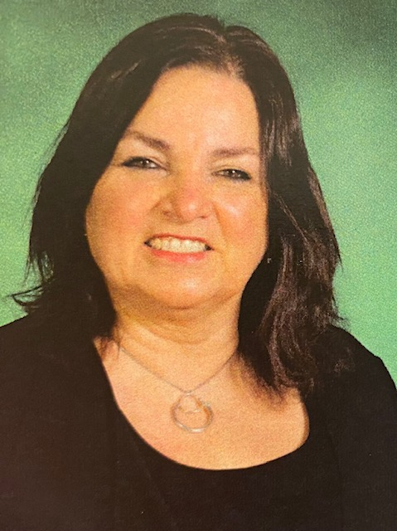
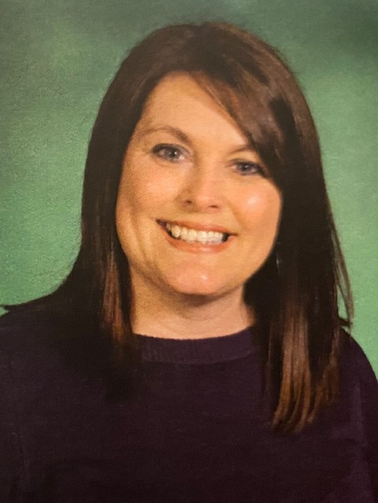
Barnhill Memorial School Trivia
Jill Ferguson – Principal
Liza Muise – Vice Principal

Slide 18
Barnhill Memorial School Trivia
Part of Barnhill’s Vision Statement is: Barnhill Does Their Best. What is BEST an Acronym for?

Slide 19
Better
Every
Single
Time

Slide 20
Barnhill Memorial School Trivia
What is Barnhill Memorial School’s Street Address?

Slide 21
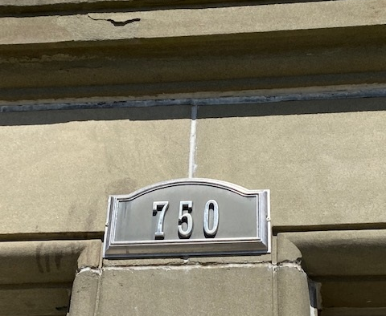
Address:
750 Manawagonish Road

Slide 22
FROM THE STUDENTS
“Make sure you get involved in clubs, sports and other programs. If you don’t get involved, you won’t have as much fun.”
  Grade 7 Student
“Barnhill is a wonderful school. I love how in Art you get to do paper mache. The teachers at the school are nice and kind. When you come to Barnhill you will have lots of fun.”
  Danielle, Grade 7 Student

Slide 23
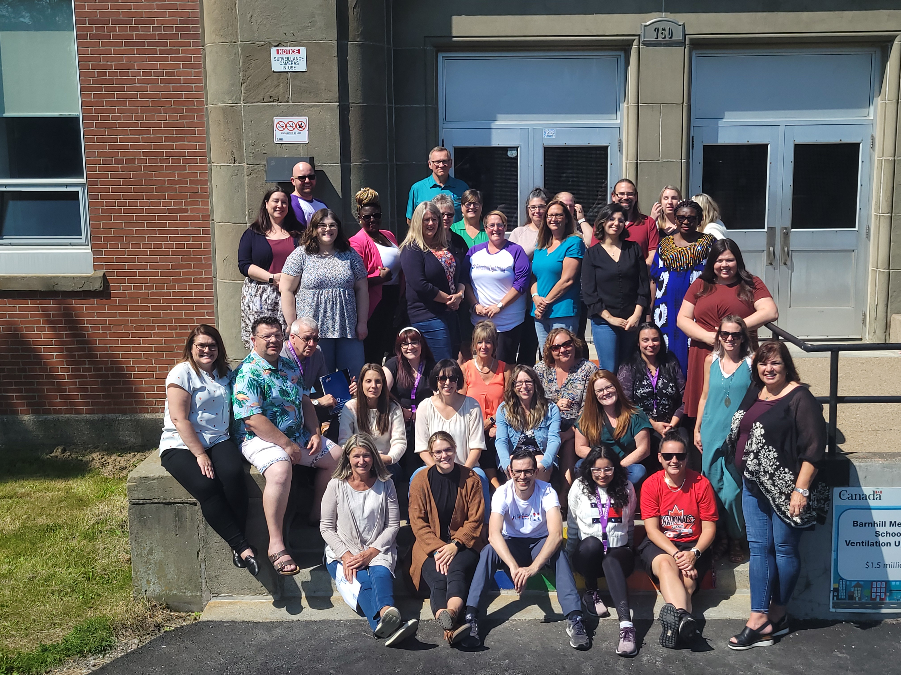
The Barnhill Staff is looking forward to meeting you.

