Slide 1



Lightning News May 15^{th -}19th
May theme of the month – “Gratitude.”
“The best and most beautiful things in the world cannot be seen or even touched. They must be felt with the heart.”
~ Helen Keller ~

Slide 2


May is Brain Tumour Awareness Month. National Gray Day is observed on Saturday, May 27th . Here at Barnhill Memorial, we are encouraging everyone to wear gray on Friday, May 26th.

Slide 3

Athletics
Volleyball
Monday: Boys’ play in the semi-finals at Bayside
Tuesday: Boys’ game TBD
Wednesday: Girls game here vs PES & FHS
Flag Football
Wednesday: Flag Football practice 3:00-4:30
Thursday: Flag Football practice 3:00-4:30

Slide 4

enjoy the Production of Alice.
You can purchase tickets in advance at the office.
The play will be in our gymnasium on May 24th and May 25th ~ Seating will be first come first serve, there is no reserved seating.

Slide 5

Host an international student
If you are interested in hosting an international student, please visit their website.
https://aei-inc.ca

Slide 6
May Is Asian heritage month
May is Asian Heritage Month in Canada, a time to reflect on and recognize the many contributions people of Asian origin have made and continue to make to Canada. Asian Heritage Month has been celebrated since the 1990s.
For more information, please check out the following links:
Celebrate Canada's Asian Heritage - Asian Heritage Month – YouTube
Asian American and Pacific Islander Heritage Month – YouTube
About Asian Heritage Month - Canada.ca

Slide 7
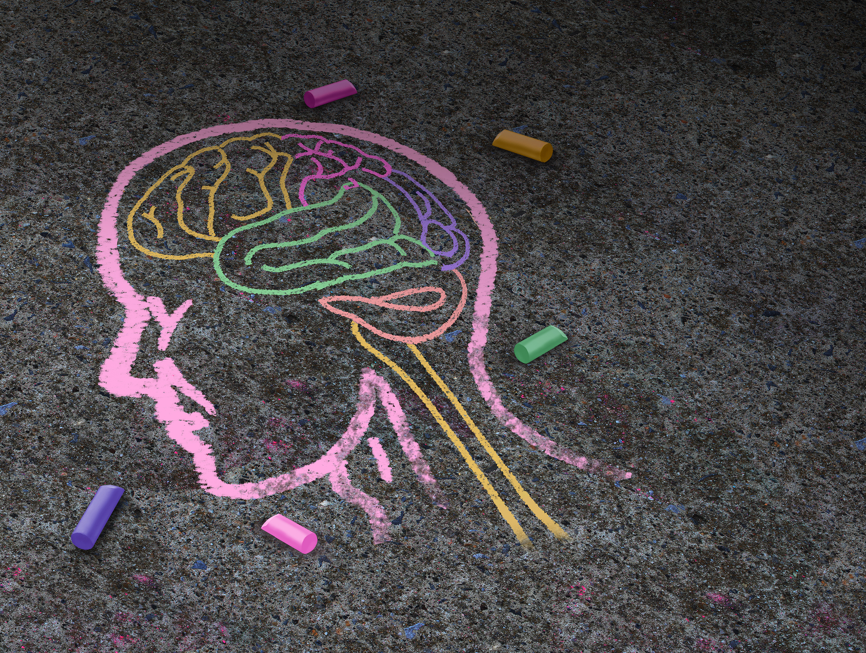
Mental Health
Raise awareness of mental illness, fight discrimination and provide support through becoming more aware of the facts.

Slide 8
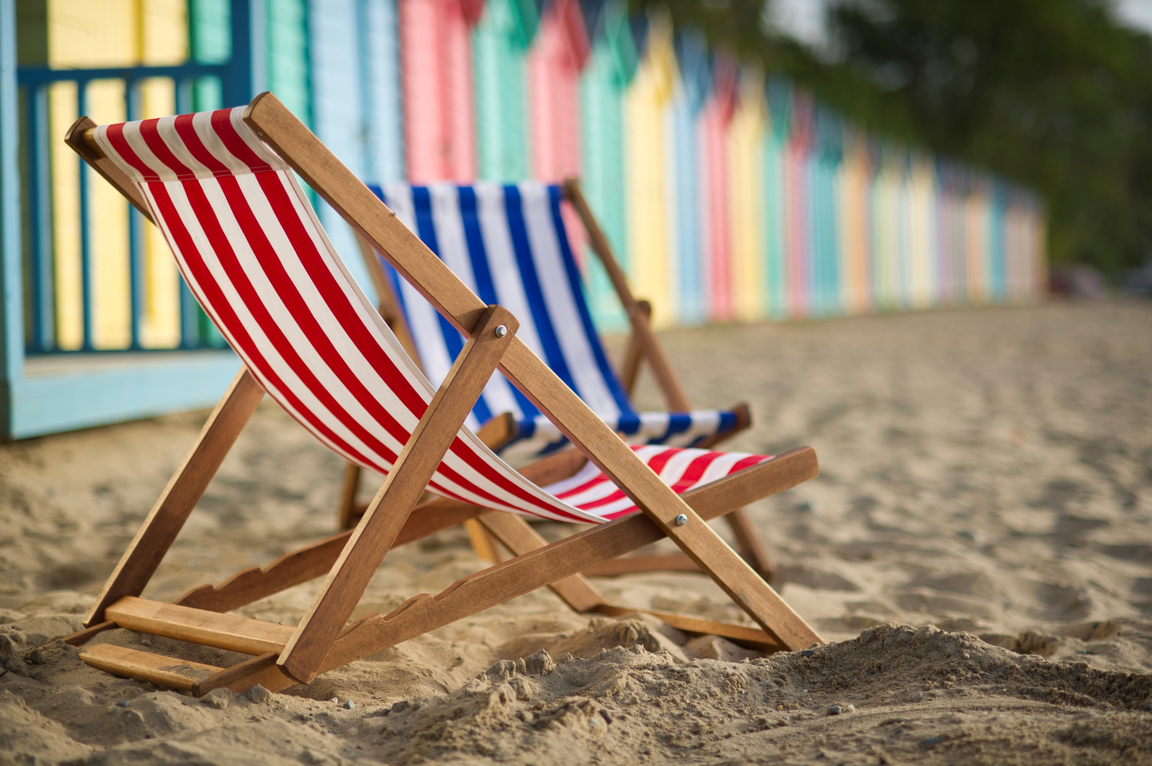
Upcoming
There is NO school for anyone on Monday, May 22nd~ this is the Victoria Day holiday.

Slide 9
Upcoming events
June 6th – Grade 6 Timbertop field trip
June 7th – Track & Field meet at UNBSJ
June 13th - Grade 8 High School visits
June 14-17th – Grade 8 Quebec Trip
June 15th – Grade 6 Bowlarama field trip
June 16th – Grade 7 Bowlarama field trip
June 19th – Field Day
June 20th – New River Beach
June 21st – New River rain date
June 22nd - Athletic Awards, Moving Up ceremony & Year End dance
June 23rd – Last Day for students

Slide 10
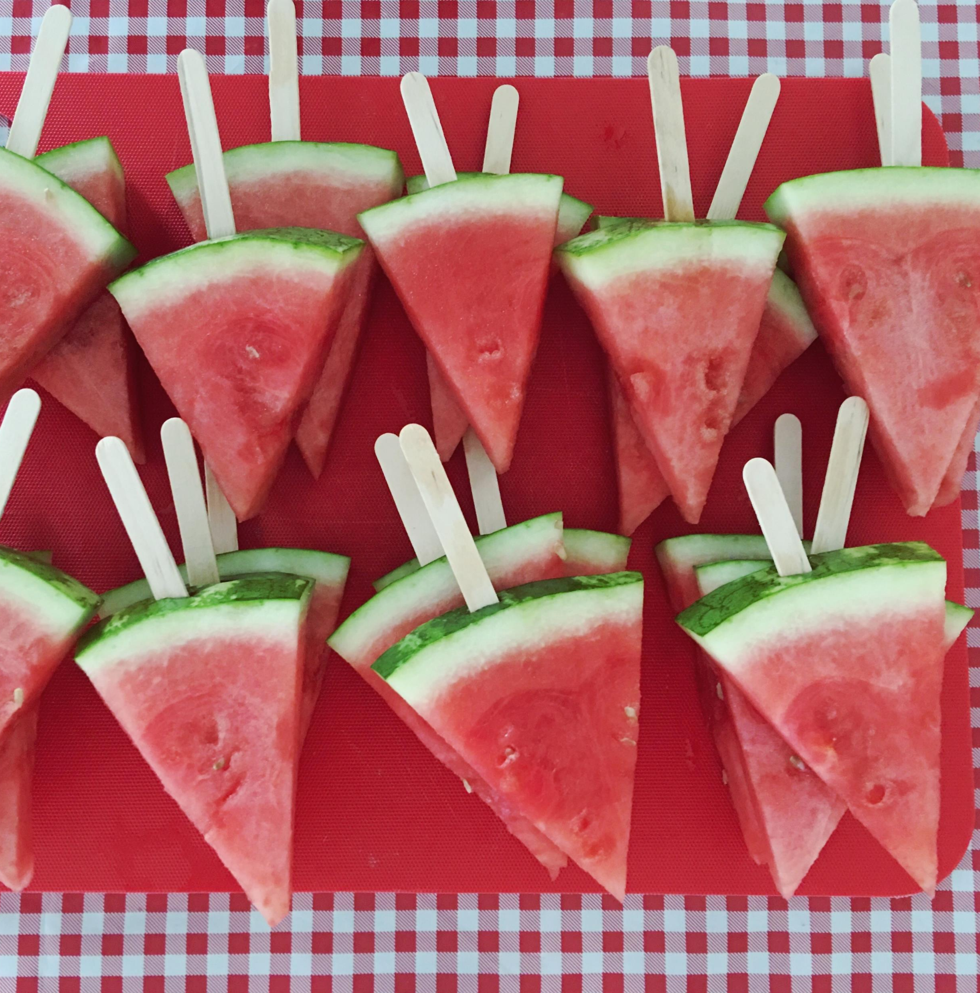

Breakfast, Snacks, and Lunch
We will have pizza and a canteen at lunch on Friday, May 19th.
Healthy breakfast items are available every morning for all students.
Enjoy your weekend.

Slide 11

MR. Freeze Fundraiser
Barnhill staff is raising money to send a student to Quebec.
Mr. Freeze will be on Sale the next 3 Fridays.
$1.00 per Mr. Freeze – Come Friday with your money!

Slide 12

Yard SALE is Cancelled!
Hello Barnhill Community. Unfortunately, there was not enough interest to continue with the yard sale. Therefore, it has been cancelled.
Contact: Please contact Liza Muise for more questions – 506-658-5972 liza.muise@nbed.nb.ca

Slide 13

Happy Mother’s Day to all our Mother’s. Enjoy your Day on Sunday.

