Slide 1




Lightning News
April 24 – April 28

Slide 2

Congratulations you are a good citizen.
z
Just Be a Nice Human: by K. Hunter (student).
We all know in our heart that all things are possible.
We need to be kind, respectful and believe in miracles.
We can all stand on our own two feet, and we have the potential to reach out and help a friend or a classmate.
Just be a nice human and our world could be so much more peaceful.

Slide 3

Drama Club!
z
The students are working very diligently on the production of “Alice.”
There are practices on Tuesday and Wednesday of this week.
The students are also working on the sets.
The production will be performed on the 24th and 25th of May. Please stay tuned for details about the show.

Slide 4
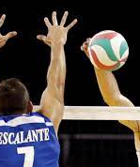
Volleyball
z
Monday: Boys’ volleyball practice from 3:00 – 4:30 p.m.
Tuesday: Boys’ volleyball game @ Sam de Cham.
Wednesday: Girls’ volleyball practice from 3:00 – 4:30 p.m.
Thursday: Girls’ volleyball game here vs Sam de Cham.

Slide 5
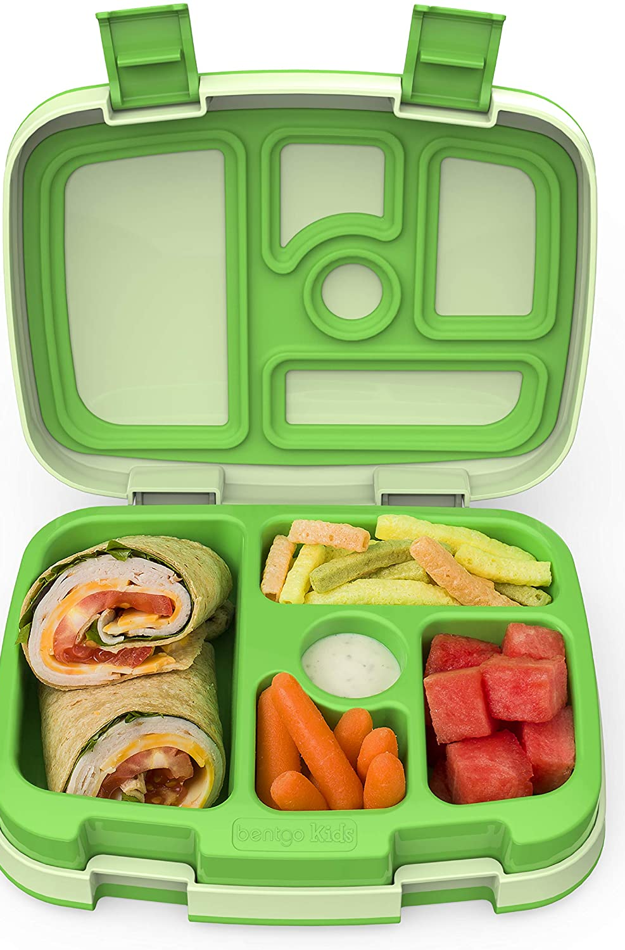
Lunch
All students have designated areas to eat:
Music Room
Gym
Intramurals
Learning Commons
Art Room
Lunchroom for grades 6 and 7.
We have intramurals at lunch for students to participate in and enjoy.
For the second half of lunch; now that it is getting nicer outside, please take the opportunity to go outside.
Students will not transition on indoor days.
z

Slide 6

Speak Out 2023
z
Are you interested in poetry, public speaking, and speech writing? Please see Mrs. Seales to submit your information and you could be invited to attend the 2023 Speak Out Competition.
~ On the horizon, there is no school for students on May 5th and again on May 8th. It is Subject Council for Staff.

Slide 7
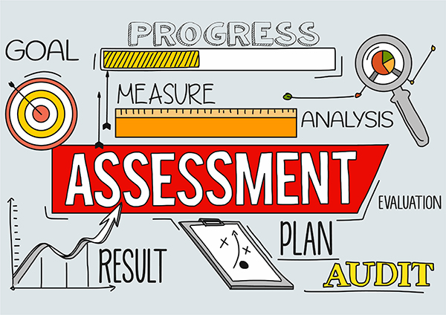
PCAP and have a wonderful week this last week of April.
All students will be completing the PCAP assessment starting on Monday, April 24th.

