Slide 1
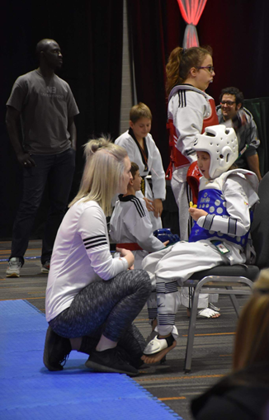
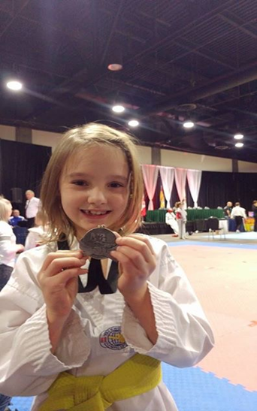
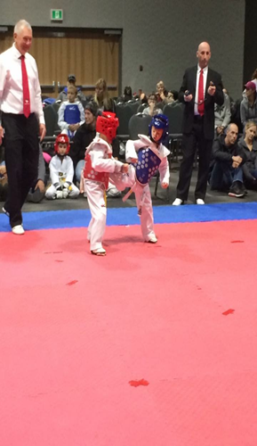
Starter program available for children ages 5 years and older!
Lessons offered two times per week in Musquash!
Taekwondo focuses on the A-B-C’s; Agility, Balance & Coordination!
Long-term benefits for Mind – Body – Spirit!
Improvements in school and home life through practicing the tenets of TKD
Courtesy – Respect – Integrity – Perseverance – Self control
Contact us today for a Free trial lesson
333-6990 // Masterp.tkd@hotmail.com // visit our fb page @ MP Taekwondo

