Slide 1
Using Electrical Energy
Grade 9 Science

Slide 2
Measuring Electrical Energy
Energy is defined as the ability to do work.
Electrical energy can be defined as the energy transferred to an electrical load by moving electric charges.
The symbol for electrical energy is E and the unit for measuring energy is the joule.
Energy can also be measured in larger units such as watt hours or kilowatt hours.

Slide 3
Three Factors
There are three factors that determine the amount of electric energy that is used:
Voltage drop (V) – a measure of the energy each electric charge gave up as it moved through a circuit.
Electric Current (I) – a measure of the rate at which the electric charges moved through a circuit.
Time (Δt) – The length of time the electric current is flowing in a circuit.

Slide 4
Calculating Electrical Energy
To calculate the amount of electrical energy used in a circuit use the formula:
E = V x I x Δt
Where:
E is electrical energy measured in joules
V is voltage drop measured in volts
I is the electric current measured in amperes
Δt is the time measured in seconds

Slide 5
Units
Although the correct SI unit for measuring energy is the joule (J), it is not a very practical unit for measuring electrical energy in everyday use.
When we use electric devices we usually measure time in minutes or hours, not seconds.
Consequently, electrical energy is also measured in other more convenient units such as watt hours (Wh) or kilowatt hours (kWh)

Slide 6
Example 1
Calculate the energy, in joules, released from a battery in a flashlight bulb that was switched on for 4.5 hours, in which the voltage drop was 6 V and the current flowing through the bulb was 0.35 A
Solution:
E = ?
V = 6 V
I = 0.35 A
Δt = 4.5h = 16 200s
(multiply by 3600 to go from hours to seconds)
E = V x I x Δt
E = 6 x 0.35 x 16200
E = 34 020 J

Slide 7
Example 2
Use the same information as in the previous example, but now find energy in Watt hours.
Leaving time in hours automatically gives us Wh as a unit for our answer
E = ?
V = 6 V
I = 0.35 A
Δt = 4.5 h
E = V x I x Δt
E = 6 x 0.35 x 4.5
E = 9.45 Wh

Slide 8
The Rate at Which Energy is Used
Electrical power is a measure of the rate at which electrical eergy is being used.
The symbol for electrical power is P and the unit for electrical power is the watt.

Slide 9
Calculating Electrical Power
To calculate electrical power use the formula:
Electrical power = $\frac{Electrical Energy}{Time}$
Using symbols, this formula is P = $\frac{E}{Δt}$

Slide 10
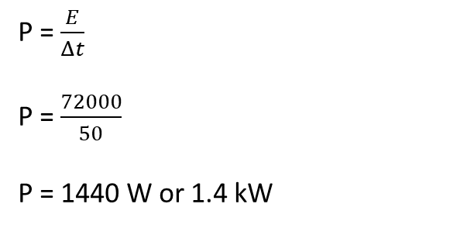
Sample Problem 1
Calculate the power of a toaster that uses 72000 J of energy in 50 seconds.
E = 72000 J
Δt = 50 s
P = ?
P = $\frac{E}{Δt}$
P = $\frac{72000}{50}$
P = 1440 W or 1.4 kW

Slide 11
This formula for electrical power is rarely used in practice, because you have to measure both the energy and the time interval to be able to solve the formula.
Because we already know that E = V x I x Δt, we can substitute that into the power formula for E. So the formula that is most commonly used is:
P = $\frac{V x I x Δt }{Δt}$
Notice that in this formula the time would cancel from the numerator and denominator, so we are left with P = V x I

Slide 12
Sample Problem 2
Calculate the power of a vacuum cleaner if the operating voltage is 120 V and the current flowing through it when used is 7.90 A.
P = ?
V = 120 V
I = 7.90 A
P = V x I
P = 120 x 7.90 A
P = 948 W or 0.948 kW

