Slide 1

Welcome to Assiniboine Ave. Elementary School!
May 2022

Slide 2
Welcome to new and returning families!
Principal – Lori Jones Clark
Vice Principal – Sara MacKay
Administrative Assistant – Jennifer Howe

Slide 3
Honoring the Land
I would like to acknowledge that land we are gathered on is the traditional, unceded and unsurrendered territory of the Wolostaqey people. We honor Indigenous culture as a whole school and have additional teachings for First Nation students.

Slide 4
School Population
Approximately 250 students
Approximately 40 staff
Our population includes students and families from Welamuktuk First Nation community
Many of our families proudly serve in the Canadian Armed Forces
Our school includes families from Fredericton Function, Geary, Burton, and the Town or Oromocto
Next year we are projected to have 14 classrooms – 4 kindergarten classrooms

Slide 5
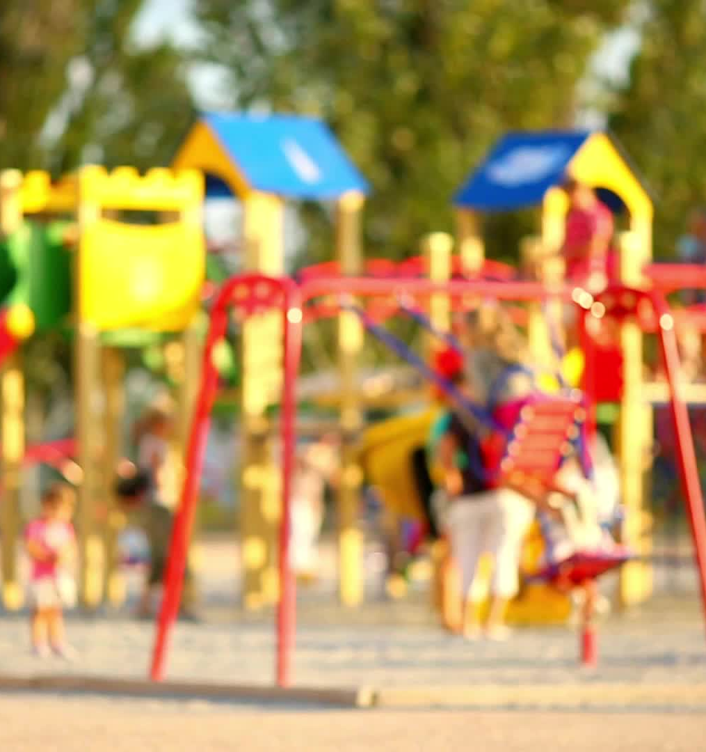
Outside learning and recess times
As a school we are committed to outdoor learning. Some instructional goals will be covered outside of the classroom. Fresh air and activity are important to wellness.
Weather permitting students are expected to go outside. Appropriate clothing is required for each season.
We have 3 playground sections that children will rotate. We have open playground on Fridays where students can choose which section to play.
Supervisors (3) and WITS pals support safe and fun play during recess times.

Slide 6

Cashless Schools
School Messenger
Please see school website.
Notes:
Hand out
Email classroom teacher
Phone Mrs. Howe at 357-4069

Slide 7
Cashless School Program
All money transactions are handled through our cashless school program.
Hot Lunch – starts on October (pizza, PitPit, Subway, Great Canadian Bagel)
School Fees: $40 supply fee $10 agenda
Field Trips
Fundraising (Jump Rope for Heart, Terry Fox Run, Scotts, Coffee)

Slide 8
Toys and Invitations
Invitations for private activities will not be distributed at school. A class Contact List will be distributed to all parents within each classroom (with individual parental permission) including student name, phone number and/or email address.
Non-essential items will not be permitted at school. These include all items that are not required for regular school activities such as all toys, electronic games, playthings

Slide 9
Save and Secure School Building
To maintain a safe and secure building for all staff and students, we ask that all parents and guardians report to the main office in the lobby. If you are dropping off items for your child, they will be left at the office and delivered to the child by staff. If you are picking up your child, the child will be paged to the lobby to meet you.
While you are known to your child, you are a stranger to other children.
We have restricted custody arrangements.
There are disputes with neighbours that do not need to come into the building.

Slide 10
Volunteers
We want you!
Criminal background check
Policy 701 (Pupil Protection Policy)
Policy 702: Tobacco-Free Schools
Policy 703: Positive Learning and Working Environment Policy 703
Confidentially Agreement

Slide 11
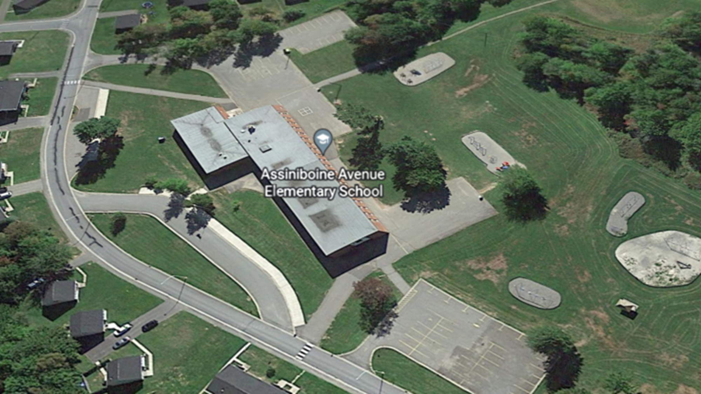
Staff Parking Lot
Bus Lane – No Parking
Parent Parking Lot
Be cautious, kind and respectful.
Notes:
Please walk if you can.
Please car pool is you can.
We have less than 40 spaces in the fall and spring. We have even fewer spaces when the snow arrives.
Please no not park in the bus lane.
Be kind and be patient always. Move slowly.
Please don’t park in restricted areas, fight with each other, use inappropriate language or send me people’s lisence plate numbers. I don’t have the software to search them.

Slide 12
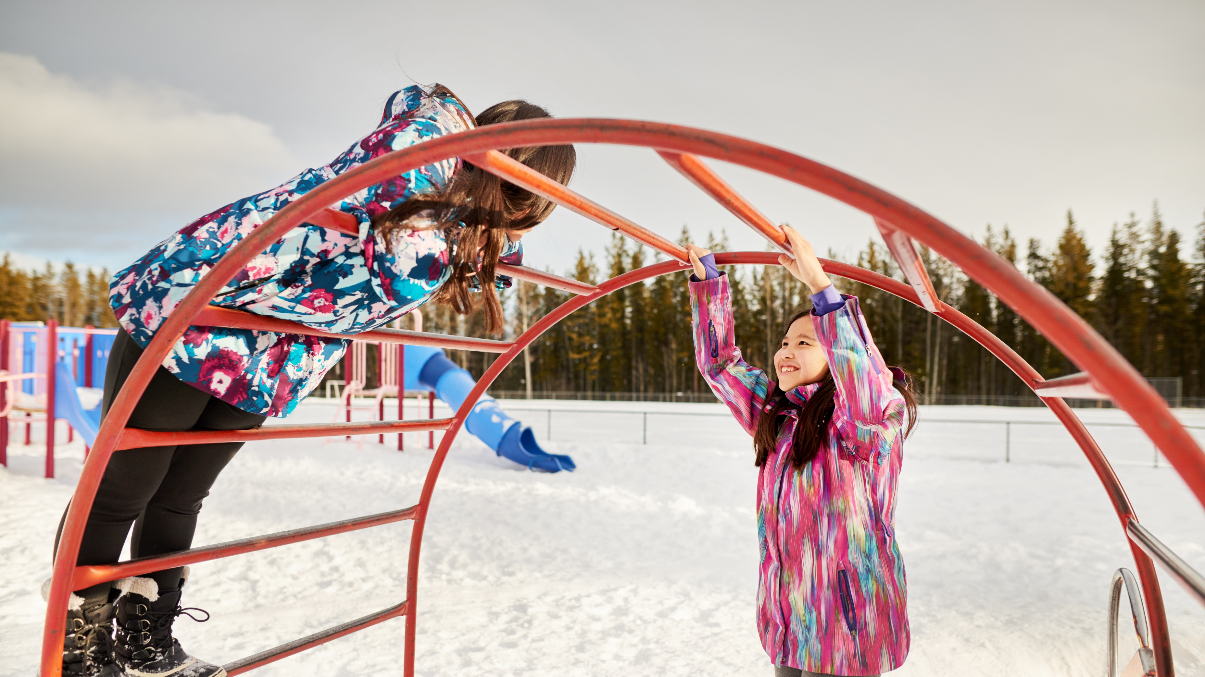
Lost and Found
Please, please label your children’s belongings

Slide 13

Lisa Dormer
Parent Volunteer Coordinator

Slide 14
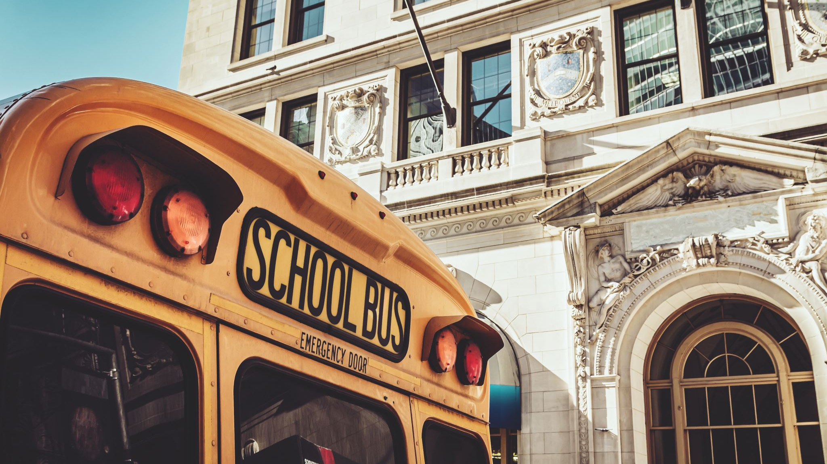
Bus
Notes:
Your children are going on a short bus ride around the block with the teachers. While they may not all be bus students there will be times, for example field trips, that they may be on the bus.
In my experience students tend to be excited to go on the bus. If your little one really needs you to accompany them that’s ok but starting today we need to be partners in supporting their independence.

Slide 15

We look forward to your return in September

Slide 16

Assiniboine is a great place to learn and grow! Your kids are in good hands.

