Slide 1
Grade 12 Course Selection 2023-24
!
Counsellor Presentation

Slide 2
Changes to high school credits
Formerly, credits (each course = 1 credit)
NOW, credit hours (each course = 4 credit hours)

Slide 3
Graduation Requirements
Pass 8 required courses (32 credit hours)
Pass 10 electives (40 credit hours)
Total of 18 courses (72 credit hours)
5 courses (incl. English) at Grade 12 level
Must be enrolled full time in grades 11&12
Must attempt 21 courses (84 credit hours)
Successfully complete the ELPA

Slide 4
Graduation Requirements
Required Courses:
English 11 Informational Text
English 11 Literary Text
2 Math courses from (NRF 10, Foundations 110, Fin & Workplace 110, Fin and Workplace 120 or NBCC Skilled Trades Math 120 – only in grade 12)
Science course
Humanities course
Fine Arts & Life Development course
English 12
Total: 8 courses = 32 credit hours
ELPA must be passed; re-writes in gr. 11

Slide 5
Competitive & Application Courses
Some courses have limited enrolment so students may not get in. Ex: Yoga, wellness, writing. It is important to select alternat courses carefully as they will be used if they don’t get in the course they chose.
The following courses require a written application
Personal Interest 1 - (4 credit hours)
Personal Interest 2 – (8 credit hours)
Coop 120 – (8 and 12 credit hour options)
Applications are available at guidance and must
be passed in by April 6th.
No Application = No Consideration

Slide 6
Special Programs: Co-Op 120
8 Credit hours = Afternoon
12 Credit hours = Mornings
Early Childhood COOP 120
Long-Term Care COOP
4 credit hours = 1 period
FHS courses (see page 8 of course guide)

Slide 7
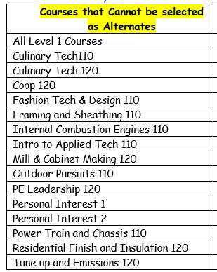
These courses cannot be selected as alternates because they are popular and will fill.

Slide 8
French Immersion
French Immersion Certificate: 5 FI Courses in Grade 11 & 12 – ensure you select “FI”
Oral Proficiency Interview: Must be in grade 12 – eligible to any student who has been enrolled in French Immersion at any point.

Slide 9
Post Secondary Dual Credit
More information to come in late spring.
Sign up as per usual (10 courses, 3 alternates), schedule can be ammended later on.

Slide 10
Please note!
High School Graduation Requirements & Post-Secondary Admission Requirements
are not the same!
admission Requirements for UNB and STU can be found in our course guide
Universities have different admission requirements. It is important to look them up and make sure students are selection the courses they need.

Slide 11
– Important information!
Grade 11 considering NBCC programs for September 2024 should apply on April 1st of 2023 (Legit!)
Apply on-line, pay application fee, and have guidance send your transcript on April 1st.
Admission is on a first-come, first served basis for all programs.
Take a look at programs now. Delaying application may force you to wait a year before entrance.

