Slide 1
Entering Grade 11 Course Selection 2019-20
Grade 10
Homeroom Teacher Presentation

Slide 2
Moving into Grade 11
All grade 10 subjects must be passed
Failed courses must be repeated in Summer School or in Grade 11; if you know you failed a course semester one and won’t go to summer school, select it for next year
Caution:
Grade 10 courses are prerequisites for grade 11-see course guide
Every grade 10 course taken in grade 11 takes away from credits that you need for graduation.

Slide 3
Graduation Requirements

Slide 4
Graduation Requirements
All Grade 10 courses must be passed
ELPA must be passed; re-writes in gr. 11
Compulsory Courses
English 11 (full-year, 2 credits)
Math 11
Science
History 11
Fine Arts & Life Development course
English 12
Total: 7 credits

Slide 5
Graduation Requirements
Must earn 17 out of 20 credits
Remaining 10 credits are elective
5 credits must be Grade 12 courses (incl. Eng 12)
If you are in French Immersion, 5 credits out of 20 must be F.I. One grade 12 FI course must be taken in grade 12 to be eligible for your oral proficiency interview.
Only two of your 17 credits toward graduation can be local option courses. Do not select more than two going into grade 11.
You are responsible for ensuring that you meet graduation requirements!

Slide 6
Course Levels
Level 1- Enriched university preparation (teacher recommendation required); faster pace and increased scope
e.g. English 111, Modern History 111, Physics 111
Level 2- University preparation, some community college & private training technology programs (not all require level 2-look up the programs of interest)
e.g. English 112, Modern History 112

Slide 7
Course Levels
Level 3- Non-technical community college & private training institutions
e.g. English 113, History 113
Level 0-Not offered at other levels
Will vary in difficulty. Some qualify for university entrance and some do not. Every university is different in what they accept as academic electives-look them up!
e.g. Law 120, Media Studies 120 and many others

Slide 8
Choosing Courses
Choose compulsory courses first
Note if prerequisites required
Generally, take courses at your grade level although some Grade 12 courses may be taken in Grade 11 and 11 in grade 12, especially the level 0 courses

Slide 9
Choosing Courses
Consider future learning/career goals
Work, community college, university, private training school, apprenticeship, military
Discuss everything with parents, teachers, counsellors
Check with teachers who are teaching the courses you are interested in to learn more about them.
Check with your current teachers (math, English, science, social studies) regarding recommendations for your future courses

Slide 10
REMINDER
Graduation Requirements are not the same as Post-Secondary Admission Requirements-
You have to do some research

Slide 11
Courses Requiring Applications
Some courses require an application
All applications available at Guidance
All applications are due March 29th at Guidance
If you select a course, but don’t put in the application form, your request will be denied. Don’t wait until last minute as most require you go get teacher references.

Slide 12
The Course Selection Guide
Read It! You are responsible for making the correct course decisions.

Slide 13
Read course descriptions carefully
Course Name, Grade, Level
Prerequisites, Co-requisites, recommended prerequisites (very important)
At end of description
course fees
application required-all due March 29th

Slide 14
Grade 11 Course Selection Planning Form
Must be completed and brought to your English class presentation with guidance counsellor this Friday!

Slide 15
Enter Compulsory Courses
Complete the top section to verify meeting
Grade 10 requirements
Line #1: English 111, 112 or 113
Line #2: Foundations Math 11 or Financial & Workplace 11
Line #3: Modern History 111/112/113
Line #4: Science course (see Options)
Line #5: *Fine Arts & Life Role Development Course (see Options)
*Can be taken in grade 12 if conflicts occur

Slide 16
Enter Elective Courses
#6-9: Enter 4 courses (4 credits)
Consider prerequisites for grade 12 courses
Electives should support your post-secondary, career and personal interests

Slide 17
Enter Three Alternate Courses
Carefully consider and choose 3 additional courses that will be used if any of your chosen courses cannot be scheduled.
You must choose 3 Alternate courses

Slide 18
Choosing Courses
Choose courses carefully.
Courses chosen by students. determine courses offered next year.
If you choose a course, you will be expected to remain in the course.
Once schedules have been created, course changes are not entertained.

Slide 19
English Class Presentation-This Friday with Counsellor
Bring your completed Course Selection form to your English class on Friday for the presentation by guidance counsellors.
Counsellors will review in more detail some of the requirements of post-secondary and graduation
During this class, the counsellor will be able to review some of your questions and look at your tentatively selected courses
Following this presentation, once you are confident your choices are correct, pass the form into your homeroom teacher
These should all be into your homeroom by March 14.

Slide 20
The Course Selection Process
All courses will be selected using an on-line request process through Power School
This will be done during Extended Homerooms March 18th -21st
You will need your user ID and password to gain access to the system; you will need to have logged in once to a hard-wired computer and change your password.
You will need a completed course selection form.
Add HR# at top.
You will not be able to enter any requests without a completed form

Slide 21
Once requests have been entered and submitted, they cannot be changed
You will receive a verification form listing the courses you have chosen
The form must be signed by your parent/guardian and returned
There will be no changes made after this point except for failures

Slide 22
Failures
If you have failed a Grade 10 course this year, select the appropriate Grade 10 course
If you failed any course in the past requiring you to take a Grade 10 course next year (because you didn’t have room to take it this year), select the appropriate Grade 10 course
If you fail a course this semester, and do not go Summer School, you will be placed in the failed course next year

Slide 23
Caution
Be VERY, VERY careful to input the correct course code and grade level when inputting course selections into Power School
FI Students please be especially careful to choose the FI course when entering selections.
Accuracy is important to avoid being scheduled into the wrong courses!

Slide 24
Remember…
You can
Talk to me!
Talk to your parents!
Talk to your teachers!
Talk to your counsellor-every day there is someone available at lunch!

Slide 25
The following slides should be shown now and again during the Extended Homerooms March 18th -21st to guide students through the process

Slide 26
Entering Courses Selected
March 18-21 2019

Slide 27
Log-on Using Student ID & Password
In case of username /password unknowns:HR teachers will ask tech teachers, in advance, to reset.
Login here: Student Course Selection Login Page
Step 1: Choose Compulsory courses
Step 2: Choose 2 Elective courses
Step 3: Choose 2 Alternate Electives
Choose a 3rd alternate if you have selected FHS courses, Co-op 120 or Career Exploration 110
If Required
Step 4: Choose Grade 10 Compulsory Course(s)
Step 5: Choose Grade 10 Elective Course(s)

Slide 28
Special Note-Music Electives
If choosing Music 112 as an elective, you may choose only 1 of the 4 strands:
Guitar FEMUD1120 Music 112
Instrumental FEMUD1110 Music 111
Keyboard FEMUD1130 Music 113
Choral FEMUI0092 Music Art (90hr) 9
When choosing, be sure to select the above course names for the strand you want

Slide 29
Special Note-Alternate Courses
You must choose 2 Alternate Courses
Choose these carefully
They will be used if all the courses selected cannot be scheduled due to conflicts
If selecting 3-credit Co-Op, you must choose 3 alternate courses

Slide 30
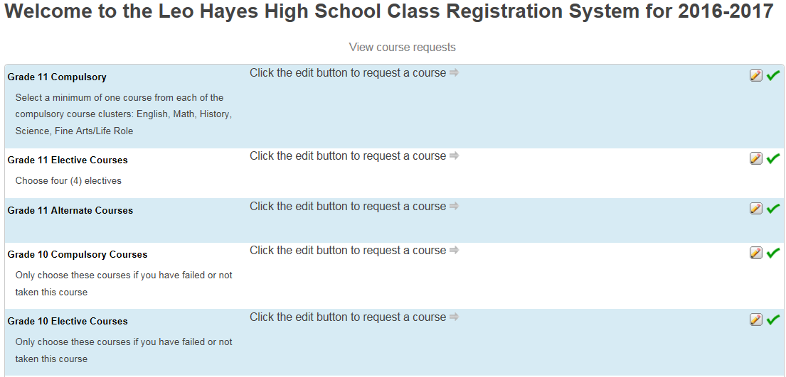
2019-2020

Slide 31
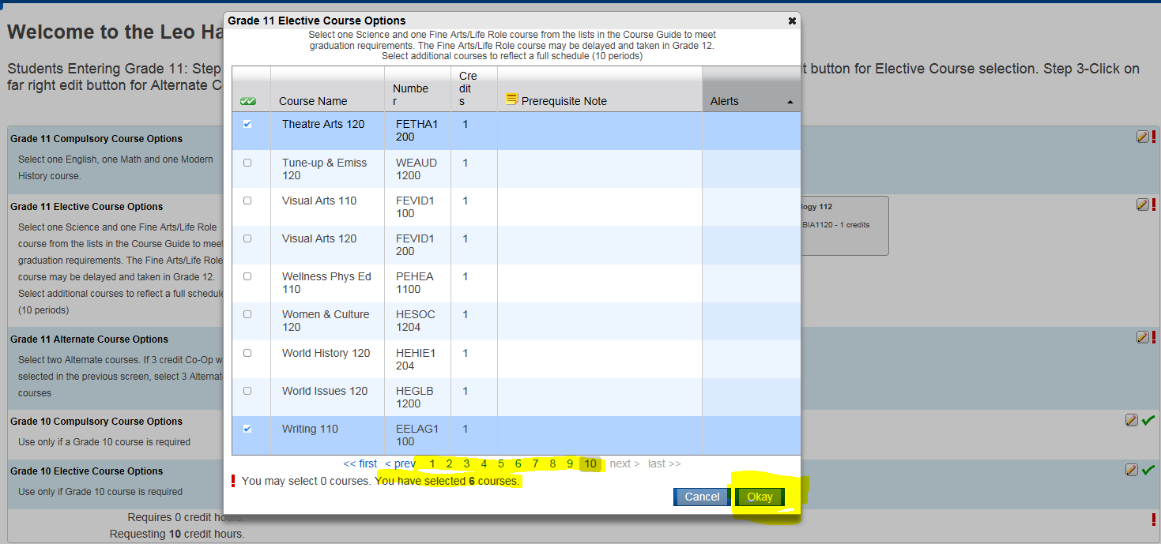

Slide 32
When Finished
Before you hit submit. . .
your homeroom teacher will verify that the courses on the screen are the courses on your course selection planning sheet.
Give your planning sheet to your homeroom teacher so they can place in folder of homeroom student requests
Teacher checks off the student name as complete
Log Off so next student can Log On with homeroom teacher assistance

