Slide 1
Teen Dating Violence
Individual and Family Dynamics

Slide 2
Agenda
Example Video “The Teen Dating Bill of Rights” (1:50 Minutes)
ACTIVITY: Create a Teen Dating Bill of Rights (25 Minutes)
Video “Love Lesson” (4 Minutes)
ACTIVITY: Love Is… (25 Minutes)
Reflection #19 (5 Minutes)

Slide 3
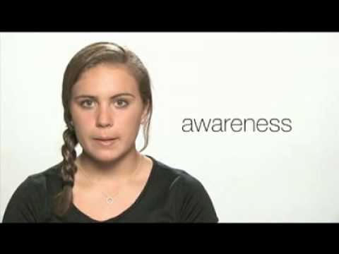
The Teen Dating Bill of Rights

Slide 4
Activity
In groups create a Teen Dating Bill of Rights
Include at least 10 Rights you feel every teenager has when it comes to dating
Include at least 5 Pledges/Responsibilities you feel every teenager has when it comes to dating.
Will be collected at the end of class.
Examples may include:
I have the right to be treated with respect and not be criticized.
I have the right to have a partner who values me for me, encourages me, and wants the best for me.
I have the right to be safe.

Slide 5
Love Lesson

Slide 6
A Force of Nature
Inherently Free
Bigger Than You Are
Its own Law
LOVE IS…

Slide 7
Reflection #19: Why are there so many different words in your heart?

