Slide 1
Teen Dating Violence
Individual & Family Dynamics

Slide 2
Agenda
How Socialization Contributes to Teen Dating Violence : STEREOTYPES
Activity: Be A Real Man VS Act Like A Lady (15 Minutes)
Chart Paper and Markers
Ted Talk (Manhood) (13 Minutes)
What are stereotypes? Questions & Discussion (20 Minutes)
Friends Clip (G.I. Joe vs. Barbie) (5 Minutes)
Reflection #20 (7 Minutes)

Slide 3
How Socialization Contributes to Teen Dating Violence

Slide 4
“Be A Real Man” VS “Act Like A Lady”
In your groups create a chart. On the left hand side define what it means to “be a real man.” On the right hand side define what it means to “act like a lady.”

Slide 5
What is a stereotype?

Slide 6
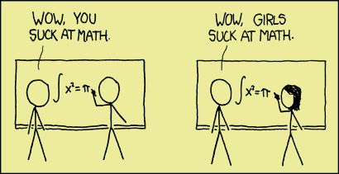
A stereotype is when a person has a fixed or rigid image of something. Sex role stereotypes are the interests, abilities, values, and roles that all females or all males are supposed to share in common because they are the same sex. Stereotypes are confining because they give a limited definition of what it means to be a man or a woman. Stereotypes can distort our perception of others.

Slide 7
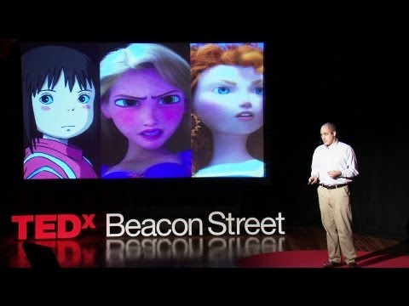

Slide 8
How did we learn these roles or stereotypes?

Slide 9
What are some examples of stereotyping of young men and women in our society? Discuss.

Slide 10
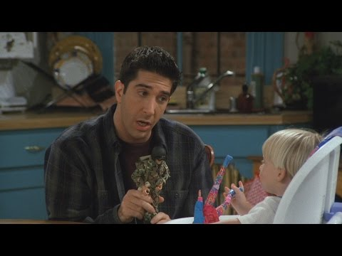

Slide 11
Reflection #20
Do you think that certain stereotypes will influence how you interact with others and your dating behaviour? How?

