Slide 1
Writing a Biography

Slide 2
Keep It Short
Describe yourself in three to four sentences.

Slide 3
Write in Third Person
People generally write a bio in third person, rather than first person. Think of yourself as a story that you are describing to someone else in one short paragraph.

Slide 4
Write about yourself
Use your full name (first and last) when you first describe yourself. After that, you can opt to continue describing yourself with your full name, only your first name, or only your last name.
Whether you choose to write your bio with your first or last name, remember to stay consistent.

Slide 5
Write about your Acheivments
Now that you know which point of view to use, start writing a brief account of your achievements. When you write a bio, only discuss your high points and not a full description of your career. The key is to remain brief.
Cite the most critical pieces of education and work in your dance career with actual dates and names.

Slide 6
Show your Character
While you write a bio, make sure your personality shows through. If you're humorous, put some humour in the bio (be careful with humour though). If you have a passion, talk about it! A bio is more interesting if it conveys something unique about the writer.

Slide 7
10 Questions to get your started
1. Where were you born and raised?
2. Where, what and with whom have you studied?
3. Where and what have you performed?
4. Where and what have you taught?
5. How did you first become interested in dance? How old were you?
6. What do you think is distinct about your style?
7. What aspects of dance do you like the most/ what do you do best?
8. Are there other dancers in your family? What was your upbringing like?
9. What are your goals for your dance career?
10. If you had one thing to say about dance, life or learning, what would it be?

Slide 8
Editing and Polishing your bio
Read your bio carefully.
have a friend of someone you trust give it a read and provide you with feedback. Carefully check the spelling and grammatical accuracy. This is the time to tweak sentences as necessary and get everything just right!
No longer than 150 words
By the end of this process you should have a well polished, super tight, and super interesting bio ready to go.
Remember, like anything else, the more you practice the better your bio writing skills will become!

Slide 9
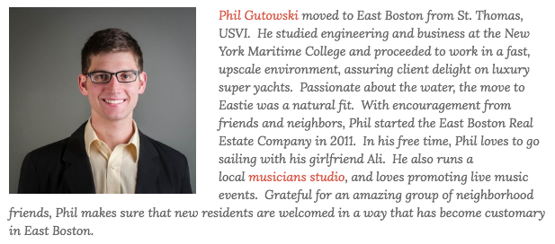
Example of a Professional Bio

Slide 10
Mrs. Perez
Lindsay perez born and raised in Fredericton N.b.. Graduate from Leo Hayes High School, St. Thomas University and University of Presque Isle Maine.

