Slide 1
Nutrition and the Elderly

Slide 2
Key Issues for Nutrition and Elderly
The digestion and absorption of food becomes less efficient with aging.
The quality of food intake may also be reduced for a variety of reasons: poor chewing, reduced income, physical disabilities, lack of motivation

Slide 3
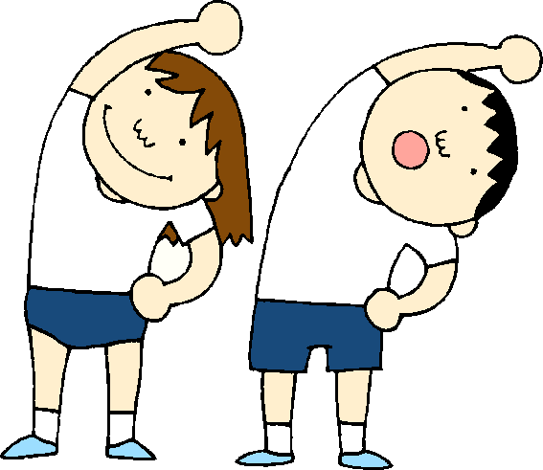
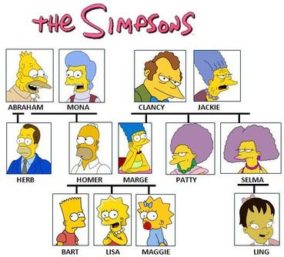
The quality of life of an elderly person is affected by a number of factors – nutrition, physical activity, health habits, heredity and environment.

Slide 4
Changes in Body Composition
The ratio of muscle to fat changes during the aging process.
There is a gradual reduction in the amount of active muscle tissue. (3% every ten years after age 20); this is reversible with regular physical activity.

Slide 5
Other changes
Another change with inactivity is the loss of calcium from the bones. With physical inactivity this loss is greater.
The basic functions of the body have slowed down. So it is recommended that fewer calories be consumed. However, it is important to still get the recommended nutrients.

Slide 6
Other information
Medications can affect appetite and nutrient absorption
Research is still ongoing about nutritional requirements. For example, RDA’s are usually listed for 51 yrs + (so, does a 91 yr old have the same requirements?)
Elderly are subject to nutritional misinformation and supplements

