Slide 1

-Welcome Grade 9 students -
Fredericton High School
Class of 2022

Slide 2

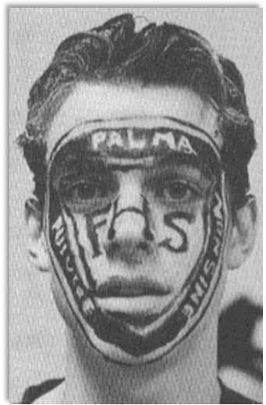
Life @ FHS
Slide 1: Don’t panic
Slide 2: Our school day
Slide 3: Arriving on time
Slide 4: Nutrition Break
Slide 5: Lockers
Slide 6: Technology
Slide 7: Academics
Slide 8: Making high school
your best 4 years…

Slide 3
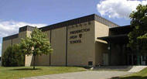
The school isn’t as big as it looks… you WILL find your way around.
Don’t panic

Slide 4
Breakdown of our school day
8:30 am homeroom
5 periods / classes in the day
15 minute nutrition break
One-hour lunch
3:30pm dismissal

Slide 5
Our school day
Class times
Period 1 - 8:50 – 9:52
Period 2 - 10:07 – 11:09
Period 3 - 11:14 – 12:16
Lunch 12:16 – 1:16
Period 4 - 1:16 – 2:18
Period 5 - 2:28 – 3:30

Slide 6
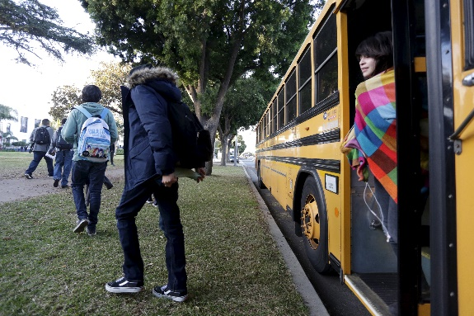
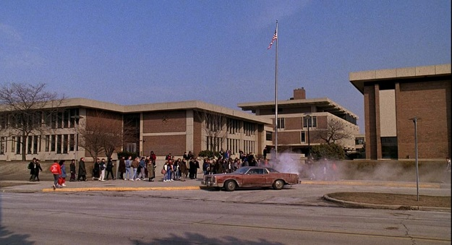
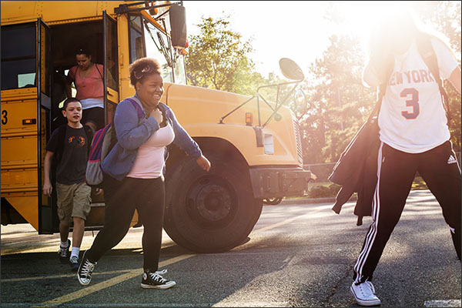
Arrive
ON TIME
8:30 am
(not 8:35, not 8:50)

Slide 7


Watch The Daily Roar during homeroom
The Daily Roar will let you know what’s happening. It is also uploaded to our school’s website.

Slide 8
15 min
Nutrition Break
No one may leave the building during nutrition break, we are a closed campus until lunch.
The cafeteria is open for snacks during this time.

Slide 9
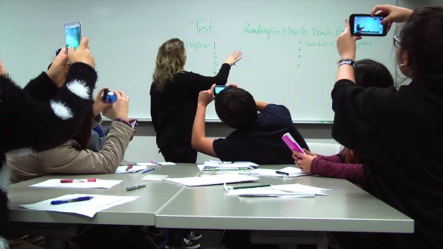
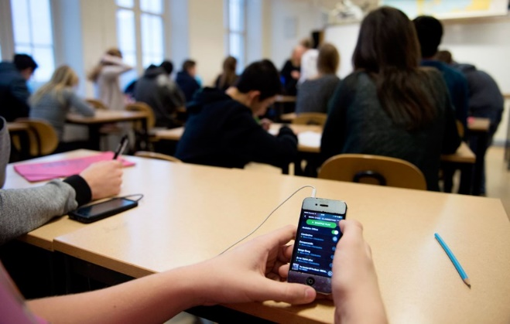
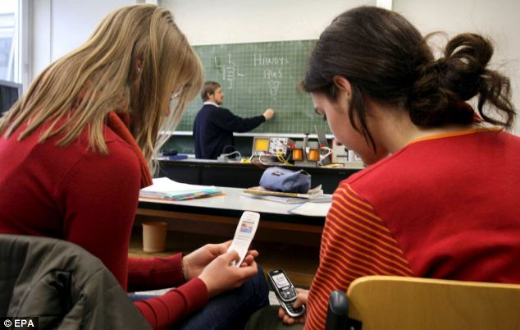
Technology
Each teacher has his/her own rules & expectations when it comes to using your devices in their classrooms. Please respect them.
*Wellness tip:
Find balance - too much screen time is unhealthy & distracting to learning

Slide 10



Academics
It’s all about EFFORT
Find time to engage in your learning, both inside and outside of the classroom.
What does that mean?
Learning takes TIME.
At the very least, you need to sit down and read/review each night, even if it is for 10 minutes. Setting a time each day to engage and review will pay off in the long run.

Slide 11

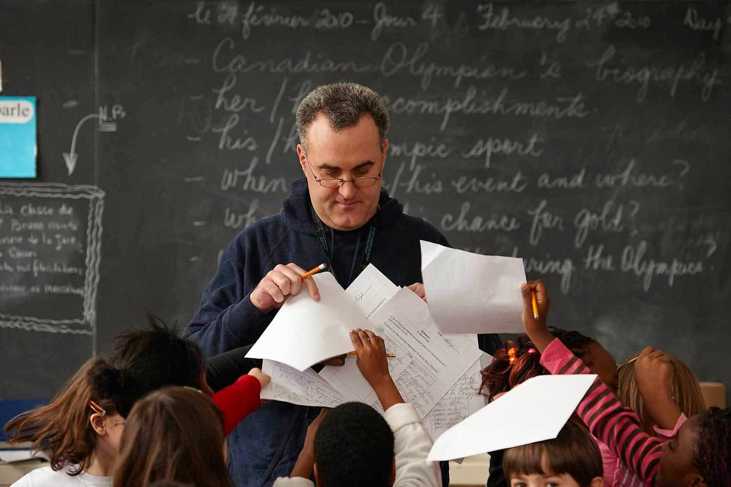

Academics
Hand in ALL of your assignments… even if you missed the deadline.
Every Mark Counts!

Slide 12
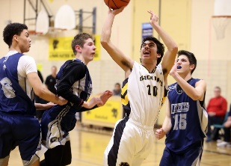

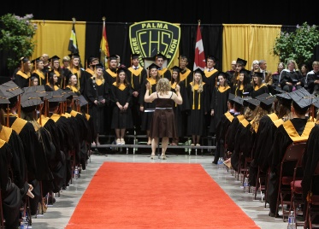
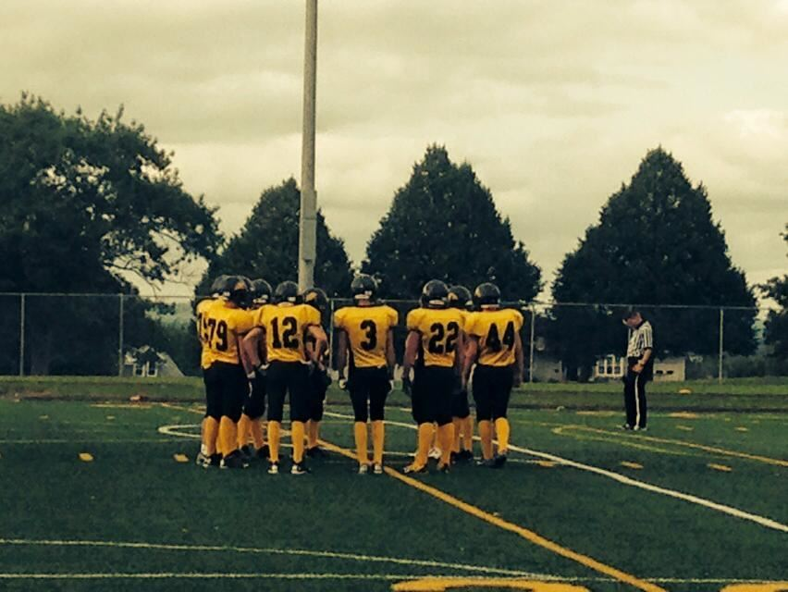
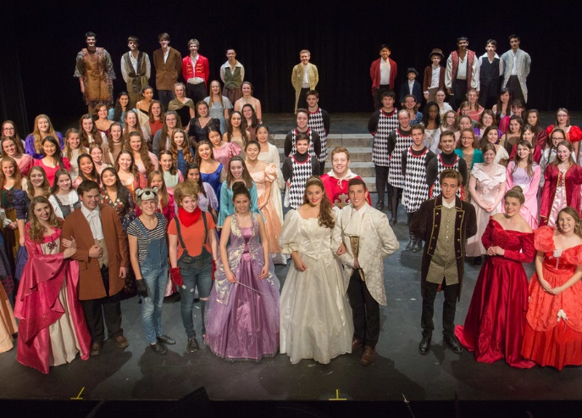

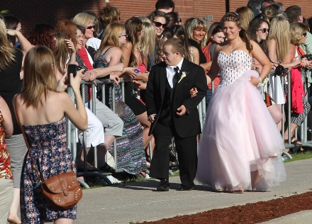
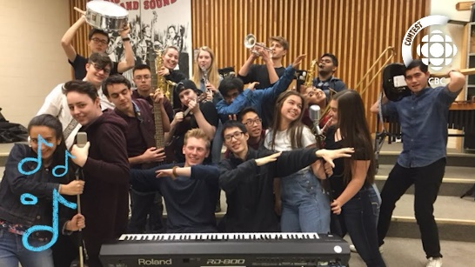
Make the best of the next 4 years, Black Kat!

Slide 13


School Spirit
FHS clothing is comfy and warm!
Wear it to school or after school events and you’ll fit right in! Buy it at the Bookstore at lunch hour.
Did you know??
We’re the oldest high school in Canada…. We’re 233 years old! Let your pride show!

Slide 14

PRACTICE KINDNESS & POSITIVITY
Stay away from gossip, hurtful words and conversations, in person and/or online … it is just not cool.

Slide 15
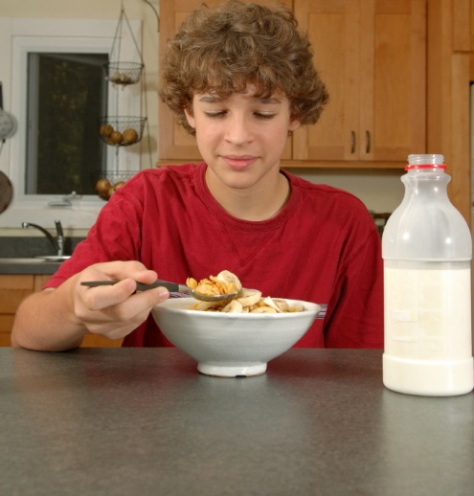
EAT BREAKFAST
(fuel for school)
It’s the most important meal of the day! You will feel better and learn more when you do.

Slide 16

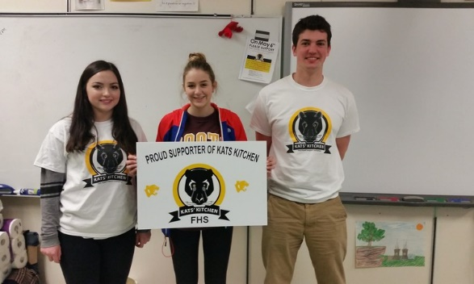
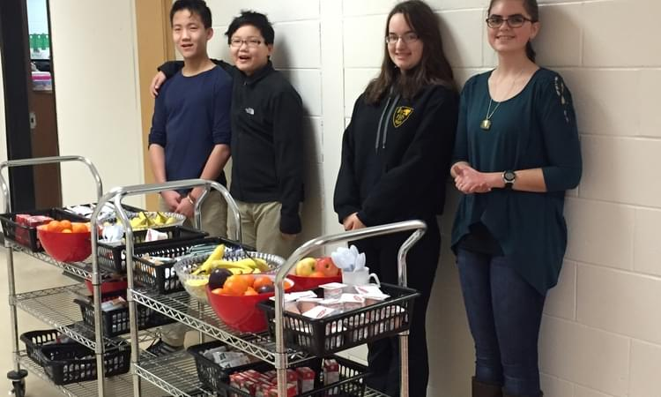
If you’re hungry
Kats’ Kitchen Grab & Go
Breakfast and Lunch located in D-Wing

Slide 17
Where to go at lunch…..
A Kats Club classroom!
The Kats Club decal means that the classroom is open for you at lunch time. The purpose of the Kats Club is to offer a safe welcome location where students can go to do:
Homework
Read
Relax
Socialize with a friend
Play a board game
The individual teachers will let you know if it is okay to eat in their classroom.
I

Slide 18

When you need help….
The Link Program at FHS
The Link Program is there for you. With the support of a LINK COMPANION (a participating FHS teacher), you will have an opportunity to talk about your concerns so that the teacher can help you access support services in the community.

Slide 19

SCENTS
Please do NOT wear perfume or cologne, including scented hair products.
Some students & staff have very serious allergies.
Good news: Deodorant is okay!

Slide 20


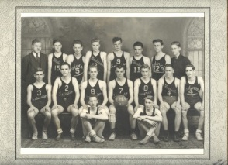
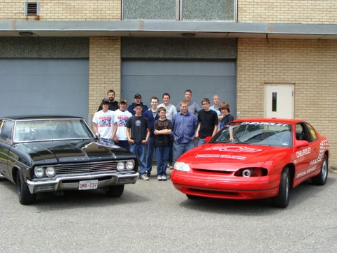
Get involved!
It is the fastest way to make new friends & have fun!
We have many clubs, activities and sports to choose from!
Listen to announcements.

Slide 21
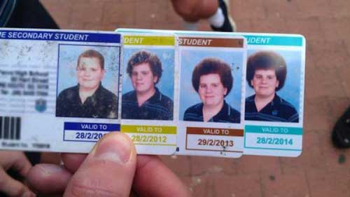
Student ID
You will receive a free student ID in the next few weeks. Please carry it at all times.
You need it to: sign out books from library - attend school events - identify yourself
*Replacement cost - $5.

Slide 22

Questions?
Just ask!
Welcome to FHS

