Slide 1
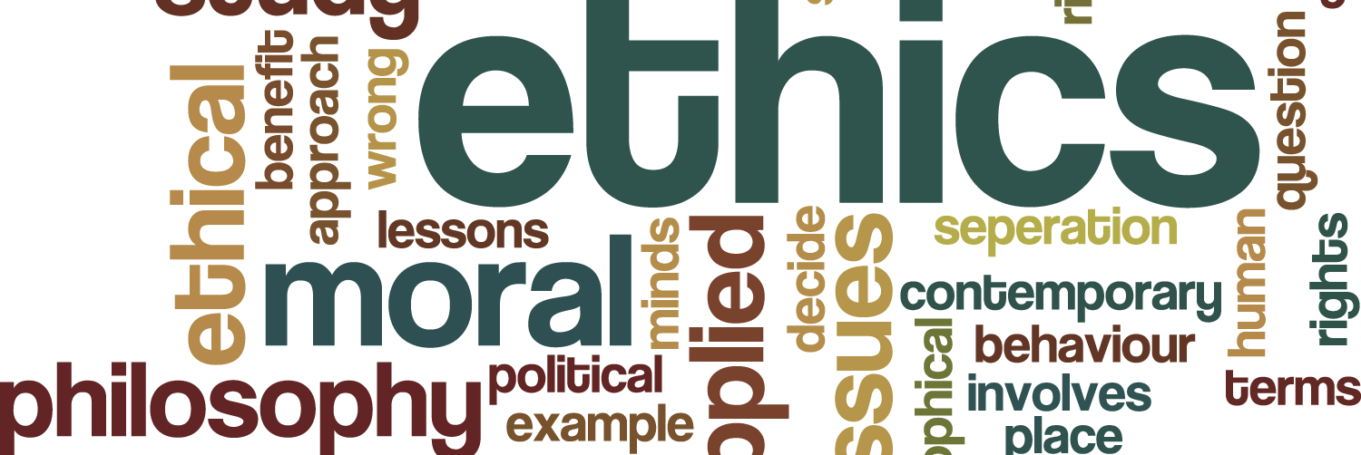
Ethics

Slide 2
ETHICS
As a group, write down key words that you associate with ethics.
What do you think it means?
Share with the class.

Slide 3
What are Ethics?
Behaviour that is accepted by society as right versus wrong
Principles or morals that help shape our behaviours in certain situation or activities

Slide 4
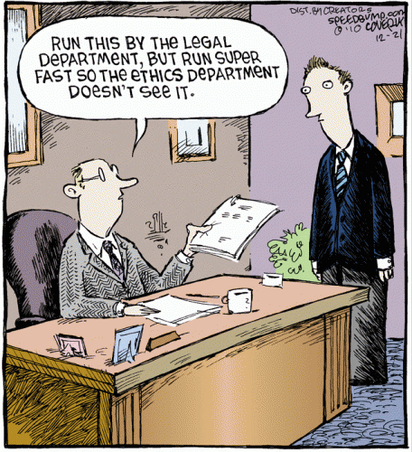
Is there an ethics crisis in the world?

Slide 5
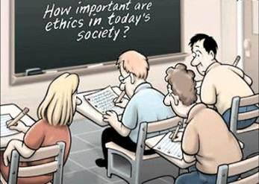
In a recent Wall Street Journal article, Psychology professor Steven Davis says that cheating by high school students has increased from about 20 percent in the 1940’s to 75 percent today.

Slide 6
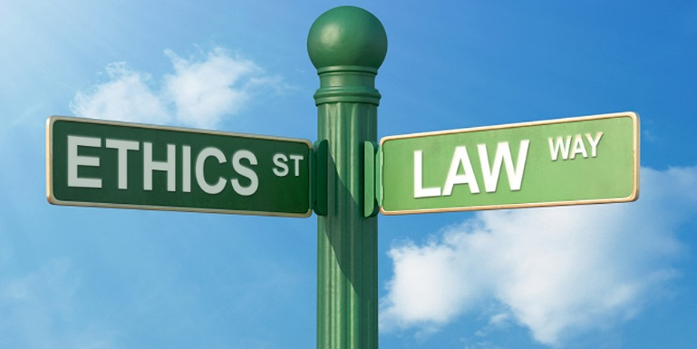
Ethics and Legality
As a group, think of what the difference between ethics and legal is.

Slide 7
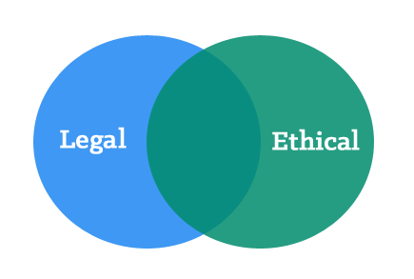
Legal vs. Ethical
The law provides boundaries for defining what activities are illegal
The law, however, does not outline what is “ethical.”

Slide 8
LG 2.1: Ethics and Legality Are Two Different Things
How should people treat others?
What responsibility should they feel to others?
Ethics
Laws we have written to protect ourselves from fraud, theft & violence
Legality

Slide 9
Brainstorm
Write down three ethical values that are inherently right
Write down three that are inherently wrong– but not illegal!

Slide 10
Ethical Standards Are Fundamental
Moral Values – Right
Moral Values - Wrong
Integrity
Respect for human life
Self-control
Honesty
Courage and
Self-Sacrifice
Cheating
Cowardice
Cruelty

Slide 11
Ethical Dilemma
Situations where there is no desirable alternative
You must choose between equally unsatisfactory alternatives.
EXAMPLE:
You haven’t studied for a test, if you cheat you can pass. If you don’t cheat, you will fail.

Slide 12
Ethical Dilemma
As a group, think of three ethical dilemmas that you could find yourself in as an entrepreneur.
Share with the class.

Slide 13
Ethical Dilemma
Examples:
Taking credit for others' work.
Offering a client a worse product for your own profit.
Utilizing inside knowledge for your own profit.

Slide 14
Ethical Dilemma Questions to Ask Yourself
Is it Legal?
Is it balanced?
How will it make you feel about yourself?

Slide 15
Is it legal?
Am I violating any law or company policy?
Whether you are thinking about having a drink and then driving home, gathering marketing intelligence or hiring or firing employees
It is necessary to think about the legal implications of what you do.
This question is the most basic one in behaving ethically in business.

Slide 16
Is it balanced?
Will I win everything at the expense of another party?
Win-lose situations often end up as lose-lose

Slide 17
How will it make me feel about myself?
Would I feel proud if my family or friends learned of my decision?
Would I be able to discuss the proposed situation or action with my immediate supervisor? The company’s clients?
How would I feel if my decision were announced on the news?
Will I have to hide my actions?
Am I feeling unusually nervous?

Slide 18
Ethics within businesses
Many businesses develop their own codes of ethics or conduct
These codes outline what employees are to do in order to carry out what the company sees as the “right thing to do” in various circumstances
For example; Discuss or think about how you would handle the problem and/or what policy, or procedure would you implement for your employees to follow in the following circumstance:
“Negotiating” special prices for friends and family.

