Slide 1
Post-Secondary and Scholarship Information Session
FREDERICTON HIGH SCHOOL
CLASS OF 2023

Slide 2
Grad 2023
What’s next?
College?
Military?
University?
Workforce?
Apprenticeship?
Hubert.perkins@gnb.ca

Slide 3
The Heavy FEELING in the room: I have no idea what I want to Do for a Career
You are not alone. There are many options and you are still learning about yourself.
Now IS time to explore though. Here are some starting points:
My Blueprint https://myblueprint.ca/
Quizzes on canada.ca (https://www.jobbank.gc.ca/career-planning/quizzes;jsessionid=E9B00234391736991045D85601498340.jobsearch76)
Questioning a certain career? Ask people in your community to job shadow for a day!
Focus on your interests and strengths as your starting point...not $$$
Look at labour market outlook reports (ie., www.nbjobs.ca )

Slide 4
Post-Secondary Plans
Step one: Go online! Look at schools/programs that interest you.
Verify that you have the admission requirements (use caution – not all are the same!)
Many schools have early admission; admission deadlines vary by school.
NBCC Admission is first come, first served, so apply early – grades are not what they look at first when making decisions.
Universities mostly look at grades – especially competitive programs, like nursing and engineering. Your grades need to be top notch.
*Remember that your admission average is calculated from the courses required for the program (admission requirements) not your overall average

Slide 5
AARAO Tour 2022
AARAO stands for The Atlantic Association of Registrars and Admissions Officers (they represent the Atlantic Region Post-Secondary Institutes)
Open to the public/parents night: Wednesday, November 2nd, 6-7pm
Open to FHS Grade 11 & 12 Students only: Thursday, November 3rd, 8:50am-11:15am (your classes will be called down and you will have 30 minutes to tour around and ask questions, gather information, etc).
There will about 27 university reps here that day.
Trying to decide between schools? Prepare some questions in advance!

Slide 6
How Do I Apply?
Most schools have applications online
From website, create a student profile to complete a basic application (and upload additional files if necessary)
All schools charge an application fee (this varies from $40-$100) which can be paid online. Some are offering free applications if you do a virtual tour.
The application is not considered complete until you send your official transcript IN JUNE!!
Ontario School Applications go through Ontario Universities Application Centre (OUAC)
US Schools – SATs (specific testing dates), Common Application

Slide 7
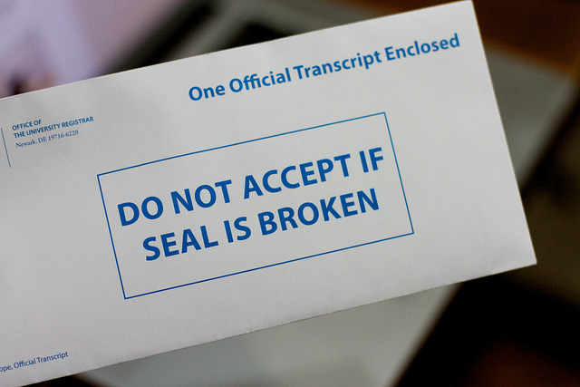
FHS Transcripts
Official document which shows Grade 11 & 12 marks from FHS
Will show mid-term mark once report card comes out in November; final mark at end replaces it.
If you have marks from somewhere else, you must also have those marks sent
Schools want transcripts that you have not handled (sent directly from FHS to post-secondary)
To request transcript you must email Julia.Woodhouse@nbed.nb.ca indicating where you want your transcript sent (with at least a week’s notice)
This Photo by Unknown author is licensed under CC BY-NC-ND.

Slide 8
Scholarships
Scholarships are not just for high academic, university bound students.
Many scholarships go unclaimed because no one applies…….
$ values of scholarships vary: $50 - $60,000+

Slide 9
Scholarships: Different types are available
Post -secondary Institutions
Entrance scholarships: based on admission averages (average is calculated from the courses you need for admission – not your overall average)
Special applications: often separate application required - the criteria varies….financial, leadership, etc…

Slide 10
Scholarships: Different types are available
Community Scholarships
National Scholarships
Sponsored Scholarships (Schulich, Chancellors)
In-house scholarships (these come out in May for FHS students only)
Each organization creates their own requirements for the scholarship they are offering.
To see a list of scholarships, go to the FHS website. Click on quick links, guidance. Scroll to ASDW scholarship info (right side of page) Pages - Home (nbed.nb.ca)

Slide 11
Main Criteria for Scholarships
Most Scholarships take into consideration the following criteria individually or in some combination:
- Academic Record
- Community Service/Volunteerism
- Extra-curricular involvement
- Financial Need
- Leadership
Occasionally, the criteria is more obscure (membership to a specific organization, identified challenge, etc.)

Slide 12
Scholarships: Time Management
Deadline dates change from year to year
Many deadlines are non-negotiable
Plan to have application completed and in the mail at least a week before the deadline date

Slide 13
Scholarships
Students are encouraged to plan ahead...
Develop an Activity Resume (samples available)
Secure 2 Letters of Reference (min. 2 weeks notice)
Create application letters/essays that can be saved and reused
Register at the following websites… (also on FHS website on guidance page)
www.studentawards.com
www.canlearn.ca
https://scholartree.ca/

Slide 14
FHS School counsellors
Mr. Cook (A-Co)
Mrs. Hamilton (Cr-Hi)
Mr. Dionne (Ho-Mc)
Mrs. Maxwell (Me-Sc)
Mrs. Langille (Se-Z)
Book an appointment through Harmony in Guidance if you have questions!

