Slide 1
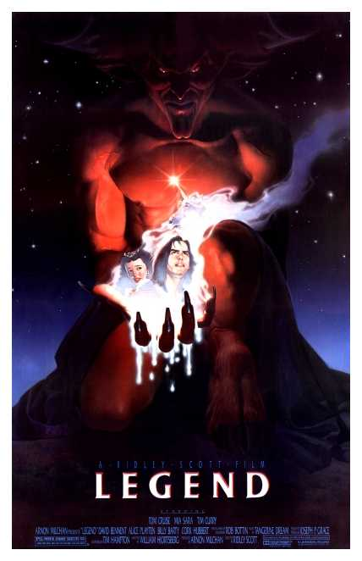
WHAT IS A….

Slide 2
What is a Legend?
Legend: from the Latin word legenda, which means "things to be read.“
It is a narrative of human actions.
Unlike other stories, there is a certain set of rules that go along with a legend.

Slide 3
Legend Rules!
1) The story took place within human history.
2) The story includes no happenings that are outside the realm of "possibility.”
3) The story is probably often told by word of mouth.
4) The story is usually about a single episode.

Slide 4
What’s different?
While a legend “could” have happened. Chances are it did not.
The story may be based in a bit of “truth” but is often exaggerated.
In this sense, a legend is a lot like a rumour.

Slide 5
Let’s take a look!
In the next 2 minutes, write everything you know about:
1) Robin Hood
2) Pandora’s Box
3) Sleepy Hollow

Slide 6
Write the statement and write 1,2, or 3 if it applies.
A) This story is often told by word of mouth.
B) This story “could” have happened, but I doubt it.
C) The characters in this story probably didn’t exist.
D) I have heard different versions of this story.

