Slide 1
Figurative
Language

Slide 2
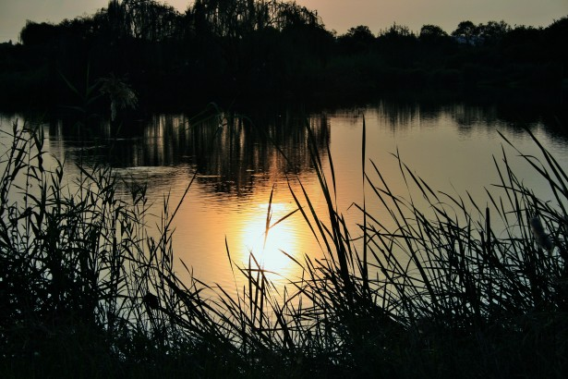
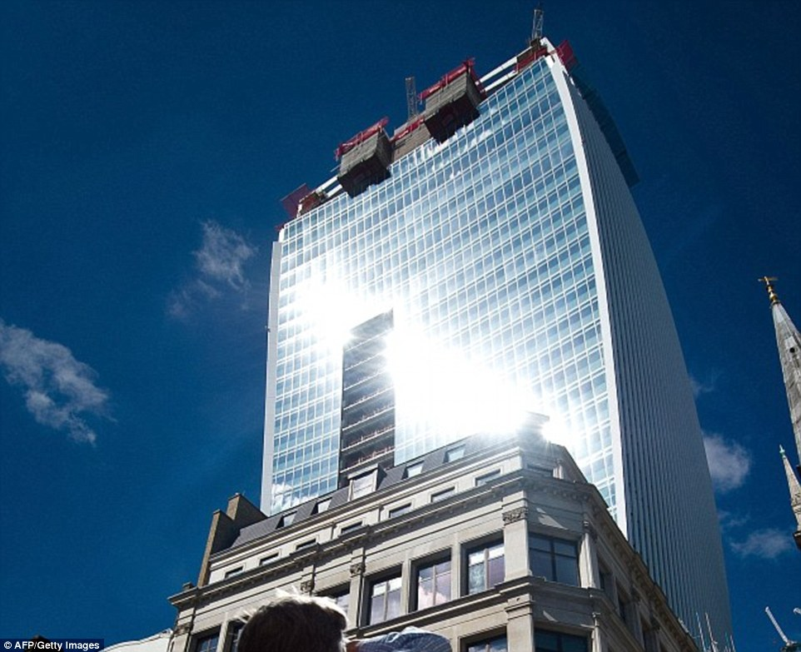
Figurative language…
the use of words in a way that makes them go beyond their ordinary individual meanings.
The water’s reflection was like the sun on glass.
Figurative language is a tool the writer uses to “paint” the coloured picture in the readers’ mind.

Slide 3
SIMILE A figure of speech comparing two different things using the words “like” or “as.”
After the football game, the boy was so sore he walked like a toy soldier.
Notes:
1:33

Slide 4
Metaphor … A figure of speech comparing two different things without using the words “like” or “as.”
Stars are buttons off the angels’ gowns.

Slide 5
Onomatopoeia … a word or words that imitate a sound
The click, click, click of the keys gave Ms. Smith a headache.
Notes:
24s

Slide 6
Personification … giving human characteristics to things that are not human
The moonlight danced across the water.

Slide 7
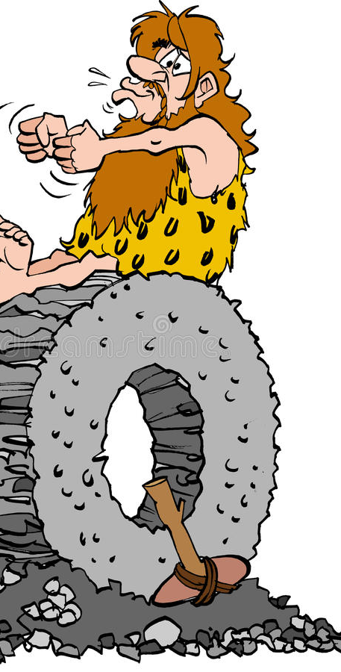
Hyperbole … exaggeration statement or claim not meant to be taken literally
Our teacher is so old he probably taught cavemen how to make a wheel.

Slide 8
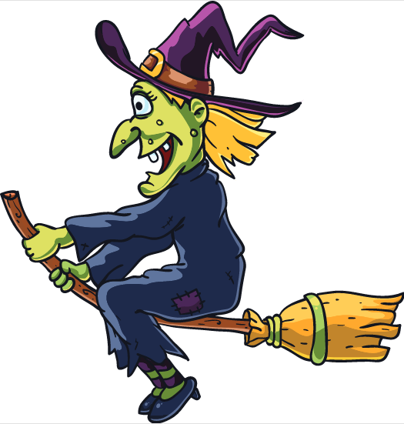
Alliteration … figurative language using the repetition of the same consonant or consonant sounds
Courteous Cop Curt wrote wicked Wanda Witch a spectacular speeding ticket because she was flippantly flipping and flying over the fifty-five km an hour speed limit.

Slide 9
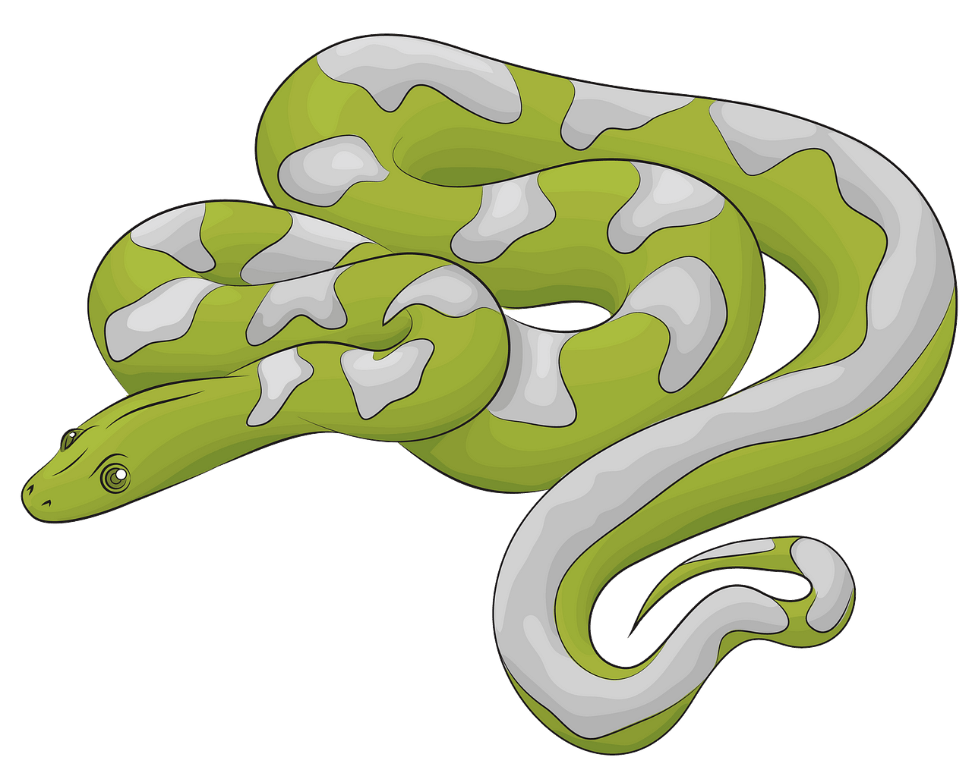
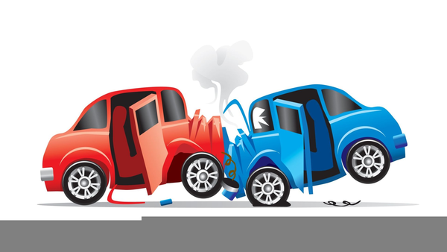
Bang, clang, and hiss are examples of what type of figurative language?

Slide 10
ONOMATOPOEIA

Slide 11
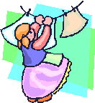
What type of figurative language is the following sentence?
Helga hangs handkerchiefs on the line.

Slide 12
ALLITERATION

Slide 13
What type of figurative language is the following sentence?
The boy could swim like a fish.

Slide 14
SIMILE

Slide 15
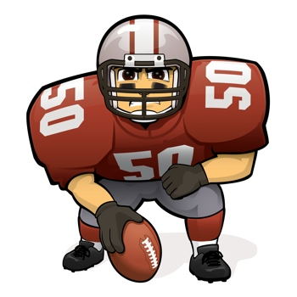
What type of figurative language is used in the following sentence?
John is a mountain
on the field.

Slide 16
Metaphor
Hyperbole

Slide 17
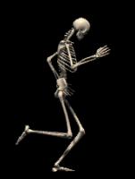
What type of figurative language is used in the following sentence?
Jimmy is so skinny, a skeleton looks fatter than he does!

Slide 18
HYPERBOLE

Slide 19
What type of figurative language is the following sentence?
The trees danced by the shore.

Slide 20
Personification

