Slide 1

Proposal for School Closure and Consolidation – Saint John West
November 2014

Slide 3
District Education Council (DEC) Priorities:
DEC meeting, August 21, 2013 – motion was made for the following priorities:
  New school K-5 in Quispamsis
  New school for west side of Saint John
  New school K-5 for Grand Bay
DEC meeting, April 9, 2014 – motion was re-affirmed and sent to Minister of Education and Early Childhood Development (EECD).

Slide 4
Policy 409 – Section 6.4 Determining a School’s Sustainability
6.4.2 A DEC must consider the following criteria when studying a school’s sustainability. This list does not preclude a DEC from considering other factors relevant to their local circumstances.
1. Low/declining enrolments:
2. Health and Safety:
3. Quality of Education Programs and Services:
4. Transportation:
5. Finances:
6. Impact on the local community:
7. Impact on other schools:
8. Economic development:

Slide 5
Policy 409 – Section 6.5 Public Consultation on School’s Sustainability
6.5.3 The DEC will ensure that affected persons:
are provided with information relevant to the proposal;
have adequate time to consider the information provided; and,
have adequate time and opportunity to make a presentation to the DEC (i.e. let their views be known either in writing or orally) and are heard impartially at an open DEC meeting.

Slide 6
Policy 409 – Section 6.5 Public Consultation on School’s Sustainability
6.5.4 There will be a minimum of three public DEC meetings on the possible closure – one meeting to inform the school community of the DECs’ intention and the steps to be followed, a second meeting to provide the opportunity to make a presentation (in writing or orally) and a final meeting to provide the public with the results of the consultation, including an account of the factors considered, as per section 6.4 of this policy, and resulting recommendation being submitted to the Minister.

Slide 7
Policy 409- School Infrastructure Planning
First Meeting – Inform the school community of the DEC’s intentions
Second Meeting – Provide school community opportunity to make a presentation
Final Meeting – Provide public with results of the consultation and factors considered, and resulting recommendation to the Minister

Slide 8
Policy 409 – Section 6.6
Ministerial Approval of a School Closure
6.6.1 A DEC will inform the Minister in writing of a recommendation to close a school, following the public consultation process.
6.6.3 The Minister shall normally respond to a recommendation to close a school within a period of time no less than 30 days and not exceeding 60 days.

Slide 9
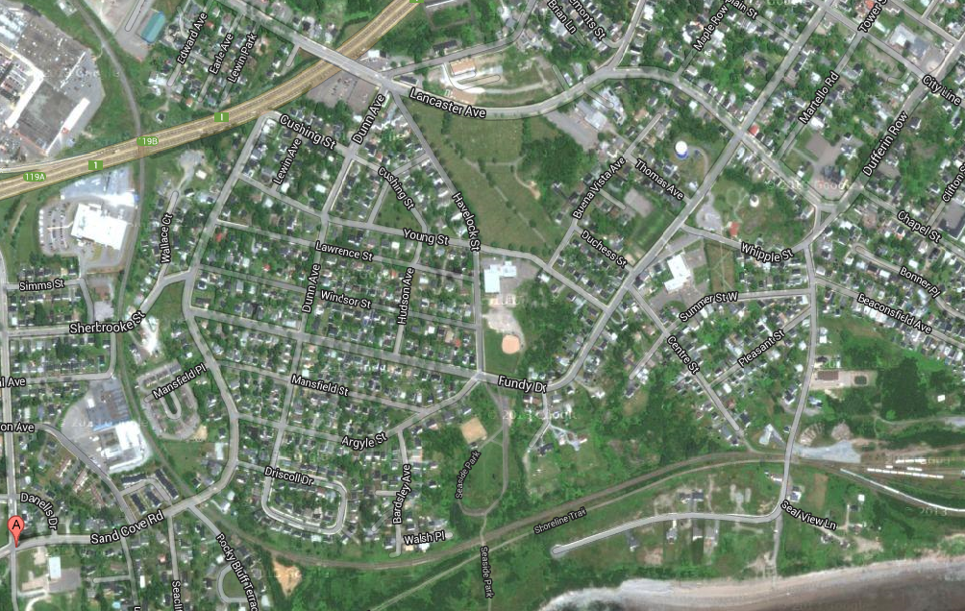
St. Patrick’s
Beaconsfield
Havelock
Seawood

Slide 10
St. Patrick’s School - Background
K-5 School owned by the Diocese
Built in1924, gym added in 1959 and new wing added in 1964
Enrolment declined by 45% since 1997
Max capacity for St. Patrick’s is 459 students
Infrastructure concerns led to the school closure in fall 2014
Estimated cost of repairs is $5.7 million
STAFFING:
Description FTE’s (Full Time Equivalents)
Teacher FTE’s 13.70*
Clerical Staff 1.00
Custodial 1.50
EA’s/School Intervention Worker 11.83
Community Schools Coordinator 1.00
Total 29.03
* (including admin.)

Slide 11
St. Pat’s
Annual Operating Costs 2013/14:
Light & power $15,446
Heating fuel 38,180
Minor repairs 3,770
Sewage & water 18,851
Garbage removal 3,545
School lease 135,042
Total $214,834

Slide 12
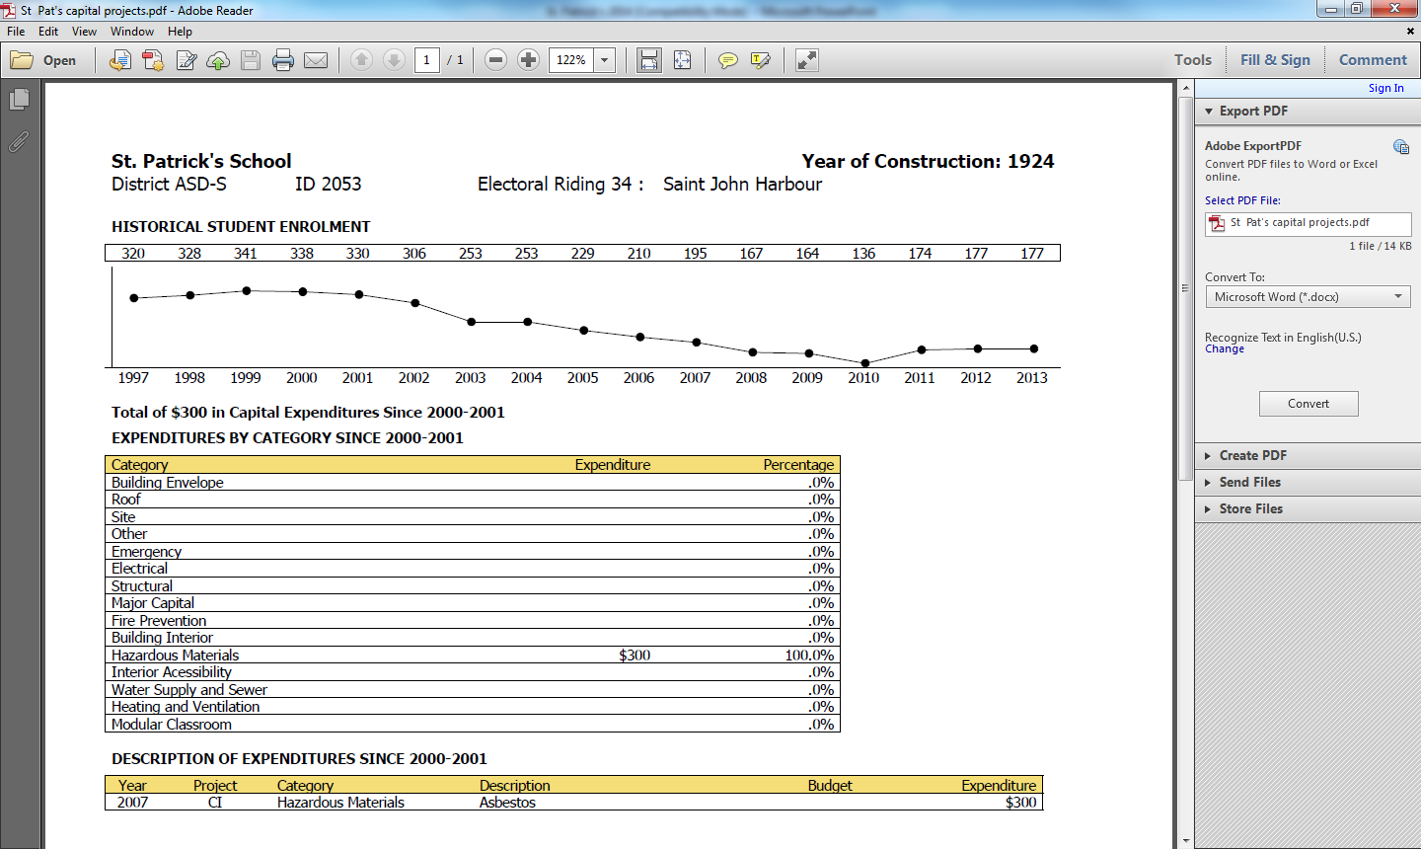

Slide 13
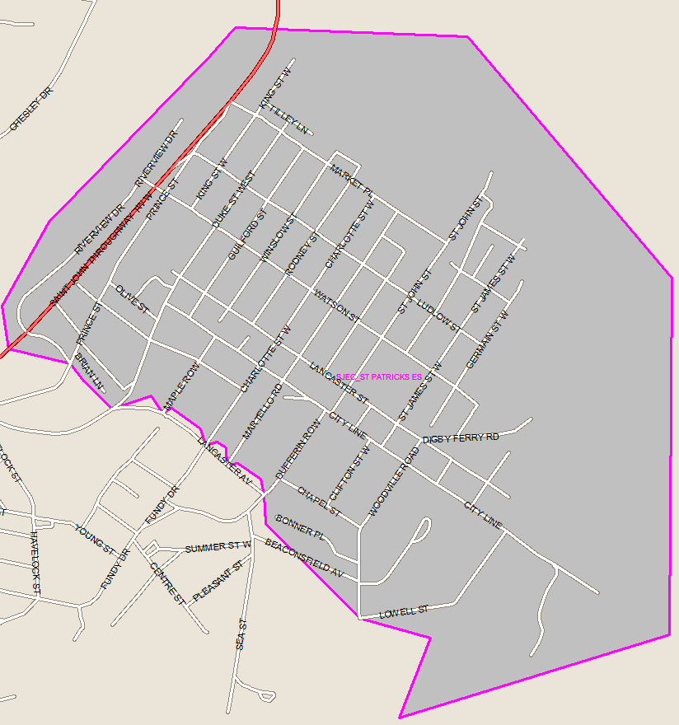

Slide 14
Havelock School - Background
Constructed in 1966
Grade levels – K-5 English and 3-5 French Immersion
Enrolment peaked in 2005, declined by 33% since then
Max capacity for Havelock is 288 students
12 classrooms, plus gym and computer room
Has playground and ball field
No handicapped accessibility
Havelock students continue onto Beaconsfield for middle school or Barnhill for late French Immersion

Slide 15
Havelock Staffing
Description FTE’s
Teacher FTE’s 13.20*
Clerical Staff 1.00
Custodial 2.00
EA’s/School Intervention Worker 8.00
Total 24.20
* (including admin., guidance, etc.)

Slide 16
Havelock
Annual Operating Costs 2013/14:
Light & power $28,208
Heating fuel 26,024
Minor repairs 10,696
Sewage & water 5,823
Garbage removal 2,429
Snowplowing 3,800
Total $76,980

Slide 17
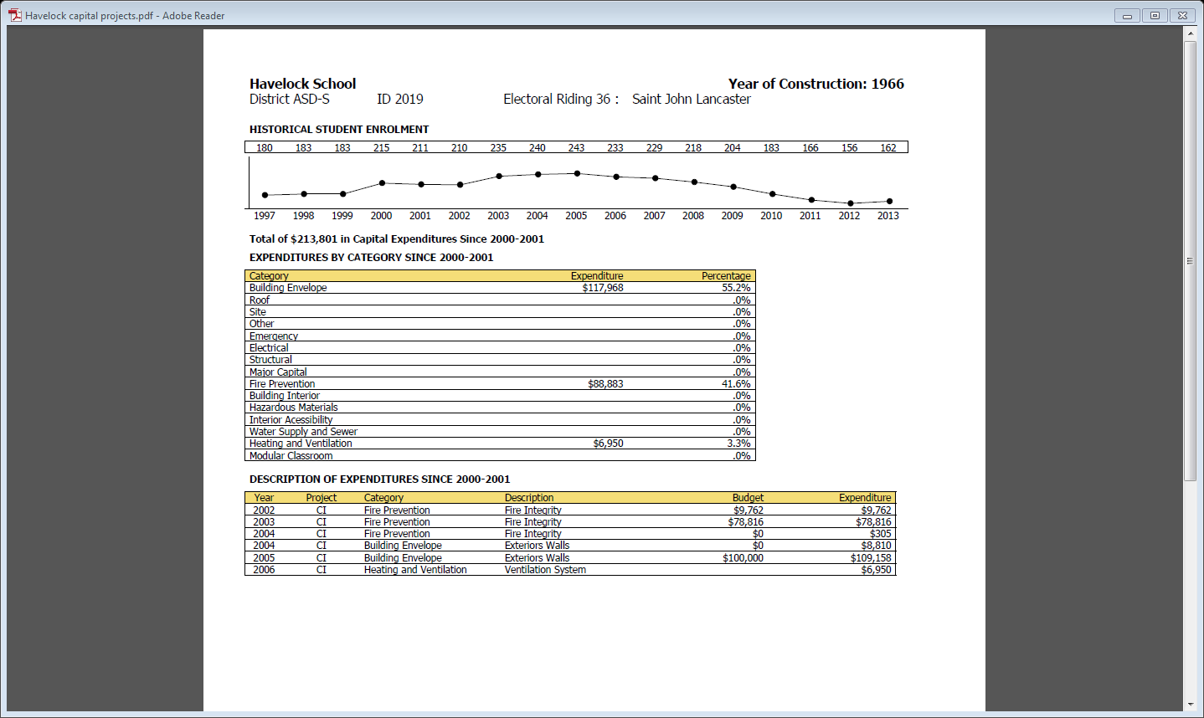

Slide 18
Havelock
Capital Improvement Projects Completed
Project Cost
Fire protection upgrade $88,678
Building envelope - exterior walls 117,968
Heating & ventilation – upgrade 6,950
Total $213,596

Slide 19
Havelock
Capital Improvement Projects Required
Project Cost
Site improvement – upgrade parking and add bus lane $150,000
Exterior windows & doors – replace all 150,000
Heating & ventilation – upgrade and controls added 350,000
Lift – interior accessibility, no existing elevator or ramp 140,000
Floors – replace floors in classroom and gym 40,000 Total $830,000

Slide 20
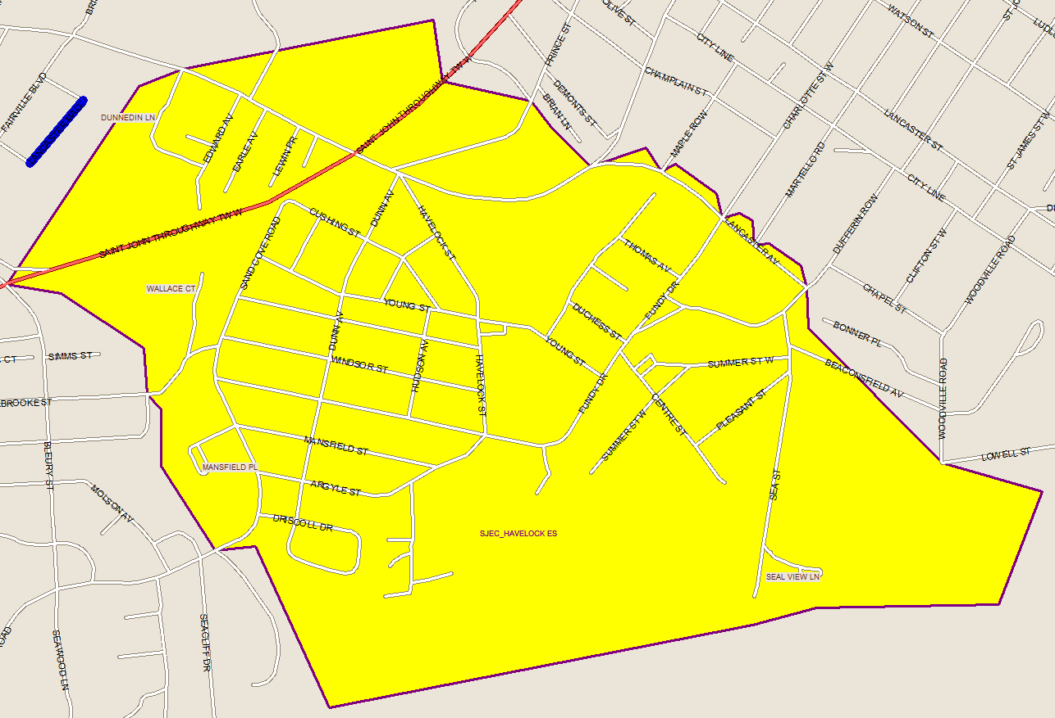

Slide 21
Seawood School - Background
School built in 1960
Grade levels – K-5 English
Enrolment peaked in 1998, declined by 11% since then
Max capacity for Seawood is 144 students
6 classrooms, plus multipurpose room
Has playground and ball field
No gym
No handicapped accessibility
Seawood students continue onto Beaconsfield for middle school or Barnhill for late French Immersion

Slide 22
Seawood Staffing
Description FTE’s
Teacher FTE’s 8.10*
Clerical Staff 1.00
Custodial 1.00
EA’s/School Intervention Worker 4.00
Total 14.10
* (including admin., guidance, leads, etc.)

Slide 23
Seawood Annual Operating Costs 2013/14:
Light & power $7,340
Heating fuel 11,909
Minor repairs 1,788
Sewage & water 5,763
Garbage removal 2,037
Total $28,837

Slide 24
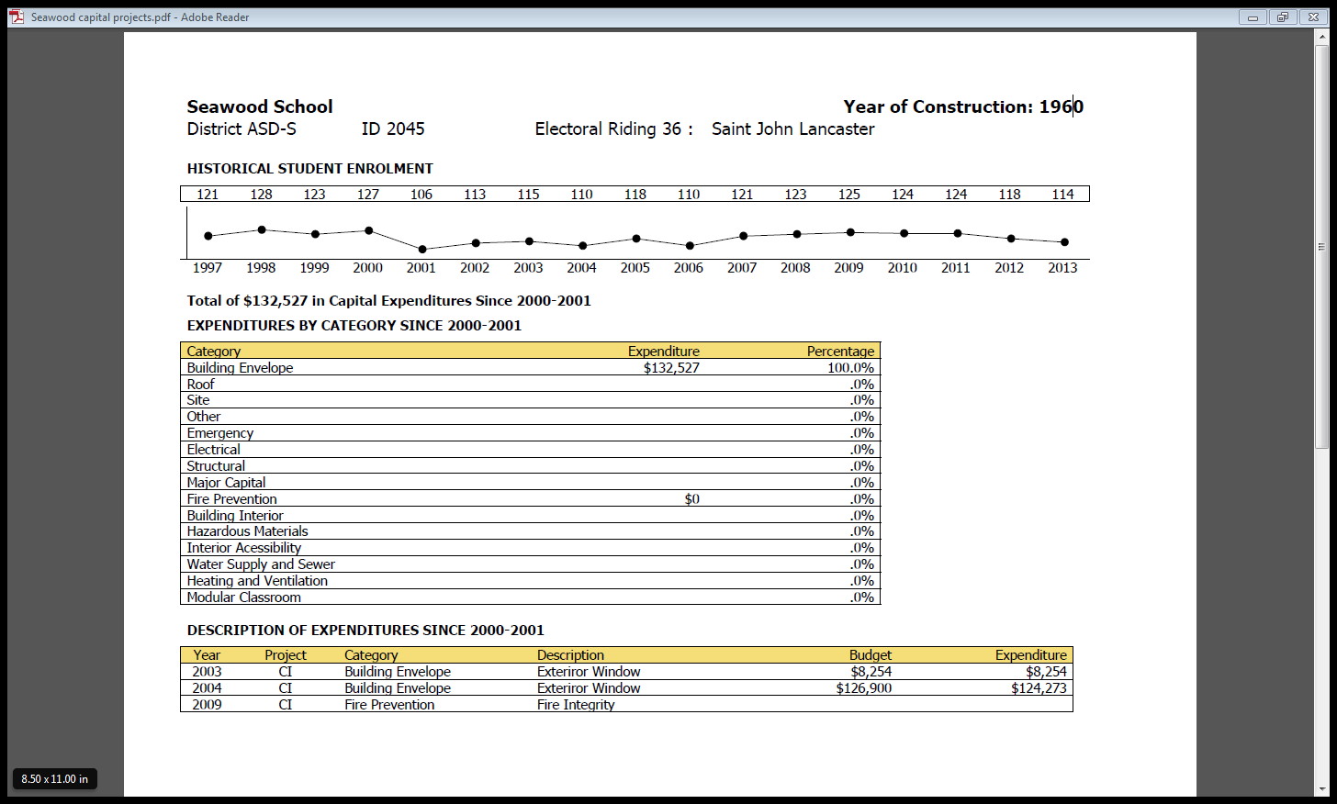

Slide 25
Seawood Capital Improvement Projects Completed
Project Cost
Building exterior – window panel replacement $132,527

Slide 26
Seawood Capital Improvement Projects Required
Project Cost
Building exterior – masonry & lintel replacement $75,000
Lift – interior accessibility, no existing elevator or ramp 90,000
Building exterior – window and door replacement 90,000
Ventilation - new ventilation system 180,000
Building exterior – widen driveway and paving 75,000
Floors – replace tiles in corridors and classrooms 25,000
Painting – hallway and classroom painting 30,000
Total $565,000

Slide 27
Proposal for School Closure and Consolidation
New 450 capacity K-5 school for the west side of Saint John
To replace St. Pat’s, Havelock and Seawood
School
Timeline – 3 to 4 years for completion
St. Pat’s students will remain at Havelock and Beaconsfield
Havelock and Seawood will remain open until new school is ready

Slide 28
Saint John West Has Limited Space Suitable For New School Construction
St. Patrick’s
610m
310m
Beaconsfield
Havelock
1.3km
Seawood
Source: Google Maps.
Notes:
An property further out from Seawood (1216 Sand Cove Road, the old Dr. Roberts property) was looked at to see if it was still provincially owned. It was determined that it is now commercially owned property.

Slide 29
Under EECD Current Planning Guidelines A New 450 Student K-5 Would Contain:
Kindergarten classrooms with in-floor heating & dedicated bathrooms
General instruction classrooms
Resource/special care classrooms
Student/project work areas for open/collaborate learning
Early childhood development classroom (pre-school room)
Music room
Performing arts/theatre classroom with bleachers for spectators
Double gymnasium with change rooms and ancillary spaces
Guidance/visiting professionals offices
Student government room
Multi-function classroom
Library/media centre
Cafeteria/kitchen/stage
Recycling room

Slide 30
Under EECD Current Planning Guidelines A New 450 Student K-5 Would Contain (cont.):
Dedicated administration space
Personnel centre with staff lounge
Playfield
Outdoor playground
Complete lock-down at the push of a button with the building separated into zones
After hours spaces (i.e. gym) are separated and can be locked from the general teaching spaces
Separate parent drop off and bus loading zones for safety
Natural lighting in all teaching areas
Improved air quality with operable windows in all occupied spaces
Alternate transportation support for staff and students (i.e. bike racks, car pool spaces)

Slide 31
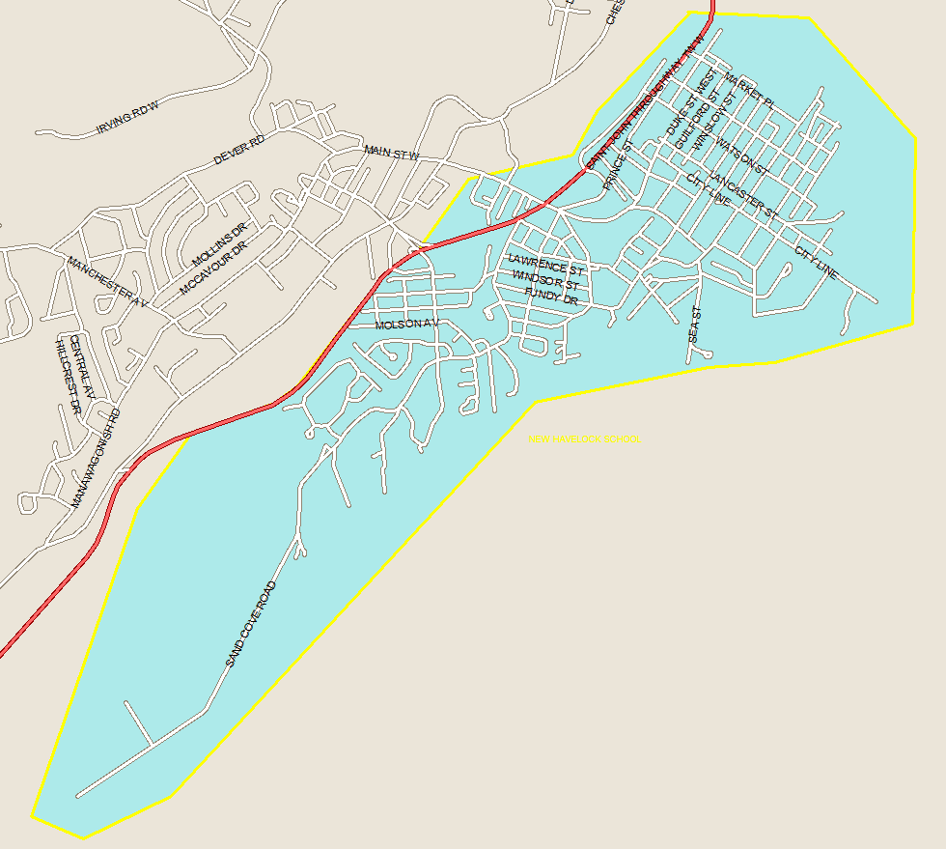

Slide 32
Thank You for Attending!
Next meeting -
This presentation will be posted to ASD-S website at: http://web1.nbed.nb.ca/sites/ASD-S/
Written feedback can be submitted:
via email to asds.schoolreview@gnb.ca
0r send a letter to the attention of: Robert Fowler, Chair District Education Council 490 Woodward Avenue Saint John, NB E2K 5N3

