Slide 1



Everyone at their best
Learning French as a Second Language
In New Brunswick, all students have an opportunity to learn French.
Notes:
Welcome to this presentation on New Brunswick French second language programs. The information will help you know the options you have for helping your child learn French.

Slide 2
French Second Language (FSL) Programs
French Immersion Program Entry Points
  Grade 1 (Early Immersion)
  Grade 6 (Late Immersion)
English Prime with Intensive French Program
  K to Grade 3: French language and cultural learning experiences
  Grade 4: Pre-Intensive French
  Grade 5: Intensive French
  Grades 6 through 12: Post-Intensive French
French Learning Opportunities for Rural Areas:
  Currently a pilot program in K-3
  Offered in rural areas without access to immersion.
  Note: There are eleven sites piloting a program for the early grades in rural schools with no access to French Immersion.
Notes:
There are multiple programs to learn French in New Brunswick:
Where circumstances warrant, students may enter French Immersion in Grade 1 and until September 2018, Grade 3.. As of September 2019, the only early entry point is Grade 1. There is another French Immersion entry point at Grade 6, if circumstances warrant.
Pre-intensive, Intensive and Post-Intensive French is offered in all schools for English Prime students. As well, all students in the primary grades participate in French language and cultural learning experiences to support positive attitudes and introduce some simple French vocabulary.
Currently, eleven schools rural schools are piloting a new elementary French program in regions without access to an early immersion entry point.
For all programs, French is compulsory until the end of Grade 10. In Grades 11 and 12, there are additional opportunities to build French Language skills.

Slide 3
French Immersion Overview
Subjects taught in French
Most subjects are taught in French: Literacy, Social Studies, Math and Science
Specialties (Art, Music, Physical Education, etc.) may be taught in French
Hours of French instruction
Grades 1 and 2:
Grades 3 to 5:
Grades 6 to 8:
Grades 9 and 10:
Grades 11 and 12:
90%
80%
70%
50%
25%
Notes:
In the French Immersion program, most subjects are taught in French; this typically includes Literacy, Social Studies, Math, and Sciences.
Other subject areas are also included, according to the number of hours needed to complete program requirements.
The total hours of French instruction depends on the grade level.

Slide 4
French Immersion Overview
Language proficiency targets
Each program has its own language proficiency targets in the areas of reading, writing, and oral proficiency
Program availability
Depends on such factors as student enrollment (see Policy 309)
French Immersion and Inclusion
French Immersion is an option for all learners
Notes:
Each FSL program has its own language proficiency targets describing how well learners are expected to perform in the areas of reading, writing, and oral proficiency. It is important to recognize that language learning is a lifelong pursuit rather than a performance level rating at high school graduation.
Students will strive to reach these language goals. They are provided with opportunities to use the language in various contexts.
French Immersion program availability depends on student enrollment (and sustainability of the program). Early registration will support district planning according to policy 309. Students are encouraged to register within the designated dates as this supports district planning.
There will be no waiting lists to register in a French Immersion program.

Slide 5



Grade 1 French Immersion
Grade 1 entry to FI was successfully introduced in September 2017 and will be the only early entry point in September 2019
Program designed for early learners
Emphasis on oral language in all subjects, followed by learning to read and write in French from the beginning of the program
Language is modelled; teachers support students as they learn the new language at their own pace
Based on most current research
Grade 2 French Immersion was implemented in September 2018
Notes:
In the Grade 1 French Immersion program, children will learn language through a literacy based approach. They will develop skills by exploring familiar topics of personal interest.
Teachers will model the language and support young learners as they acquire French through authentic language experiences. The interactive program uses music, poems, games, and educational play.

Slide 6

Grade 1 French Immersion Program Overview
90% of instruction is in French in Grades 1 and 2
80% of instruction is in French in Grades 3 to 5
English Language Arts introduced in Grade 3
Curriculum will be updated to reflect the new entry point
Notes:
In the new Early French Immersion Program, 90% or more of the instructional day is in French in grades 1 and 2. In grades 3 to 5, 80% of the day is in French.
English Language Arts will be introduced in Grade 3.

Slide 7

Transition period
There is a transition period when learning a new language. Here are the different emotional steps that your child is likely to experience:
It is important to listen to your child and to remind them that it takes patience, and it is a normal process. Maintaining a positive attitude is paramount. After a period of about 3 months, you will see progress, growth, and less frustration.

Slide 8


Grade 6 Late French Immersion
French instruction: 70% Grades 6 through 8
Literacy skills are developed through both French Immersion Language Arts and English Language Arts
There is an emphasis on oral language in all subjects, followed by learning to read and write in French from the beginning of the program
Language is modelled; teachers support students as they gradually learn new concepts in their second language
The Late FI curriculum has been recently updated
Notes:
The Late French Immersion program starts in Grade 6.
The elementary school second language experiences, including intensive French, will prepare the learners for the grade 6 entry point.
70% of their instruction will be in French from Grades 6 – 8.
Teachers will model the language to support students success in acquiring French as a second language, through French Immersion Language Arts and various subjects.
To maximize learning, students continue French Immersion at the high school level.

Slide 9

High School French Immersion
French instruction:
    50% in Grades 9 and 10 (10 courses total)
    25% in Grades 11 and 12 (5 courses total)
  The following online courses are now offered:
      FSL Law
      FSL Environmental Science
      FSL Writing
      FSL Tourism
      FSL Co-op Education
These courses are open to Post Intensive French students in grades 11 and 12.
Notes:
In Grades 9 and 10, 50% of courses are offered in French.
In order to develop a strong foundation and confidence in French, students must select a total of at least 5 French courses in Grades 11 and 12.
Immersion students are encouraged to remain in the program until Grade 12.
To ensure a strong program for all schools, the Department of Education and Early Childhood Development has committed to expanding the online offerings of French high school courses.
Students’ oral proficiency is tested at the end of Grade 12.

Slide 10


English Prime Program Overview
French Language and Cultural Experiences K-3
Subjects taught mostly in English with time for learning French
French compulsory from Grades 4-10 and offered in all schools in Grades 11-12
Intensive 5 month block usually offered in Grade 5
At Grade 6, students may enroll in the late immersion program where available
Notes:
Students in the English Prime Program also have access to French Second Language Learning.
FLORA-Pilot
Starting in Kindergarten, the learning experiences introduce French language and culture through engaging activities.
For most students in English Prime, formal French instruction starts in Grade 4. In Grade 5, students learn French in an intensive 5 month block.
For the students in the 11 rural schools doing the FLORA pilot program, these students will have French from kindergarten through grade 3 for about 35 minutes per day.
French language learning is compulsory from Grades 4-10 and French courses are offered in all schools in Grades 11-12.

Slide 11
English Prime with Intensive French
All learners in English Prime will have the opportunity to have an enhanced experience in French through the Intensive block.
Learners will:
  speak, read, and write in French daily
  acquire basic language skills and foundational vocabulary
  learn to communicate in full sentences
  explore a variety of themes of interest (e.g., me, my family, food, clothing, leisure, activities – sports, music, etc.)
Notes:
The Intensive block offers learners an enhanced experience in French. Students’ oral proficiency results in this program are much improved as compared to the model previously offered.
Learners will:
speak, read, and write in French daily
acquire basic language skills and foundational vocabulary
learn to communicate in full sentences
explore a variety of themes of interest (such as my family, food, clothing, leisure, sports, music, etc.)
Research has shown the value of experiencing a concentrated period of language instruction to build confidence and a solid foundation for future language growth.

Slide 12
English Prime with Intensive French
Pre-Intensive French (Grade 4):
150 minutes per week in two or three blocks of time
Intensive French (Grade 5):
Intensive Block: Approximately 60% of the day (3 hours and 15 minutes daily)
Less Concentrated Block: 150 minutes per week in two or three blocks of time
Notes:
In Pre intensive French, students build initial skills such as speaking in full sentences, reading simple texts and writing short texts.
In Grade 5, there are 2 blocks: a 300 hour block and a 45 hour block.
The intensive block uses a literacy based approach to develop students capacity to speak, read and write in French. 60% of the day is in French. In Grade 5, some subject areas are compacted and instructed during the non-intensive block.
If there a question about combined classes:
Grade 4/5 Intensive Classes
Based on enrolment numbers
Grade 4 students would not take Pre-Intensive French in Grade 4.
Students entering Grade 4 would be enrolled in Intensive French in both Grades 4 and 5.
A curriculum document and supporting resources have been developed for these classes.
Grade ¾ Pre Intensive Classes
Based on enrolment numbers
In place of the Grade 3 learning experiences, students in combined classes will have the opportunity to take Pre-Intensive French in both Grades 3 and 4 (150 minutes weekly)
Content will be adjusted accordingly

Slide 13
Intensive French School Year
5 Months | 5 Months
French Language Arts Development of literacy skills in French | English Language Arts Science (English) Social Studies (English) Well-Being (English)
 | French Language Arts
Mathematics (English)
Physical Education, Music, Art (English)
Notes:
This is a visual representation of the Intensive French Year. Usually, the Intensive French Block is in the first term of the year, occasionally it happens in the second term.

Slide 14
A Typical Day in the Intensive Block
Intensive Block | Non-Intensive Block
Warm-up (French) | English Language Arts
Message of the day: word work and sound work (French)
Oral (French) | Science (English)
Recess | Recess
Oral (French) | Social Studies (English)
Reading (French) | Well-Being (English)
Lunch | Lunch
Writing (French) | French
Math (English) | Math (English)
Physical Education, Music, Art (English) | Physical Education, Music, Art (English)
Notes:
This slide represents a typical day in both the Intensive and the non-Intensive blocks in a grade 5 year.

Slide 15
English Prime with Intensive French
Post-Intensive French Grades 6-8
    2-3 blocks per week (200 minutes) of French
    Focuses on further development of oral, reading, and writing communication skills
Post-Intensive French Grades 9-10
    90 hours per year (1 course per semester)
    Reading texts include greater complexity
    Writing tasks are more complex
Post-Intensive French Grades 11-12
    Available for all students
    May select additional courses in French
    Both courses are available online
Notes:
Students who learn French as a second language through the English Prime program will continue until Grade 10. From Grades 6 through 8, there are 200 minutes of instructional time in French per week.
Students will have the opportunity to improve their language skills and aim for higher oral, reading and writing performance. More complex learning will take place in Grades 9 and 10 when instructional time is 90 hours per year.
Students’ oral proficiency is tested at the end of Grade 12.
In Grades 11 and 12, students may choose post intensive French and French Second Language courses, including those that are offered online. The online courses for PIF 110 and 120 are well designed and allow for all students to access quality French instruction. These courses have a strong oral component and are interactive in nature. In grades 11 and 12, students may choose to enroll in any course offered in French. As well, there are five other online courses in French accessible from every high school.
Later in this presentation you will learn about some of the great opportunities available outside of instructional hours to enhance French Language learning.

Slide 16

Cultural and Language Learning Opportunities
Explore Program Pilot – for ages 13-15
New Brunswick or Québec – 3 weeks
Grades 9-10 Junior Summer Program
(Université de Moncton) - 4 weeks
Grades 9-10 Québec - New Brunswick Exchange Program
(Québec - New Brunswick) – 3 months away
Grades 11-12 Explore Program
(locations across Canada)
Notes:
Planning to participate in other exciting opportunities offered through government programs will maximize French language development. Doing a bilingual exchange or participating in summer programs can dramatically improve a student’s confidence and ability in French.
Information is accessible through the Education Government Website. Typically, applications for these programs must be completed by mid-February.

Slide 17

Electronic Language Portfolio
The electronic language portfolio will help the students track their progress in French.
The portfolio is being implemented from Grades 6 through 12, for all language learners.
Notes:
New Brunswick introduced a portfolio at middle and high school.
Learners can access the portfolio online and will be able to monitor and understand their own progress in French.
Eventually, all students from grade 6 through 12 will have language portfolios based on the Common European Framework of Reference. They will be able to display their competencies in the global environment.

Slide 18

French Second Language
Attitude and motivation contribute to success in attaining language targets.
The level of French that students attain by high school graduation will vary from one student to another, in the same way as performance varies in other subject areas.
Notes:
Regardless of the program, activities such as reading for pleasure or watching shows or films in French will help students develop their second language skills to maximum potential.
ervices such as Netflix or YouTube provide an easier access to French materials which will appeal to student interests. Strategies such as viewing in French with the support of French subtitles can really make a difference to your proficiency.

Slide 19
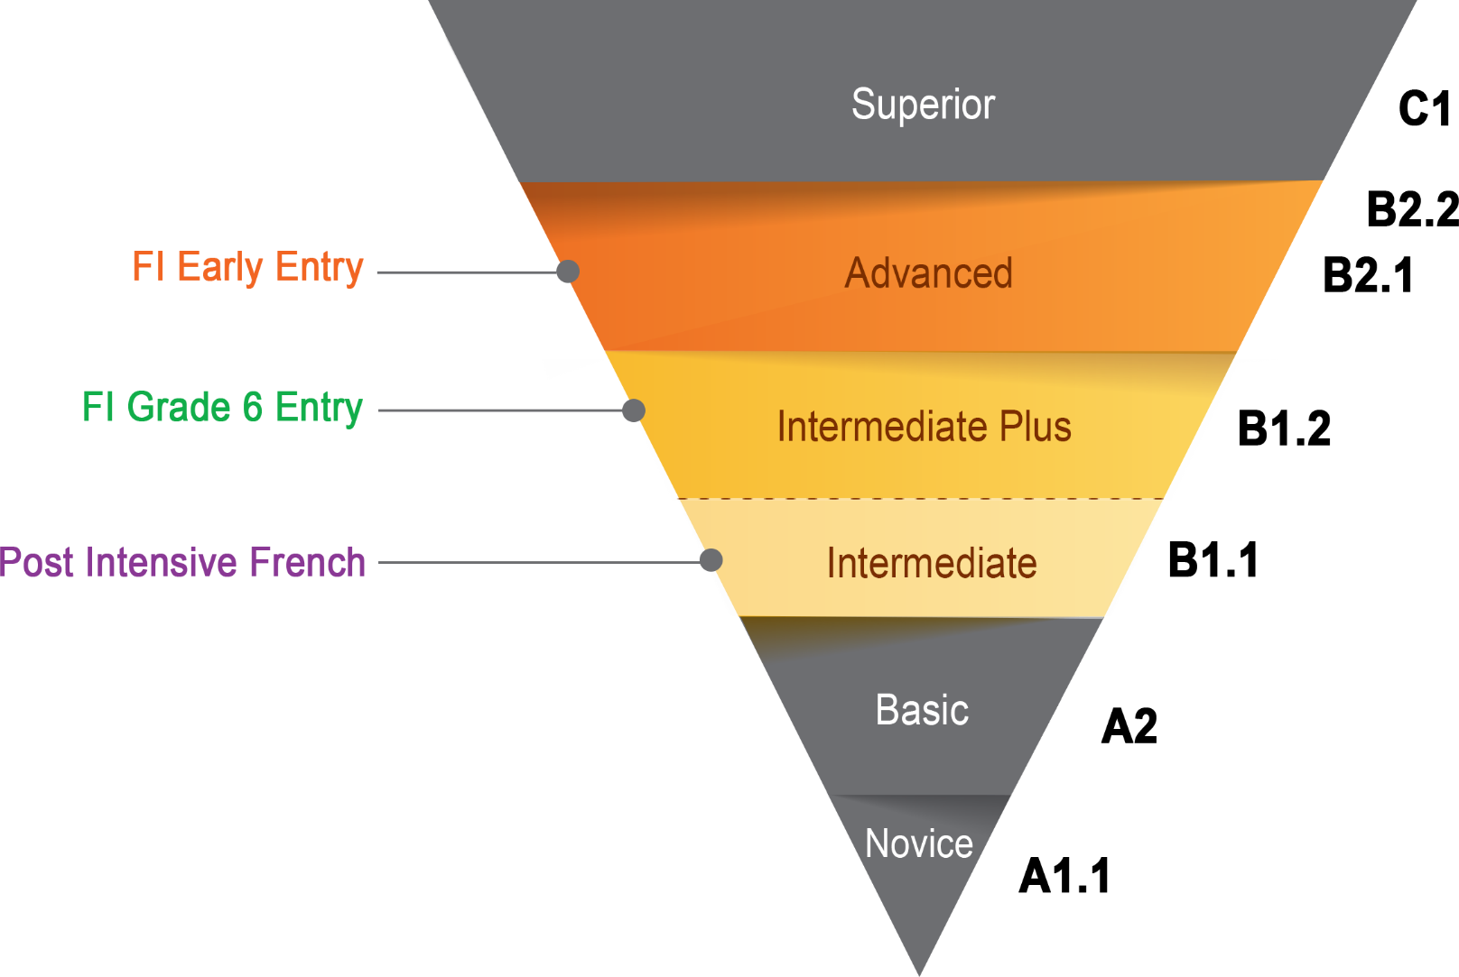

Oral Proficiency Levels
Notes:
There are performance targets for each French Second Language program. Student performance will depend upon various factors (e.g., personality, attitude, motivation, and French language opportunities). Not all students will reach the program target while some will exceed it. Click on the live links to hear examples of what to expect.
Please, refer to the brochure for more detailed descriptions of the levels of proficiency (OPI and CEFR).
NOTE: Mouse over each audio icon to reveal the audio control bar. Then, click on the play icon.

Slide 20




Everyone at their best!
For more information, visit:
Everyone at their best:
Learning French as a Second Language
Notes:
Thank you for your interest in New Brunswick’s French second language programs. If you have additional questions, you can contact your local school district.
http://www2.gnb.ca/content/gnb/en/departments/education/k12/content/promos/learning_french_as_a_second_language.html

Slide 21

ASD-S Contacts
Early Education of Childhood Development
http://www2.gnb.ca/content/gnb/en/departments/education/k12/content/promos/learning_french_as_a_second_language.html
District personnel to assist
Jillian.garey@nbed.nb.ca (Gr 9-12)
Martha.garey@nbed.nb.ca.ca (Gr 3-8)
Jacqueline.turnbull@nbed.nb.ca (Gr k-3)
Jennifer.keilty@nbed.nb.ca (Gr 6-8 Math & FSL projects)
Look for registration forms coming home with your child next week ☺

