Slide 1
D-Contract Positions
Completing the new online form
Click here for .pdf version

Slide 2
STEP 1
When the D-Contract position list is finalized, D-Recall Contract teachers will receive an email from Human Resources with a link to the online form.
The form is housed on the ONE site, therefore make sure you are logged into the ONE site when you are accessing the link.

Slide 3
STEP 2
Complete the required personal information in the first section of the form.
Your current school is the school in which your most recent position is in.
The Ed Centre will auto-populate.
If you do not have a French teaching level, leave it blank.

Slide 4
STEP 3
Attach your resume and any supporting documents.
You may upload one attachment only. Therefore, you must combine all of your documentation into one file. This might include resume, teaching certificate, transcripts,
cover letter, etc.
If you are unsure how to combine documents into one file, you may reach out to Technology Subject Area Coordinator Moira Sherwood (moira.sherwood@nbed.nb.ca), or Technology mentors, Stephen MacEachern (Stephen.MacEachern@nbed.nb.ca) or Maurice Savoie (Maurice.Savoie@nbed.nb.ca).
Be sure to title your attachment [Name Year]

Slide 5
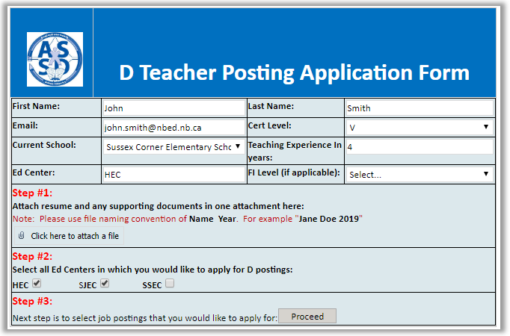
STEP 4
Select which Ed Centre you would like to see the job postings in.
You may select one, two, or all three Ed Centres.
Click ‘Proceed’ for the list of positions in the specified Ed Centres.

Slide 6
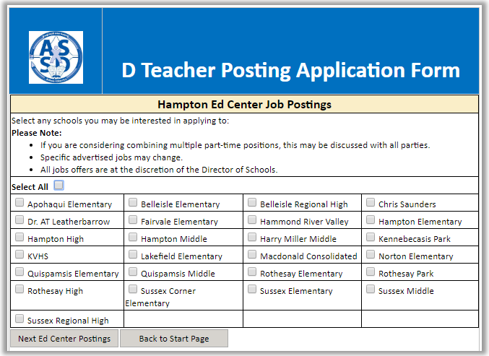
STEP 5
You will be brought next to a list of schools in the Ed Centre you selected.
If you selected more than one Ed Centre, they will appear on subsequent pages.
Select the schools for which you would like to see the advertised positions. You may choose any and as many schools as you wish. To select all schools in the Ed Centre, click “Select All.”

Slide 7
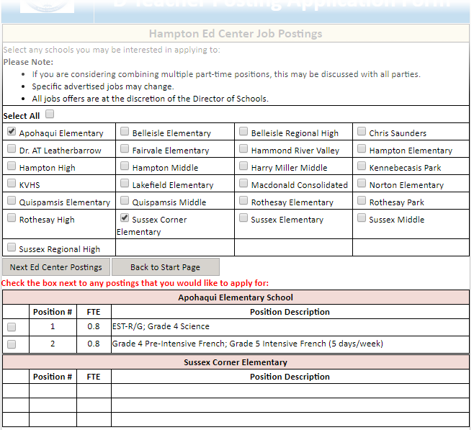
STEP 6
The job postings for the school you selected will appear at the bottom of the form.
In this example, only two schools were selected and both can be seen below.
If you select a school and there are no positions listed, as in this example, this means that school has no advertised positions.
EXAMPLE

Slide 8
STEP 7
Check the box next to the position(s) you wish to apply for, if any.
Click ‘Next Ed Centre Postings’ to move onto the next group of schools.
If you only selected to see postings in one Ed Centre, click the Finished-Submit button.
EXAMPLE

Slide 9
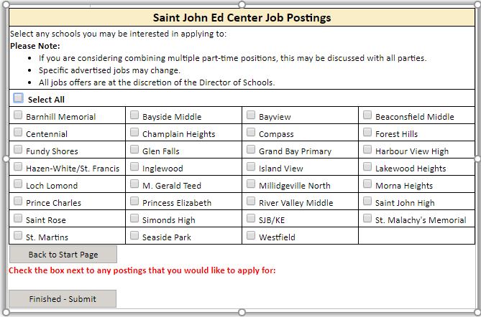
STEP 8
Repeat Steps 5, 6, and 7 to narrow down schools and click desired job positions.
When you are finished checking off all the jobs you wish to apply for, click ‘Finished-Submit.’

Slide 10
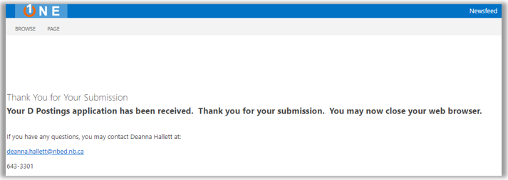
COMPLETE
Your application will then be sent to ASD-S Human Resources.
You will be directed to a confirmation page.

Slide 11
QUESTIONS
If you have any questions about your application please contact
Human Resource Officer Deanna Hallett at:
Deanna.hallett@nbed.nb.ca or
Director of Human Resources Susan Moffatt at:
Susan.Moffatt@nbed.nb.ca

