Slide 1

SSHS
S T S T E P H E N H I G H S C H O O L
High School Renewal
2023-2024 Course Selection
(For all graduates from 2026 and after.)

Slide 2
Note:
ch= credit hours
A one semester course = 4 ch
Required vs. Elective
Your choices are NOT final…there will be time to make changes.

Slide 3
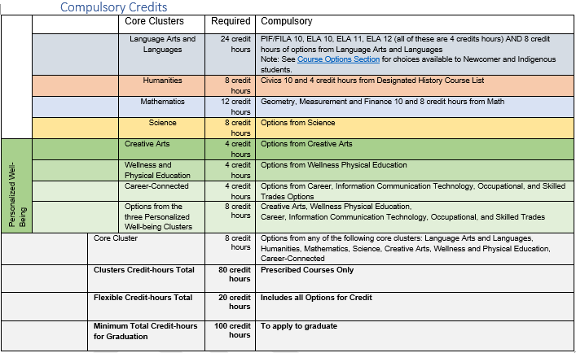
What courses will you need to graduate?

Slide 4
Languages & Literacies
Graduation Requirements:
24 Language and Literacies credit-hours
Successful completion of the English Language Proficiency Assessment (ELPA).
Required Course(s):
English Language Arts Foundations 10 AND Extended 10
PIF 10 is required for non-immersion students.
FILA 10 is required for immersion students

Slide 5
Languages & Literacies
French Immersion Note:
Students that acquire 40 credit-hours in French Immersion courses will receive a French Concentration on their transcript.
Students wishing to take fewer FI courses may do so and will still be eligible to take the OPI as long as they have taken FILA 11 and FILA 12. The OPI assesses their French language proficiency.

Slide 6
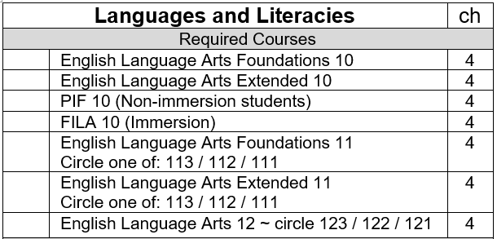
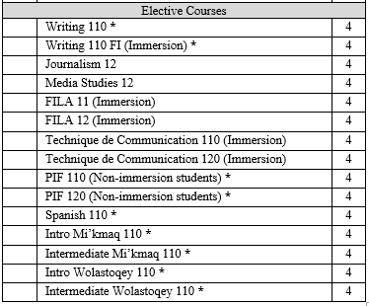
Languages & Literacies

Slide 7
Humanities
Graduation Requirements:
8 Humanities credit-hours
Required Course(s):
Civics 10
plus 4 credit-hours from one of the designated history courses.

Slide 8
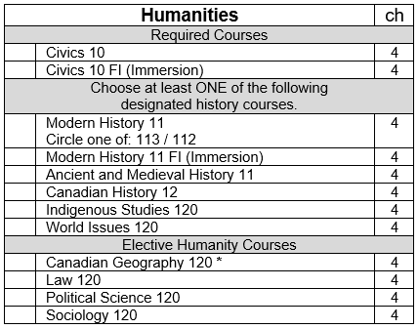
Humanities

Slide 9
Mathematics
Graduation Requirements:
12 Mathematics credit-hours
Required Course(s):
GMF 10 plus 8 credit-hours from elective courses.
Note:
NRF 10 is a prerequisite for Chemistry or Physics.
Foundations of Mathematics 110 is a pre-requisite for Foundations of Mathematics 120 and for all Calculus pathway courses.

Slide 10
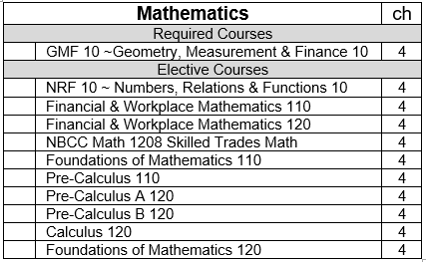
Mathematics

Slide 11
Science
Graduation Requirements:
8 Science credit-hours
Required Course(s):
Any 8 credit-hours from the following list
Note:
Science for Sustainable Societies 10 and NRF 10 are a prerequisite for Chemistry 112 or Physics 112.
Chemistry 112 is a prerequisite for Chemistry 122 and Physics 112 is a prerequisite for Physics 122.

Slide 12
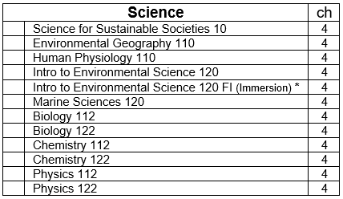
Science

Slide 13

Personalized
Well-Being
Creative Arts
Wellness and Physical Education
Career- Connected

Slide 14
Personalized Well-Being
Graduation Requirements:
4 Creative Arts credit-hours
4 Wellness and Physical Education credit-hours
4 Career-Connected credit-hours
8 Additional credit-hours from any of the three Personalized Well-Being Clusters
Note:
French Immersion students will choose ONE of Physical Education 10 FI or Career Pathway Design 10 FI.
Personal Interest Courses can be used for any of the three Personalized Well-Being Clusters.

Slide 15
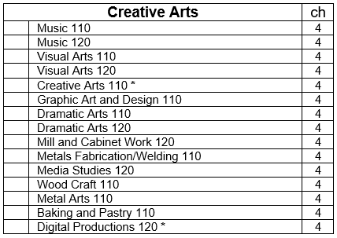
Creative Arts

Slide 16
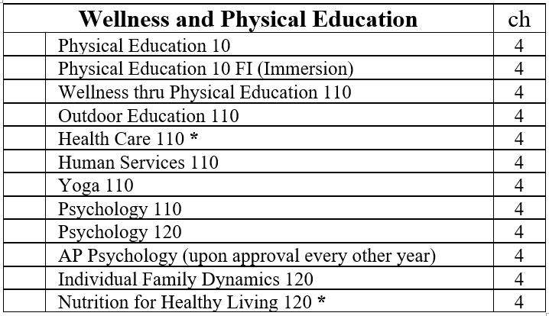
Wellness & Physical Education
 | Sport and Recreation Leadership 120 | 4

Slide 17
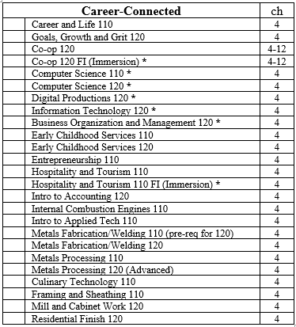
Career-Connected
 | Sport and Recreation Leadership 120 | 4

Slide 18
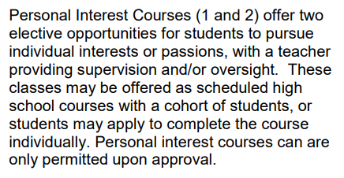

Personal Interest Courses

Slide 19

Online Courses
Note: Courses marked with an asterisk * are only available as online courses. To be a successful online student you must have a superior work ethic and time management skills.

Slide 20

Want to learn more about a course?
Hover over the hyperlinked course name on the course selection sheet to see the course description.
OR
Go to the SSHS website. Click the “Students” tab and find the “Course Calendar” option where you can see descriptions of each course.

Slide 21


Now count to see that you have:
10 courses with X and
2 courses listed as A (alternates).

