Slide 1

SSHS
High School Renewal
2024-2025 Course Selection
(Graduates from 2026 on)

Slide 2
Note:
ch= credit hours
a one semester course = 4 credit hours

Slide 3
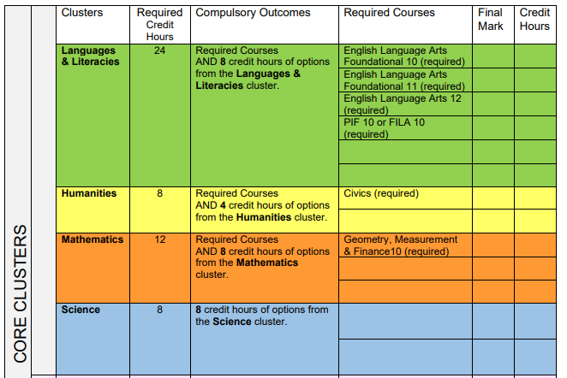
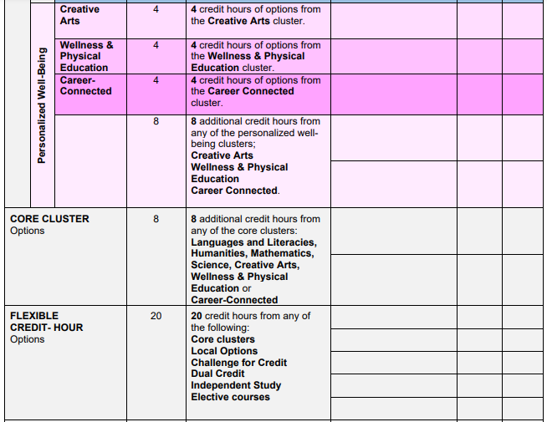
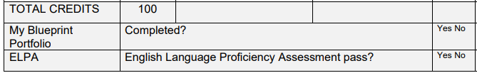
What courses will you need to graduate?
Refer to the Graduation Requirements Tracking Sheet.

Slide 4
Languages & Literacies
Graduation Requirements:
24 Language and Literacies credit-hours
Successful completion of the English Language Proficiency Assessment (ELPA).
Required Course(s):
English Language Arts Foundations 10
English Language Arts Foundations 11
English Language Arts 12
PIF 10 is required for non-immersion students
FILA 10 is required for immersion students

Slide 5
Languages & Literacies
Note:
English Language Arts EXTENDED 10 and EXTENDED 11 are both highly recommended for University prep students.
French Immersion Note:
Students that acquire 40 credit-hours in French Immersion courses will receive a French Concentration on their transcript.
Students wishing to take fewer FI courses may do so and will still be eligible to take the OPI as long as they have taken FILA 11 and FILA 12. The OPI assesses their French language proficiency level.

Slide 6
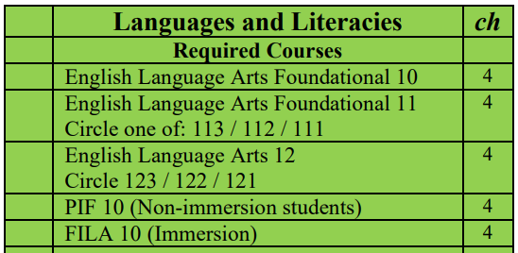
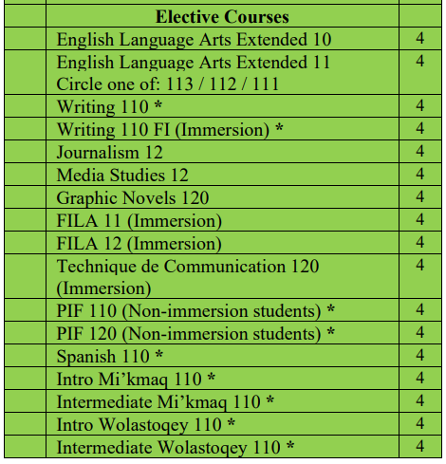
Languages & Literacies

Slide 7
Humanities
Graduation Requirements:
8 Humanities credit-hours
Required Course(s):
Civics
plus 4 credit-hours from one of the designated history courses

Slide 8
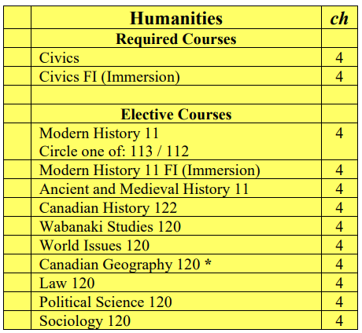
Humanities

Slide 9
Mathematics
Graduation Requirements:
12 Mathematics credit-hours
Required Course(s):
Geometry, Measurement & Finance 10 plus 8 credit-hours from elective courses.
Note:
Geometry, Measurement & Finance 10 is a prerequisite for Financial & Workplace Math 110. Students who take Financial & Workplace Math 110 will then take either Financial & Workplace Math 120 or NBCC Math 1208 Skilled Trades Math.
Numbers, Relations and Functions 10 Math is a prerequisite for Chemistry or Physics.
Foundations of Mathematics 110 is a pre-requisite for Foundations of Mathematics 120 and for all Calculus pathway courses.

Slide 10
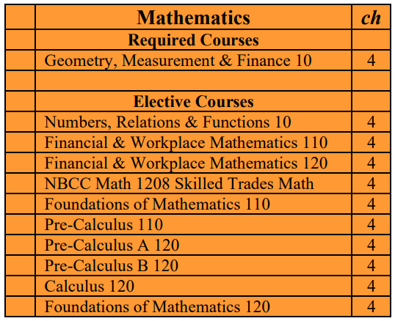
Mathematics

Slide 11
Science
Graduation Requirements:
8 Science credit-hours
Required Course(s):
Any 8 credit-hours from the Science list.
Note:
Science for Sustainable Societies 10 is highly recommended to take before Chemistry 112, Physics 112 or Biology 122.
Environmental Science 120 students must complete one other Grade 11 or 12 provincial Science course as a pre-requisite, as well as Foundations of Mathematics 110 as a pre- or corequisite
Science for Sustainable Societies 10 and Numbers, Relations and Functions 10 are strongly recommended for Chemistry 112, Physics 112 and Biology 122.
Chemistry 112 is a prerequisite for Chemistry 122and Physics 112 is a prerequisite for Physics 122.
Marine Sciences 120 can only be used as flexible credit hours and not as science credit hours.

Slide 12
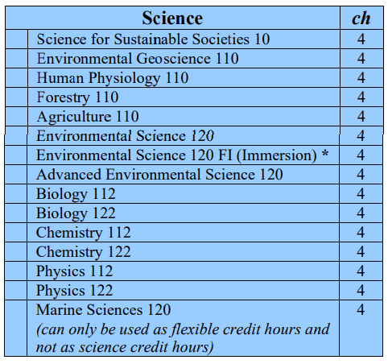
Science

Slide 13

Personalized
Well-Being
Creative Arts
Wellness and Physical Education
Career- Connected

Slide 14
Personalized Well-Being
Graduation Requirements:
4 Creative Arts credit-hours
4 Wellness and Physical Education credit-hours
4 Career-Connected credit-hours
8 Additional credit-hours from any of the three Personalized Well-Being Clusters
Note:
French Immersion students will choose ONE of Physical Education 10 FI or Career Pathway Design 10 FI.
Personal Interest Courses can be used for any of the three Personalized Well-Being Clusters.

Slide 15
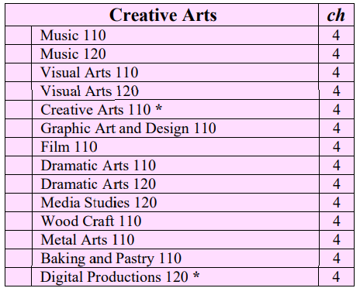
Creative Arts

Slide 16
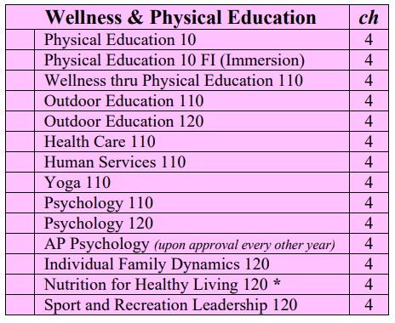
Wellness and Physical Education

Slide 17
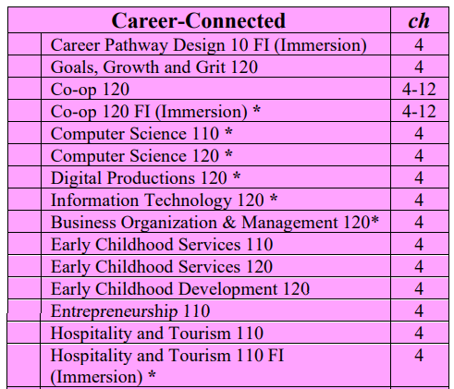
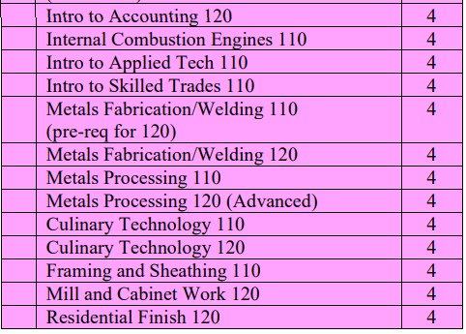
Career-Connected

Slide 18
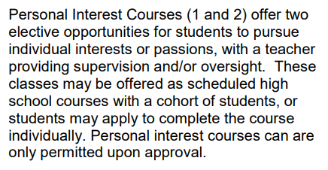

Personal Interest Courses

Slide 19

Online Courses
Note: Courses marked with an asterisk * are only available as online courses. To be a successful online student you must have a superior work ethic and time management skills.

Slide 20

Want to learn more about a course?
Hover over the hyperlinked course name on the course selection sheet to see the course description.
OR
Go to the SSHS website. Click the “Students” tab and find the “Course Calendar” option where you can see descriptions of each course.

Slide 21


Course Selection Sheet
Students need to count to see that they have:
10 courses with X and
2 courses listed as A (alternates).

