Slide 2
□ About QMS
□ What is Middle School?
□ Cougar Pride
□ Day 1 (Sept 8th)
- Becoming a Cougar

Slide 3
Quality Motivation Success
1986: Quispamsis Junior High School
1997: Renamed Quispamsis Middle School (QMS)
Mascot: Cougar
2019: Enrollment 544 (incl. 185 Gr 6)
English Prime 209
Early FI 278
Late FI 57
Mission: QMS will provide a Quality learning environment in which all students are Motivated to achieve Success.
Vision: QMS is committed to improved achievement and personal growth in an inclusive, positive learning environment.

Slide 4
Middle School 101
Smaller communities for learning (PLCs) within a larger school building
Core academic program for all learners with curriculum subject specialists:
Math [5 classes / week]
English Language Arts (ELA) [5 or 3 classes / week]
French Immersion Language Arts (FILA) or Post Intensive French (PIF) [5 or 3 classes / week]
Science [3 classes / week]
Social Studies [3 classes / week]
Personal Development & Career Planning (PDCP) & Health [1 class / week]
Physical Education (PE) [2 classes / week]
Practical Related Arts (PRA) [Technology; Music; and Art] [3 classes / week]
Teachers who are experts at teaching young adolescents
Global Competencies & Citizenship
Pro-social Behaviour

Slide 5
Your Keys to Success

Slide 6
Daily Schedule
8:20 Grade 6 Enter the Building (via end door)
8:20 Grade 7/8 Enter the Building (via main doors)
8:30 – 8:40 Homeroom (O Canada & Announcements)
8:40 – 9:40 Period 1
9:40 – 9:50 Break
9:50 – 10:50 Period 2
10:50 – 11:50 Period 3
11:50 – 12:40 Lunch
12:40 – 1:40 Period 4
1:40 – 2:40 Period 5 (*During first 4 weeks of school Grade 6 Homeroom)
2:40 Dismissal

Slide 7
Lockers
Each student will be assigned a locker, but remember that these are “rentals” for one year
Combination locks will be provided as part of your Student Fee
Anything you place on, or in, the locker must be removed at the end of the year (or before)
Lockers are like your room; they must be kept clean
Students can go to their lockers:
Upon arrival to prepare for Period 1
At break to prepare for Periods 2 and 3
After lunch to prepare for Periods 4 and 5
At the end of the day

Slide 8
Student Fees
Each student will be given a t-shirt and lock as part of your Student Fee
Students will be shown how to use the lock on Day 1
FI Students pay a one time $12 fee for our French Grammar Book
Athletic teams charge a fee based on the sport
Musical instruments for band have a rental fee

Slide 9
Show your Cougar PRIDE
 | Class | Common Areas | Community
P Prepared | I am prepared when I … - have my supplies (books, pen/pencil, etc.). - arrive on time. - attend all classes. | I am prepared when I … - have my supplies (lunch, money, clothing, etc.). - have a plan/destination. - arrive on time. | I am prepared when I … - have my supplies (equipment, clothing, etc.). - arrive on time.
R Respect | I show respect when I … - exercise kindness. - follow classroom procedures. - use materials properly. | I show respect when I … - exercise kindness. - leave an area cleaner than the way I found it. - follow procedures (hands to self, feet to self, line up, etc.). | I show respect when I … - exercise kindness. - use positive words and actions. - use appropriate volume/tone/language.
I Involved | I am involved when I … - participate and listen actively. - share ideas. - am a valuable team member. | I am involved when I … - speak up. - support school events. - join in. | I am involved when I … - help others. - am a role model. - volunteer.
D Determined | I show determination when I … - persevere. - seek / accept assistance. - set goals. | I show determination when I … - use time wisely. - interact with purpose. | I show determination when I … - work with others. - make a positive difference.
E Effort | I display effort when I … - give 100% and produce quality work. - accept a challenge. - know attendance matters. | I display effort when I … - own my actions. - encourage others. - problem solve. | I display effort when I … - support community needs. - represent the school with PRIDE at all times.

Slide 10
Celebrate @ QMS
We strongly encourage our students to get involved as much as possible in school life.
QMS celebrates academic, social, musical, artistic, and athletic successes throughout the year.
Each student is challenged to set a goal to be involved in at least one activity within the school.

Slide 11
Show your Cougar PRIDE

Slide 14
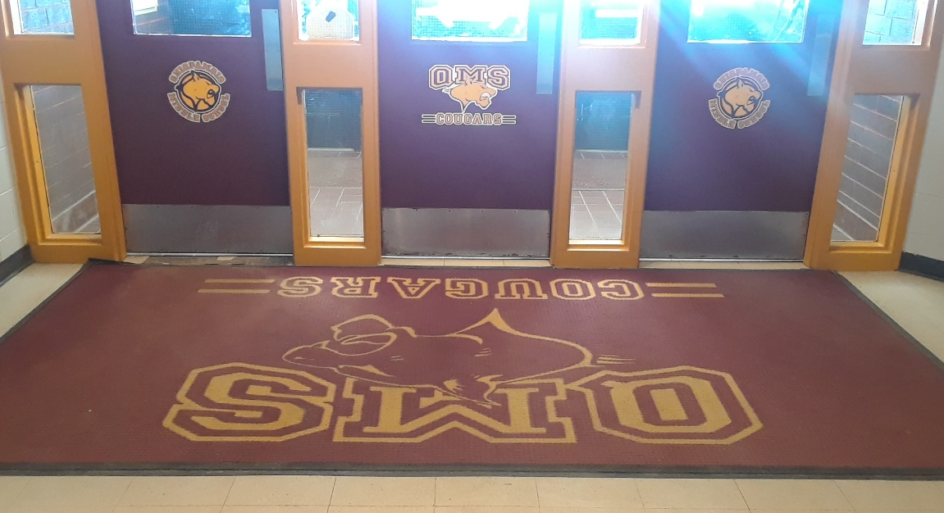
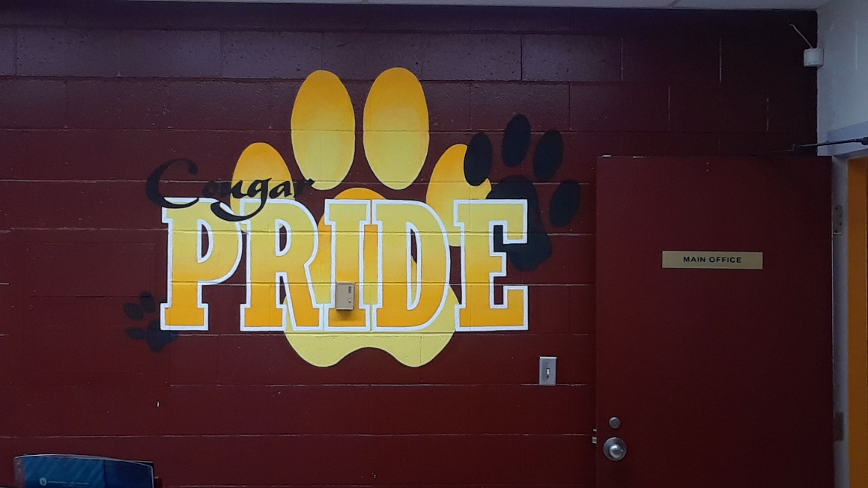
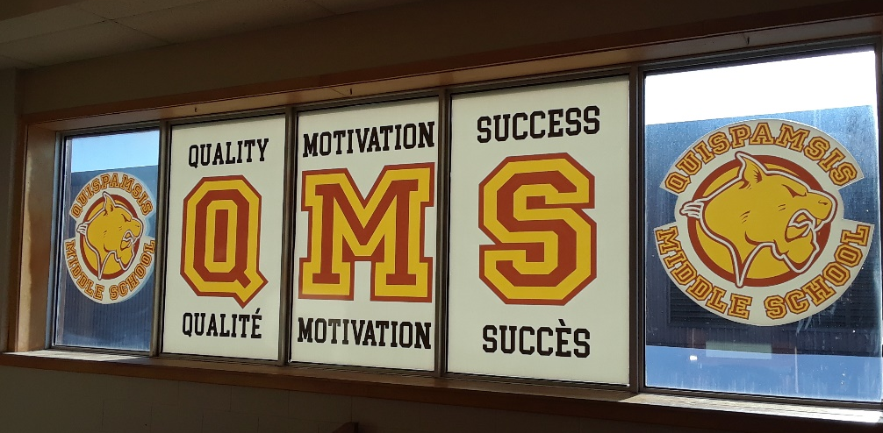
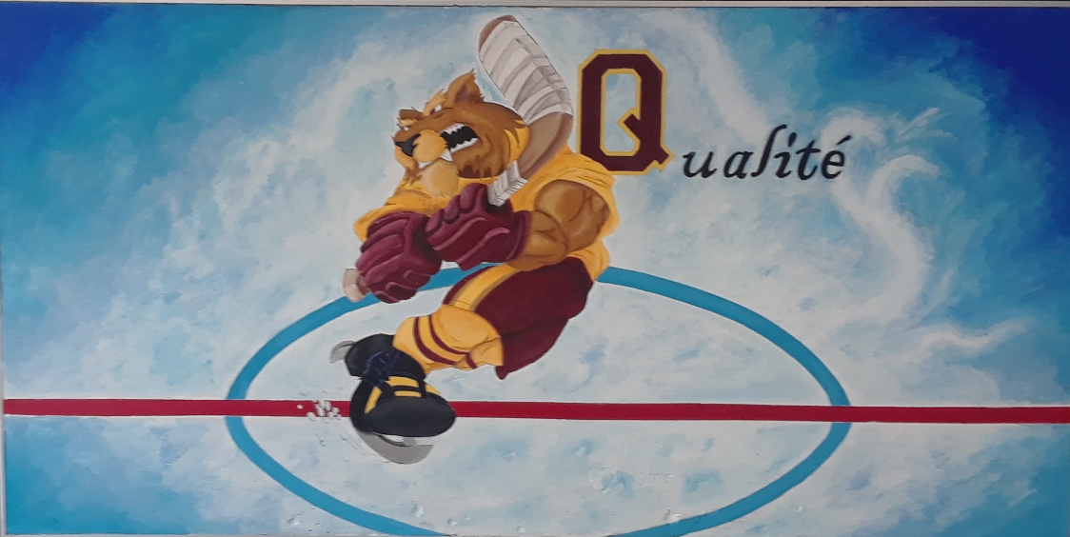

Slide 15
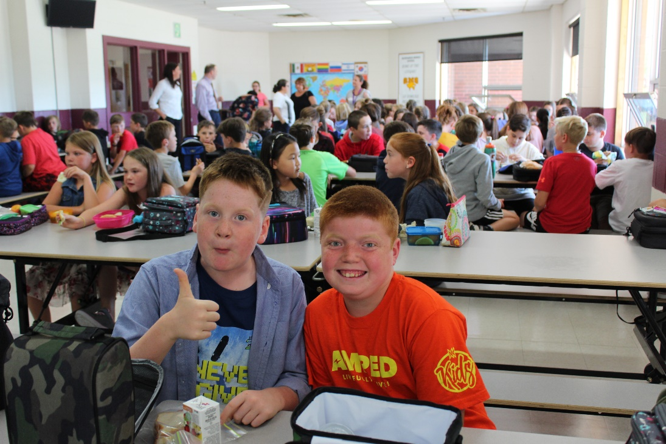
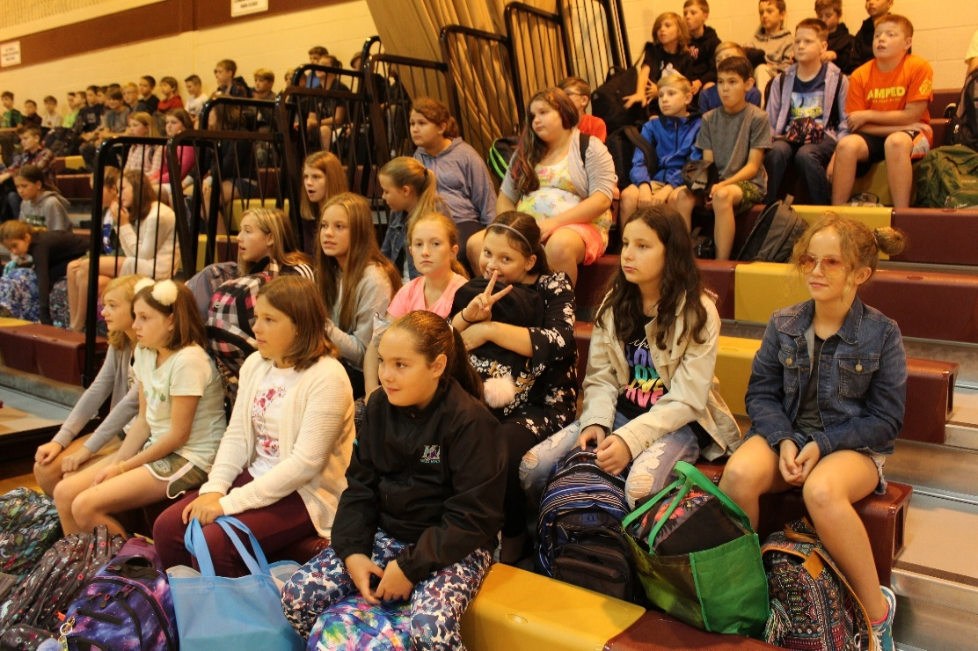
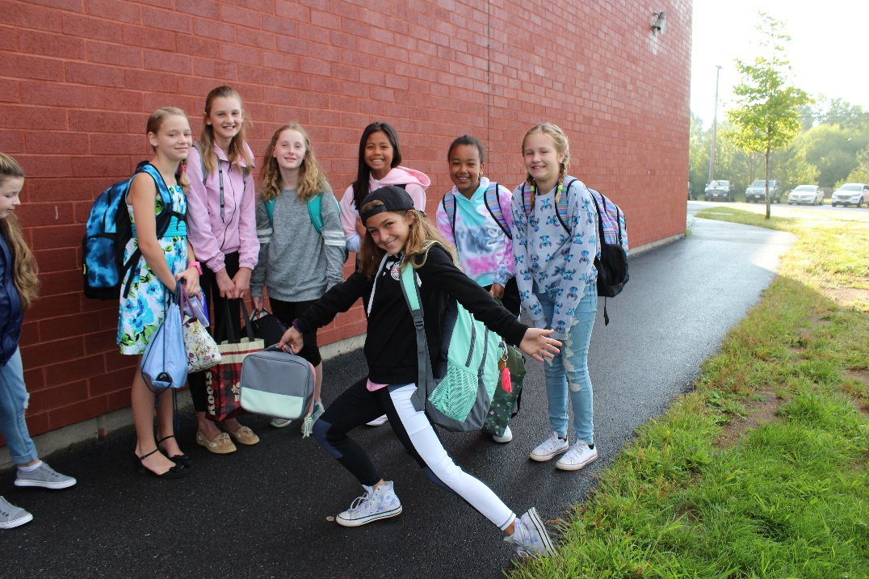
FIRST DAY

Slide 16
COUGAR CAMP

Slide 17
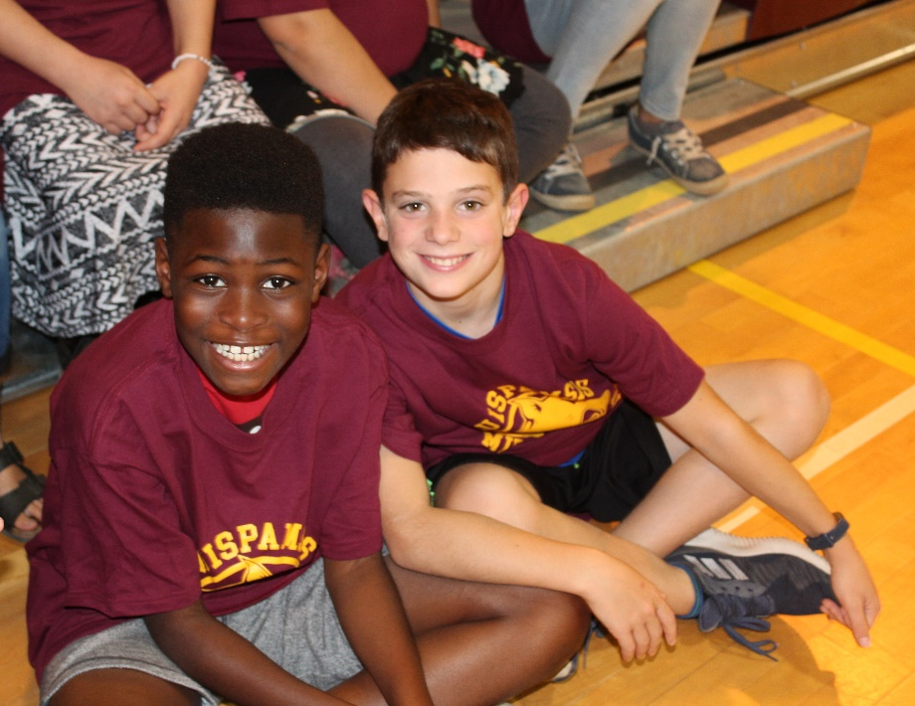
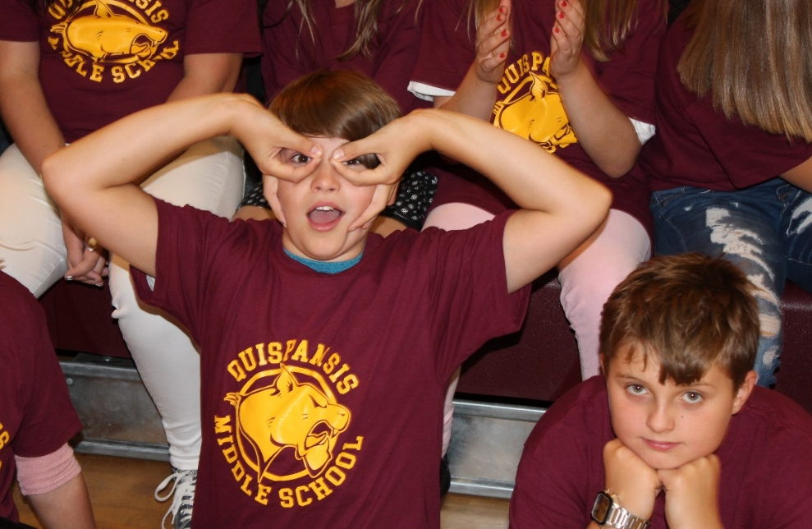

Slide 19
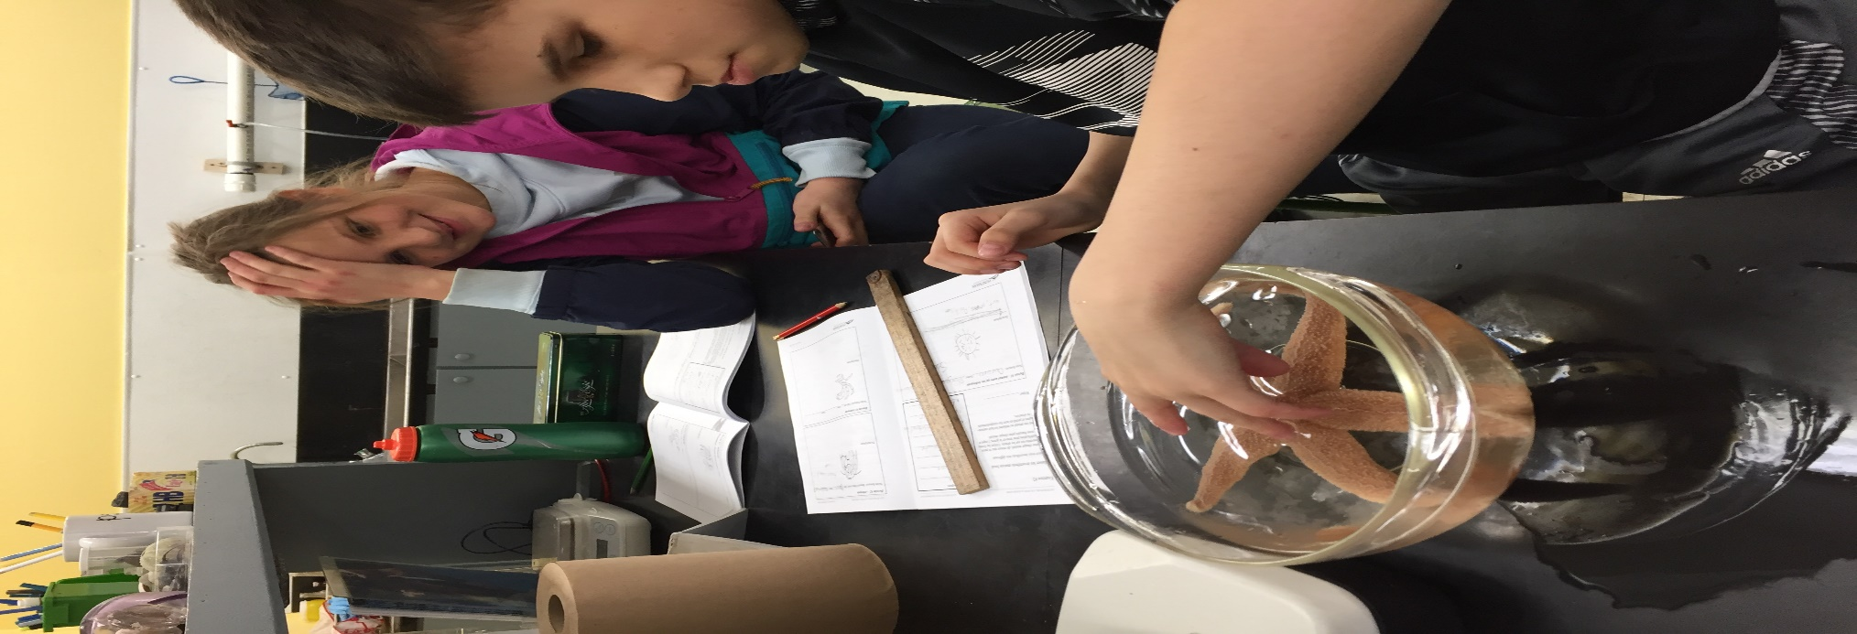
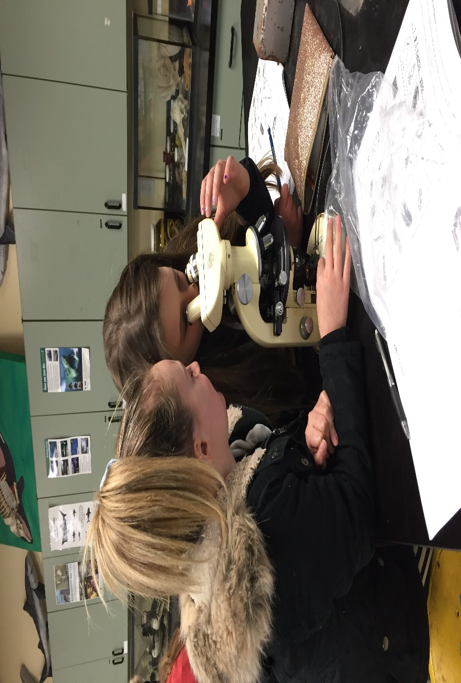
GRADE 6
HUNTSMAN
FIELDTRIP

Slide 20
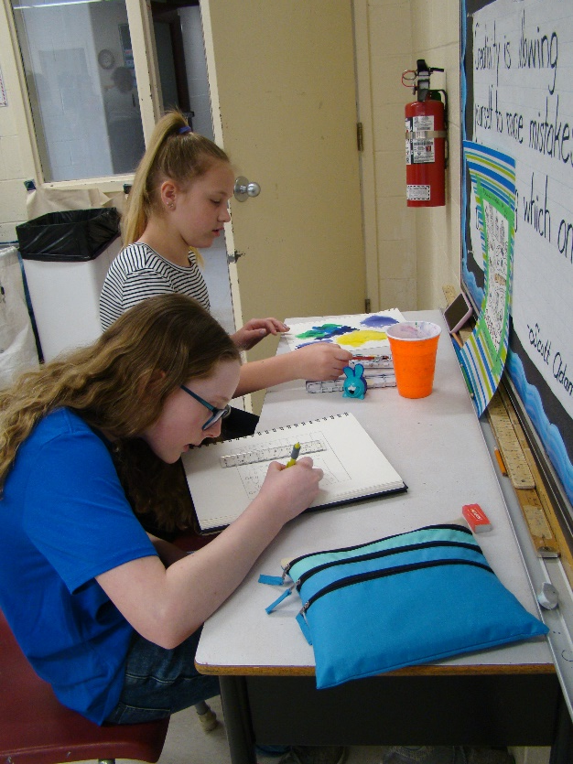
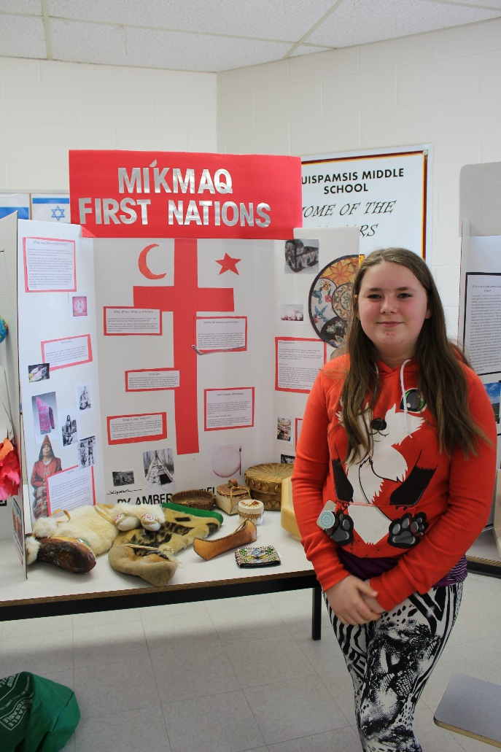
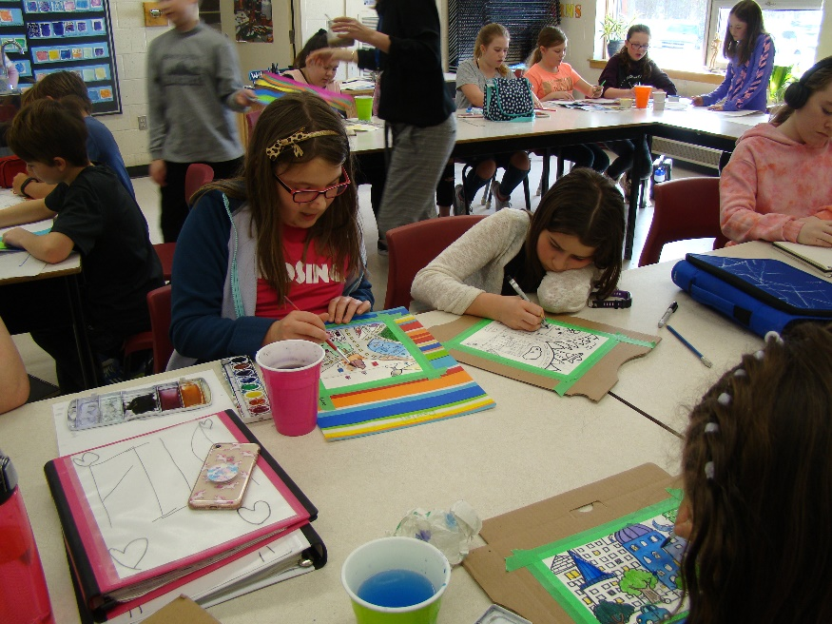
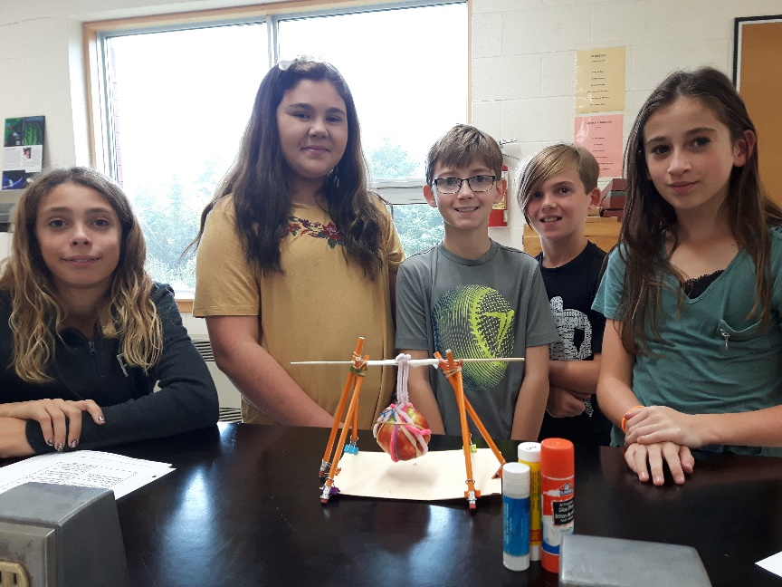
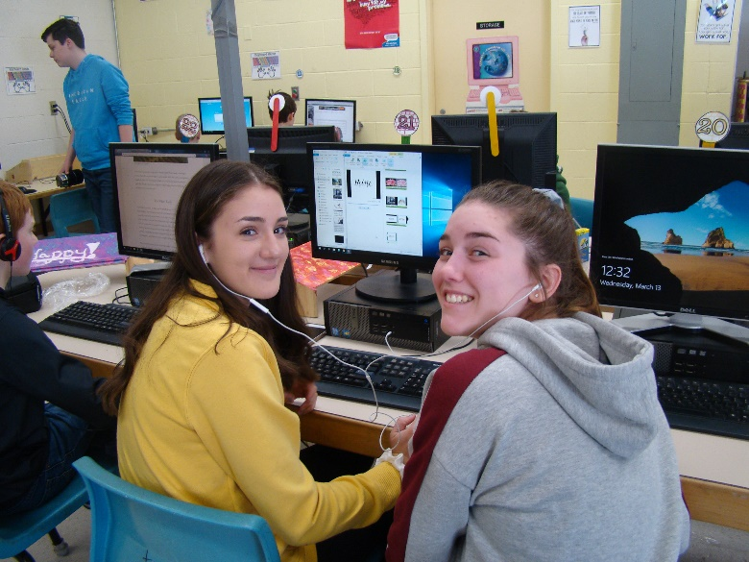
ACADEMICS

Slide 21
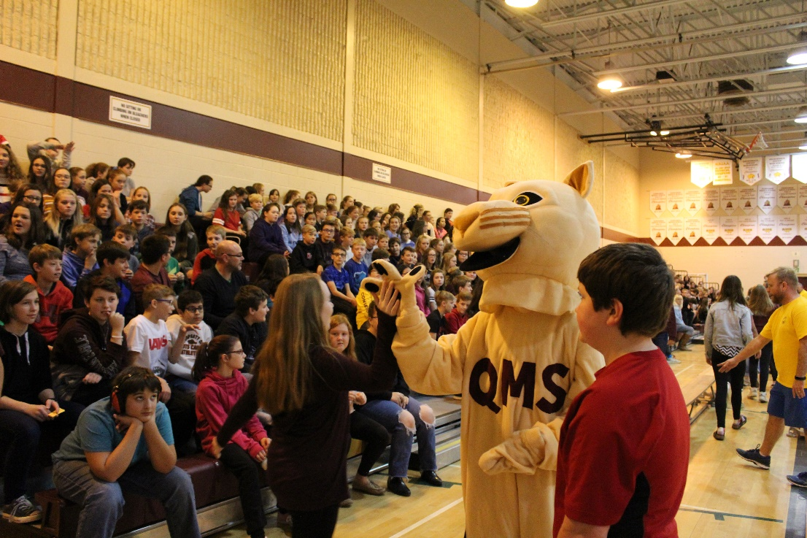
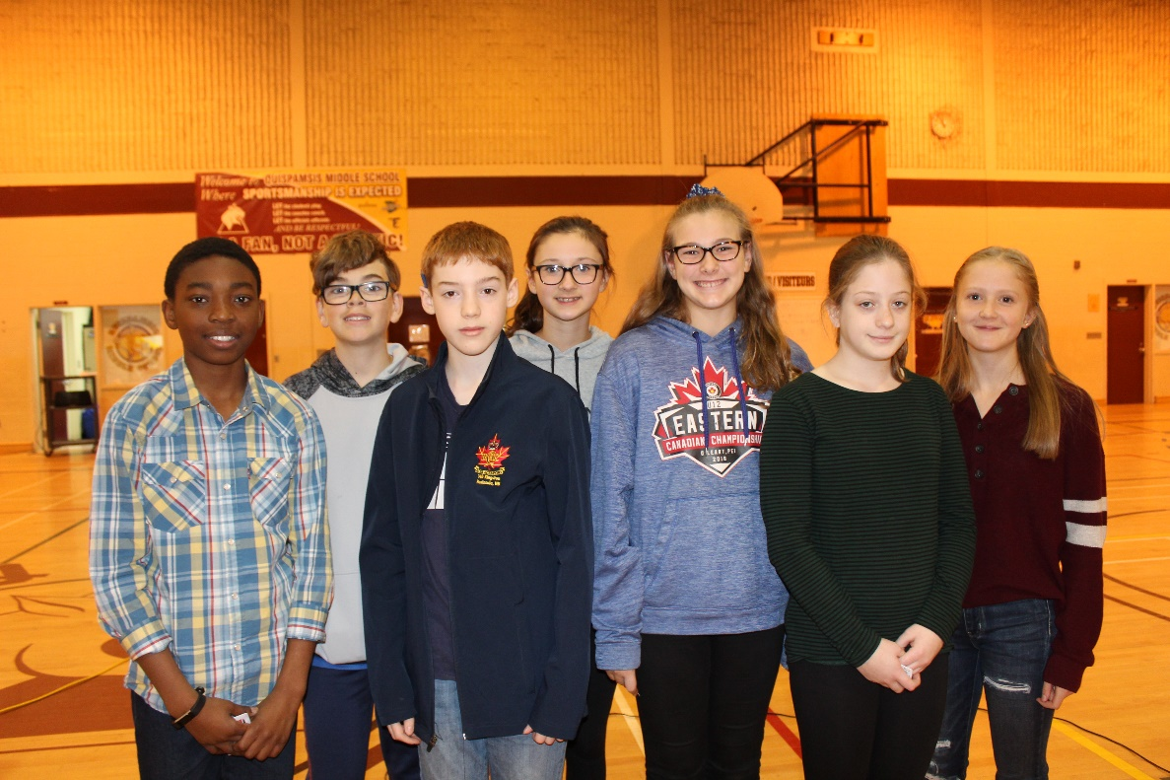
ASSEMBLIES

Slide 22
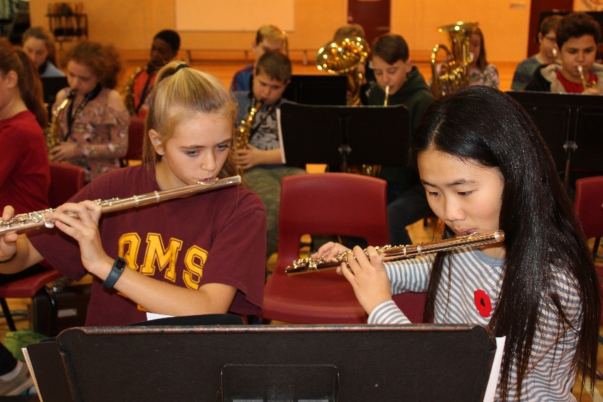
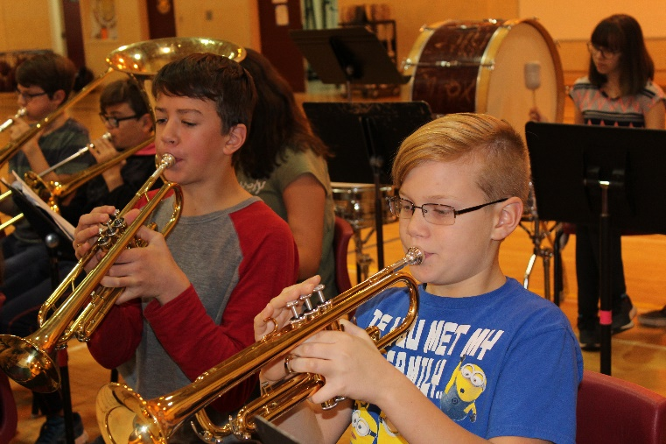
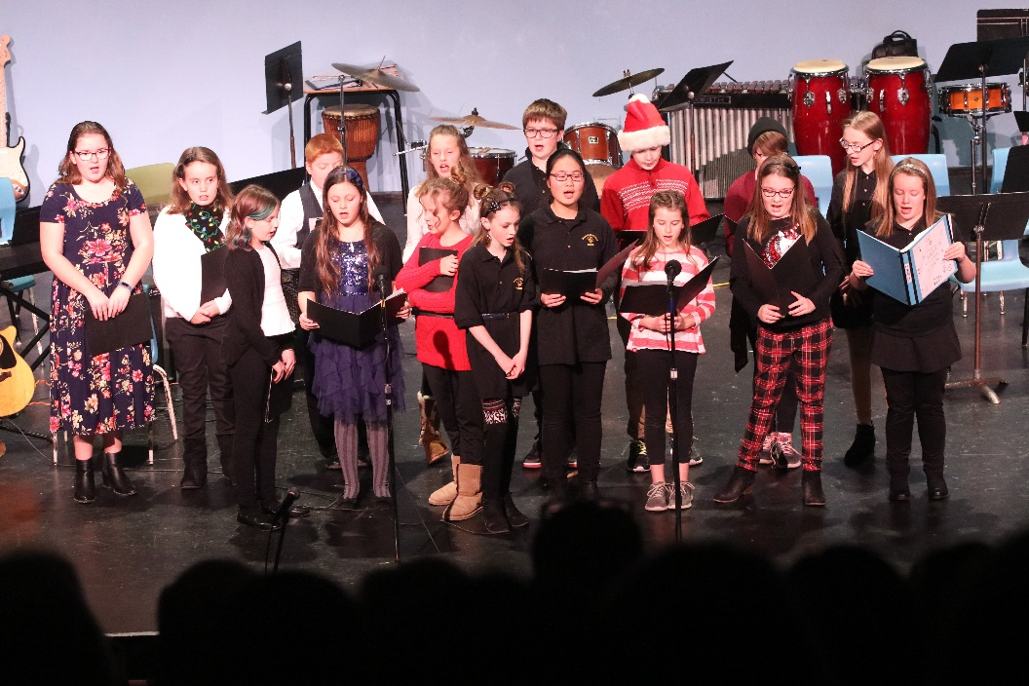
BAND / CHOIR

Slide 23
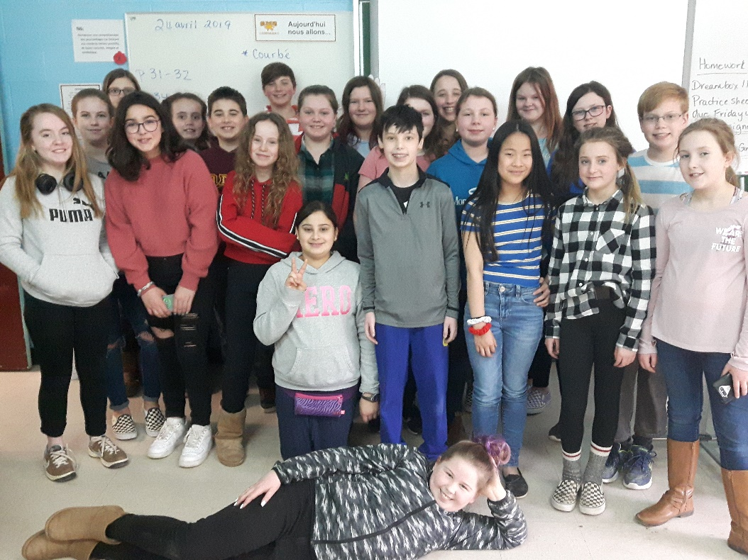
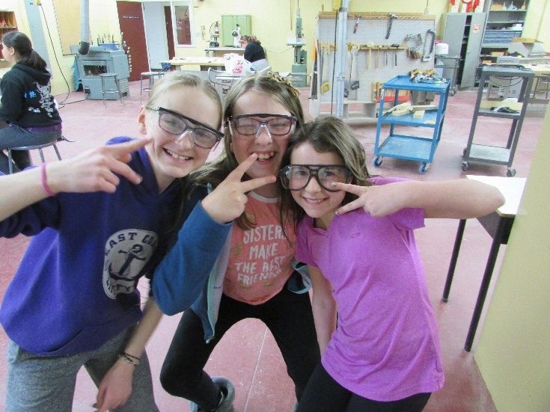
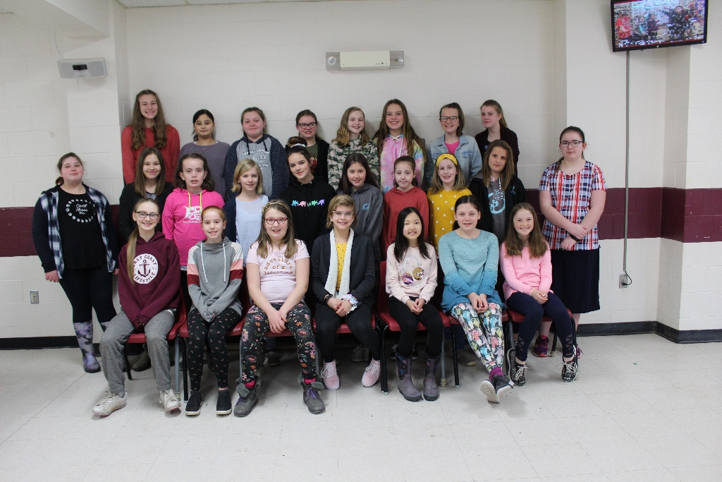
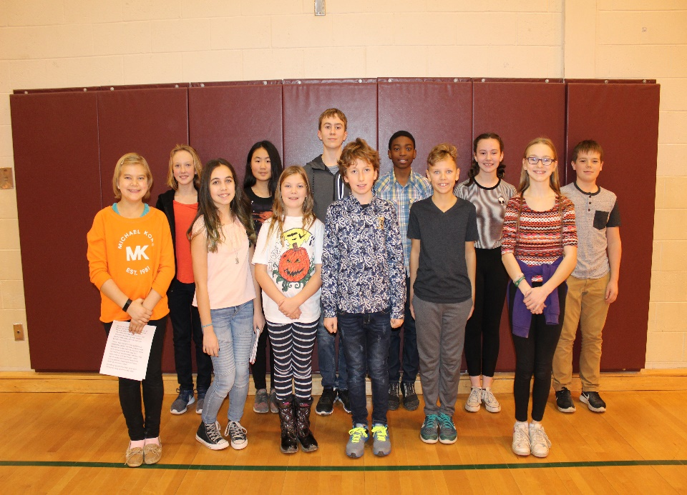
Q Crew
Chess Club
Woodworking Club
CLUBS
Knitting Club
Student Council

Slide 24
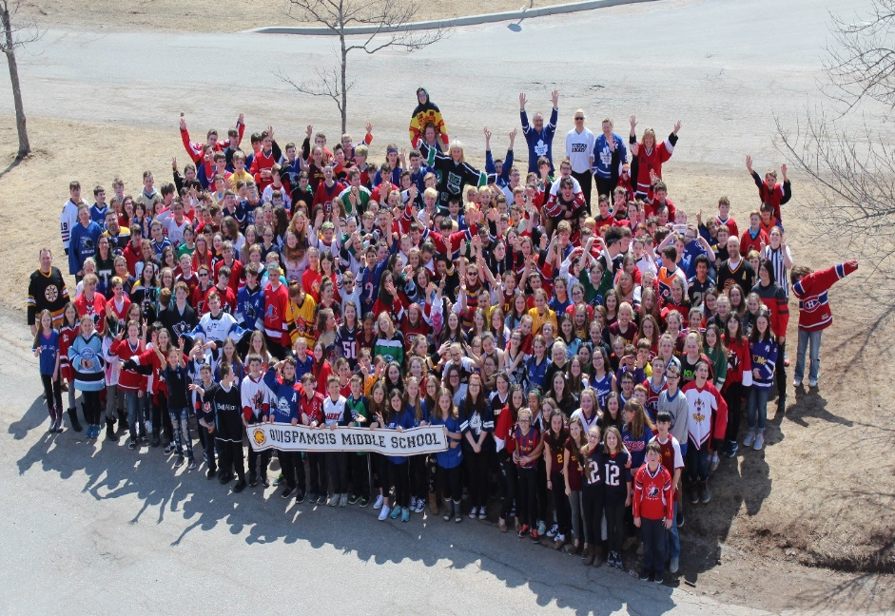
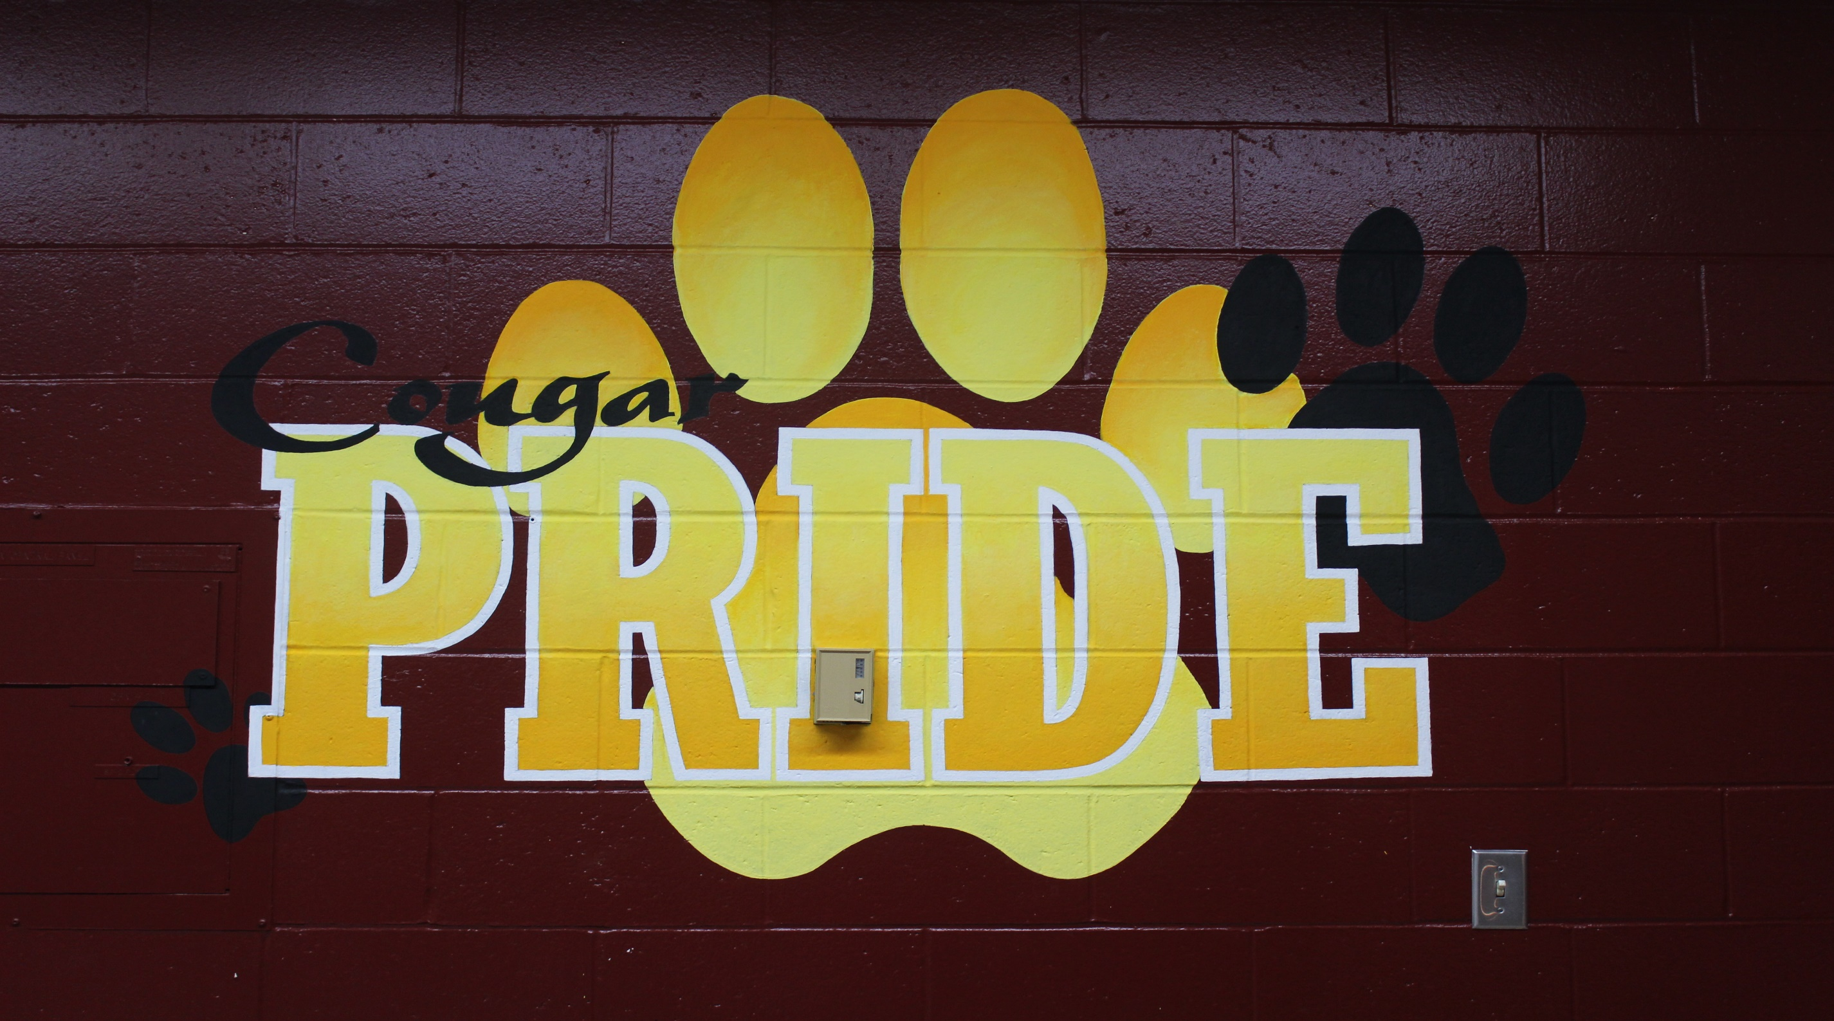
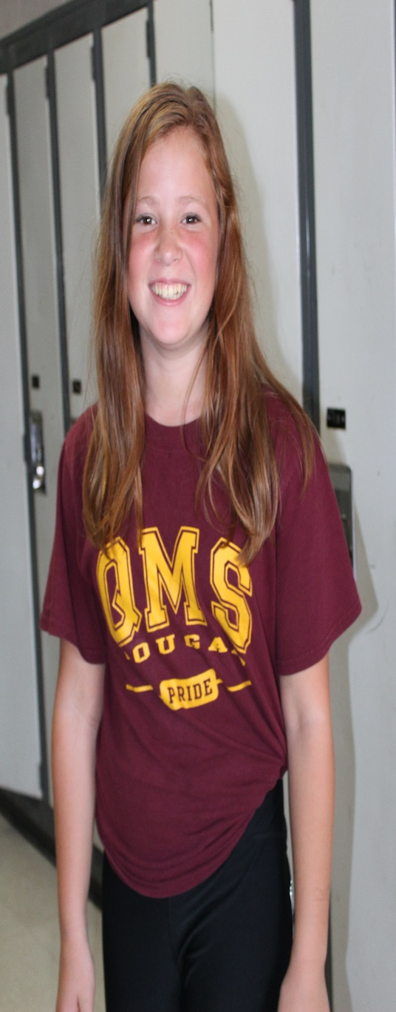
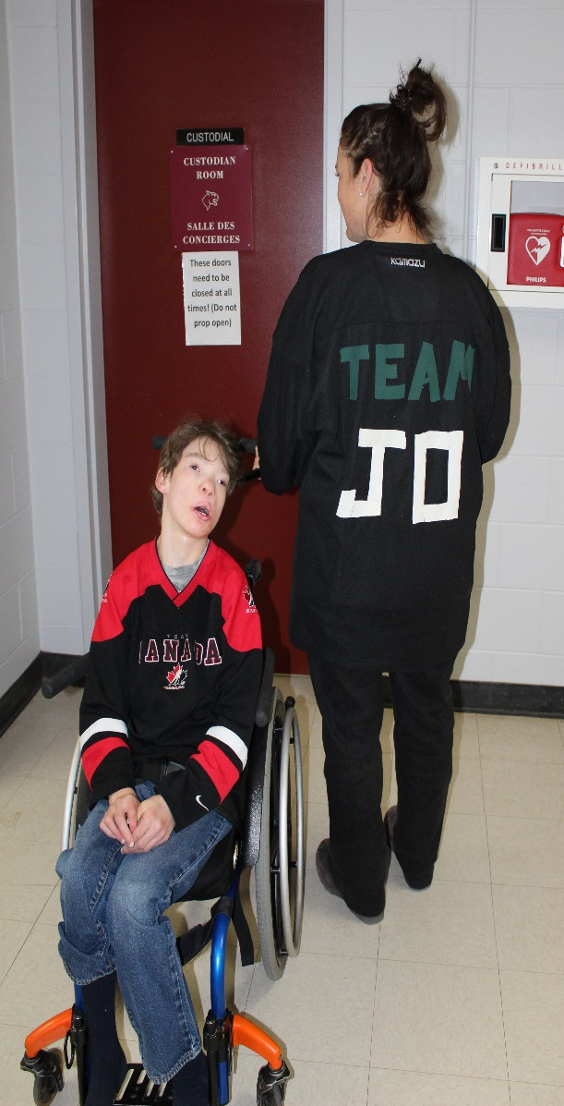

Slide 26
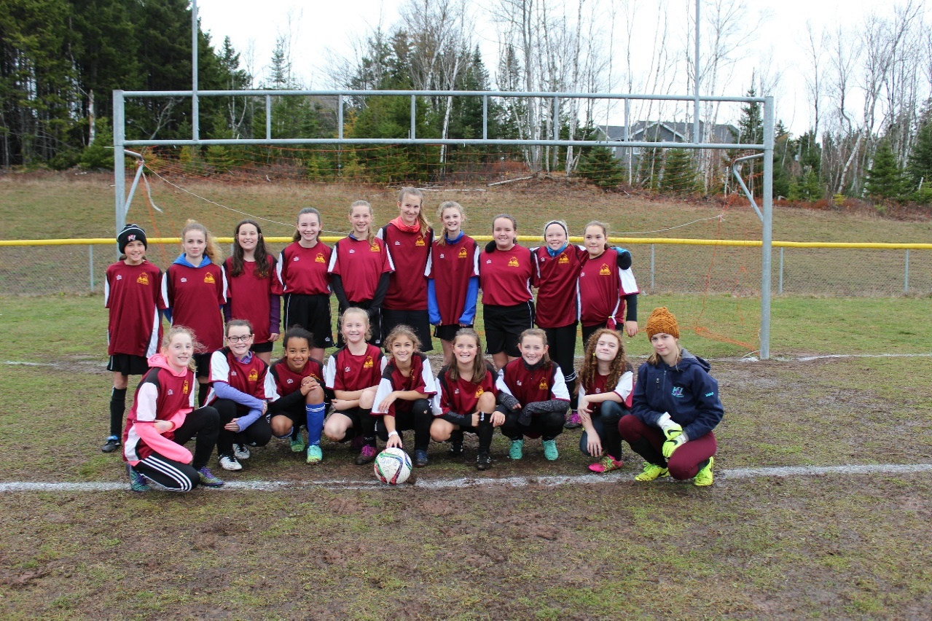
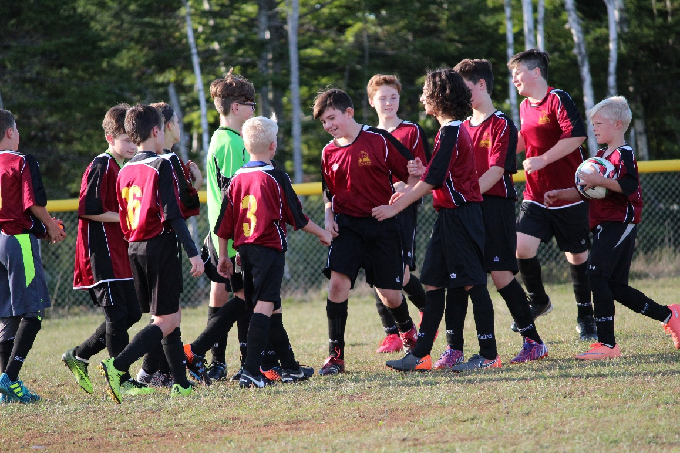
ATHLETICS

Slide 27
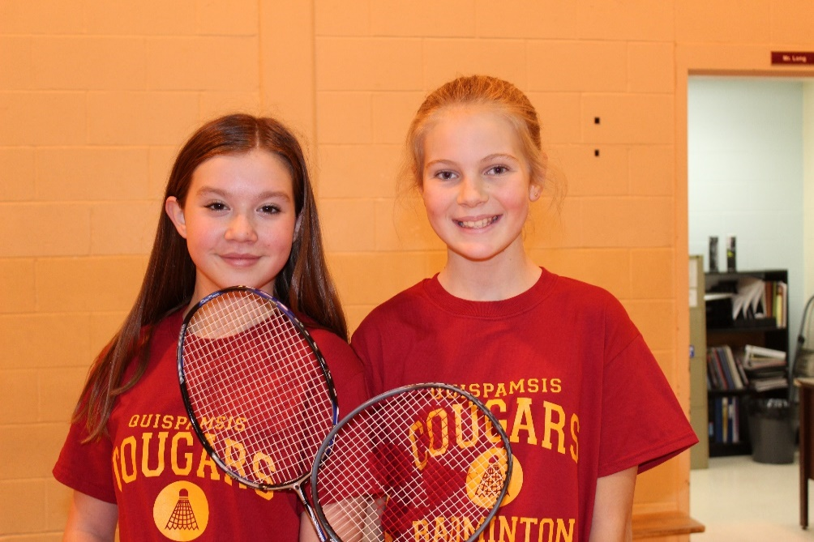
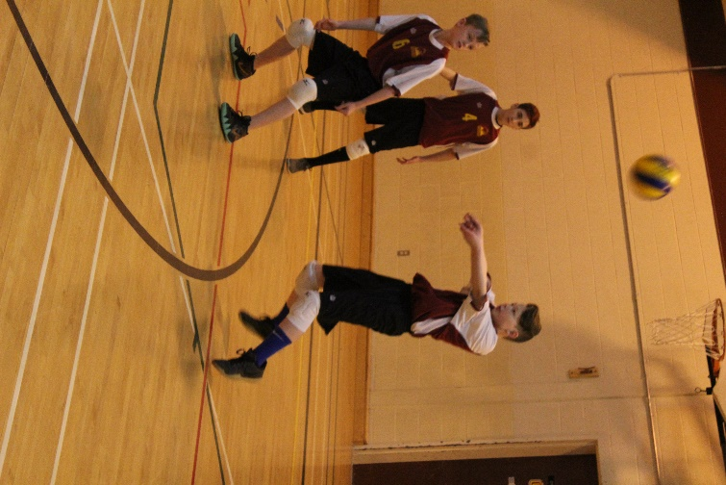
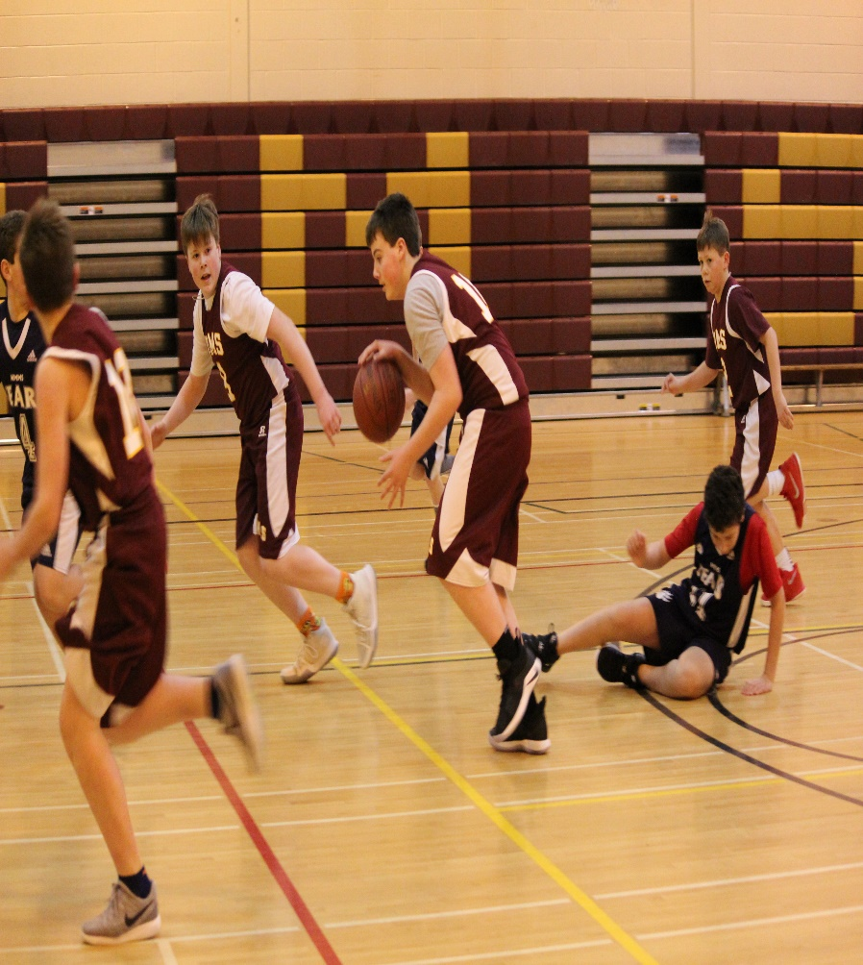

Slide 28
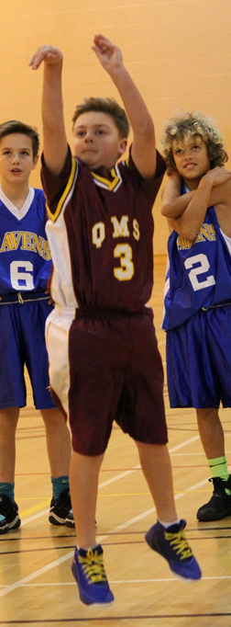
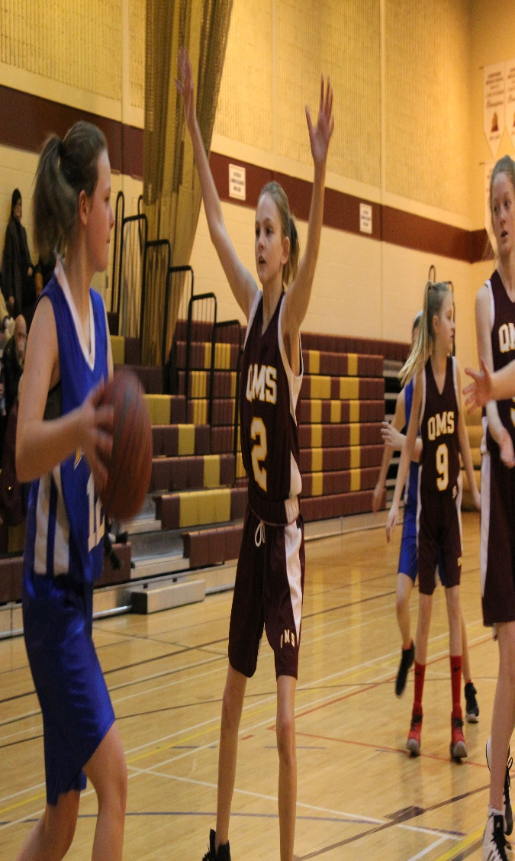
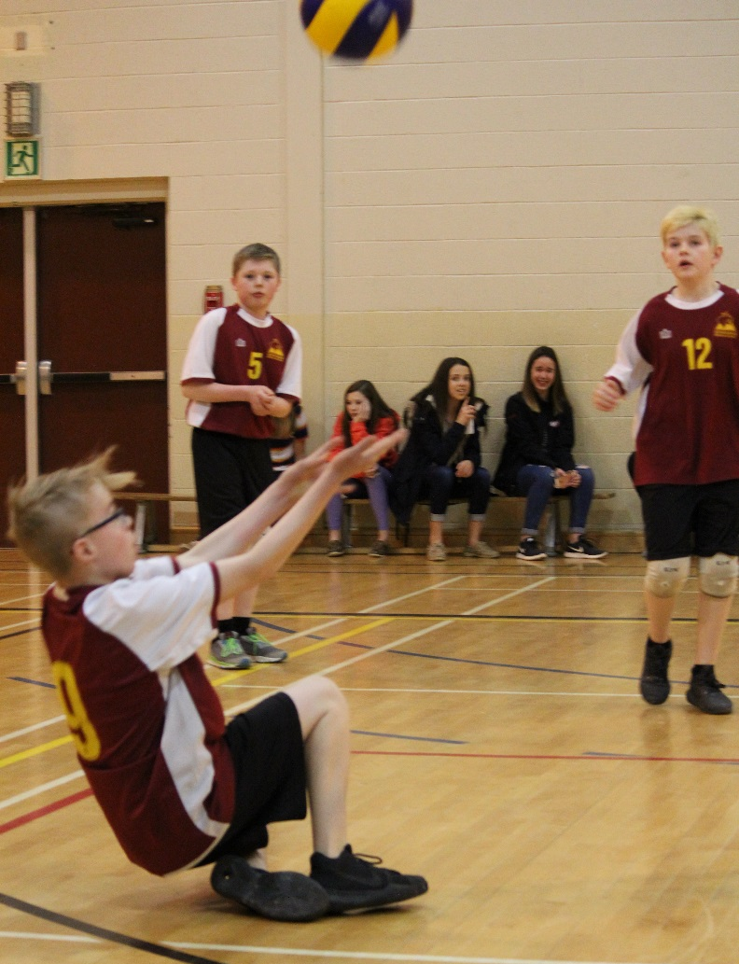
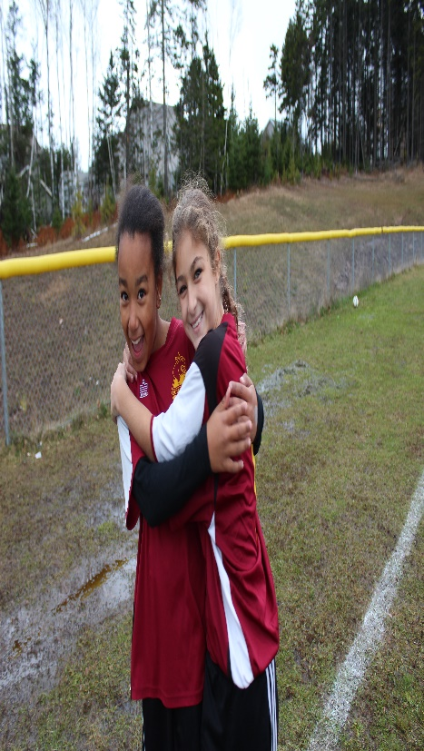

Slide 29
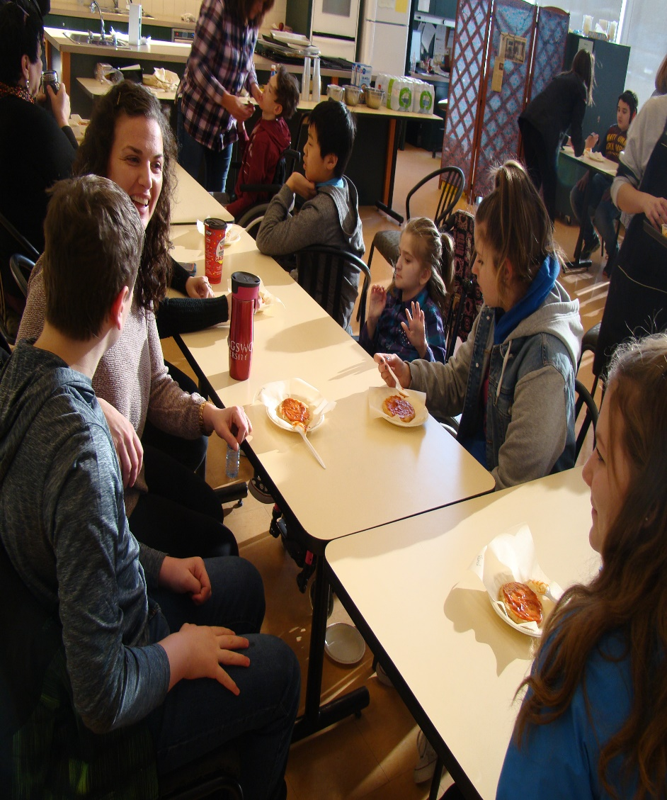
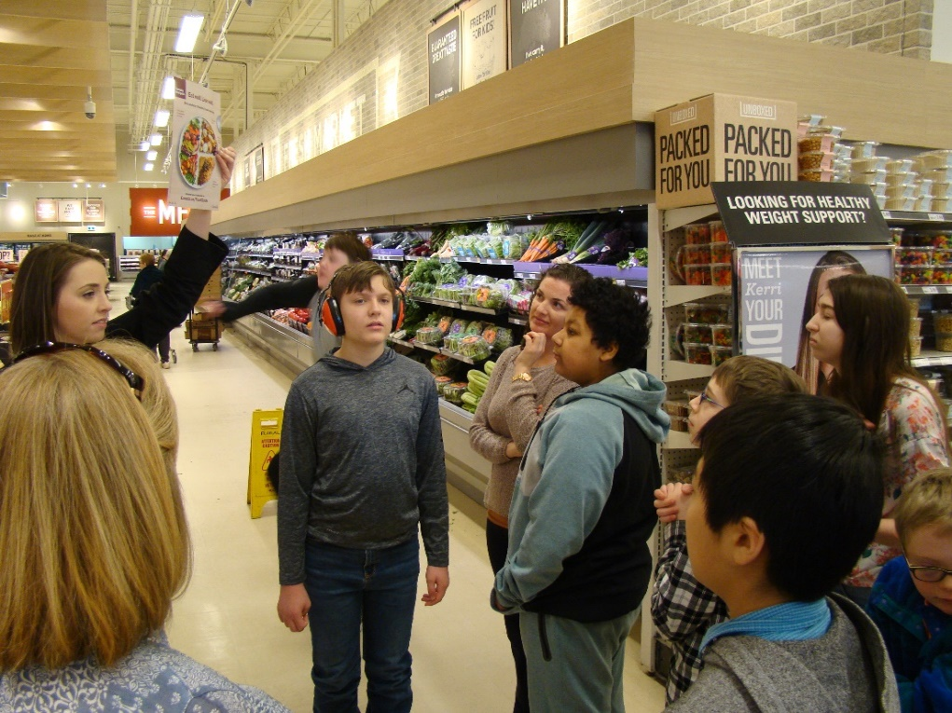
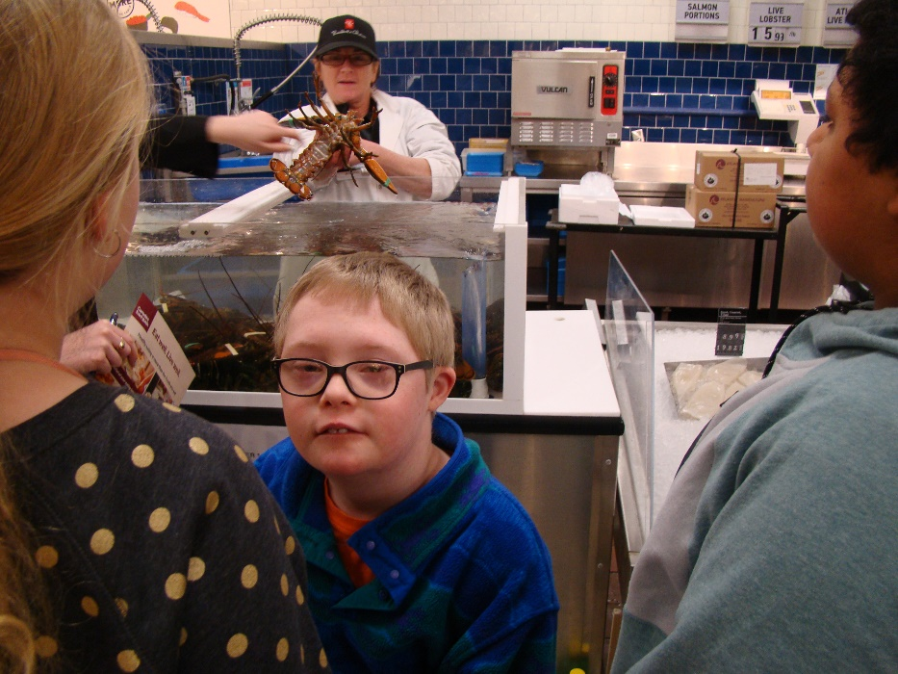
BEST BUDDIES

Slide 30
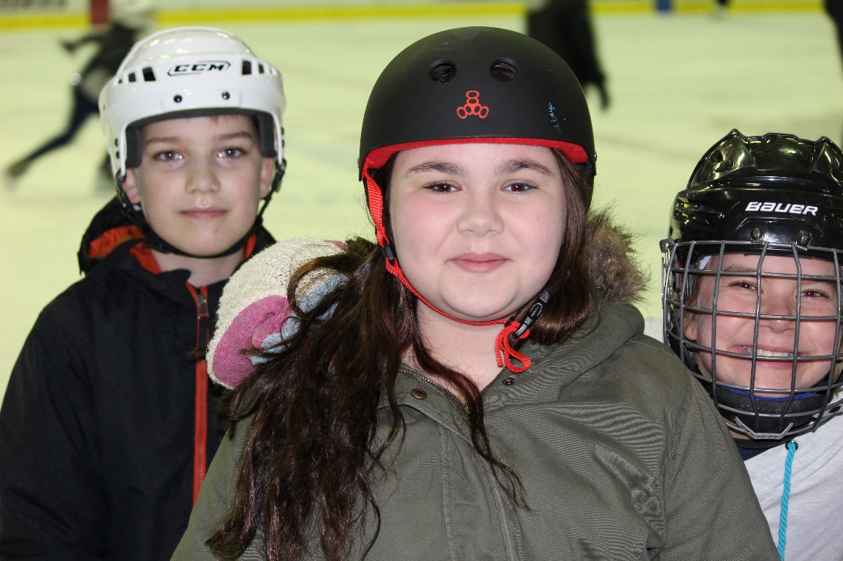
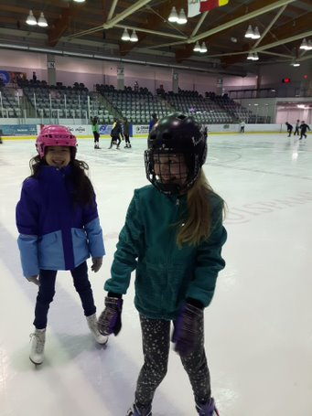
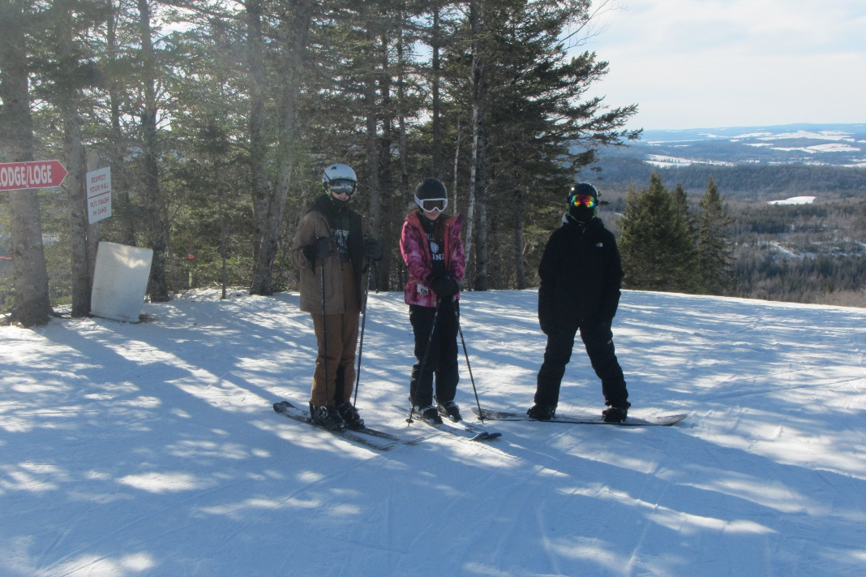
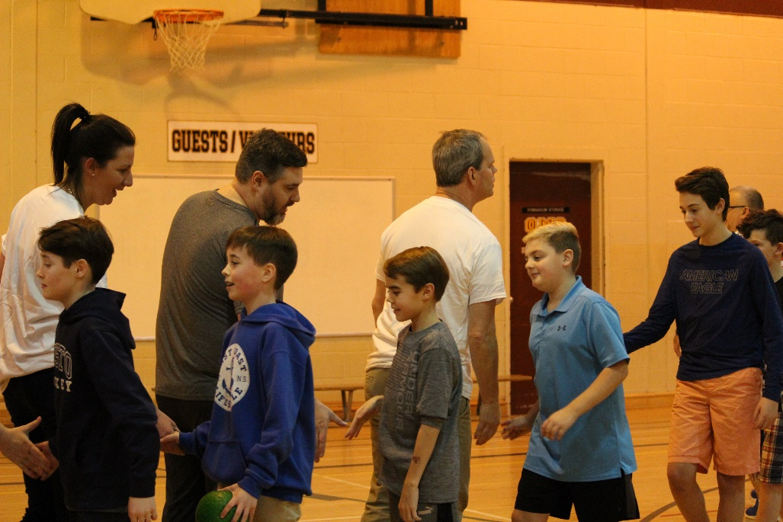
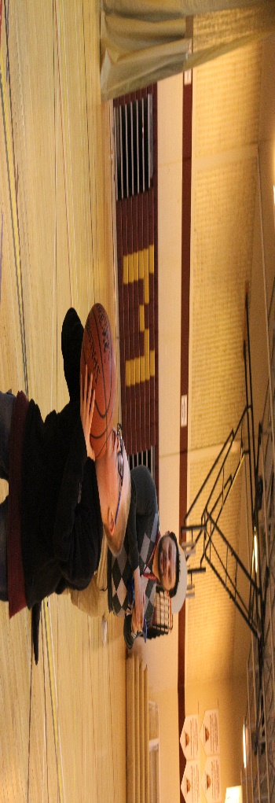
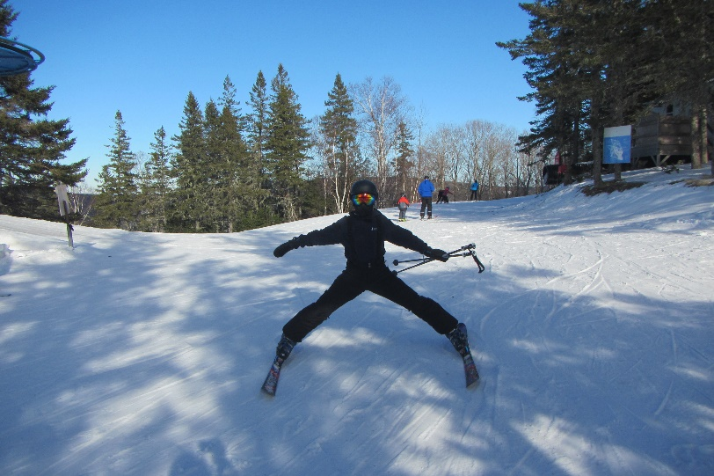
BE ACTIVE

Slide 31
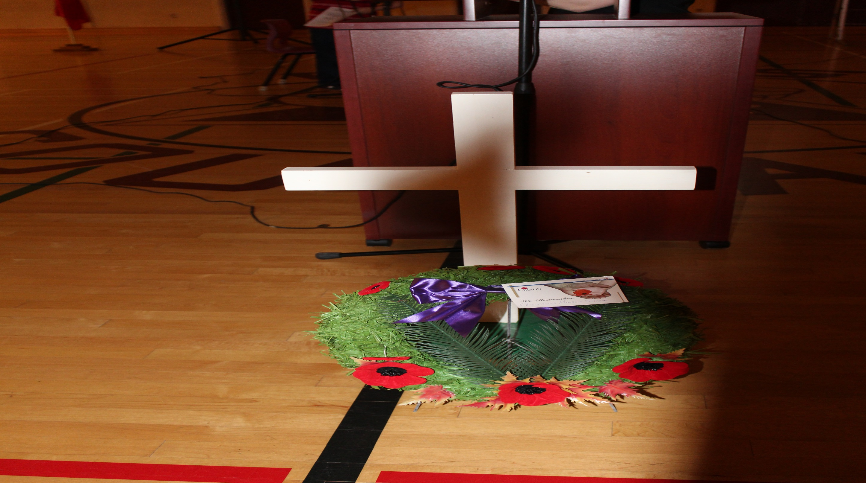
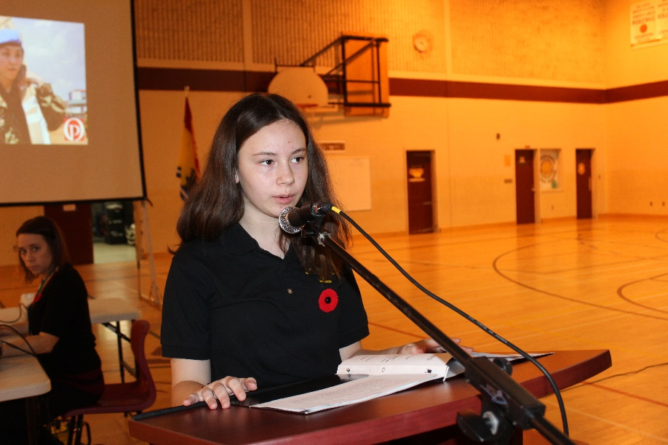
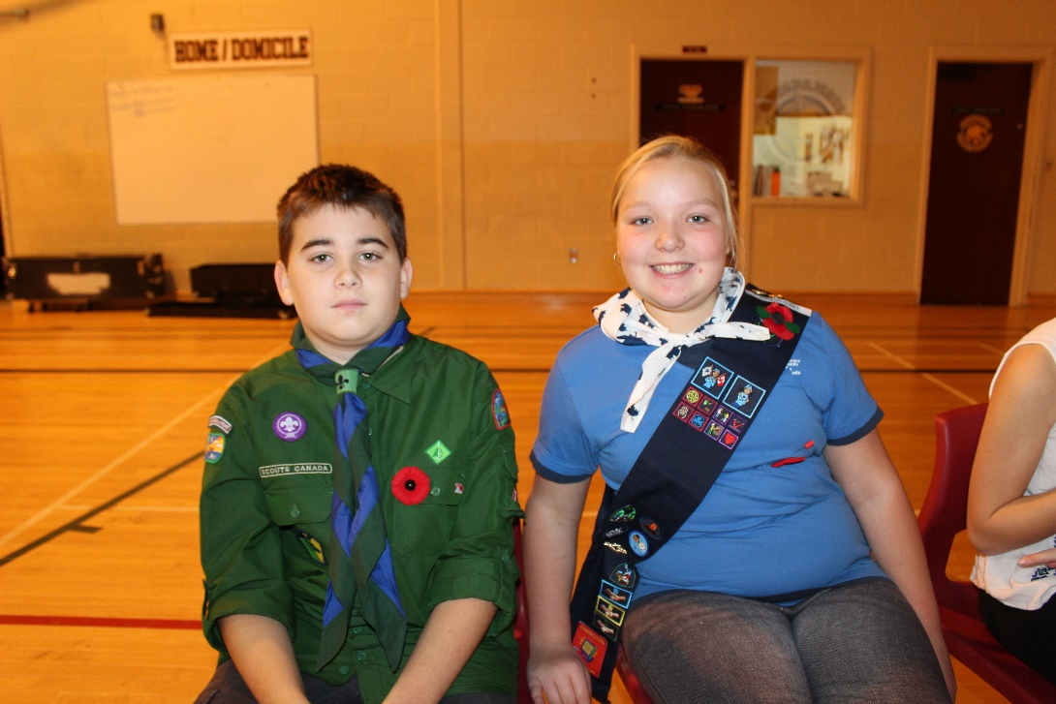
LEST WE FORGET

Slide 32
WINTER ENRICHMENT

Slide 33
QMS
TALENT

Slide 34
FRIENDS

Slide 38
Holiday Dinner

Slide 39
CELEBRATIONS

Slide 40
TURKEY DRIVE

Slide 42
STAND UP FOR OTHERS

Slide 43
Moo Crew
SERVICE TO
SCHOOL
Calendar Crew

Slide 44
SERVICE TO COMMUNITY

Slide 45
SERVICE TO OTHERS

Slide 47
Show your Cougar PRIDE

Slide 48
Clubs & Activities
Art Club
Chess Club
Debate Club
Woodworking
Recycling Club
Q CREW
Leadership
Student Council
GSA
Calendar Crew
Oratorical
Entrepreneurial Adventure
Spelling Bee
Red Cross Babysitting
Moo Crew
Yearbook
Breakfast Helpers
Math League / Competition
Choir
Geography Challenge
Sewing Club

Slide 49
Physical Fitness & Sports
Badminton
Track and Field
Ski /Snowboard Team
Rugby
Varsity and JV Sports
Soccer
Basketball
Volleyball
Softball
Flag Football
Open Gym
Intramurals
Badminton Club

Slide 50
Band/ Music
Grade 6 Band
Grade 7/8 Band
Concert Band
Singing Club / Choir

Slide 51
Guidance & Resource
We have a full time Guidance Counselor, three grade level Resource teachers, and an SIW, who are available to support students with:
Transition to middle school, and beyond
Pro social behaviours and positive peer interactions
Anti-bullying
Organization
Learning outcomes
Academics
Other issues

Slide 52
Day 1 of Middle School: “Cougar Camp”
Welcome Assembly: Gym
Homeroom
Mini-Schedule – meet your subject teachers
Homeroom
Lunch
Group Activity
Scavenger Hunt
Homeroom - dismissal

Slide 53
QMS Tour
Guidance
SIW & EAL
Grade 6 Classrooms
Gr 6 Resource
Male / Female Washroom
Gr 6 Entrance
Gender Neutral Washroom

Slide 54
We cant’t wait to meet you

