Slide 1
QMS SKI AND SNOWBOARD TEAM
2018

Slide 2
EQUIPMENT DROP OFF
Where: Enter Art room door, drop equipment into the gym storage room (across from Tech room). Mr. Robichaud will be there to assist you.
When: Between 8 am to 8:30 am on Wednesdays
*If parents drop equipment later in the day, drop off will be in the office.
Storage room will be locked during the day! If you want access to your equipment, see Mr. Robichaud or Mr. Long.
Make sure that your equipment is labeled with a name.

Slide 3
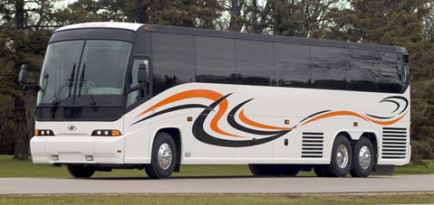
BUS DEPARTURE
When: 2:40 pm after classes are dismissed.
Pick up gear in storage room, and proceed to the bus with your equipment.
Bus will be waiting outside. Put your own equipment in the storage compartment underneath the bus, but keep your personal items with you.(phone, money, ipod, etc.)

Slide 4
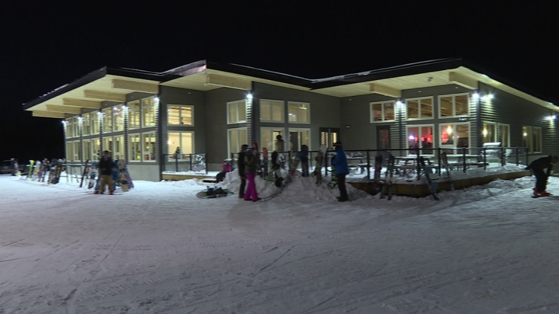
ARRIVAL AT POLEY MOUNTAIN
Approximate arrival around 4pm.
Pick up your own gear from the storage compartment underneath the bus.
Place your skis or snowboard on racks.
Go down to locker area to change into your ski pants, etc.
If you’re renting equipment, go to rental shop and a teacher will be there to assist you with your equipment rental.

Slide 5
FREE SKI AND LUNCH
When: Between 4pm and 6:30pm
Students can ski with their friends between this time.
Students are not allowed on the Terrain Park or Out of Bounds! No exceptions!
Please make sure you take the time to eat your supper!!!
Student can bring a bag lunch or bring money to eat at the canteen.

Slide 6
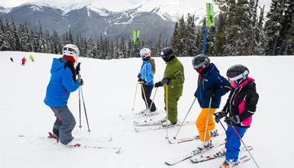
LESSONS
When: 6:30pm to 7:30pm
Where: Meet in front of the lodge, and meet your instructors.
On the first night, everyone will do an evaluation to establish which level you’re at.
Once you’re assigned an instructor, he/she will be with you for the whole 6 weeks sessions.

Slide 7
RETURNING HOME
When: Bus leaves Poley Mountain at 8pm.
Be ready to leave at 7:45pm.
Bring your equipment to the bus.
Make sure you double check your equipment/clothing, and don’t leave anything behind.
We’re not responsible for lost equipment.

Slide 8
ARRIVAL AT QMS
When: 9pm
Parents, please be on time!
When passing through Hampton, your child will be advise to call their parents.
Any help taking off equipment from the storage compartment will be greatly appreciated. The faster the equipment is taken off, the faster you can go home.

Slide 9
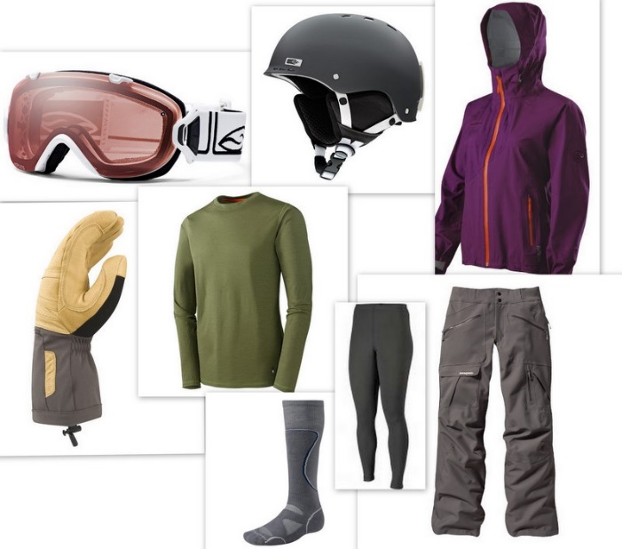
WHAT TO WEAR…IN CASE YOU DON’T KNOW
Socks: should be warm, extra pair always good for when coming home.
Legs: ski pants, no jeans!
Body: long sleeve sweater, good jacket (remember layers!)
Head: Helmet, mandatory!, a tuque for warmth after ski or under helmet.
Hands: ski gloves or mittens, extra pairs in case they get wet or humid.
Eyes: goggles

