Slide 1
Mental Wellness: Understanding
Anxiety & Depression
Quispamsis Middle School
December 6, 2017
Rob Mather, Guidance Lead, ASD-South

Slide 2
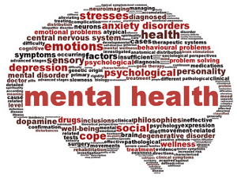
Mental Wellness/Health
Mental health means striking a balance in all aspects
of one’s life: social, physical, spiritual, economic and
mental. Reaching a balance is a learning process.
At times, we may tip the balance too much in one direction and have to find our footing again. Our personal balance will be unique, and our challenge will be to stay mentally healthy by keeping that balance.
http://www.cmha.ca/mental-health/your-mental-health/

Slide 3
Mental Health Disclaimer
FEELINGS ARE COMPLICATED AND CAN HAVE LEVELS.
  1. NORMAL – normal day-to-day feelings - regular ups and downs of life.
  2. PROBLEMATIC - negative feelings that can impact or be evident in one’s life.
  3. DISORDER - debilitating issues that severely impact day to day life.
This can be seen as a Mental health continuum.
NOTE: We all have our own knowledge/attitudes and experience of mental
health - this can help and hurt situations as we begin to
focus on things through our own “lenses”.

Slide 4
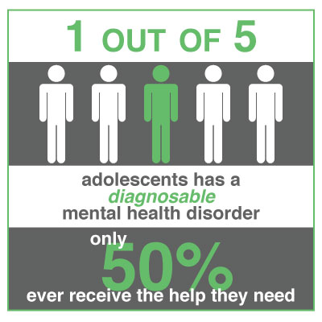
Why are we talking?
Middle School Statistics:
Students with moderate or high levels of anxiety -
The Canadian norm for girls is 21% and 14% for boys.
Students with moderate or high levels of depression
The Canadian norm for girls is 17% and 12% for boys
High School Statistics:
Students with moderate or high levels of anxiety -
The Canadian norm for girls is 21% and 14% for boys.
Students with moderate or high levels of depression -
The Canadian norm for girls is 22% and 16% for boys.
(Source: the “Tell Them From Me Survey”)

Slide 5
Statistics continued…
It is estimated that 10-20% of Canadian youth are affected by a mental illness or disorder – the single most disabling group of disorders worldwide.
The total number of 12-19 year olds in Canada at risk for developing depression is a staggering 3.2 million.
Mental illness is increasingly threatening the lives of our children; with Canada’s youth suicide rate the third highest in the industrialized world.
Suicide is among the leading causes of death in 15-24 year old Canadians, second only to accidents; 4,000 people die prematurely each year by suicide.
Surpassed only by injuries, mental disorders in youth are ranked as the second highest hospital care expenditure in Canada.
https://cmha.ca/media/fast-facts-about-mental-illness/

Slide 6


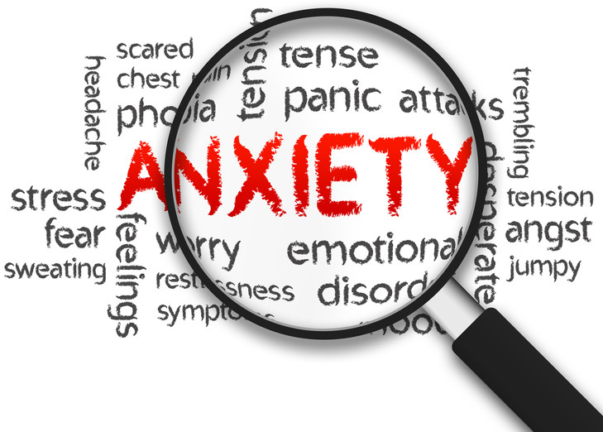
MOVING ALONG…

Slide 7
Anxiety Defined:
1a (1) : apprehensive uneasiness or nervousness usually over an impending or anticipated ill :
(2) medical : an abnormal and overwhelming sense of apprehension and fear often marked by physical signs (such as tension, sweating, and increased pulse rate), by doubt concerning the reality and nature of the threat, and by self-doubt about one's capacity to cope with it
https://www.merriam-webster.com/dictionary/anxiety

Slide 8
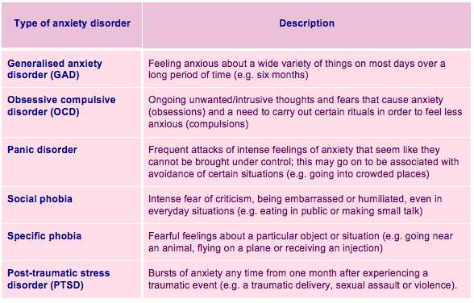
TYPES OF ANXIETY
Note:
Social Phobia/GAD/PTSD are ranked as the most prevalent in Canada.

Slide 9
Facts about anxiety
1. Anxiety is normal. Everyone experiences anxiety at times. For example, it is normal to feel anxious when on a rollercoaster, or before a job interview.
2. Anxiety is adaptive. It is a system in our body that helps us to deal with real danger (for example, anxiety allows us to jump out of the way of a speeding car) or to perform at our best (for example, it motivates us to prepare for a big presentation
3. Anxiety is not dangerous. Although anxiety may feel uncomfortable, it is not dangerous or harmful to you. Remember, all the sensations you feel when you are anxious are there to protect you from danger, not hurt you.
4. Anxiety does not usually last forever. When you are anxious, you may feel like the anxiety is going to last forever. But anxiety is temporary and will eventually decrease.
5. Anxiety is mostly anonymous. Most people (except those close to you) cannot tell when you are anxious.

Slide 10
Anxiety symptoms
Anxiety can cause many sensations which are known as the “alarm reaction”. This takes place when the body’s natural Alarm System (the “fight-flight-freeze” response) has been activated.
Rapid heart beat and rapid breathing
Sweating
Nausea and stomach upset
Feeling dizzy or lightheaded
Tight or painful chest
Numbness and tingling sensations
Unreality or bright vision

Slide 11
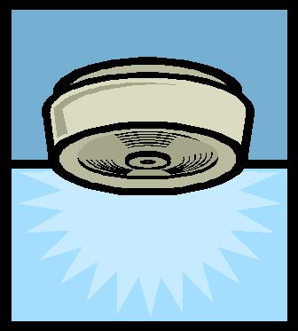
Is this a problem or not?
Anxiety is a problem when your body reacts as if there is danger when there is no real danger. It’s like having an overly sensitive smoke alarm system in your body.
Anxiety is like a smoke alarm system:
A smoke alarm can help to protect us when there is an actual fire, but when a smoke alarm is too sensitive and goes off when there isn’t really a fire (e.g., burning toast in toaster), it is rather annoying.
Like a smoke alarm, anxiety is helpful and adaptive when it works right. But, if it goes off when there is no real danger, it is not only scary, it is also very exhausting.
However, we DO NOT want to get rid of the alarm (or eliminate anxiety) because it protects us from danger. We want to fix it (i.e., bring the anxiety down to a more manageable level) so it works properly for us.

Slide 12
Might it just be stress?
Stress and anxiety are often used interchangeably, and there is overlap between stress and anxiety. Stress is related to the same ‘fight, flight, or freeze’ response as anxiety, and the physical sensations of anxiety and stress may be very similar.
Stress focuses on mainly external pressures on us that we’re finding hard to cope with. When we are stressed, we usually know what we’re stressed about, and the symptoms of stress typically disappear after the stressful situation is over.
Anxiety, on the other hand, isn’t always as easy to figure out. Anxiety focuses on worries or fears about things that could threaten us, as well as anxiety about the anxiety itself.
http://www.heretohelp.bc.ca/ask-us/whats-the-difference-between-anxiety-and-stress

Slide 13
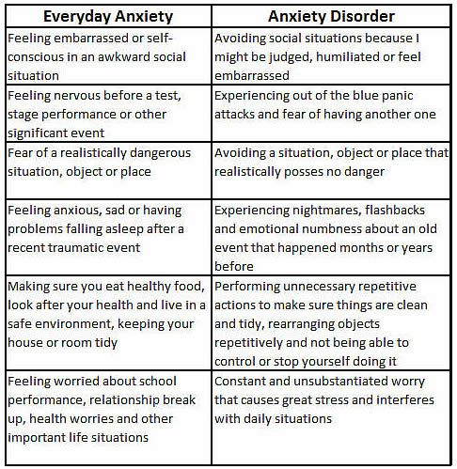
Same
or different?

Slide 14
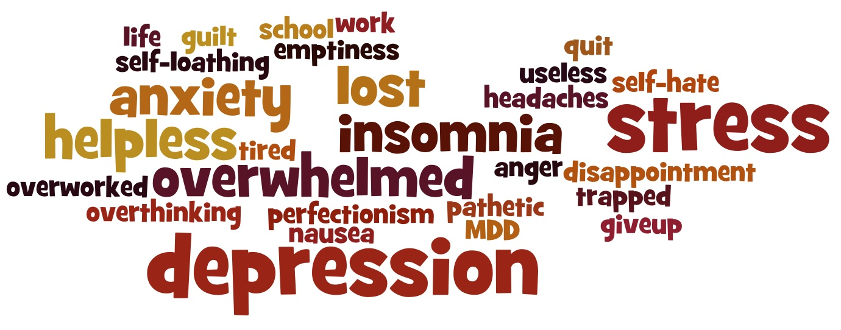

Shifting to Depression

Slide 15
Depression Defined
(1) : a state of feeling sad : dejection anger, anxiety, and depression
(2) : a mood disorder marked especially by sadness, inactivity, difficulty in thinking and concentration, a significant increase or decrease in appetite and time spent sleeping, feelings of dejection and hopelessness, and sometimes suicidal tendencies bouts of depression
https://www.merriam-webster.com/dictionary/depression

Slide 16
Depression
Depression, also known as clinical or major depression, is a mood disorder that will
affect one in eight Canadians at some point in their lives and the leading cause of suicide.
It changes the way people feel, leaving them with mental and physical symptoms for long periods of time. It can look quite different from person to person.
Depression can be triggered by a life event such as the loss of a job, the end of a relationship or the loss of a loved one, or other life stresses like a major deadline, moving to a new city or having a baby.
Sometimes it seems not to be triggered by anything at all. One of the most important things to remember about depression is that people who have it can’t just “snap out of it” or make it go away.
https://cmha.bc.ca/documents/depression-2/#what

Slide 17
Youth & Depression
More than a quarter of a million Canadian youth—6.5% of people between 15 and 24—experience major depression each year.
Depression can be hard to recognize in youth because parents and caregivers often mistake a teen’s mood swings and irritability for normal adolescence, rather than depression.
Studies have shown that gay, lesbian, bisexual or transgendered youth have higher rates of major depression.
Once depression is recognized, help can make a difference for 80% of people who are affected, allowing them to get back to their regular activities.

Slide 18
Symptoms: Could I have depression?
I feel worthless, helpless or hopeless
sleep more or less than usual
I’m eating more or less than usual
I’m having difficulty concentrating or making decisions
I’ve lost interest in activities I used to enjoy
I avoid other people
I have overwhelming feelings of sadness or grief
I’m feeling unreasonably guilty
I have a lot of unexplained stomachaches and headaches
I feel very tired and/or restless
I have thoughts of death or suicide
I’m feeling more tearful or irritable than usual
https://cmha.bc.ca/documents/depression-2/
NOTE:
If you agree with five or more of these statements and have been experiencing them for more than two weeks you should talk to your doctor.

Slide 19
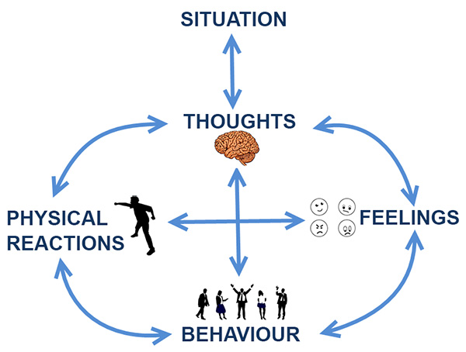
The negative thinking cycle: A Cognitive Approach (CBT-Model)

Slide 20
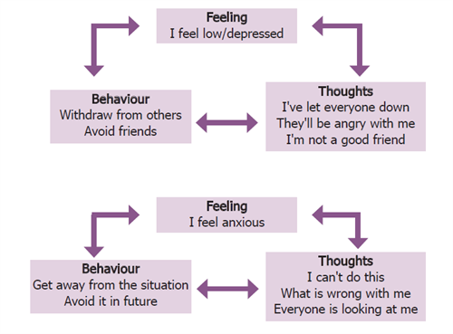
A cognitive example of anxiety and depression

Slide 21
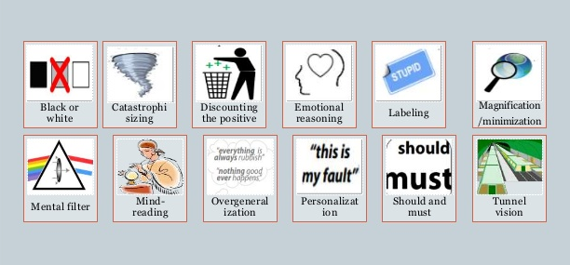
Common mistakes in our thinking
Cognitive Distortions

Slide 22
What strategies do people use?
Cognitive Behavioural Therapy:
As the name suggests, CBT focuses on the way people think ("cognitive") and act ("behavioural"). The concept behind CBT is that our thoughts about a situation affect how we feel (emotionally and physically) and how we behave in that situation.
Relaxation Strategies/Breathing exercises/Mindfulness
Realistic Thinking (helpful vs unhelpful thoughts)/Thought Records
Facing Fears/Exposure
Behavioural Activation (Activities that promote positive feelings/thoughts)
Wellness Analysis (Sleep/Diet/Exercise)
Medication may also be used as part of the treatment.

Slide 23
What can parents do to help?
Actively Listen.
Ask your child if they’ve thought about what they might need to get better.
Learn as much as you can about the situation.
Normalize their feelings.
Acknowledge your fears/worries and perception of the situation.
Offer an impartial counselor, and assure your child that information will be confidential unless it is life threatening.
Prepare to be an advocate. It takes time and effort to make sure you’re getting the best care you need - help them navigate the system.
Help your child connect with supports. Connecting with the school/guidance/ outside counsellor/family doctor etc.. is an important next step.

Slide 24
What won’t be helpful
Minimizing how they are feeling or what they say.
Letting your emotions rule your response or using the word “crazy”.
Telling your child what they SHOULD do; instead, ask what they want you to help them with.
If your child shares about bizarre thoughts or asks about strange sounds, PAY ATTENTION and EXPLORE. These experiences are early warning signs of more serious mental health problems. Acting early can change the trajectory of their lives.
Arguing if you encounter resistance from your child.
Making excuses or blame others.
Comparing your child to their siblings. “Your brother doesn’t have these problems. Why can’t you be more like him?”
http://www.mentalhealthamerica.net/conditions/talking-adolescents-and-teens-starting-conversation

Slide 25
What resources are out there to help?
People Resources:
The School (Teachers/Guidance/Resource/Administration)
Family Doctor
ISD-Child & Youth Team
Private Counselling
Online Resources:
The Link Program
AnxietyBC
Canadian Mental Health Association
Teen Mental Health
National Institute of Mental Health
Mental Health Commission of Canada

Slide 26
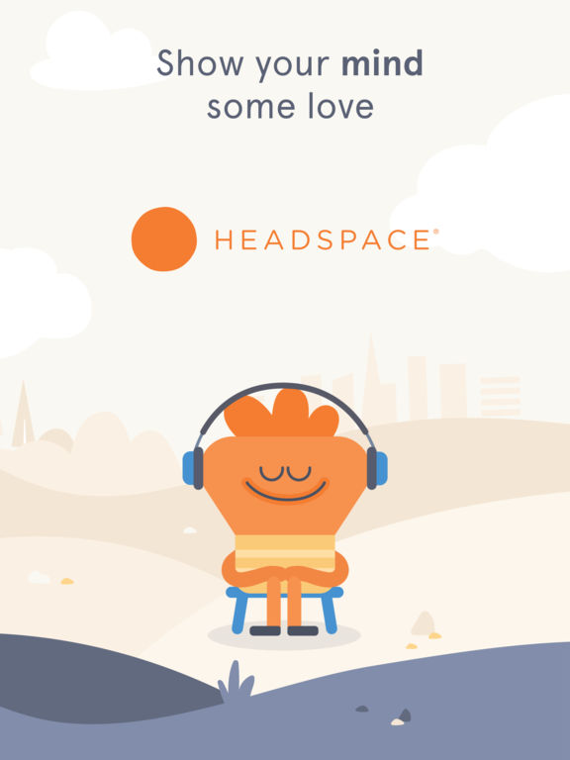




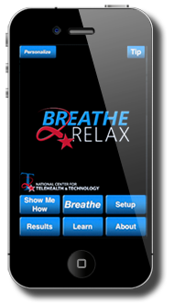


Apps:
SAM

Slide 27



