Slide 1
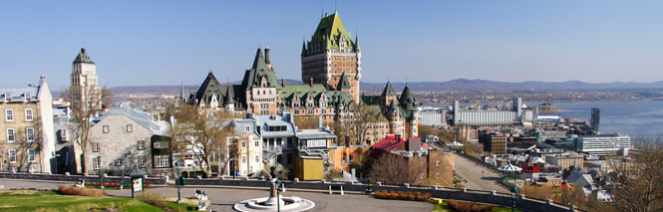
QMS Québec Trip 2016

Slide 2

To Reach Us
Jumpsteet Tours Emergency Contact
1-514-354-9990 / 1-800-663-4956

Slide 3
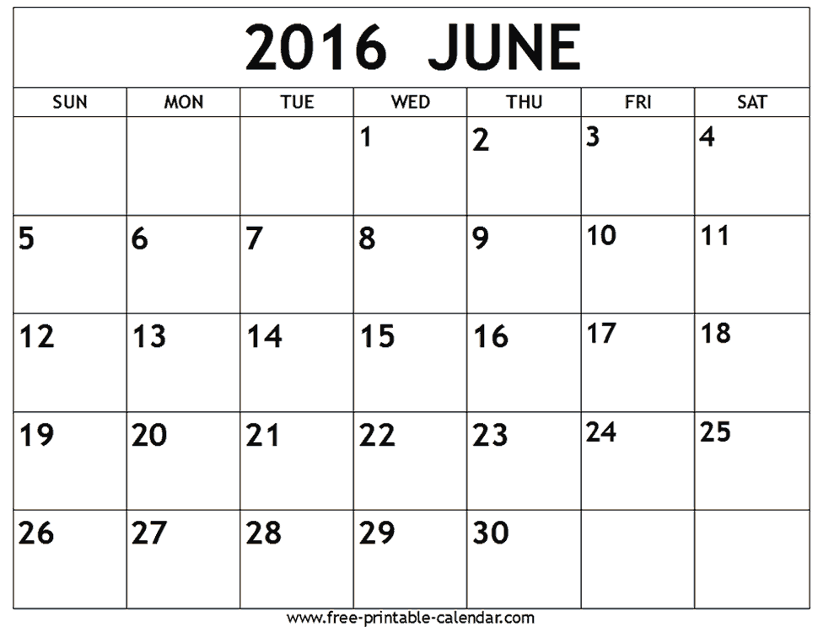
This year’s trip
106 students
8 chaperons
2 tour guides
Two bus
Leaving Friday June 17,2016
Arriving Tuesday June 21, 2016

Slide 4

Chaperons
Gilles Robichaud (trip organizer)
Paul Chiswell
Brenda O’Leary
Greg Donavon
TBA
TBA
TBA

Slide 5
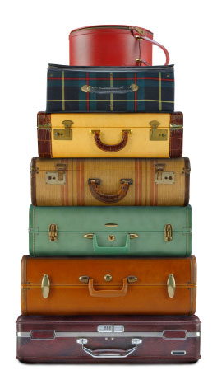
Morning Drop Off
Student must bring luggage to gym storage room
If luggage is dropped off during the day, bring to the office and it will be transferred to the gym storage room.
If coming to say “goodbye” “farewell” to your child, you must park at the church parking lot! (Because of elementary school and bus traffic).

Slide 6
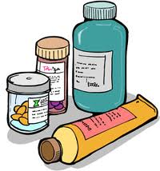
Getting ready to leave
Students will meet in the gym at the end of the day (2h45)
Get their luggage
Check with your assigned chaperon, let them know of any special information/medication you will be travelling with.
Must wait for Mr. Robichaud gives the OK before loading the bus.

Slide 7
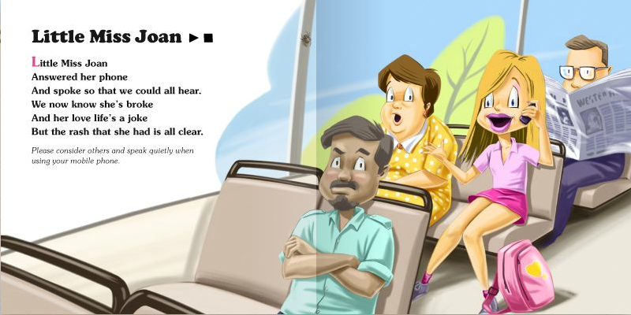
Bus etiquette
Be nice/respectful to the bus driver!
  Please / thank you / have a great day / etc.
  No screaming, no flash photography at night
Keep bus clean at all times. (garbage should be put in garbage and/or bag)
Bus washroom should be use only if necessary
If bus left messy, no food or drink will be allowed on the bus

Slide 8
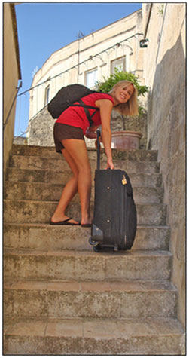
What to bring?
One suitcase
One carry-on
Students must be able to carry their own suitcase up the stairs!

Slide 9


What to bring that’s important!
Any medication! Must inform chaperon!
Watch!
Appropriate clothes (you are representing the school!) (Check weather before leaving)

Slide 10
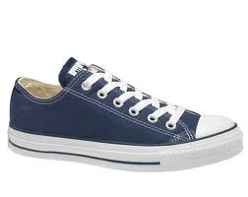
Comfortable shoes (sneakers for bike ride). No flip flops / Birkenstock. Do not try to break-in new shoes!
Light jacket/hoodie for evening.
Clothes (t-shirt, shorts, jeans, socks, underwear)
One nice outfit (dress/skirt/slacks for girls, button shirt with collar [tie-optional] for boys for our cruise night.

Slide 11
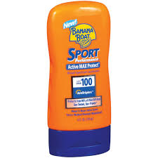
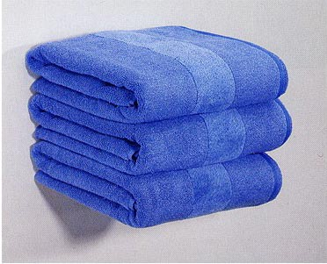
What else to bring…cont.
Toiletries (soap, shampoo, deodorant, toothbrush/toothpaste, etc.)
Sunscreen!
Sunglasses/ hat (if forecasting sun)
One towel per student will be provide in room. You might want to bring an extra towel/ facecloth.
Camera
Small umbrella (if forecasting rain)

Slide 12
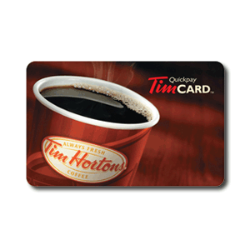
How much money do I need?
Breakfast and supper will be provided.
Students are responsible for:
  Meal on the way up and back
  Four lunches
  Minimum $60
  Good idea: purchase gift cards (Tim Horton/McDonalds) before leaving.
  Spending money will depend on your child’s spending habits.

Slide 13
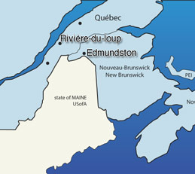
Going up….
Stopping in Edmunston for supper.
  McDonald
  Subway (in the mall)
  KFC

Slide 14
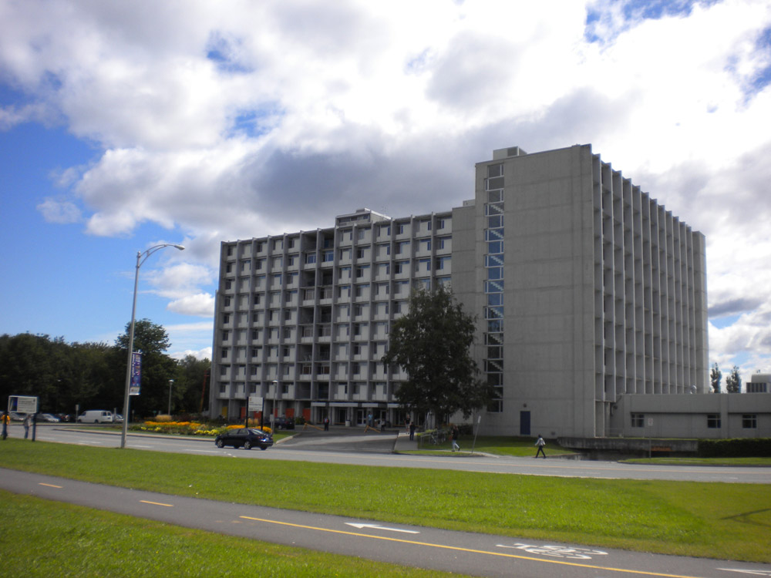
Arriving in Québec…
Go to the residence.
Meet our tour guides that will be with us for the remainder of our trip.
Curfew time will be determine each night on the behaviour of the group during that day.

Slide 15
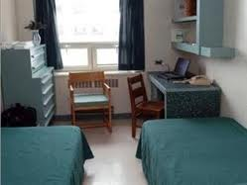
At the residence…
Students are allowed to visit around the residents only on the floors we occupy!
Students do not leave the floor unless they’ve notified a chaperon, and have a buddy.
If visiting someone else’s room, door must be left open!
Keep rooms clean and tidy!

Slide 16
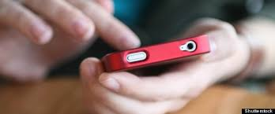
Electronic devises…
Students are responsible for any electronic devise they bring (phone, camera, computer/tablet, etc.)
We are not responsible for loss!!! Therefore be responsible for your own things!

Slide 17

Know what kind of phone plan you have so you won’t be surprise when the bill comes the next month (roaming charges $$$).
Internet available in rooms.
WiFi password will be given by Mr. Robichaud once it’s received from the tour guides.

Slide 18
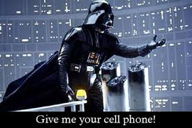
Cell phone…
Use of cell phone during tour time is not allowed!
Cell phone will be taken away and given back at an appropriate time.

Slide 19
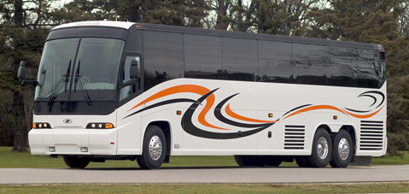
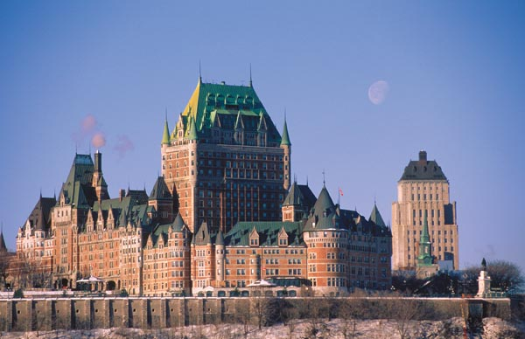
Day one
Travel to Québec City.
Stop for supper in Edmunston
Arrive at the residence approximately 10 pm
Get your assigned room
Meet your tour guide

Slide 20
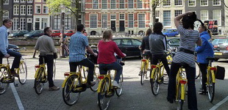
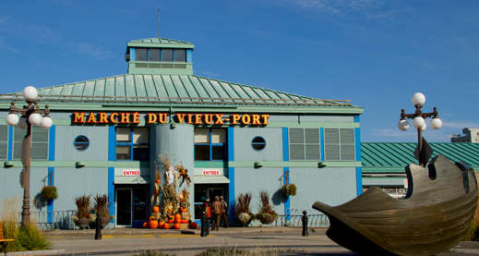
Day two
  Orientation with tour guides
  Bike tour along St-Charles River
  Visit Musée de la Civilisation
  Scavenger hunt in Le Marché du Vieux Port
  Dinner at Spag&Tini Le Resto
  Evening at the Village Huron

Slide 21
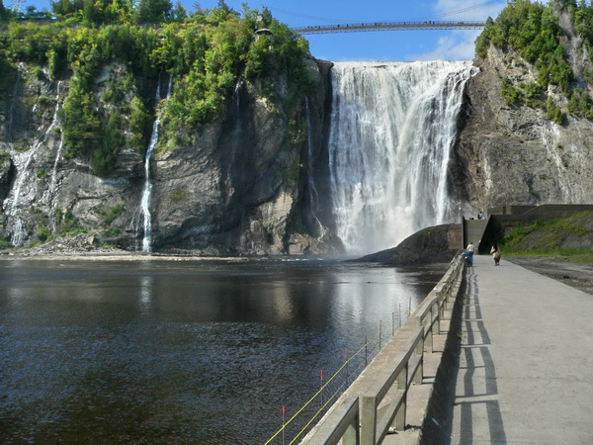
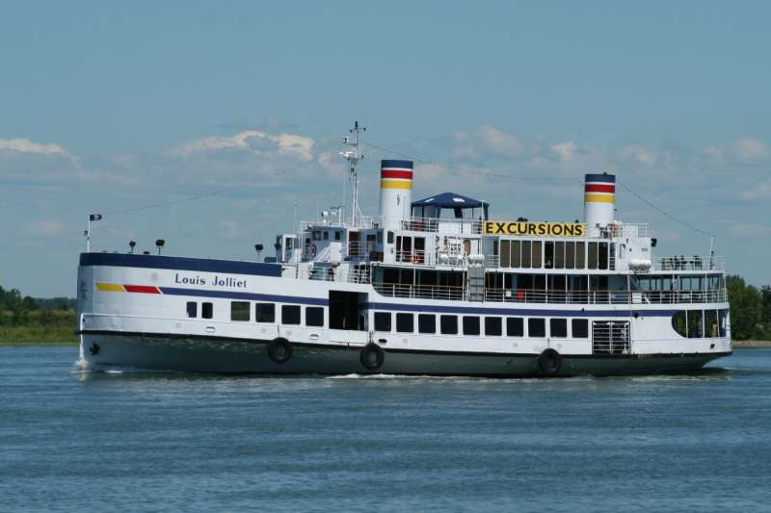
Day three
French-Canadian legends and storytelling at l’Atelier Paré, woodcarving shop.
Visit Ste-Anne de Beaupré Basilica
Montmorency Falls
Lunch and explore Old Québec (individual expense)
Return to residence to get dressed up
Dinner at Le Grand Café Québec
S.S. Louis Joliet, dance boat cruise

Slide 22
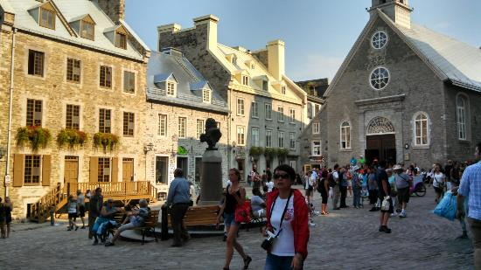
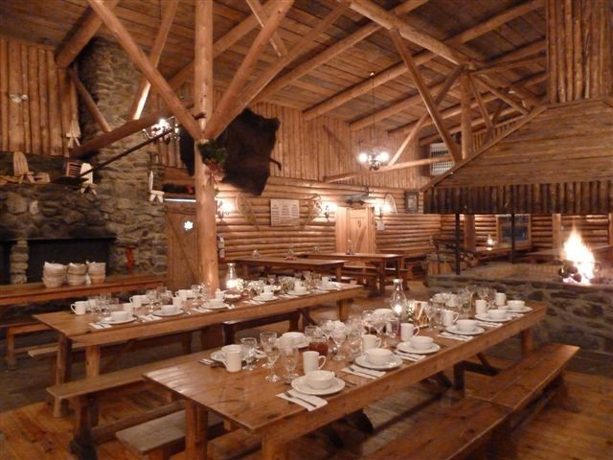
Day four
Discover Le petit Champlain, Place Royale, Château Frontenac
Multimedia presentation at Odyssée Canada
Lunch & explore Old Québec (individual expense)
Improv Game Show
Cabane à Sucre à Pierre (sugar shack) (meal, dancing & taffy pull)

Slide 23
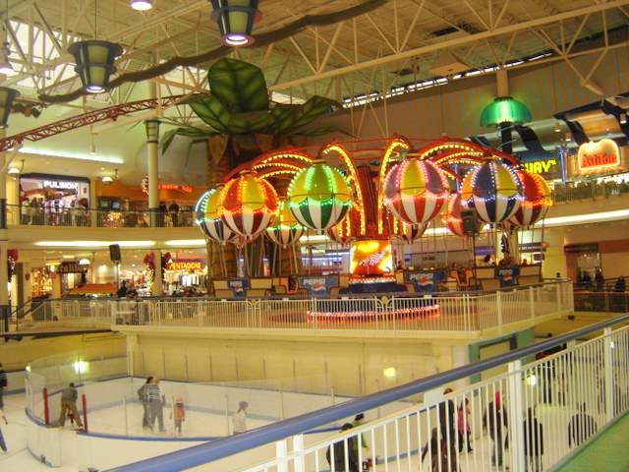

Day five
Shopping center & indoor amusement park
Hugs & handshake…as you bid farewell to your guides
Return to QMS at approximately at 11 pm.

