Slide 1

QMS Québec Trip 2015

Slide 2

To Reach Us
Jumpsteet Tours Emergency Contact
1-514-354-9990 / 1-800-663-4956

Slide 3
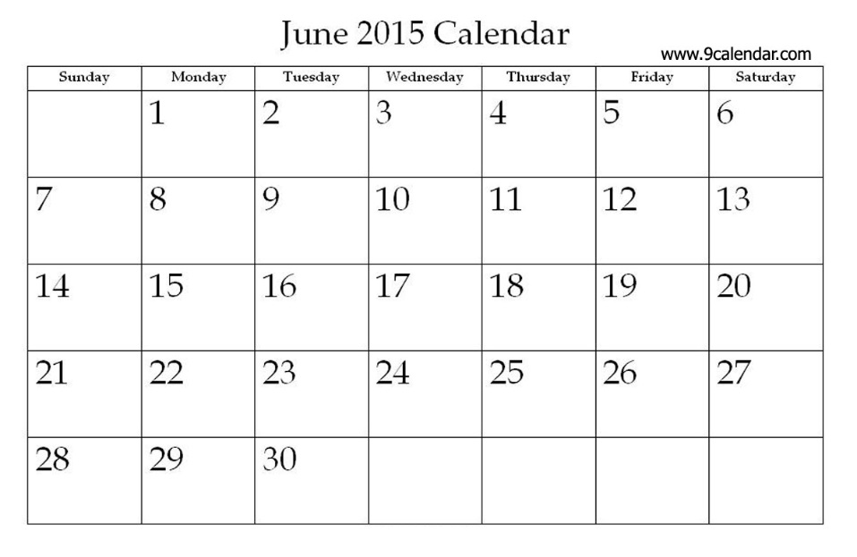
This year’s trip
107 students
8 chaperons
2 tour guides
Two bus
Leaving Friday June 12, 2015
Arriving Tuesday June 16, 2015

Slide 4
Chaperons
Gilles Robichaud (trip organizer)
Paul Chiswell
Mark Crowther
Bridget Miller
Brenda O’Leary
Emily O’Regan
TBA
TBA

Slide 5
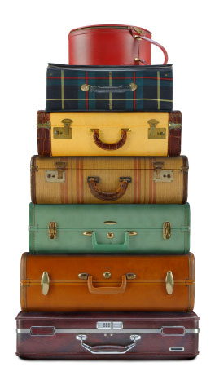
Morning Drop Off
Student must bring luggage to gym storage room
If luggage is dropped off during the day, bring to the office and it will be transferred to the gym storage room.
If coming to say “goodbye” “farewell” to your child, you must park at the church parking lot! (Because of construction, and bus traffic, we’re trying to minimize traffic flow).

Slide 6
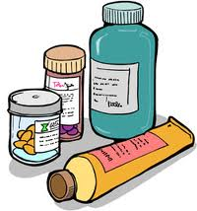
Getting ready to leave
Students will meet in the gym at the end of the day (2h45)
Get their luggage
Check with your assigned chaperon, let them know of any special information/medication you will be travelling with.
Must wait for Mr. Robichaud gives the OK before loading the bus.

Slide 7
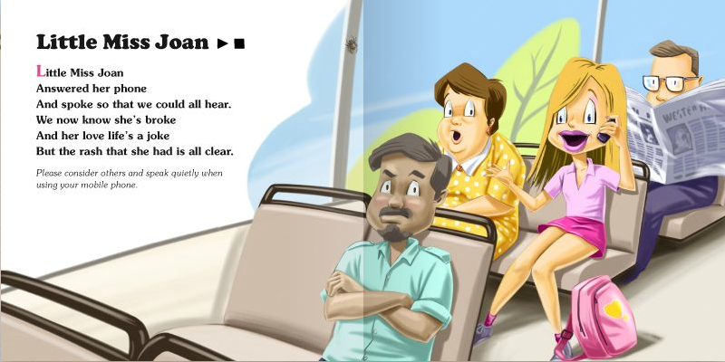
Bus etiquette
Be nice/respectful to the bus driver!
  Please / thank you / have a great day / etc.
  No screaming, no flash photography at night
Keep bus clean at all times. (garbage should be put in garbage and/or bag)
Bus washroom should be use only if necessary
If bus left messy, no food or drink will be allowed on the bus

Slide 8
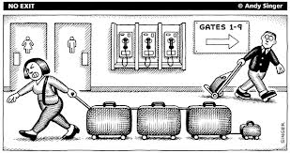
What to bring?
One suitcase
One carry-on
Students must be able to carry their own suitcase up the stairs!

Slide 9

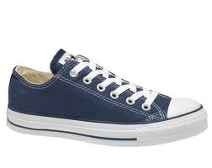
What to bring that’s important!
Any medication! Must inform chaperon!
Watch!
Appropriate clothes (you are representing the school!) (Check weather before leaving)
Comfortable shoes (sneakers for bike ride). No flip flops / Birkenstock. Do not try to break-in new shoes!
Light jacket/hoodie for evening.
Clothes (t-shirt, shorts, jeans, socks, underwear)
One nice outfit (dress/skirt/slacks for girls, button shirt with collar [tie-optional] for boys for our cruise night.

Slide 10
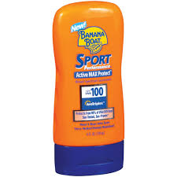
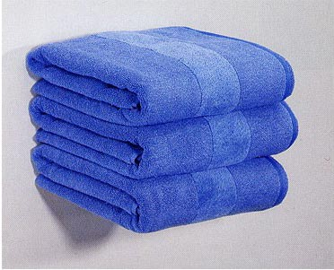
What to bring…cont.
Toiletries (soap, shampoo, deodorant, toothbrush/toothpaste, etc.)
Sunscreen!
Sunglasses/ hat (if forecasting sun)
One towel per student will be provided in room. You might want to bring an extra towel/ facecloth.
Camera
Small umbrella (if forecasting rain)

Slide 11

How much money do I need?
Breakfast and supper will be provided.
Students are responsible for:
  Meal on the way up and back
  Four lunches
  Minimum $60
  Good idea: purchase gift cards (Tim Horton/McDonalds) before leaving.
  Spending money will depend on your child’s spending habits.

Slide 12

Going up….
Stopping in Edmunston for supper.
  McDonald
  Subway (in the mall)
  KFC

Slide 13
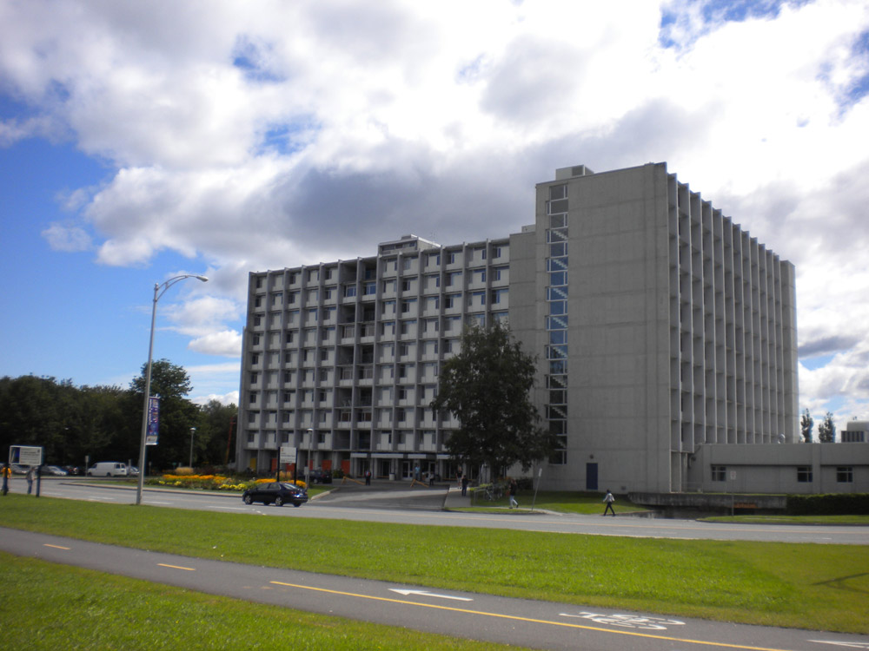
Arriving in Québec…
Go to the residence.
Meet our tour guides that will be with us for the remainder of our trip.
Curfew time will be determine each night on the behaviour of the group during that day.

Slide 14
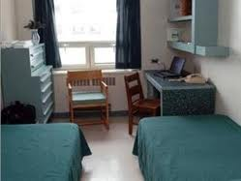
At the residence…
Students are allowed to visit around the residence only on the floors we occupy!
Students do not leave the floor unless they’ve notified a chaperon, and have a buddy.
If visiting someone else’s room, door must be left open!
Keep rooms clean and tidy!

Slide 15
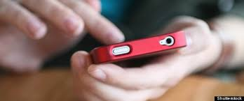
Electronic devices…
Students are responsible for any electronic devise they bring (phone, camera, computer/tablet, etc.)
We are not responsible for loss!!! Therefore, be responsible for your own things!
Know what kind of phone plan you have so you won’t be surprised when the bill comes the next month (roaming charges $$$).
Internet available in rooms.

Slide 16
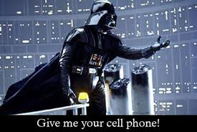
Cell phone…
Use of cell phone during tour time is not allowed!
Cell phone will be taken away and given back at an appropriate time.

Slide 17

Day one
Travel to Québec City.
Stop for supper in Edmunston
Arrive at the residence approximately 10 pm
Get your assigned room
Meet your tour guide

Slide 18
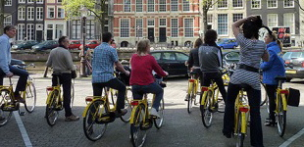
Day two
Saturday June 13, 2015
  Orientation with tour guides
  Bike tour along St-Charles River
  Visit Musée de la Civilisation
  Scavenger hunt in Le Marché du Vieux Port
  Huron Village for guided visit and dinner

Slide 19

Day three
French-Canadian legends and storytelling at l’Atelier Paré, woodcarving shop.
Visit Ste-Anne de Beaupré Basilica
Montmorency Falls
Lunch and explore Old Québec (individual expense)
Cabane à Sucre Napert (sugar shack) (meal, dancing & taffy pull)

Slide 20
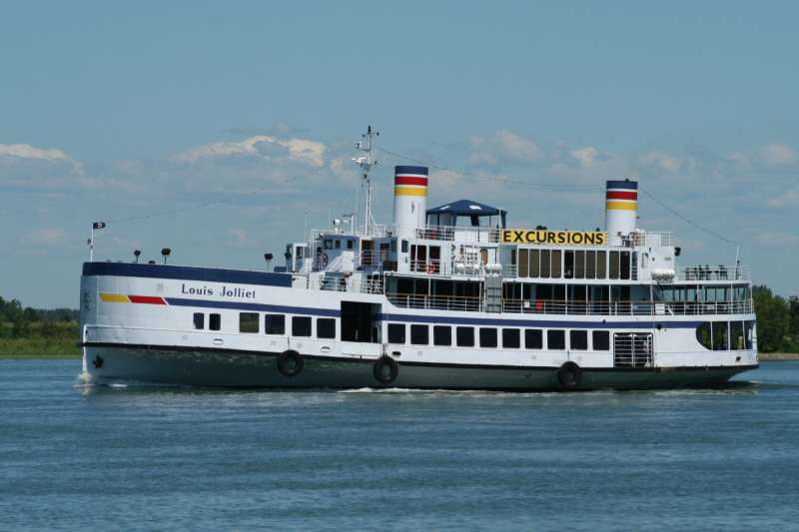
Day four
Visit l’Îlot fleurie (urban-art park)
Multimedia presentation at Odyssée Canada
Lunch & explore Old Québec (individual expense)
Improv Game Show
Return to residence to get dressed up
Dinner at l’Académie (fancy French restaurant)
S.S. Louis Joliet, dance boat cruise

Slide 21
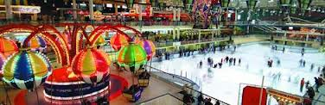
Day five
Shopping center & indoor amusement park
Hugs & handshake…as you bid farewell to your guides
Return to QMS at approximately at 11 pm.

Slide 22
BEHAVIOUR COMPLIANCE AGREEMENT
Quispamsis Middle School 189 Pettingill Road, Quispamsis, NB E2E 3S8
STUDENT NAME _____________________________________HOME TELEPHONE __________________________
ADDRESS ___________________________________________ POSTAL CODE ______________________________
DATE OF BIRTH _____________________________________ PLACE OF BIRTH ____________________________
SCHOOL CONTACT – Mr. Gilles Robichaud, Teacher, (506) 847-6210
PARENTS/GUARDIANS FULL NAMES ______________________________________________________________
PLACE/HOURS OF EMPLOYEMENT ________________________________________________________________
EMPLOYER PHONE NUMBER ________________________ CELL PHONE ______________________________
RELEASE
I, a participant in the excursion to Quebec City on June 12 – 16, 2015, sponsored by Quispamsis Middle School and approved by Anglophone School District South (ASD-S), agree to all the following conditions.
I agree to abide by all rules, regulations, policies, and standards of behavior established and to follow the specific instruction s of the chaperones in all instances. I understand that the safety and welfare of the group is of the utmost importance.
I understand that I am expected to participate in all group and individual activities and to complete all related assignments. I understand that all rules, policies and standards of ASD-S remain in force. I further understand that the use of alcohol is strictly forbidden.
In the event of any infraction of the rules, the chaperones reserve the right of final decision and may, if deemed necessary, place a collect telephone call to my parents. They may further send me home at my personal expense (or my parents/guardians) as a result of any action (s) deemed to be detrimental to the safety or well-being of the program or its participants.
As a representative of ASD-S, I agree to act in a responsible, ethical and positive manner so as to derive the greatest benefits from the Program and make a valuable contribution to the District.
I, therefore, certify that I have read and understand this behavior compliance agreement and that I agree to abide by all provisions.
________________________________________________ _______________________________
Student Signature Date
________________________________________________ _______________________________
Signature of Witness Date
I certify that I am the parent or legal guardian of the student named above ant that I have read the foregoing agreement. I agree to every part of this release and hereby relinquish any claim that I may have against the Program organizers, chaperones and Anglophone School District South both on my behalf and in my capacity as legal representative, while my child is a participant in this Program, during both supervised and unsupervised activities.
____________________________________________ _____________________________
Parent/Guardian Signature Date

