Slide 1



PSSC Parent Information Evening
K-8 Provincial Report Card Social Media / Internet Safety
Jeff Nelson Cpl Eugene Belliveau
Bridget Miller Cst Sebastien Lee
Lorraine Lamey

Slide 2

Background on Provincial Report Cards
In 2013, a collaborative decision was made to study and review reporting practices on student learning K-8. The New Brunswick Teachers’ Association (NBTA), school districts and the Curriculum Branch of the Department of Education and Early Childhood Development all saw the need for change and worked together to review research, reporting practices in other jurisdictions and to consult with educators, students and parents to create proposed recommendations.
The ultimate goal of the review of the reporting process was to:
- improve accuracy and consistency in reporting,
- increase alignment with provincial curricular learning outcomes, and
- provide clearer descriptions about what students know and are able to do.

Slide 3
Assessment and Evaluation Practices
Assessment and evaluation are critical to the teaching and learning process. By collecting and examining evidence of students’ learning on an ongoing basis, educators are able to make informed decisions about instruction to support improved student learning. They are well positioned to personalize instruction and maximize learning for all students as they compare the various forms of evidence with the learning outcomes or goals that students are expected to achieve. These actions and decisions directly support New Brunswick’s vision: Working together, in inclusive learning environments, to support each child and student in reaching their full potential. Over the past several years, New Brunswick, like many other jurisdictions, has placed a greater emphasis on assessment and how it can positively impact learning.
Educators at all levels are encouraged to be guided by the following principles of assessment:
- The purpose of all assessment is to obtain evidence of learning.
- Assessment is a powerful tool to effect change for improvement.
- Assessment is an integral component of an evidence-based, decision-making model.
- The effectiveness of assessment depends on users’ understanding and appropriate application of results.

Slide 4
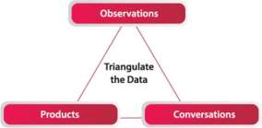
Triangulation of Data
To effectively evaluate and report on student learning, it is important that educators gather evidence from a variety of sources over time to ensure they have a comprehensive understanding of the learning of all students. Three generally agreed upon categories of evidence are observations, products and conversations (Lincoln & Guba, 1985; Davies, 2011; Cameron & Gregory, 2014).
The following are examples of types of evidence within each category:
- observations (e.g., checklists, presentations, performance
assessments, experiments being conducted);
- products (e.g., projects, benchmark assessment, quizzes,
end-of-unit tests, experiments, writing samples, journals/learning logs);
- conversations (e.g., self-assessments, interviews, conferences,
peer feedback).

Slide 5
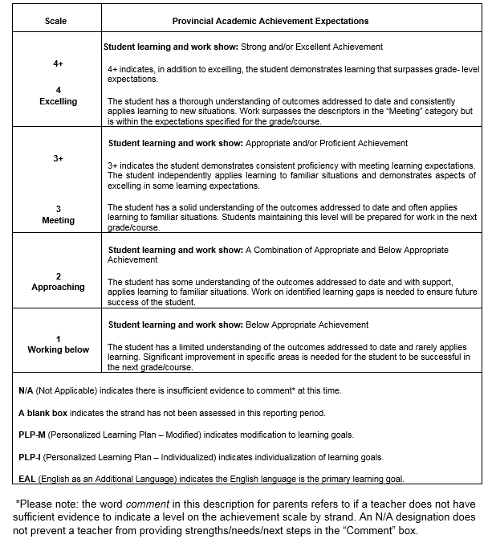
In a standards-based evaluation system, we have to account for each student’s learning in relation to the expectations for that grade and subject area. While our written and verbal comments may speak to the amount of progress students have made in their learning, the evaluation must reflect their accomplishments in relations to the standards for the subject area and level at which they are working.

Slide 6
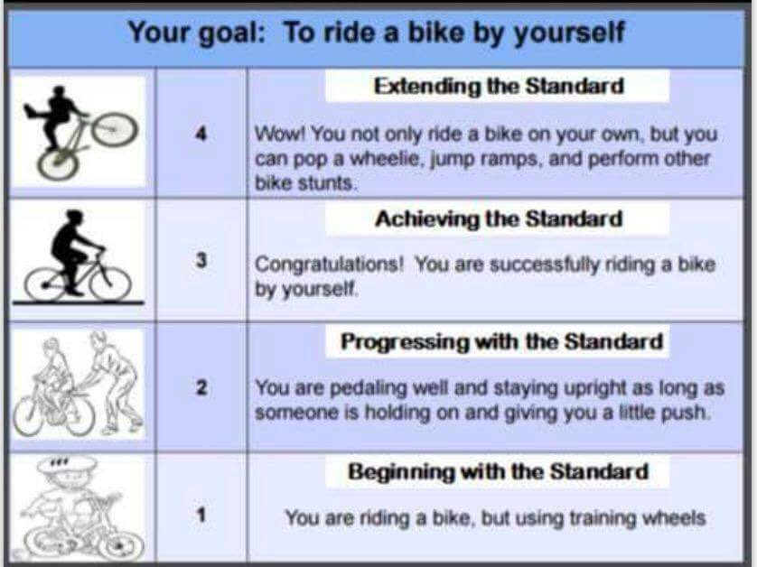

Slide 7
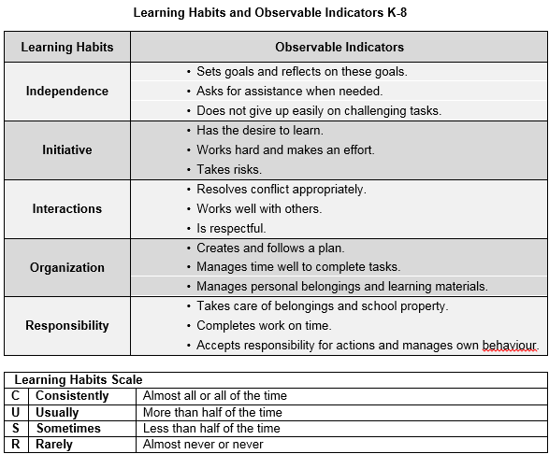
The development of work habits is an important part of a student’s learning as developing such learning habits or behaviours impacts an individual’s success in school and in life.
At Grades 6-8, each subject area teacher reports on the learning habits.

Slide 8
QUESTIONS

