Slide 1
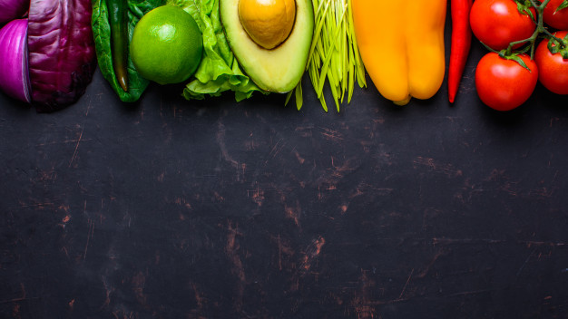


2020
Give Us a Try
Elementary-Middle Menu
 | Monday | Tuesday | Wednesday | Thursday | Friday
Week 1 Sept 14- 18 Sept 28-Oct 2 Oct 12-16 Oct 26-30 Nov 9-13 Nov 23-27 Dec 7-11 | Spaghetti with Lean Meat Sauce or Marina Sauce, with Caesar Salad, Fruit of the Day | Chicken Strips, Mashed Potato & Hot Veggies with Side of Fruit | Lunchables 6 Pinwheel Ham and Cheese Sandwiches Veggie Sticks Mini Rice Krispie Square Fruit of the Day | Hamburger with Baked Potato Wedges or Veggie Sticks & Dip and Side of Fruit | Lunchables 4 Garlic Breadsticks Pizza Sauce Cucumber Slices Mini muffin Fruit of the Day
 | Daily: Pizza, Hamburger, Chicken Burger, Soft Beef Tacos, Snack Wraps
Week 2 Sept. 21-25 Oct 5-9 Oct 19-23 Nov 2-6 Nov 16-20 Nov 30-Dec 4 Dec 14-18 | Vegetarian or Meat Lasagna with Tossed Salad | Homemade Pancakes topped with Berries, with or without Ham Slice, Cucumber Slices | 2 Soft Taco Filled With Beef, with Tossed Garden Salad Fruit of the Day | Chicken Burger, Baked Wedges or Veggie Sticks & Dip | Lunchables Naan Wedges Pizza Sauce Pepperoni Slices Shredded Cheese Mini Brownie Fruit of the Day
 | Daily: Pizza, Hamburger, Chicken Burger, Soft Beef Tacos, Snack Wraps
Meal Price : Includes Milk Sandwiches: Grilled Cheese Chicken Salad Sandwich Egg Drinks: 250ml Milk Bottled Water Frozen Juice Cup Juice Boxes Salads: Caesar Salad Garden Salad Add Chicken to your salad Other Pizza Chicken Burger Hamburger CheeseBurger Snack Wraps Snacks: Veggies and Dip Crackers & Cheese Fresh Fruit Fruit Cup Apple Slices w/Dip Pudding Cup Homemade Cookie Homemade Muffin Homemade Banana Bread | $6.00 $3.25 $3.50 $3.00 $0.55 $1.50 $1.50 $1.25 $3.50 $3.30 $1.25 $3.35 $4.25 $4.00 $4.75 $3.75 $1.50 $1.75 $1.25 $2.25 $3.00 $2.00 $0.75 $1.50 $1.50

