Slide 1

From middle school to high school
Moving Up

Slide 2
Middle school was …
FUN…

Slide 3


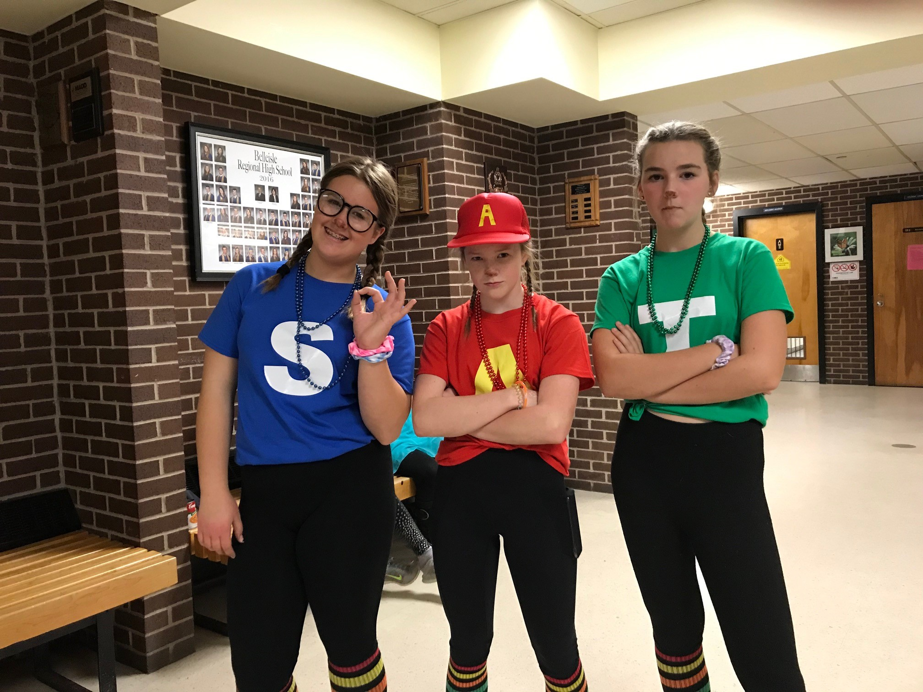

Slide 4
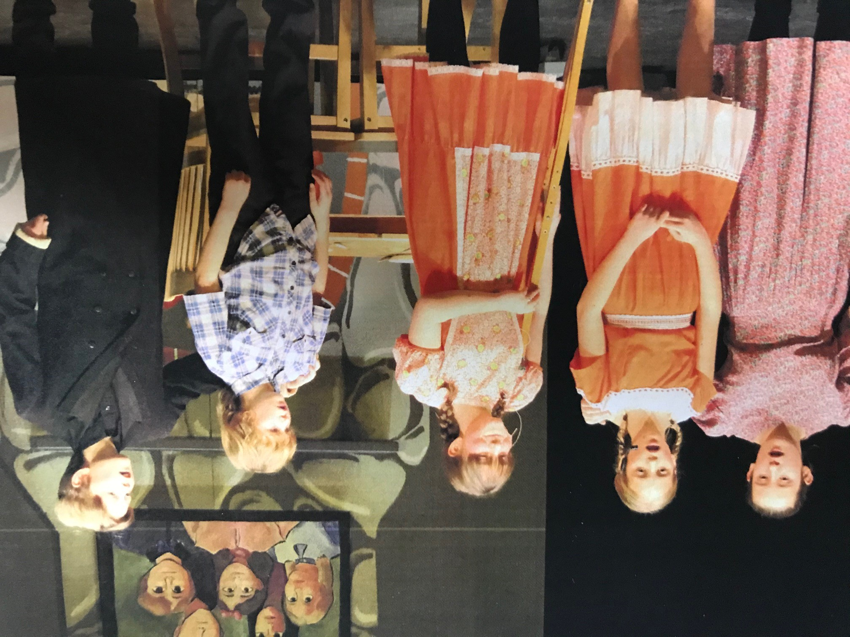

Slide 5
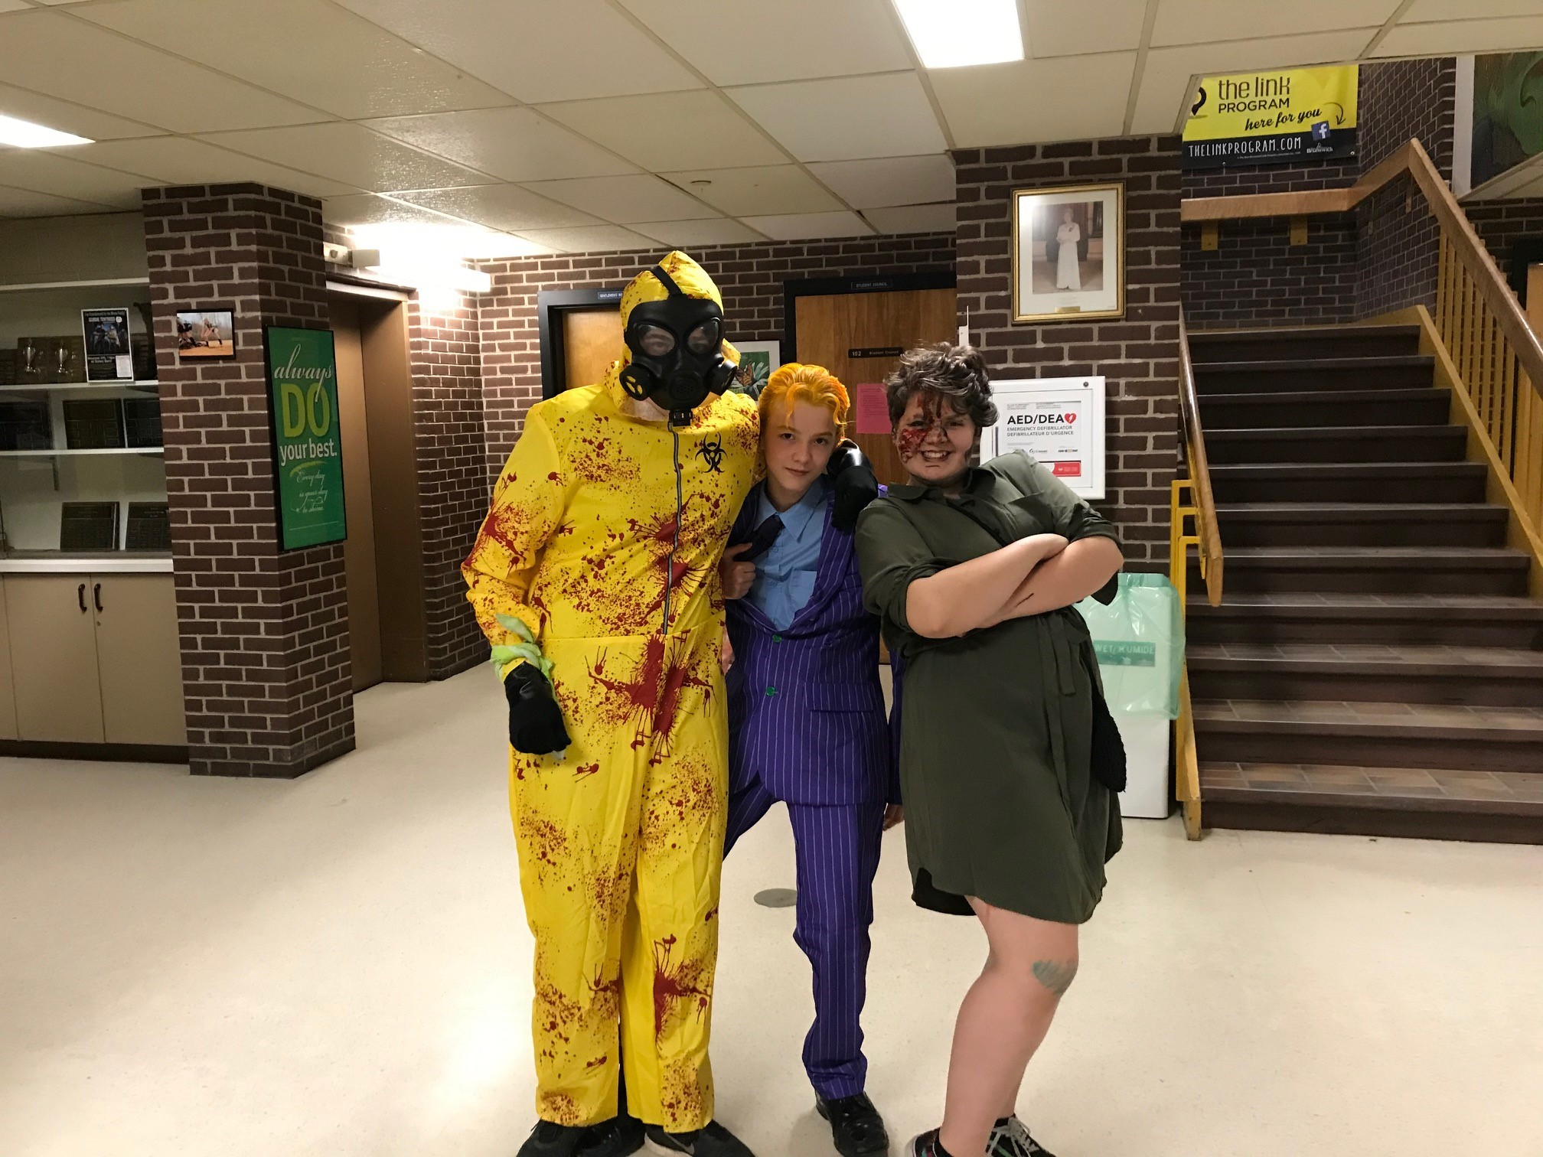

Slide 6
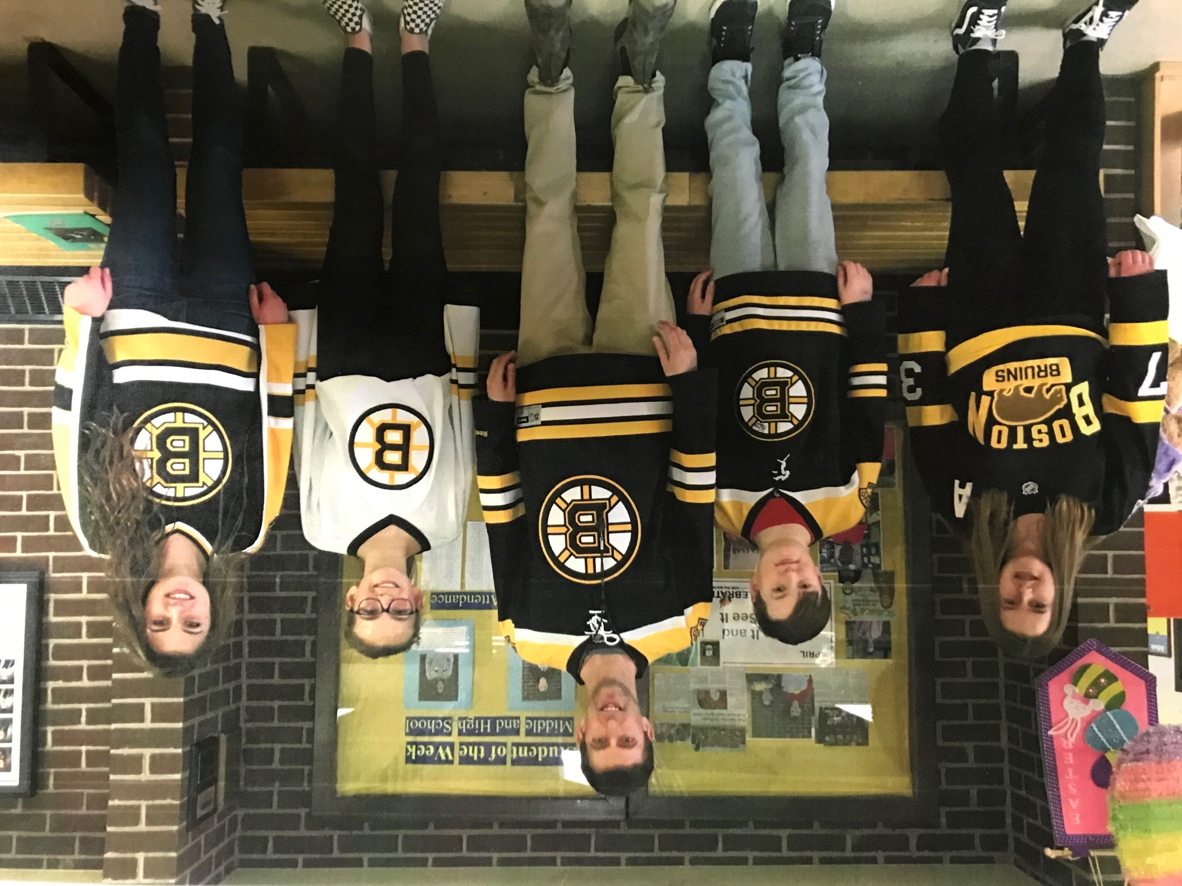

Slide 7
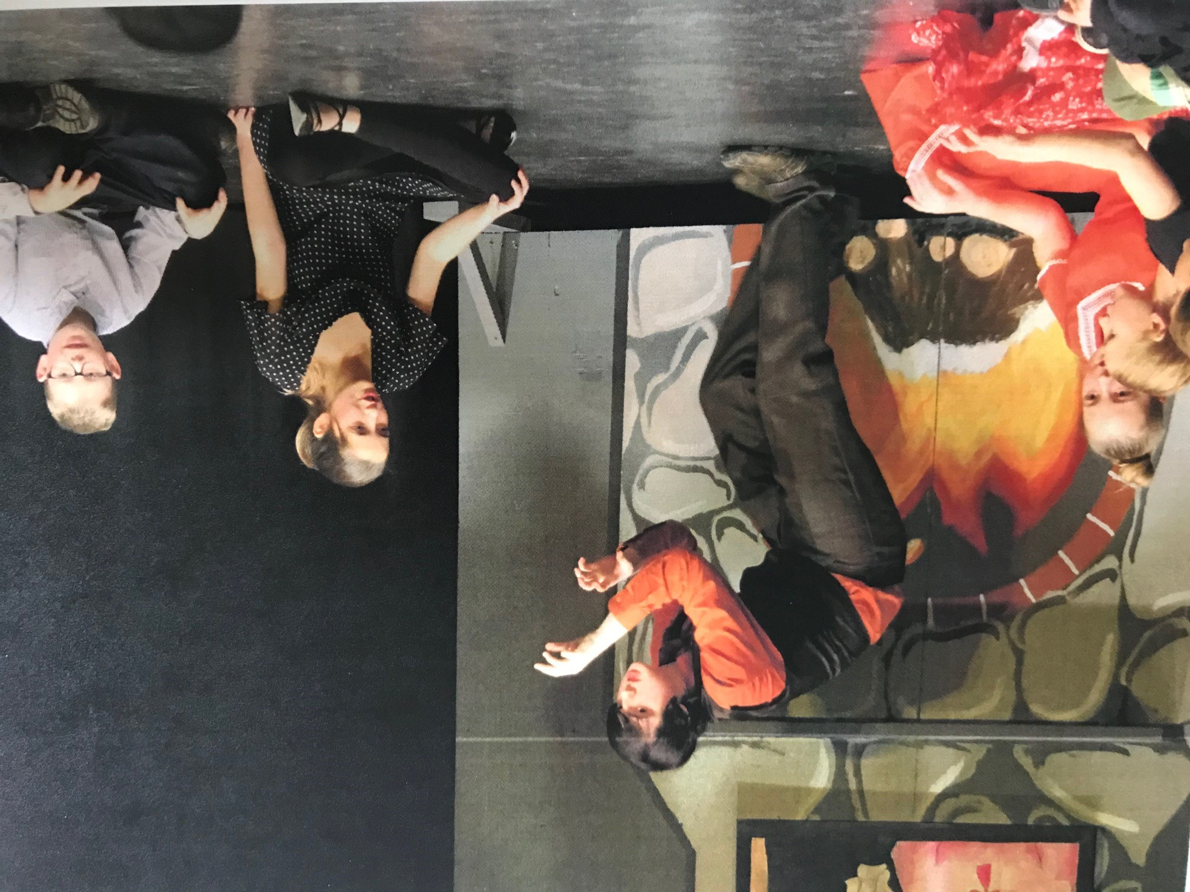

Slide 8
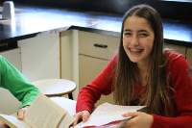
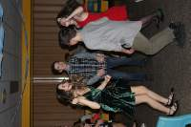
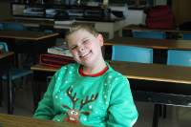

Slide 9
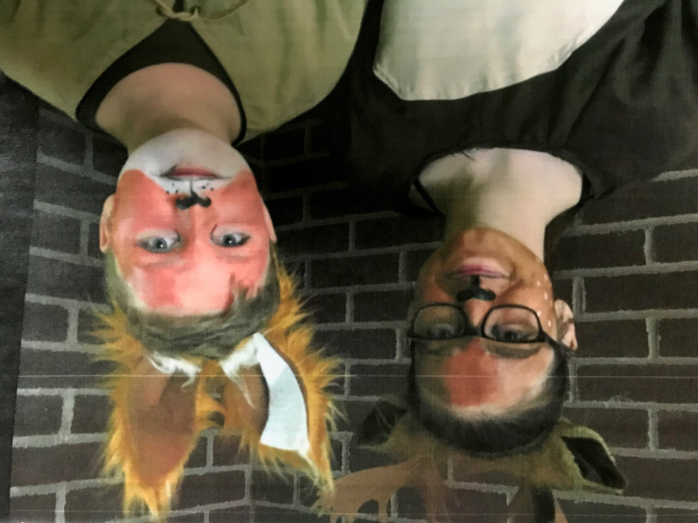

Slide 10
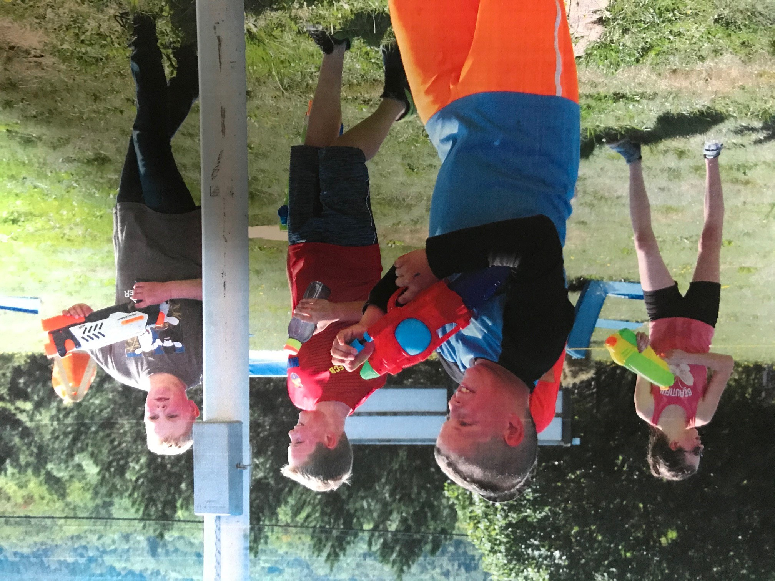

Slide 11
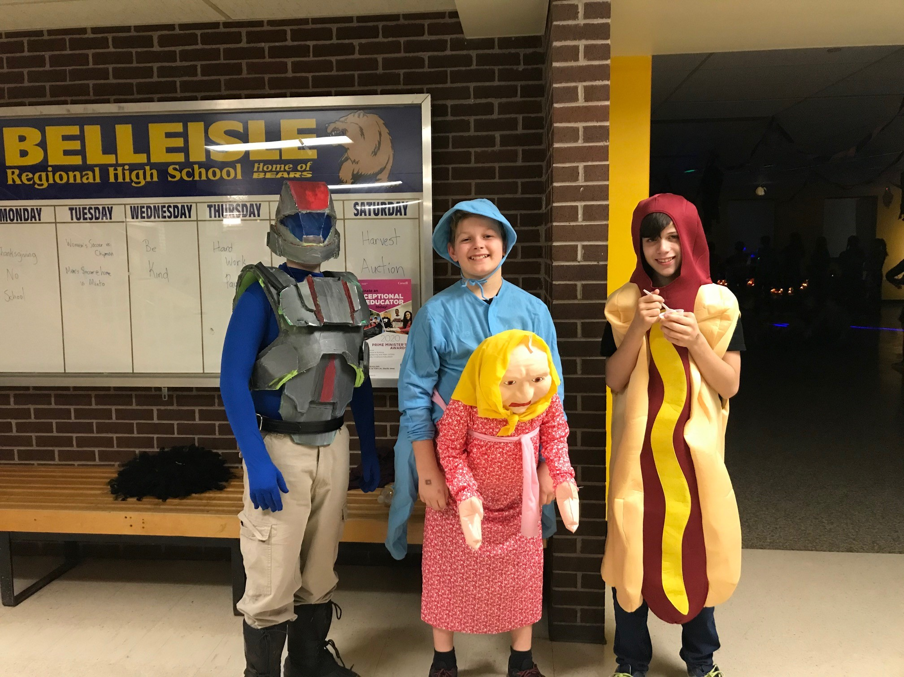

Slide 12
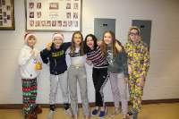
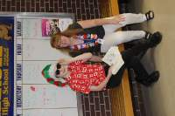
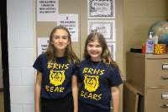

Slide 13
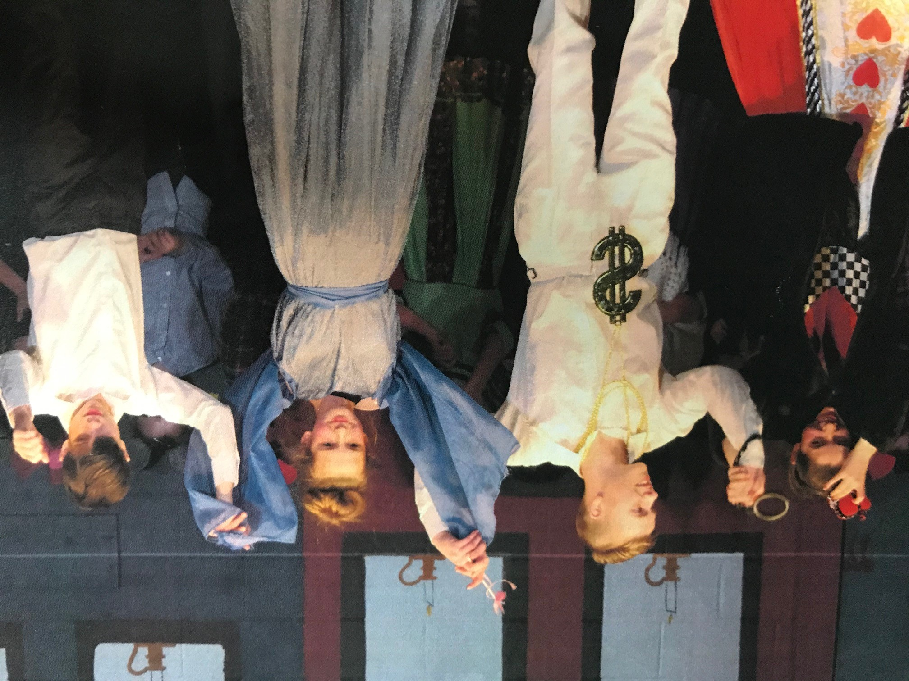

Slide 14
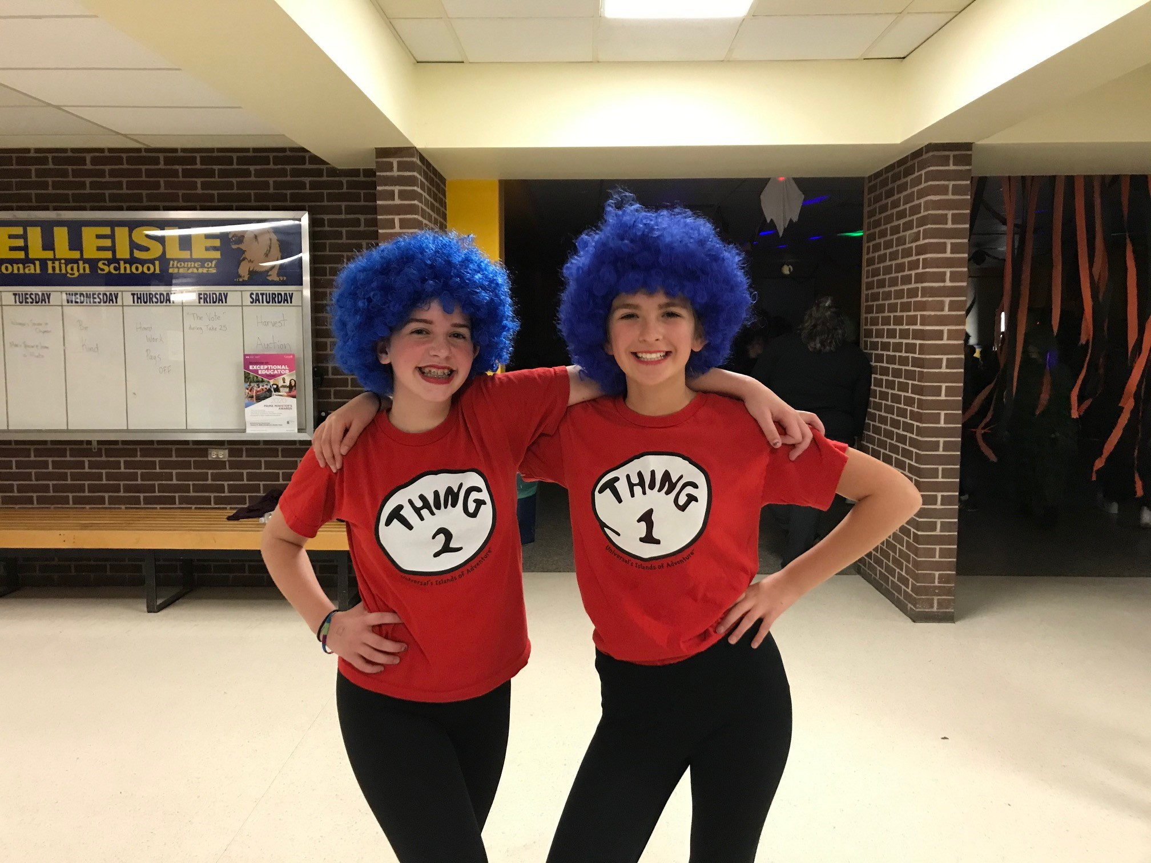

Slide 15
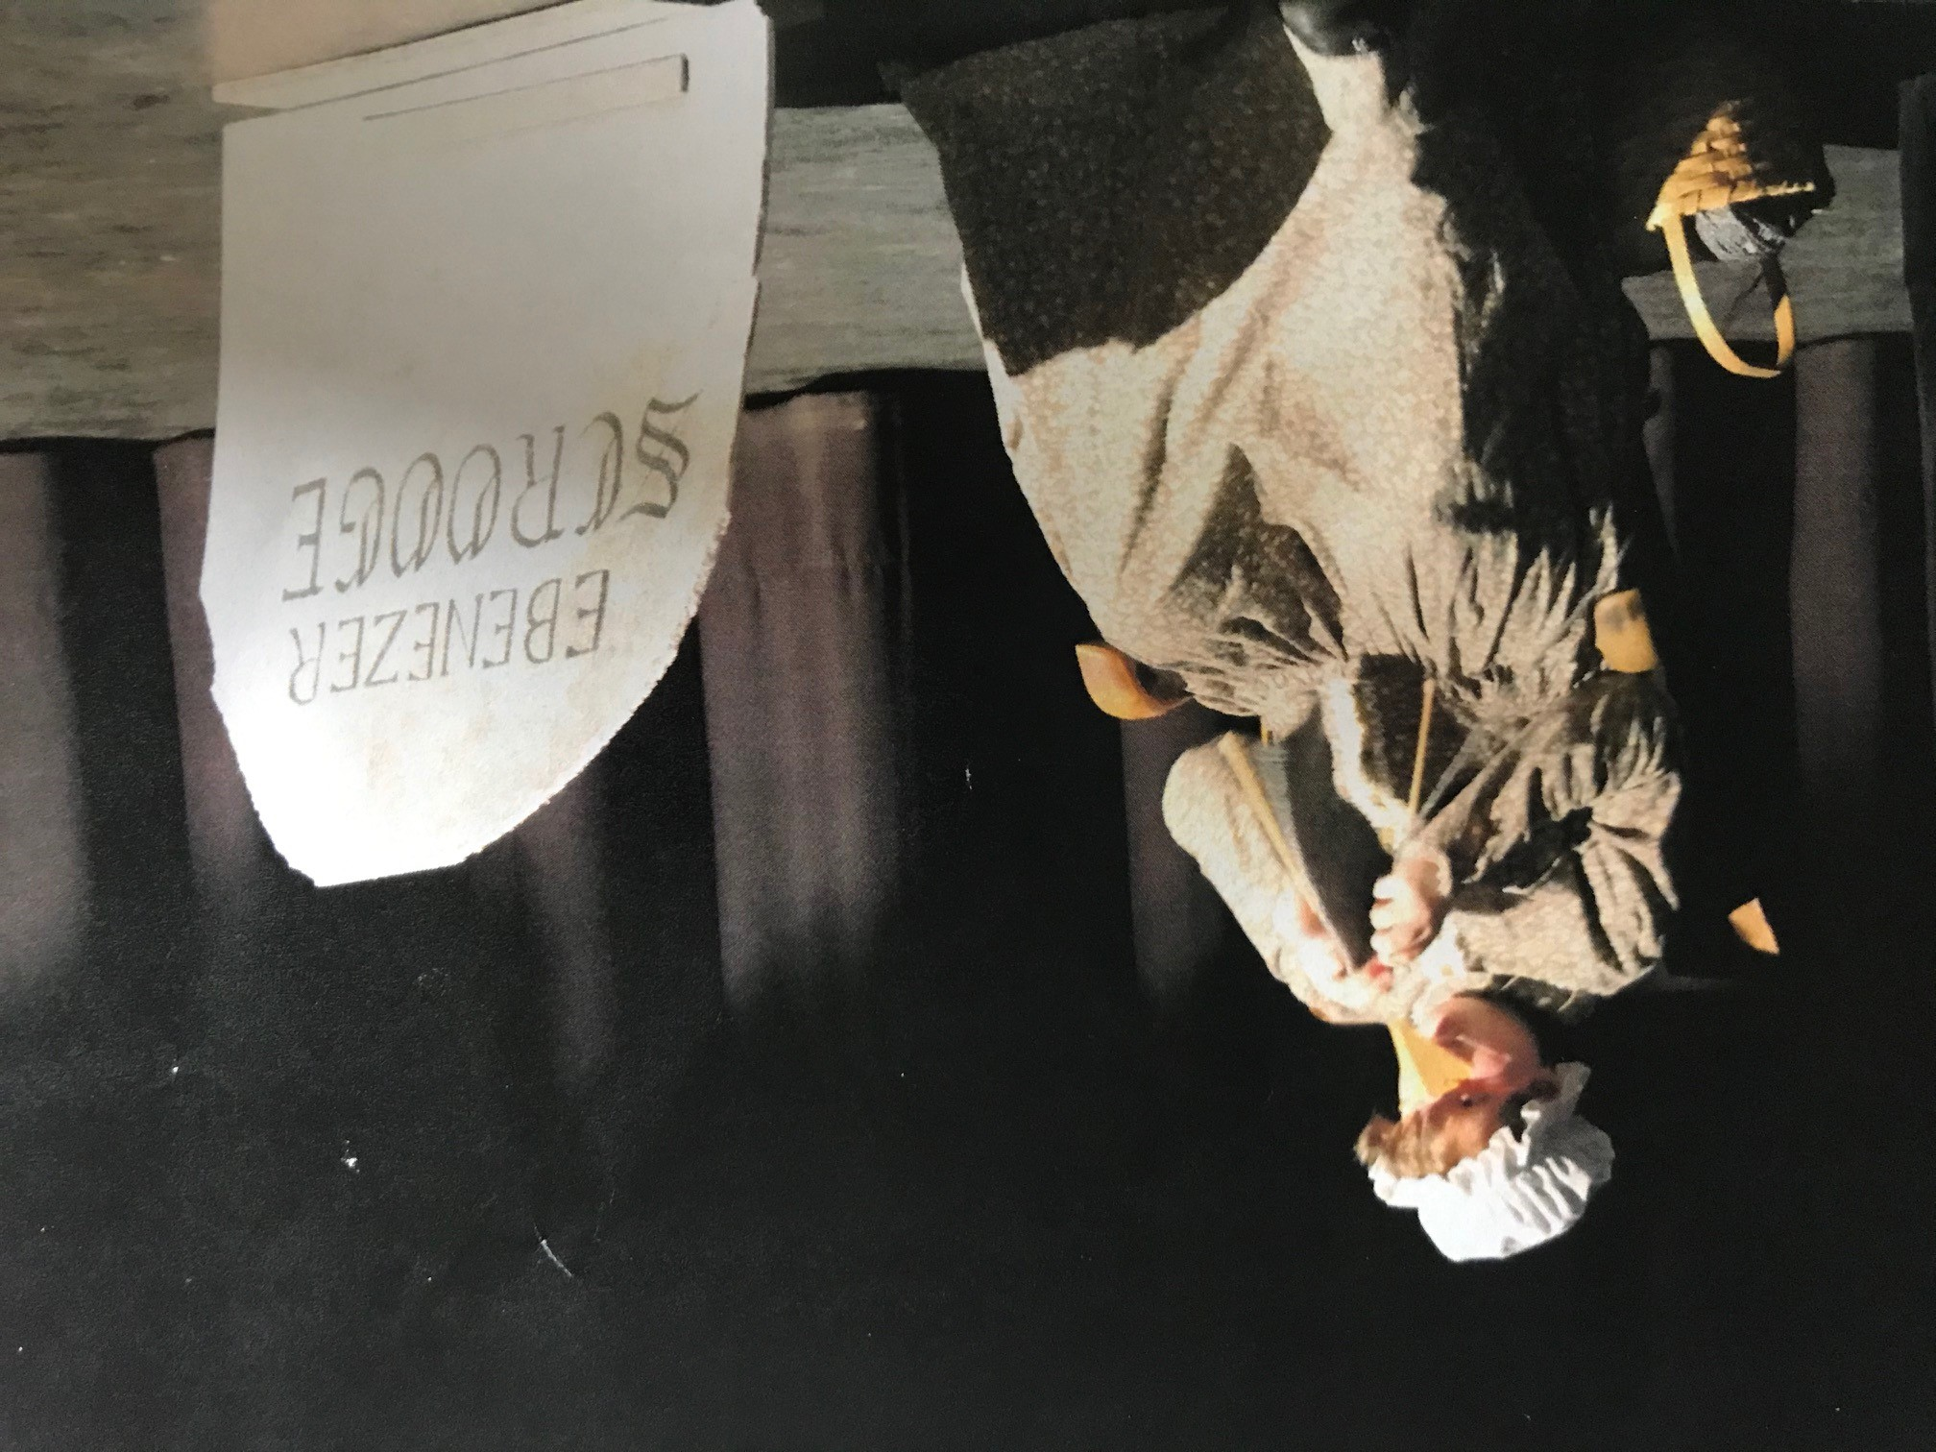

Slide 16
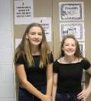
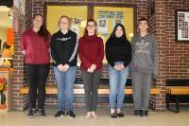

Slide 17
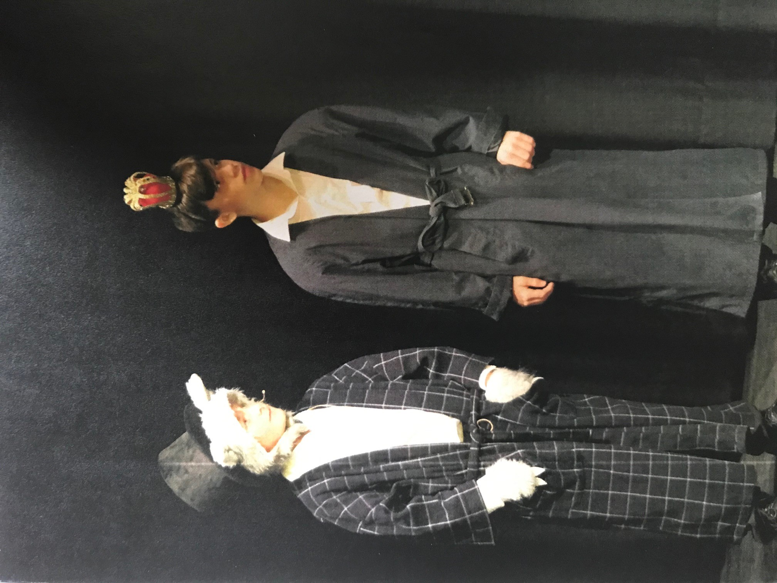

Slide 18
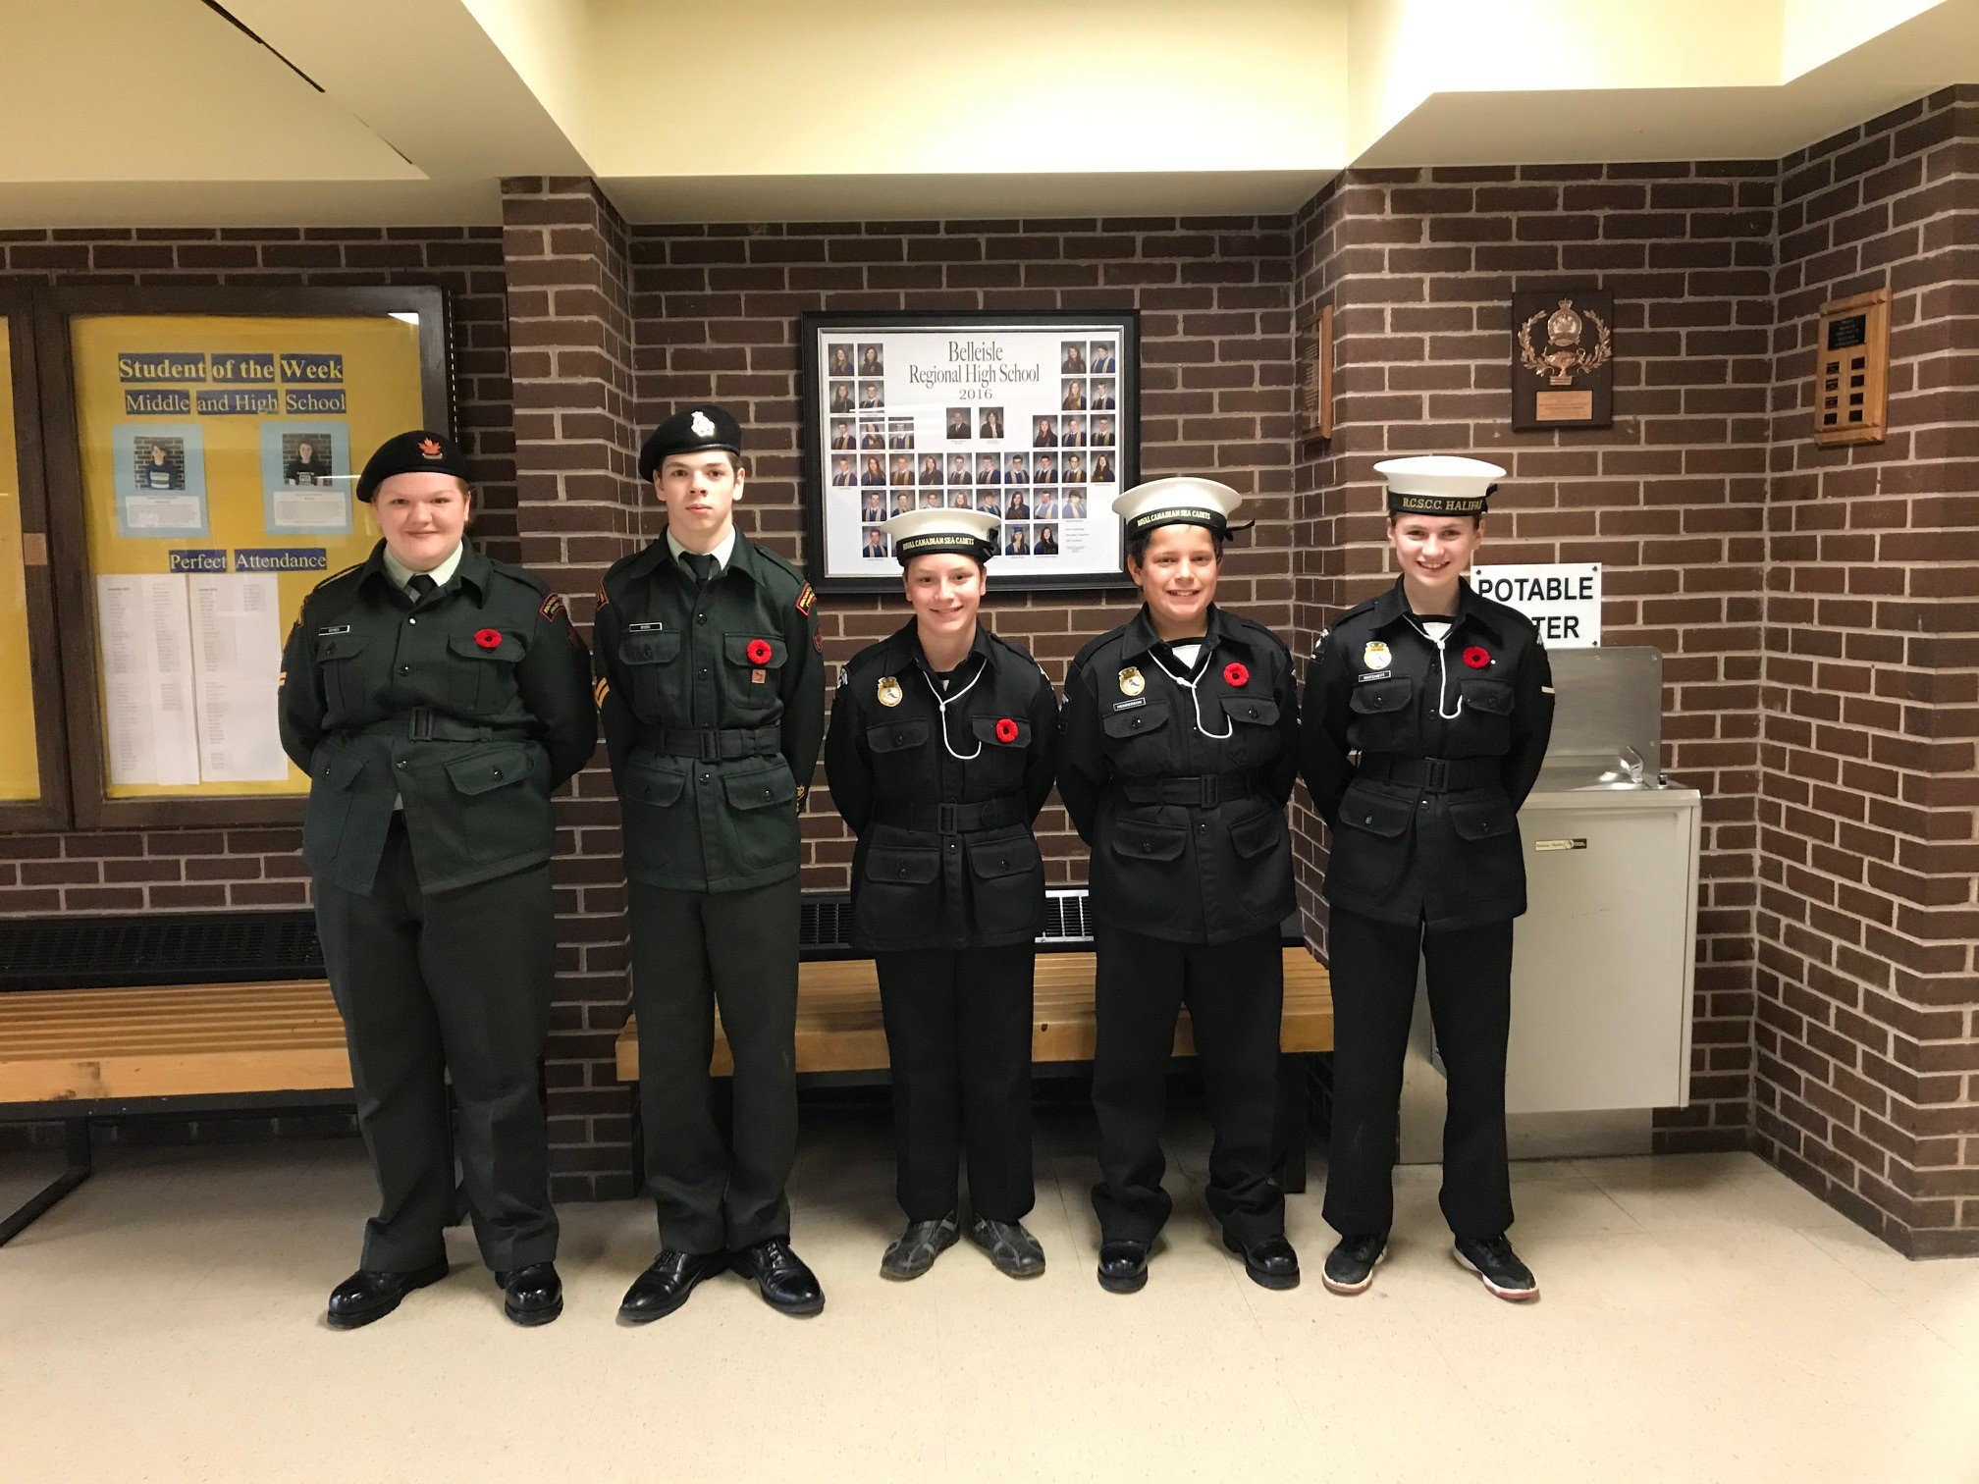

Slide 19
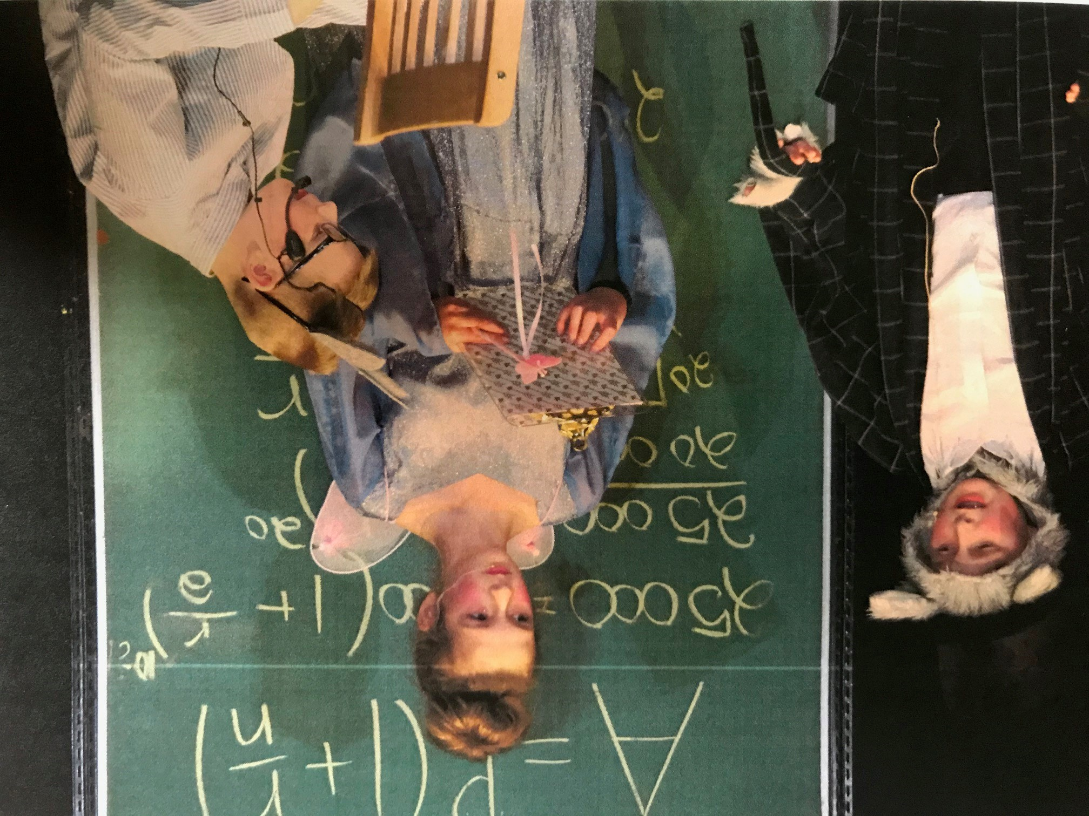

Slide 20
High school…
Will be even BETTER!

Slide 21

the future grads of 2024
In alphabetical order…

Slide 22
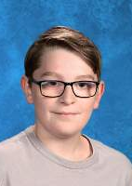
Kalan bent
“Be Bold! Be Courageous! Be your best.”
Gabrielle Giffords

Slide 23
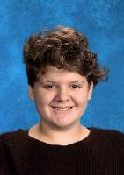
Emmarose Blanchard-Godsoe
“To accomplish great things, we must not only act, but also dream, not only plan, but also believe.”
Anatole France

Slide 24
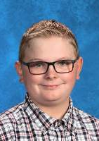
Anthony boyd
“Fall forward. Every failed experiment is one step closer to success. You’ve got to take risks.”
Denzel Washington

Slide 25
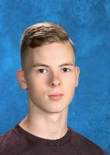
Tanner byers
“If everyone is moving forward together, then success takes care of itself.”
Henry Ford

Slide 26
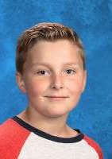
Carter cole
Awarded recognition for being reliable, co-operative and helpful.
“Don’t ever confuse the two, your life and your work. The second is only part of the first.”
Anna Quindlen

Slide 27
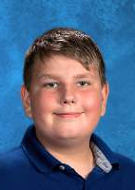
Jayden dietrich
“Life is my college. May I graduate well, and earn some honors.”
Louisa May Alcott

Slide 28
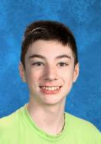
Ethan forgrave
“Start where you are.
Use what you have.
Do what you can.” Arthur Ashe

Slide 29
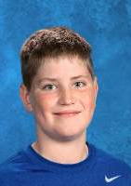
Isaiah hall
“Empathy has gotten me so much farther in not only my life, but in my career.”
Ryan Reynolds

Slide 30
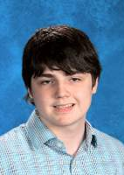
Caleb james
“Your life is your story, and the adventure ahead of you is the journey to fulfill your own purpose and potential.”
Kerry Washington

Slide 31
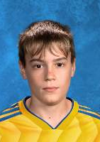
Tristan johansen-morris
“Your education is a dress rehearsal for a life that is your lead.” Nora Ephron

Slide 32
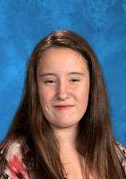
Grace johnstone-ward
Awarded recognition for being an avid reader.
“There is no script. Live your life. Soak it all in.”
Dick Costolo

Slide 33
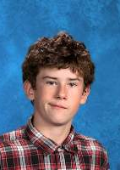
Rupert johnstone-ward
“Your path is your character defining itself more and more everyday, like a photograph coming into focus.” Jodie Foster

Slide 34
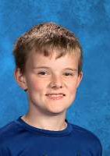
Dylan langer
“Intelligence plus character – that is the goal of true education.” Martin Luther King Jr.

Slide 35
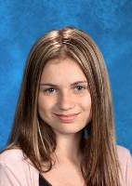
Reanna matchett
Awarded recognition for showing improvement and determination.
“The beautiful thing about learning is that no one can take it away from you.” B. B. King

Slide 36
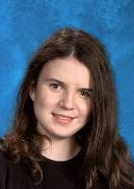
Rebekah McCreadie
“Always aim high, work hard, and care deeply about what you believe in.” Hillary Clinton

Slide 37
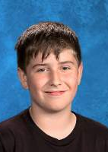
Chase mcmillan
“Success is the ability to go from one failure to another with no loss of enthusiasm.”
Winston Churchill

Slide 38
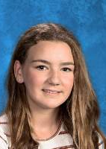
Raya mcmillan
“You have to dance a little bit before you step out into the world each day, because it changes the way you walk.” Sandra Bullock

Slide 39
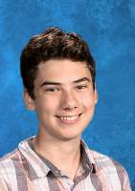
Odin mitchell
“If you hear a voice within you say “you cannot paint,” then by all means paint, and that voice will be silenced.” Vincent Van Gogh

Slide 40
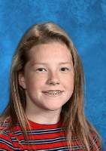
Lauren muir
“The only impossible journey is the one you never begin.” Anthony Robbins

Slide 41
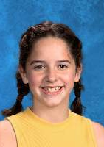
Morgan ness
Awarded recognition of having demonstrated school spirit.
“Take pride in how far you’ve come. Have faith in how far you can go. But don’t forget to enjoy the journey.” Michael Josephson

Slide 42
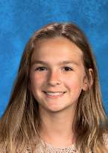
Emma pope
Awarded recognition for showing initiative and improvement.
“If you want something you’ve never had, you must be willing to do something you’ve never done.” Thomas Jefferson

Slide 43
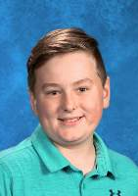
Emmerson pope
“When you take risks, you learn that there will be times when you succeed and there will be times when you fail, and both are equally important.” Ellen DeGeneres

Slide 44
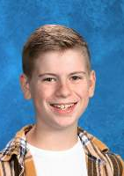
Austin reicker
Awarded recognition for making a great effort in Grade 8 Mathematics.
Awarded recognition of having the highest standing in Grade 8 French Immersion Language Arts.
“Go confidently in the direction of your dreams. Live the life you have imagined.”
Henry David Thoreau

Slide 45
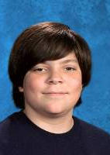
Thomas ricketson
“Things turn out best for people who make the best out of the way things turn out.”
Art Linkletter

Slide 46
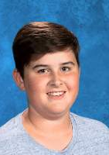
Jackson sherwood
“Don't let the noise of others' opinions drown out your own inner voice. And most important, have the courage to follow your heart and intuition.”
Steve Jobs

Slide 47
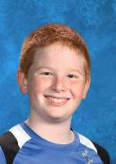
Ryder smith
Awarded recognition for making an outstanding effort in grade 8 English Language Arts.
Awarded recognition for demonstrating a real love for the arts and/or who has made an artistic contribution to the school.
“If you can imagine it, you can achieve it; if you can dream it, you can become it.”
William Arthur Ward

Slide 48
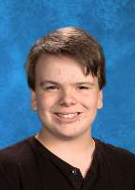
Lukas stiles
“There may be days when you’ll say to yourself, ‘I can’t. I literally can’t even.’ But you can! You can even!”
Katie Couric

Slide 49
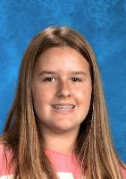
Isabelle taylor
“Every person you meet knows something you don’t; learn from them.”
H. Jackson Brown Jr.

Slide 50

Leila Tremblay-Leblanc
Awarded recognition for demonstrating school spirit.
“Life is an improvisation. You have no idea what's going to happen next and you are mostly just making things up as you go along.” Stephen Colbert

Slide 51

Hannah vail
“The future belongs to those who believe in the beauty of their dreams.”
Eleanor Roosevelt

Slide 52

Ronin Sawyer
“Fortune does favor the bold, and I promise that you will never know what you’re capable of unless you try.”
Sheryl Sandberg

Slide 53
Have a great summer!
Social distance stay safe have fun making memories
See you all in September for Grade 9!

Slide 54
Music Credit-High hopes panic at the disco
Thank you to all the students for the memories we made this year.
It was a year we won’t forget!
Moving Up 2020

