Slide 1
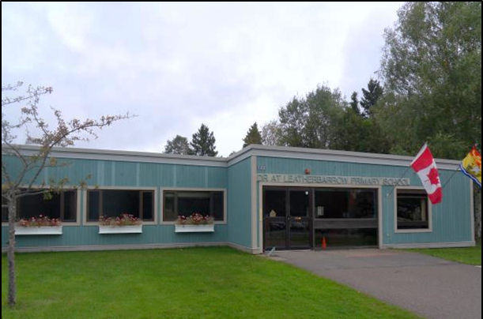


New & Noteworthy at
Leatherbarrow Primary

Slide 2
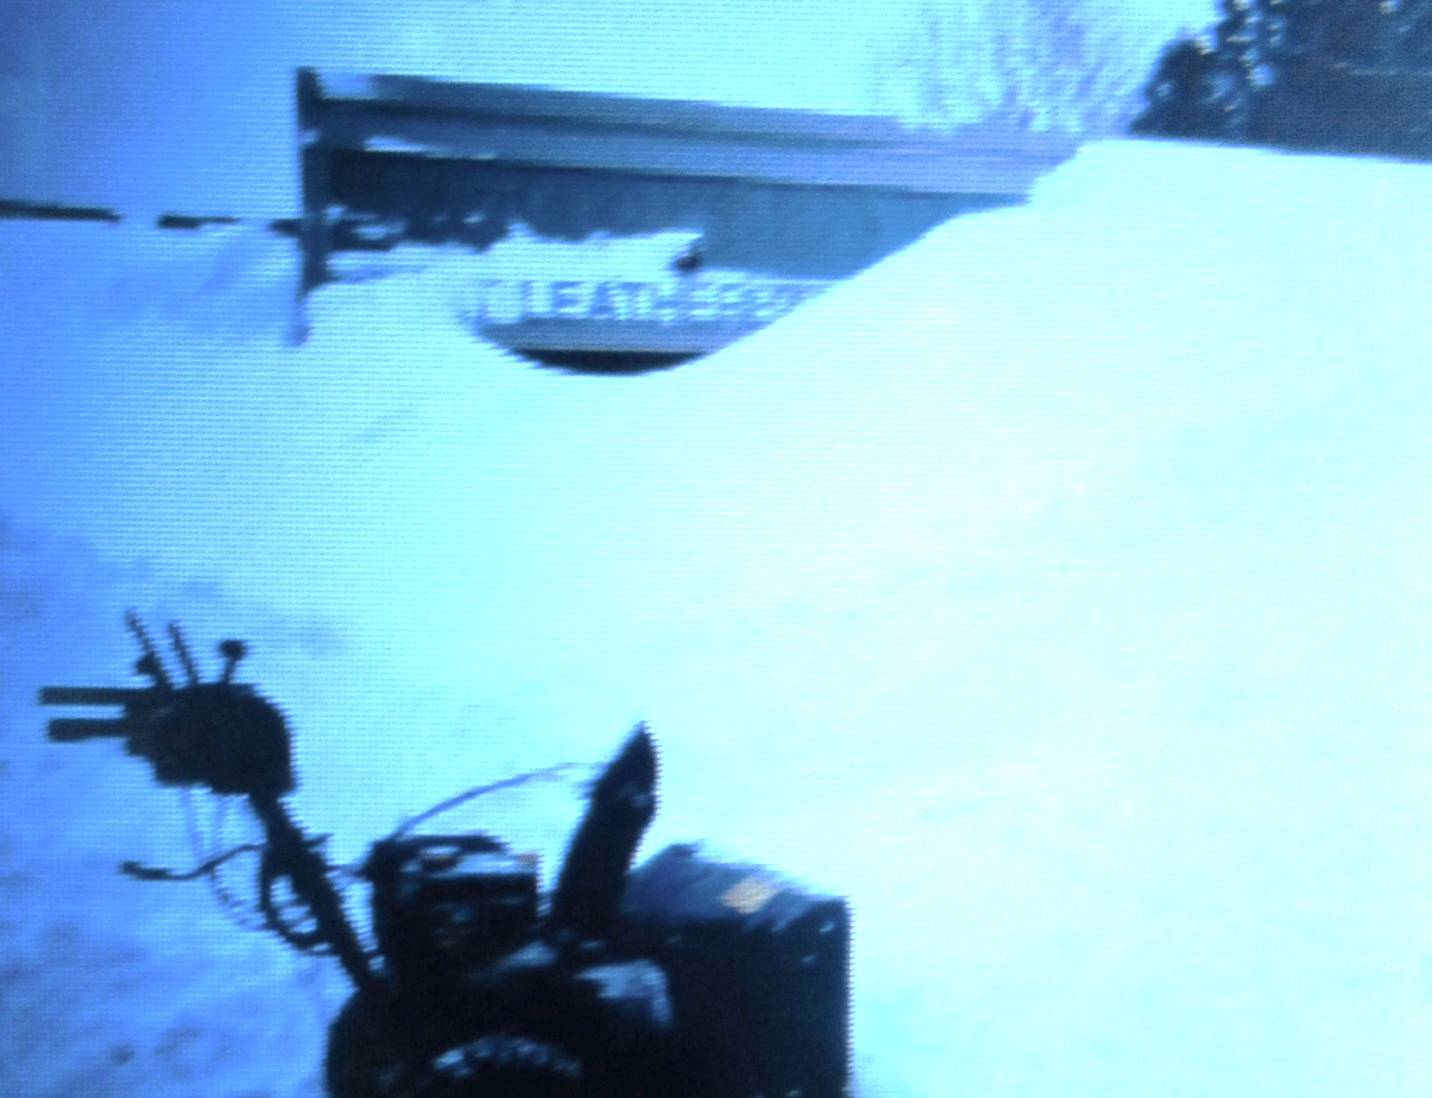
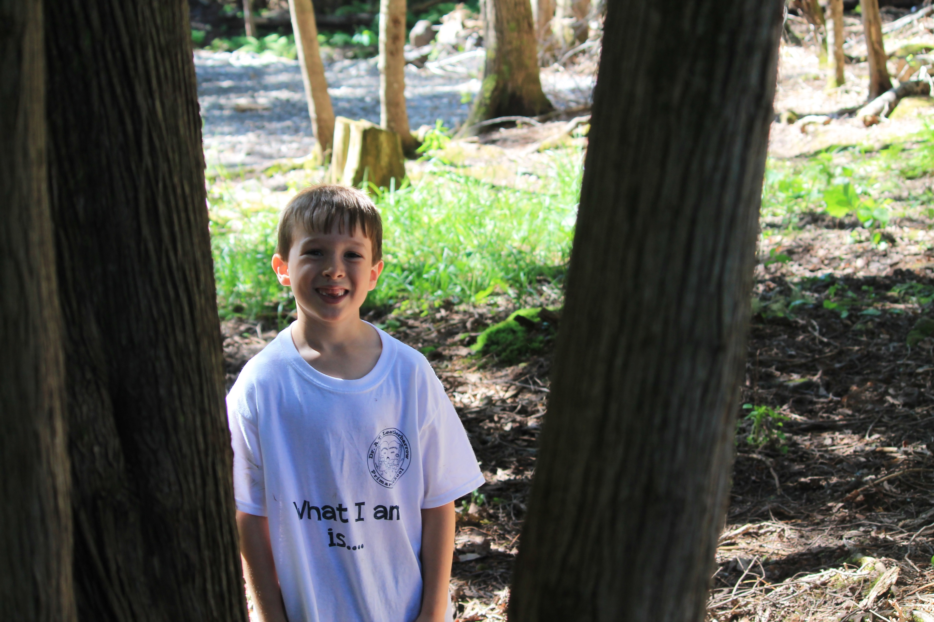
Thank you to our custodians for digging us out again!

Slide 3
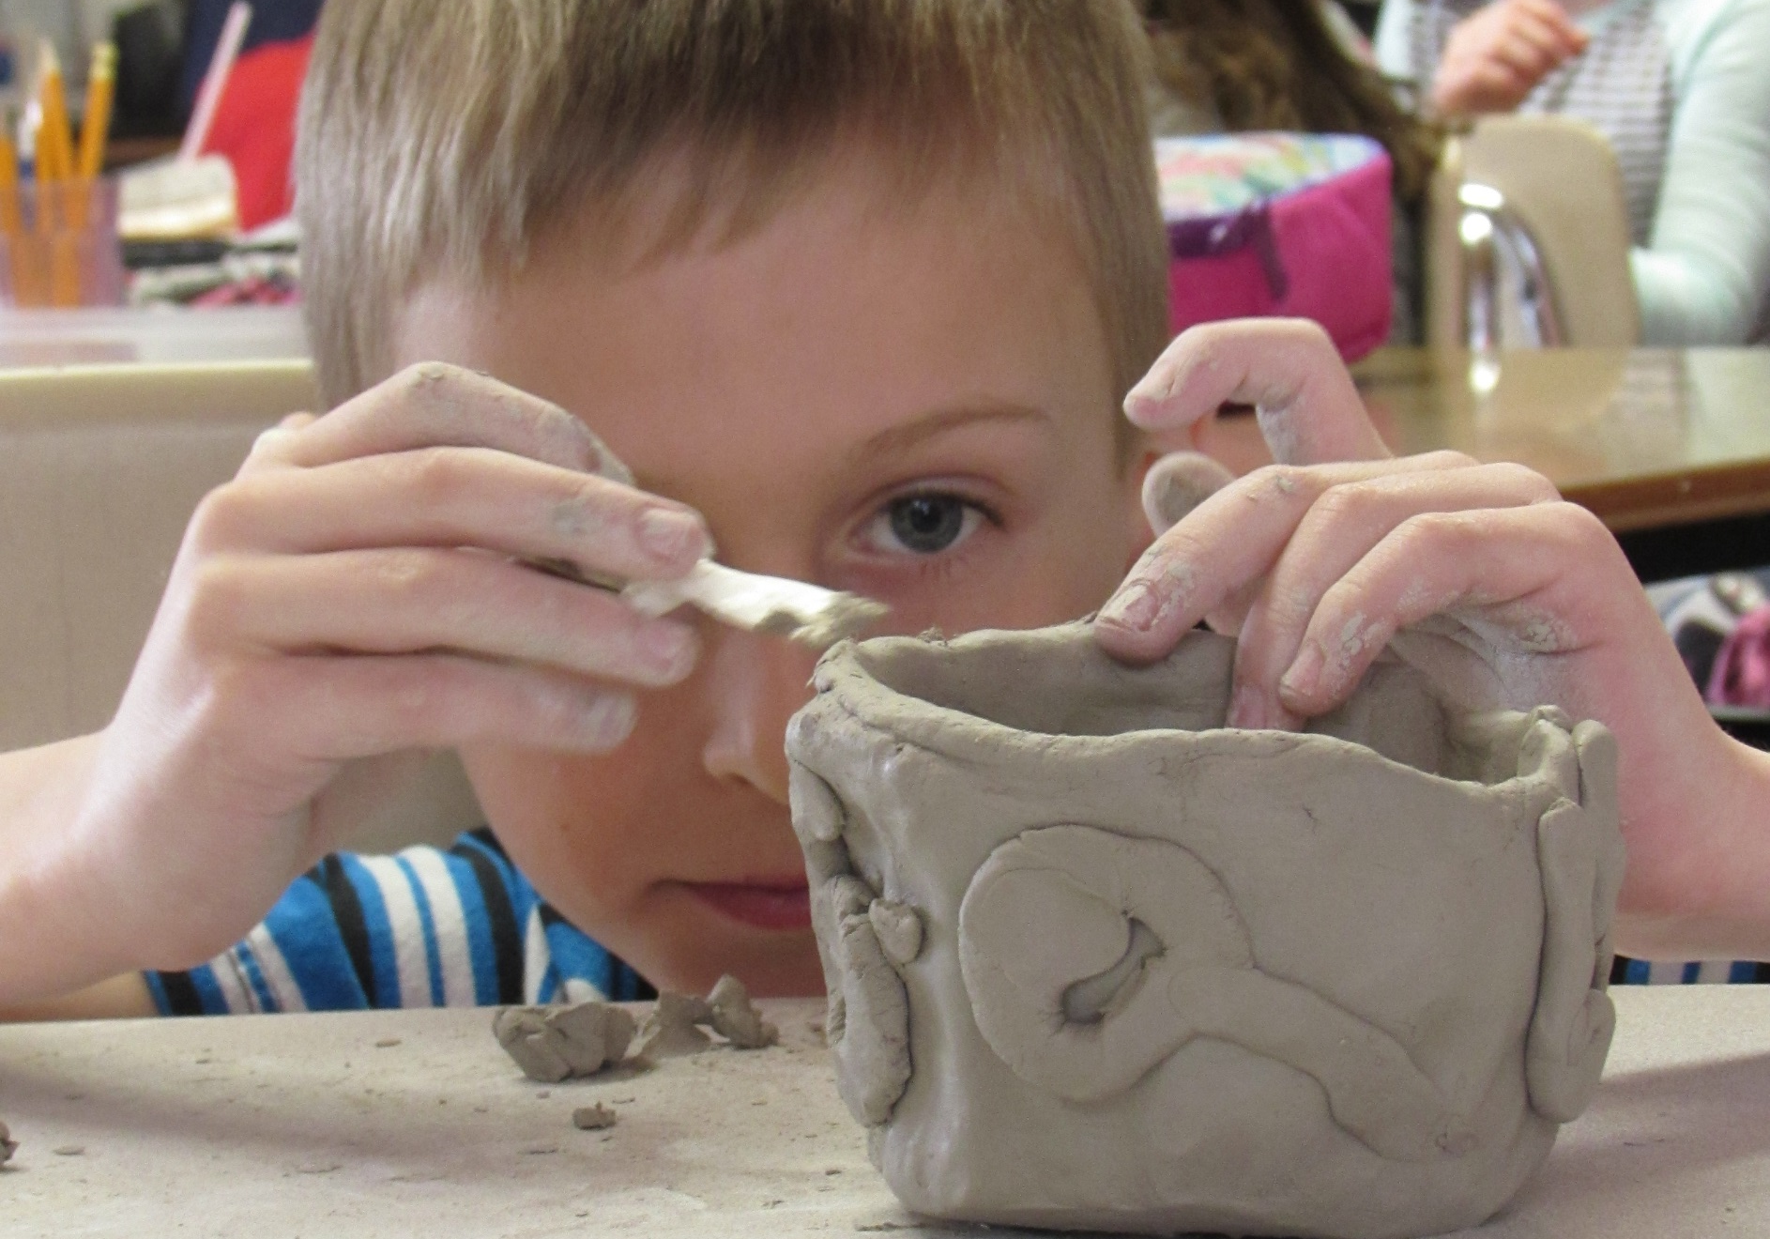
An Art Club Student Engaged in His Work

Slide 4
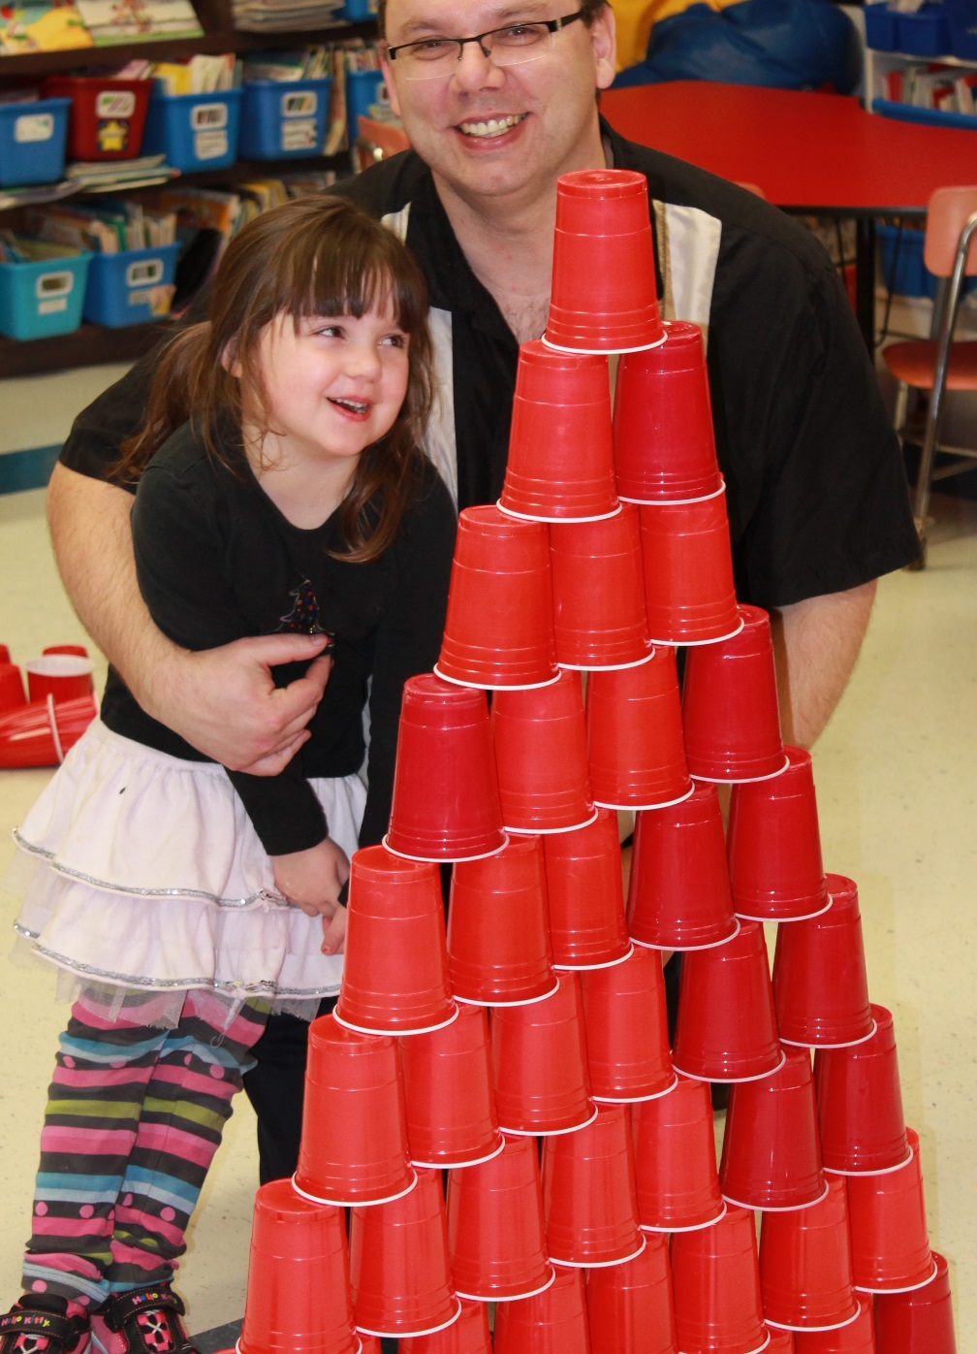
Over 100 Families Enjoyed Family Fun Fitness Night!

Slide 5
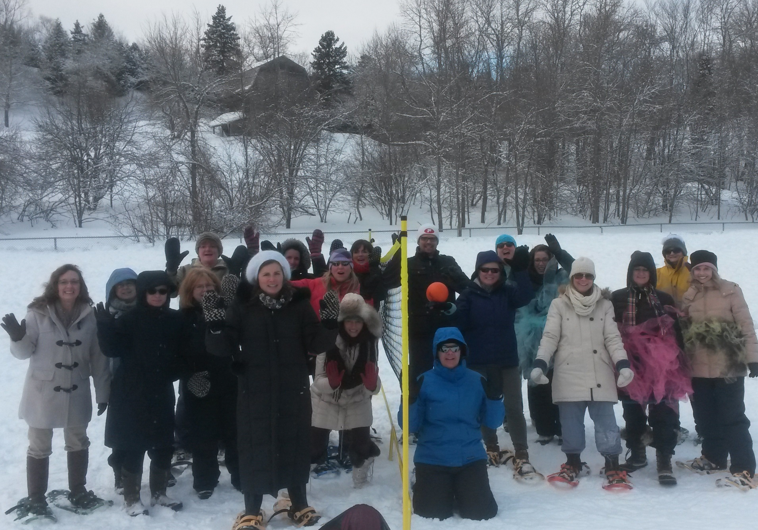
D.A.T.L. Staff Play an After-School Game of
“Mitten” Volleyball on a Winter-Wonderland ‘Court’

Slide 6
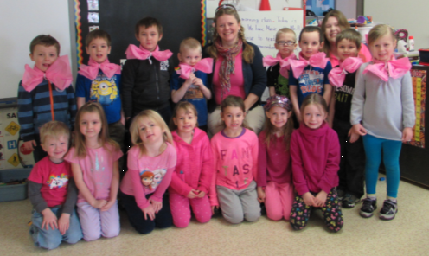
Pink Day in K Walsh --
Part of our Friendship Week Celebration

Slide 7
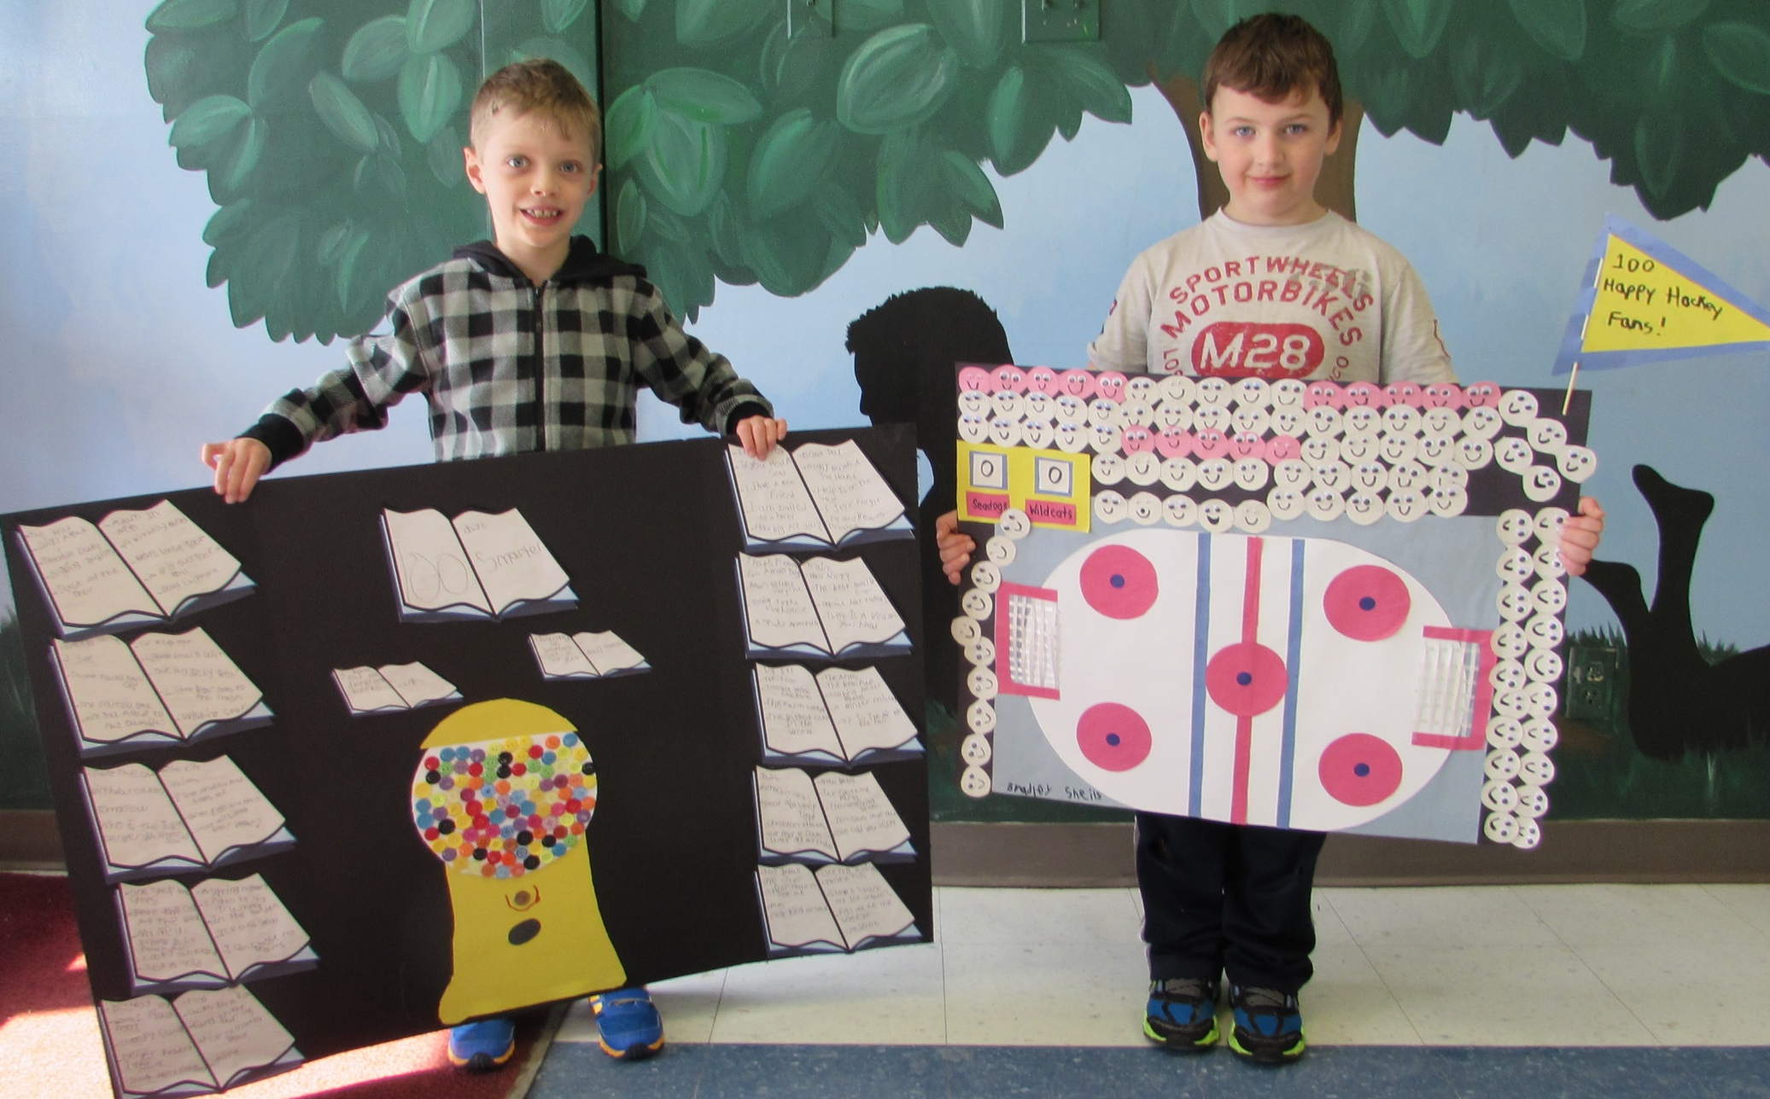
Examples of the AMAZING 100 Day Projects:
100 Books Read and 100 Hockey Fans!

Slide 8
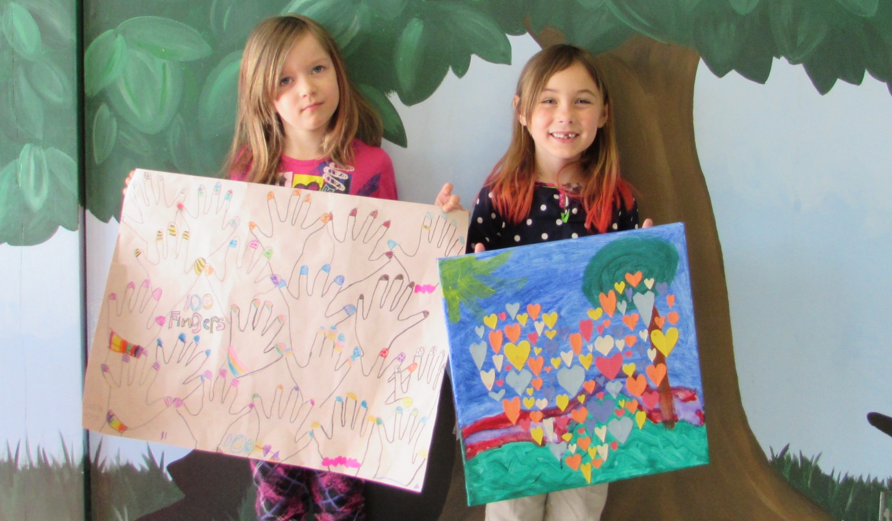
Examples of the AMAZING 100 Day Projects:
100 Fingers and 100 Hearts!

Slide 9
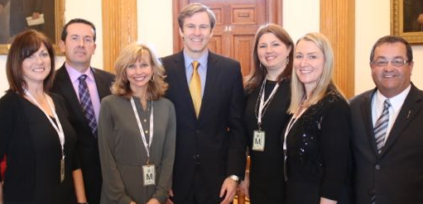
Sara Creighton was Recognized in our Legislature for Receiving the Community Living National Inclusive Education Award!

Slide 10
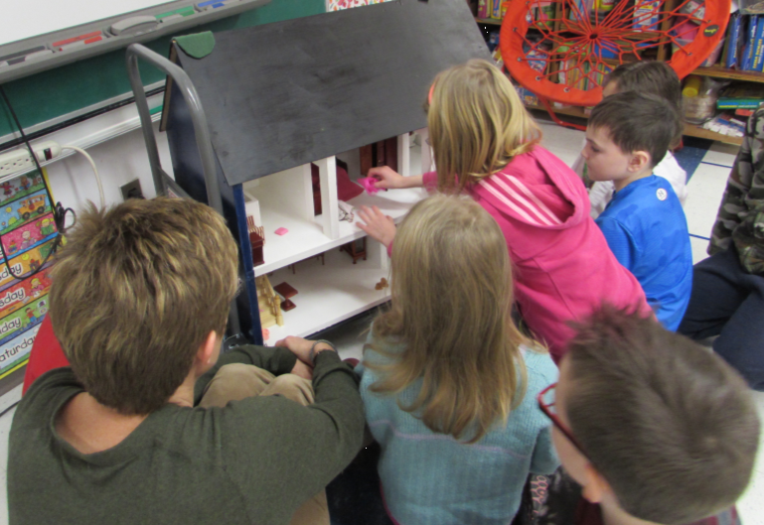
Horizon Health Presents Safety Superheroes to Grade 2
Moving A Tripping Hazard in our Homes

Slide 11
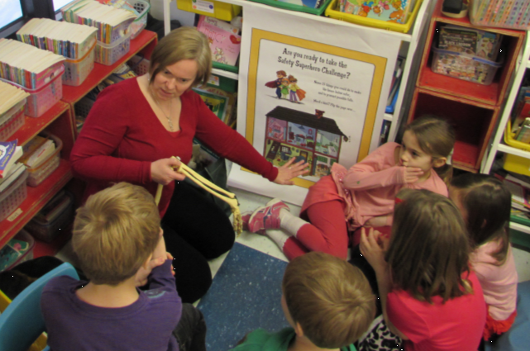
Horizon Health Presents Safety Superheroes to Grade 2
“Breaking a Fall”—See the Small Bones in our Hands & Arm

Slide 12
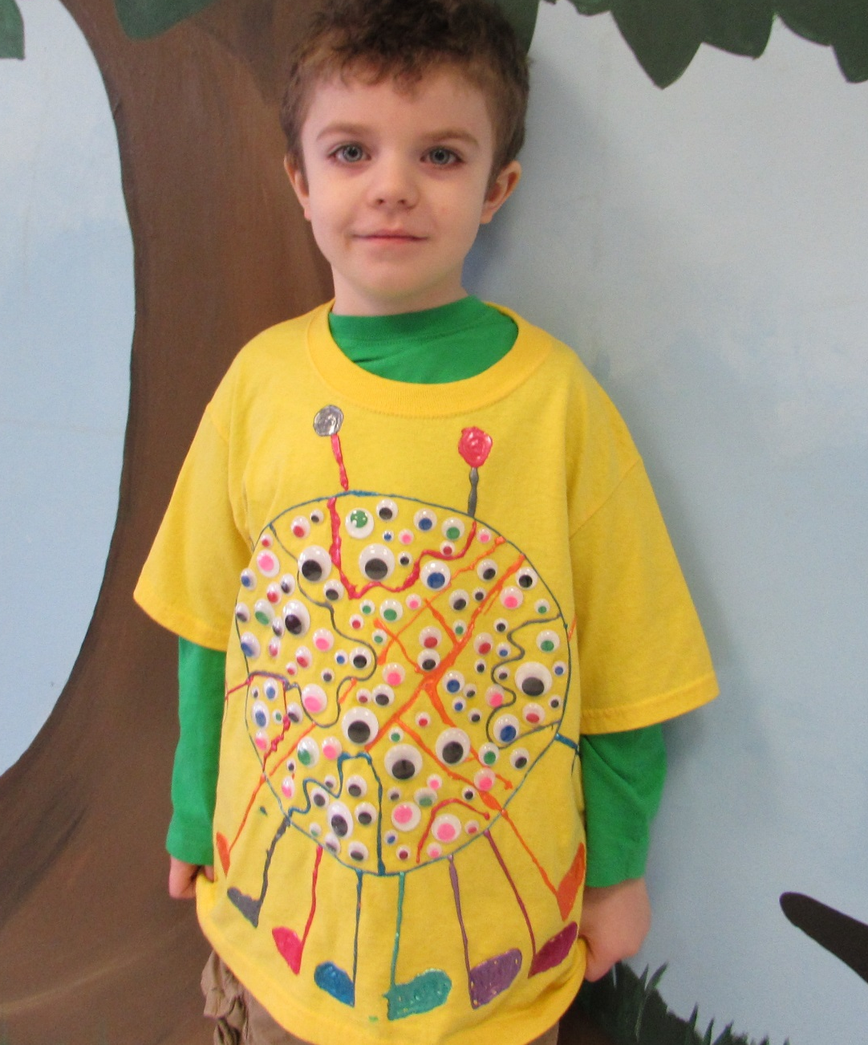
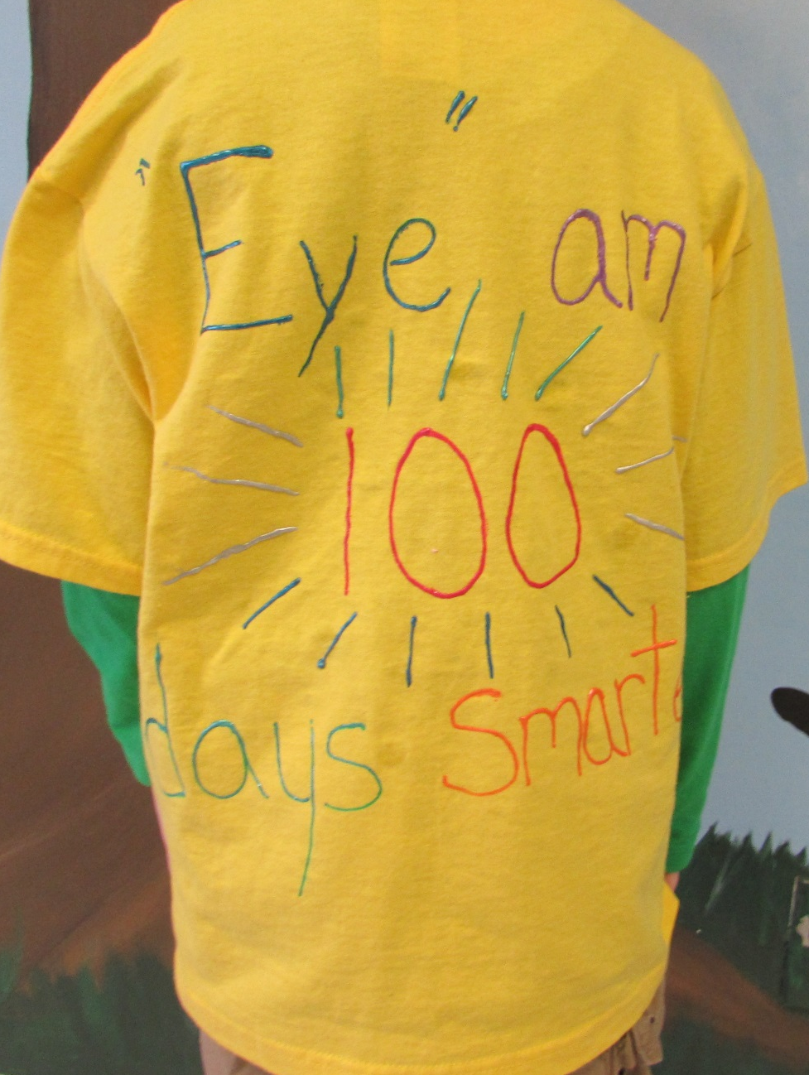
We Are 100 Days Smarter!
Great 100 Days Projects, All D.A.T.L. Students!

Slide 13
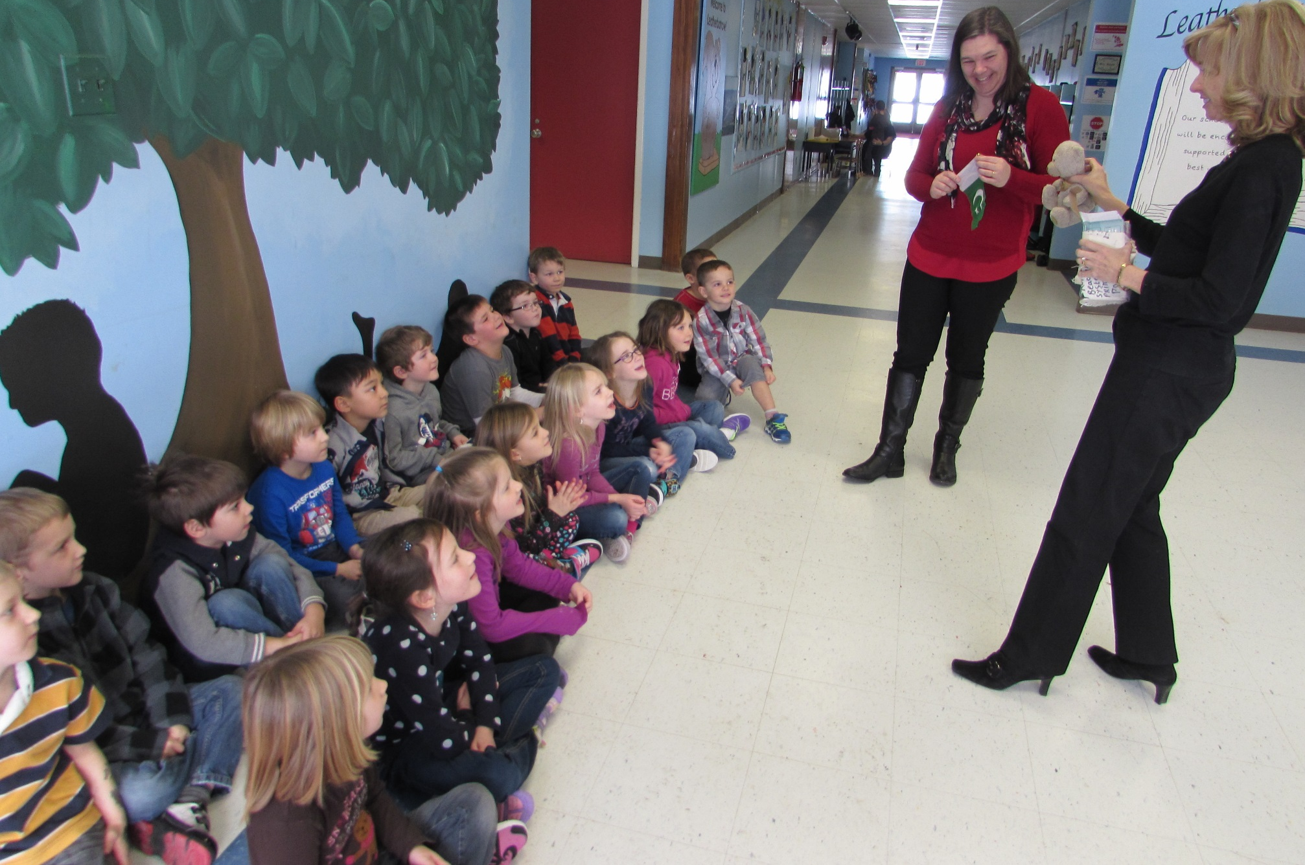
Our K-Earle Classroom is Hosting a Teddy Bear From a Pakistan School—They Will Write Back to the Students About His Adventures in Canada

