Slide 1




Dr. A.T. Leatherbarrow Primary School
Kindergarten Crash Course!
June 3, 2022

Slide 2
Fine Motor Skills
Involve the use of the small muscles that control the hand, fingers, and thumb.
Fine Motor
Printing
Legible Letters
Coordination
Visual Perception
Grasp
Scissor Skills
Immature Scissor
Skills
Grasp
Coordination
Manual Dexterity
Buttons
Zippers
Grasp

Slide 3
Components of Fine Motor
Arches of Hand – Allows the flattening and cupping of the hand.
Shift - An in-hand manipulation skill to move the pencil in place in fingers
Separation of 2 sides of the hand -The ring & little fingers hold, while thumb, index & middle fingers manipulate an object.
Translation - An in-hand manipulation movement where an object is moved between the palm and fingertips.
Finger & Thumb Isolation - The ability to move each finger and thumb individually

Slide 4
Tools to Develop Fine Motor: Things you find around the house!
Clothespins
Tweezers, tongs, turkey basters
Dice
Push pins
Dominoes
Straws and string
Q tip painting
Beads/cheerios
Nuts and bolts
Lego/small blocks
Zipping
  Tearing paper
  Pinching activities, play dough, clothespins
  Screw lids on/off
  Pop bubble wrap
  Travel size games
  Marshmallow creatures/shapes with toothpicks
  Lacing tasks
  Buttoning

Slide 5
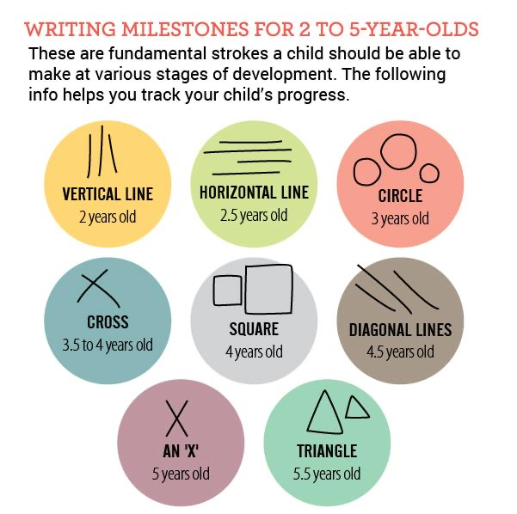
Before printing…

Slide 6
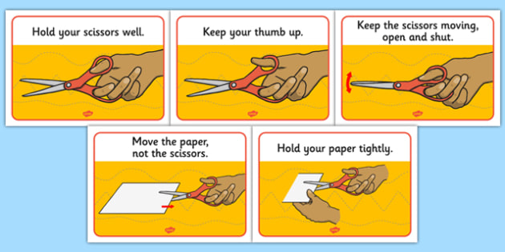
Holding Scissors

Slide 7
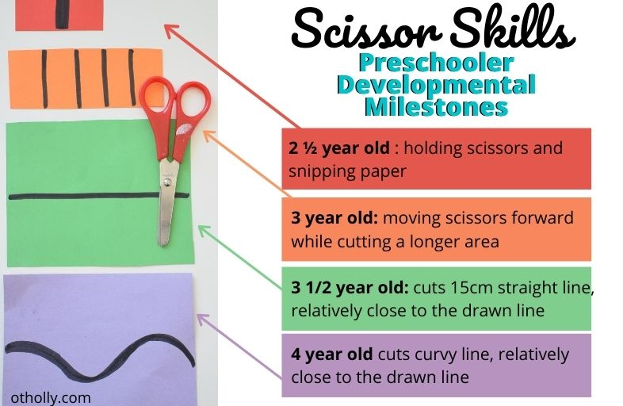
Scissor Skills

Slide 8
Phonological Awareness
Language skills move from oral to print. Important children develop these oral skills to be successful in reading/writing.
Phonological awareness refers to a global awareness of sounds in spoken words, as well as the ability to manipulate those sounds.
Rhyming
Word Awareness
Syllables
Beginning Sounds
Things you can do in the car and with eyes closed!

Slide 9
Phonics
Phonics refers to knowledge of letter sounds and the ability to apply that knowledge in decoding unfamiliar printed words.
Where phonological awareness refers to oral language, phonics refers to print.
Extremely important that you don’t add sounds at the end like tah for t
Video

Slide 10
Orthographic Mapping/Heart Words
Orthographic mapping (OM) involves the formation of letter-sound connections to bond the spellings, pronunciations, and meanings of specific words in memory. It explains how children learn to read words by sight, to spell words from memory, and to acquire vocabulary words from print.
Almost all words can be at least partially decoded. Memorizing takes 200-300x for many children to really know. Orthographic mapping takes 4-6 repetitions
https://www.reallygreatreading.com/heart-word-magic

Slide 11

Let’s Practice
At
The
Is
As more sounds/chunks are taught, fewer “heart sounds” are needed
was

