Slide 1


Slide 2
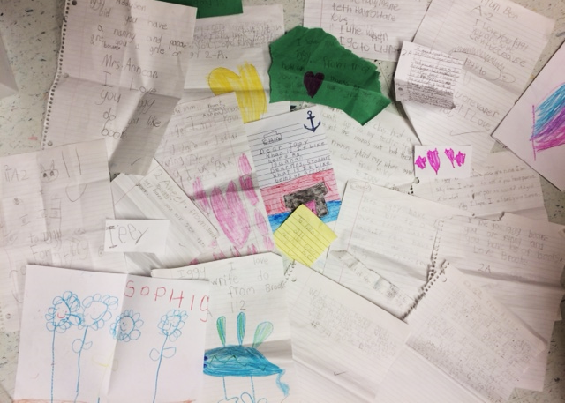
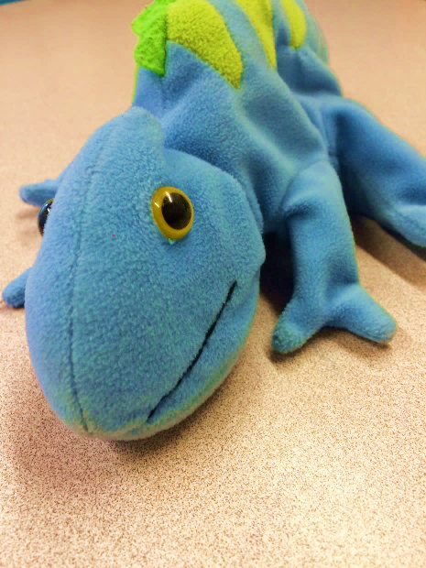

Literacy Lead = Support

Slide 3
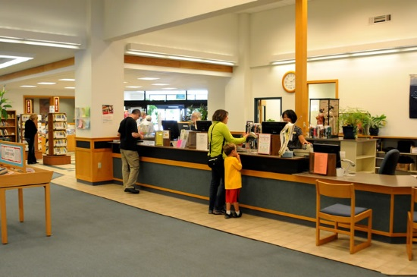
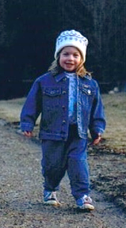
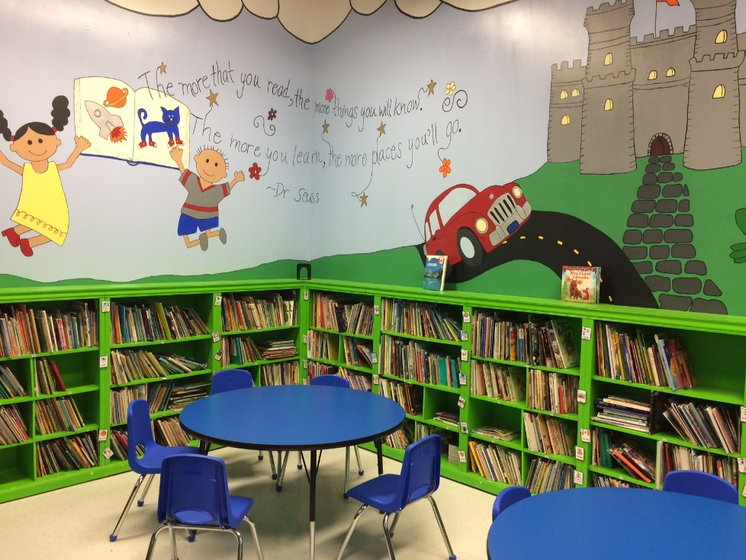
Once upon a time…

Slide 4
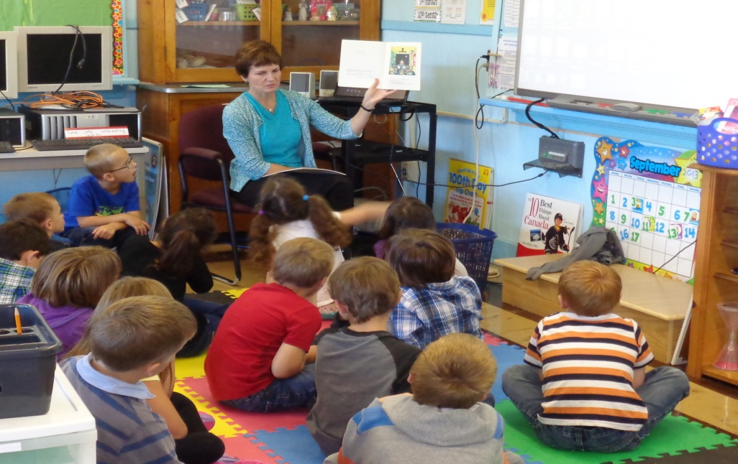

Curriculum
Reading &
Viewing
Comprehension
Accuracy
Fluency
Expand Vocabulary
Oral Language
Speaking
Listening)
Writing & Representing
Content
Organization
Word choice
Voice
Sentence structure
Conventions

Slide 5
A Balanced Approach to Literacy
Word Work
Oral Language
Read Alouds
Shared Writing
Modelled
Writing
Shared
Reading
Guided Reading
Independent Writing
Independent Reading

Slide 6



Oral Language & Word Work
p
i
g

Slide 7
A Balanced Approach to Literacy
Word Work
Oral Language
Read Alouds
Shared Writing
Modelled
Writing
Shared
Reading
Guided Reading
Independent Writing
Independent Reading

Slide 8

Read Aloud
I read the title… related words
Predictions
“Find the _____.”
Notice clues in the pictures
Fill-in-the-blank
Notice patterns
Chiming In
Model Fluency and expression

Slide 9
A Balanced Approach to Literacy
Word Work
Oral Language
Read Alouds
Shared Writing
Modelled
Writing
Shared
Reading
Guided Reading
Independent Writing
Independent Reading

Slide 10
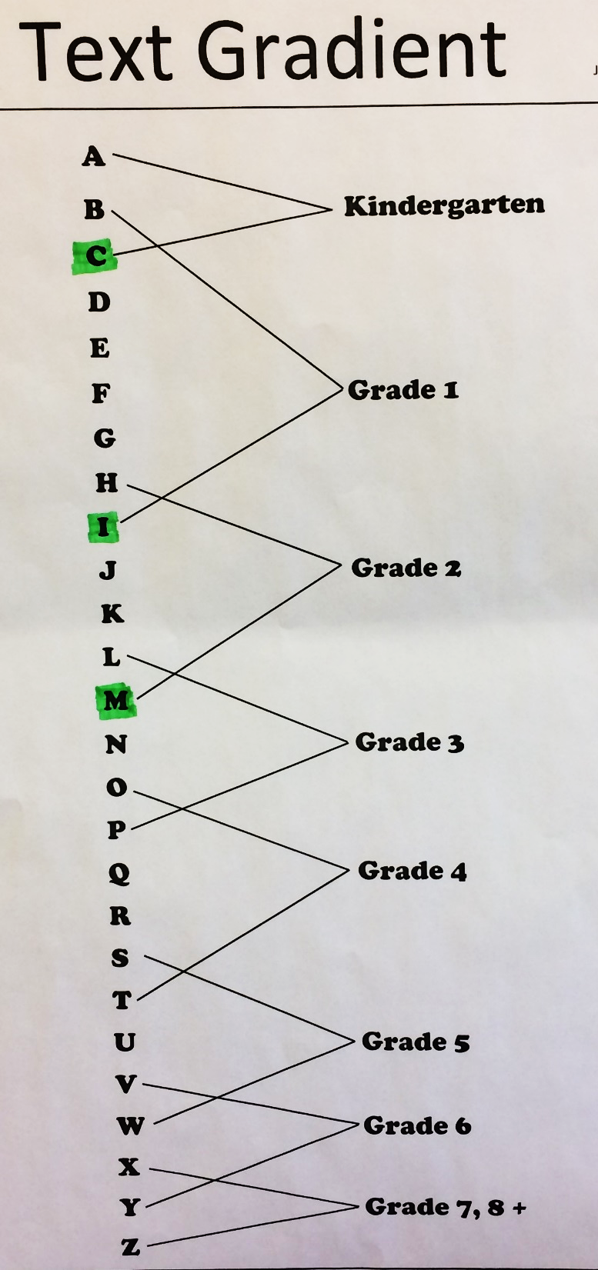









A Word about Reading Levels

Slide 11
EXAMPLES - Reading Behaviours and Understandings
Level C
Thinking WITHIN the Text
  Solving Words 10+ high frequency words
  Maintaining Fluency ending punctuation
Thinking BEYOND the Text
  Predicting how it will end
Thinking ABOUT the Text
  Analyzing connections between text & pictures

Slide 12
EXAMPLES - Reading Behaviours and Understandings
Level I
Thinking WITHIN the Text
  Solving Words 100+ high frequency words
  Maintaining Fluency full range of punctuation
Thinking BEYOND the Text
  Predicting solution; based on characters or type
Thinking ABOUT the Text
  Analyzing fit between picture and text; layout
  and print features for emphasis

Slide 13
EXAMPLES - Reading Behaviours and Understandings
Level M
Thinking WITHIN the Text
  Solving Words new and interesting words
  Maintaining Fluency function of punctuation; dialogue with expression
Thinking BEYOND the Text
  Predicting text structure to predict
Thinking ABOUT the Text
  Analyzing notices a writer’s style

Slide 14

Gr. 2 Reading Expectations
Locate information
Retell a story
Identify main idea and details
Make simple inferences/predictions
Explain meaning of words
Make personal connections and express opinions
Identify purpose of text and text features

Slide 15

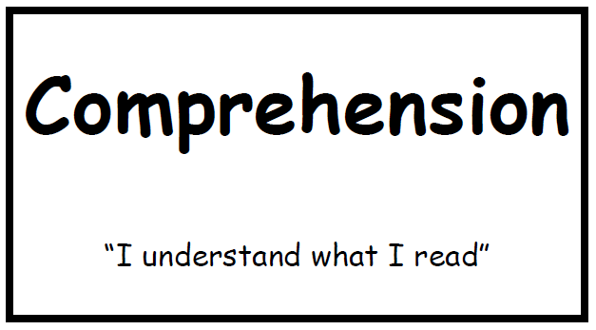
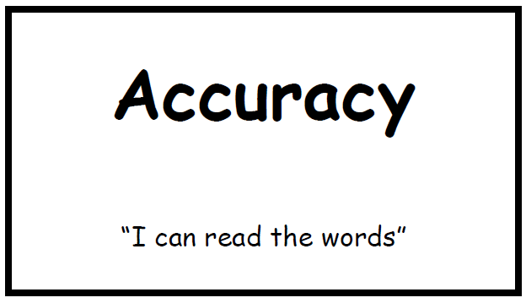
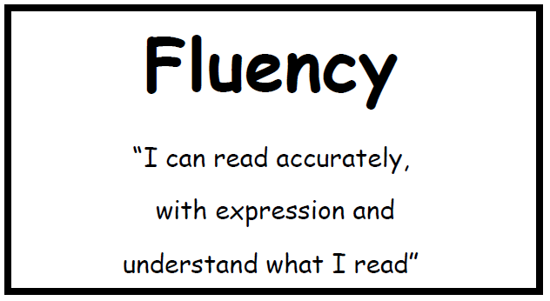
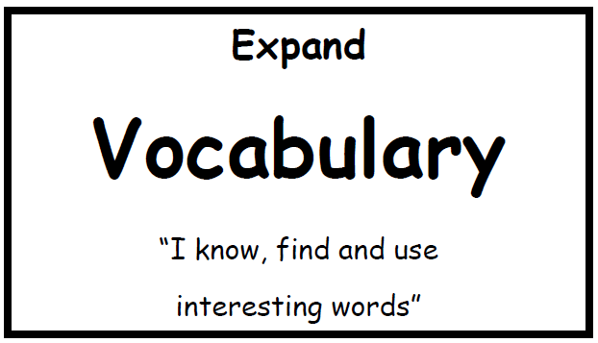
Reading… “CAFÉ” & “Daily 5”
Daily 5
Read to Self
Read to Someone
Work on Words
Work on Writing
Listen to Reading

Slide 16



Reading: 3 Levels of Comprehension
Literal
Reading “the lines”
-facts/retell
-characters (who)
-setting (where)
-main events in order
-problem/solution
Inferential Interpretative
Reading “between the lines”
INFER: to deduce or conclude (information) from evidence and reasoning rather than from explicit statements
-draw conclusions
-make comparisons
-inferences about a character (e.g. feeling or actions)
Personal, Critical,
Evaluative
Reading “beyond the lines”
Make personal connections
Relate prior knowledge
Express preferences
Express simple opinions

Slide 17
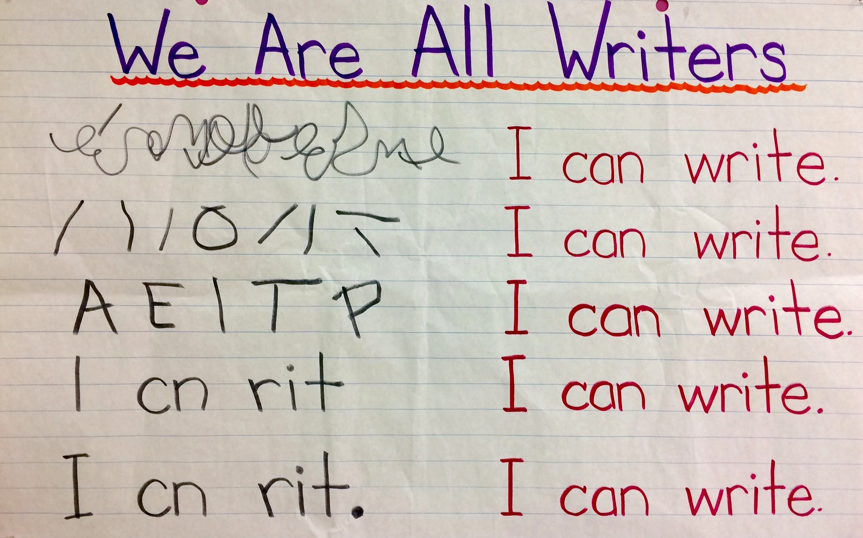

Slide 18

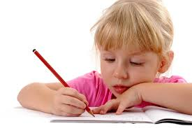
Writing – Genres or Forms
Persuasive (to convince someone)
Descriptive Report (to describe a topic)
Explanatory Report (how something came to be/works)
Instructions/Procedures (how to do something)
Recount (tell about past events)
Narrative (to entertain with an imaginative experience)
Content
Organization
Voice
Word Choice
Sentence Structure
Conventions

Slide 19
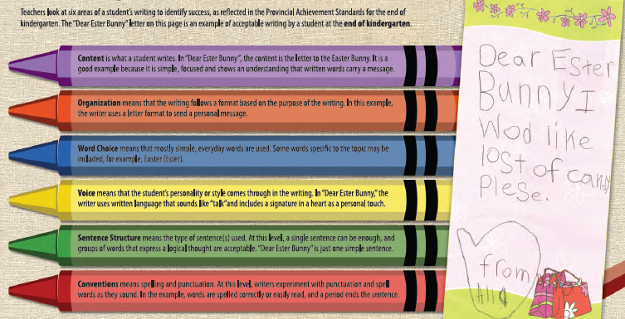
End of Kindergarten…

Slide 20
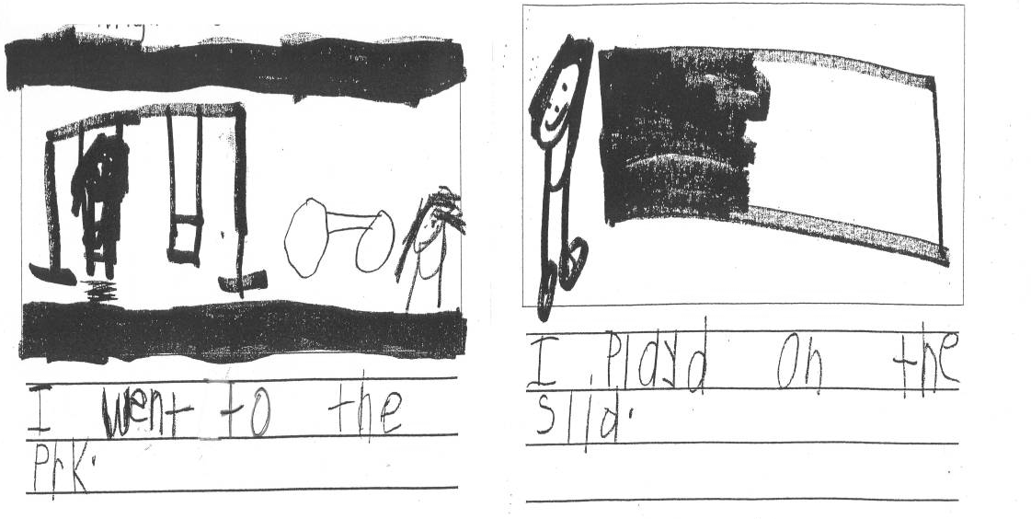
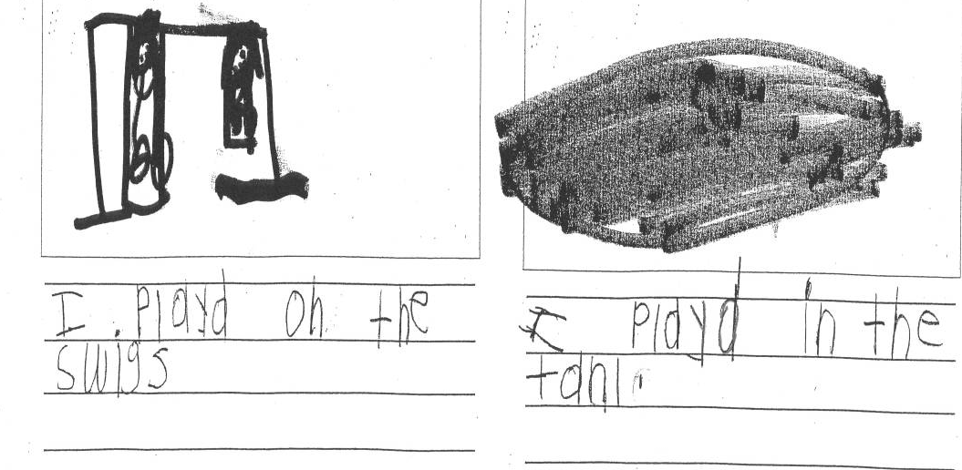
Kindergarten
Expectations
use drawings and repetitive patterns to organize ideas
• use writing tools, often with support (e.g., word wall, alphabet chart, environmental print)
• use sound/symbol knowledge to write unknown words
• share writing orally

Slide 21
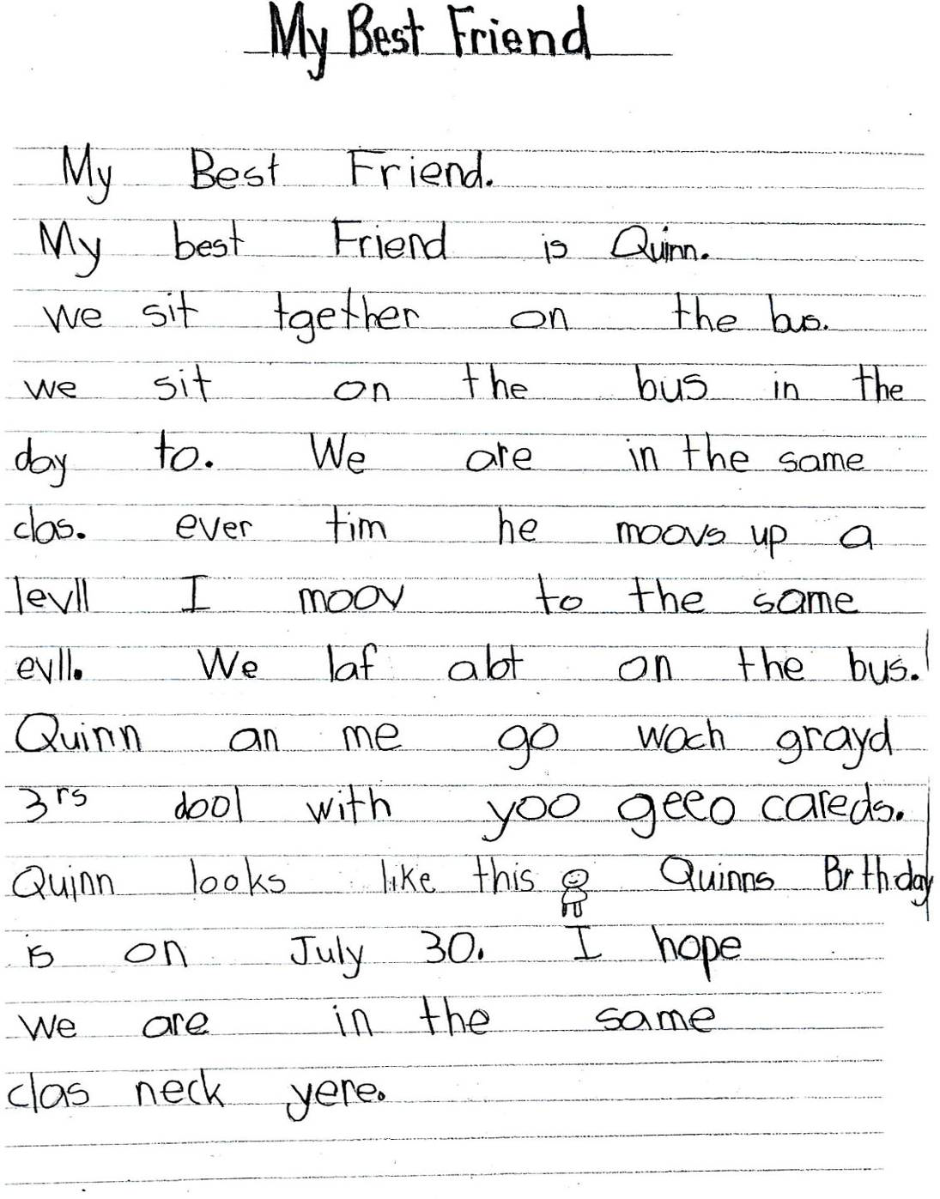
Grade 1
Expectations
• generate ideas ; use drawings and organizers to get started
• reread to check for meaning
• use writing tools (word wall, environmental print…)
• use sound knowledge, word pattern, etc. to write unknown words
• revise (add details or change words)
• periods, capitals & spelling
• present writing orally and/or in simple published forms

Slide 22
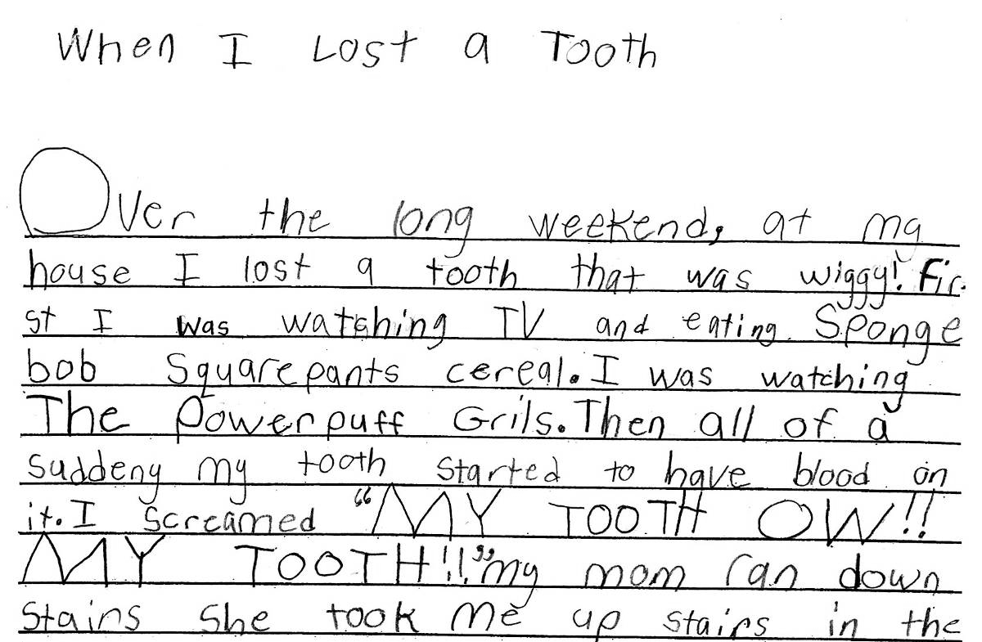
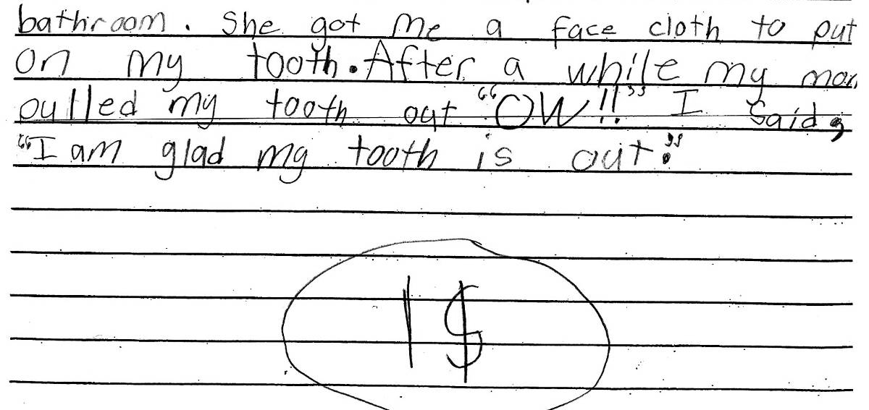
Grade 2
Writing Expectations
Stay on topic and include details
Simple beginning, ideas in sequence, simple connecting words, abrupt conclusion
Basic vocabulary with some descriptive words
Show interest in topic, personal style
Simple sentence structure, some longer, some different beginnings
Periods, ?, !, capitals and spelling

Slide 23

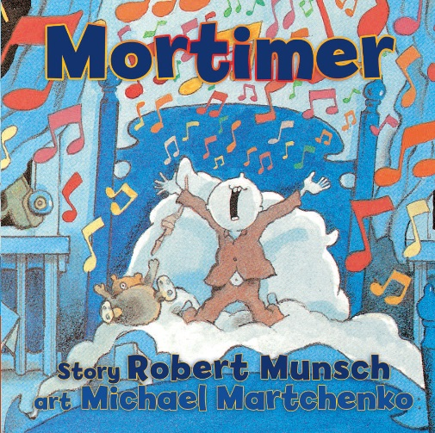








A Read Aloud… Start with a Favourite

Slide 24
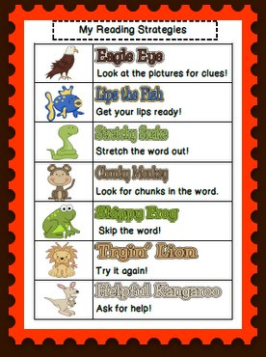
“Stuck on a Word!?”
I use my knowledge of sight words
I notice a pattern
I look at the beginning of the word
I think about what would make sense. I make a picture of what’s happening in my head

Slide 25



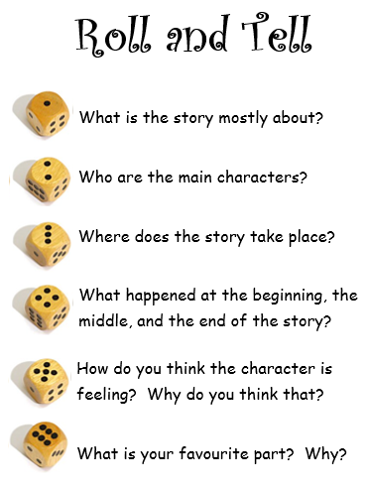
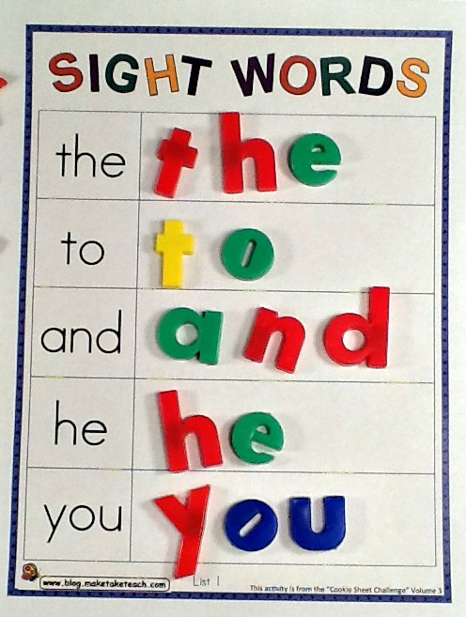

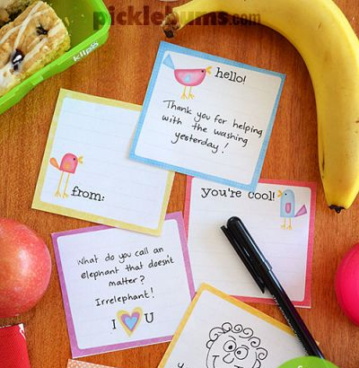
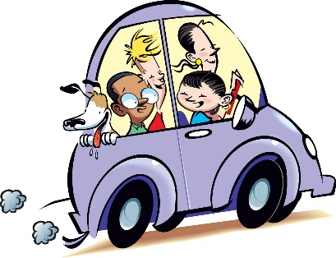
To Try at Home…

Slide 26
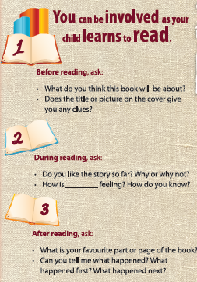
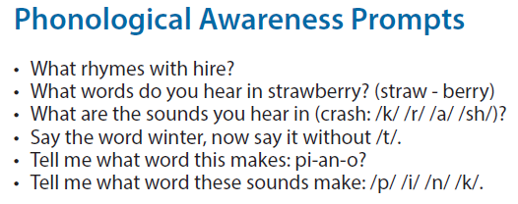
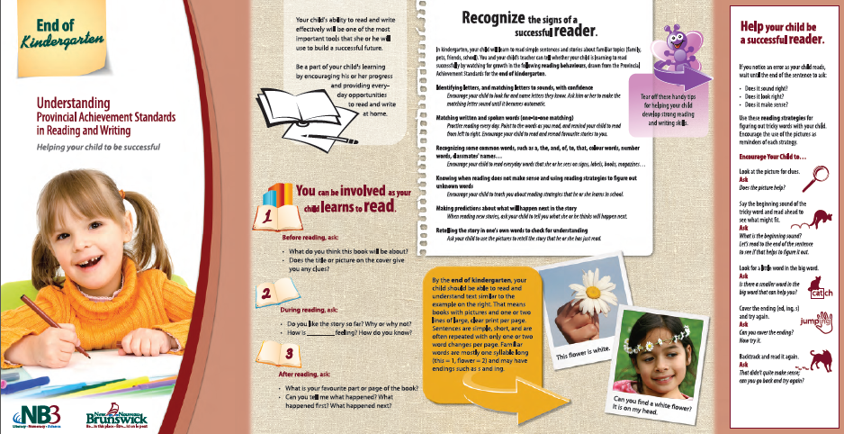
Visit…
NB Dept. of Education & Early Childhood Development
Reading Rockets

Slide 27


Slide 28


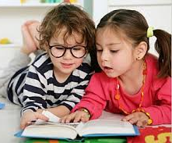


Tips for Families… Read!
Read from day one.
Share books every day.
Reread favorites.
Send positive messages about the joys of literacy.
Visit the library early and often.
Find the reading and writing in everyday things.
Give your reader something to think and talk about.
Talk, talk, talk!

