Slide 1
Grade 9 Course Selection
For students Entering grade 10 in 2022-2023
March 2022
Notes:
Please have them place their name and homeroom teacher name in their course selection book.

Slide 2
Grade 10 Year – English Program
You take 10 courses in Grade 10 (5 courses per semester)
English 10 – Information Texts
Math Course #1
(GMF or NRF)
PIF 10(semester long)
Social Studies 10 (semester long)
Broad Based Technology 10 (semester long)
Elective Course
Alternates x2
(Used if first choices are FULL)
Elective Course
English 10 – Literary Texts
Elective Course
Math Course #2
(NRF or Foundations 110 or Finance Math 110

Slide 3
Grade 10 Year – French Immersion Program
You take 10 courses in Grade 10 (5 courses per semester)
English 10 – Information Texts
Math Course #1
(FI GMF or FI NRF)
FILA10(semester long)
FI Social Studies 10 (semester long)
Broad Based Technology 10 (semester long)
Elective Course
Alternates x2
(Used if first choices are FULL)
Elective Course
English 10 – Literary Texts
FI Elective Course
Math Course #2
(FI NRF or FI Foundations 110 or Finance Math 110

Slide 4
Elective Options
Health and Phys Ed 10
Music 10
Visual Arts 10
Intro to Applied Tech 110 & Mill and Cabinet 120 (2 credits – must select both)
Independent and Family Dynamics 120 (FI option)
Biology 111 or Biology 112 (Must pass Sci 9)
Chem 111 or Chem 112 (Must Pass Sci 10)
Notes:
Science 9 & 10 may be added to your timetable if you did not pass them.

Slide 5
Course Levels - What do they mean?
Level 1 (credit courses ending with a 1) are university preparatory and Advanced Placement pre-requisites
Level 2 (credit courses ending with a 2) are university preparatory
Level 3 (credit courses ending with a 3) are college prepatory
Level 0 (credit courses ending with a 0) are inclusive of all levels

Slide 6
Enrichment Begins in Grade 10
Enriched Math→ Students select NRF 10 & Foundations of Math 110 (OR F.I. NRF and F.I. Foundations)
Leads to PC 110, PC 12A & PC12B in Grade 11
Calc 120 and AP Calculus in Grade 12
Encouraged to take at least one of the two sciences (Biology or Chemistry) at the 111 Level.

Slide 7
Enrichment(Continued)
Enriched English→ Students select English 10 (Full Year)
Leads to Eng 111 & AP Seminar in Grade 11
Eng 121 and AP English in Grade 12
Students who complete AP Seminar in Grade 11 are encouraged to complete AP Research in Grade 12

Slide 8
Enrichment Opportunities
French Camps
Homestay Family for an International Student
Participating in Musical/Band/Choir
Participating in Sports
Being a member of the SRC (Student Council)
Reach for the Top
Makerspace
AP Subject courses – History, Politics, Music, Biology, Statistics, and more!

Slide 10
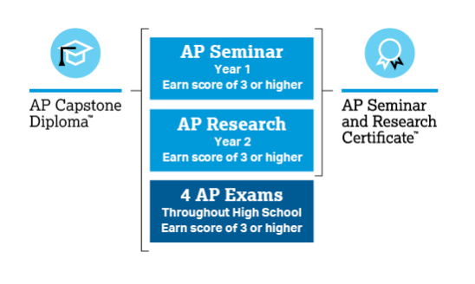
Notes:
Personalise
AP Seminar - Course Description
Students will examine materials like news stories, research studies, and literary works to craft arguments to support a point of view and communicate them effectively through the use of various media. Students will consider an issue from multiple perspectives, evaluate the strength of an argument, and make logical, fact-based decisions. Students will be assessed through a combination of individual and team projects and presentations as well as through a written exam.
AP Research - Course Description
Students will work with a mentor in order to explore an academic topic, problem, or issue that interests them and design, plan, and conduct a year-long research-based investigation to address it. The course culminates in an academic thesis paper of approximately 5,000 words and a presentation, performance, or exhibition with an oral defense; where you answer 3-4 questions from a panel of trained evaluators.

Slide 11
The Benefits of AP Capstone
Participating in AP Capstone can help students:
Stand out to universities in the application process.
Develop key academic skills they’ll use in university and beyond.
Become self-confident, independent thinkers and problem solvers.
Earn university credit: Many universities offer credit for qualifying scores.
Notes:
Advanced Placement History of Success
St. Malachy’s Memorial High School is among the few Canadian high schools who offer the program and we have three trained and experienced teachers.
We were the first school in Atlantic Canada to offer the full advanced placement Capstone Diploma and the only one thus far to graduate students in this program. Last year 7 students graduated the program.

Slide 12
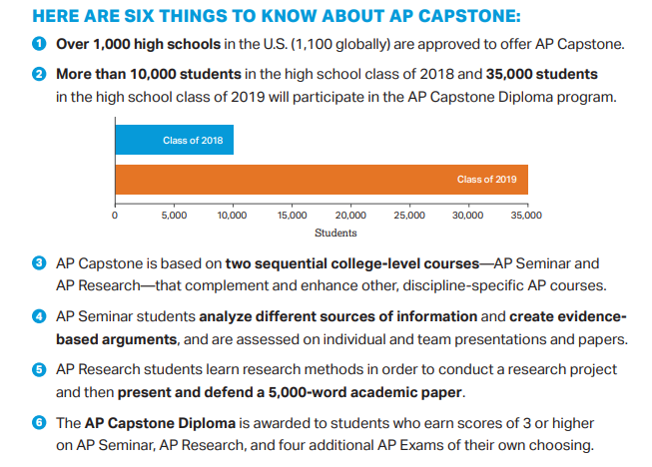
Notes:
We are willing to go above and beyond to bring enrichment opportunities to our students.
AP capstone is just that opportunity. The two courses, Seminar and research, will allow students to more fully develop their critical thinking and research skills.
Our vision would see the seminar course offered to our grade 11 students – it could serve as both a credit course and a great introduction to the AP program. We will reserve the research course for Grade 12 when many students have space for electives and would prefer a rigorous academic course.

Slide 13
Essential Skills
Offered half-way through Grade 10.
Project Based program that allows students to gain high school credits through alternate means.
Provides experiential and job-embedded learning
Students will need to apply for entry and will be selected by Guidance, Admin and the Essential Skills Teacher.

Slide 14
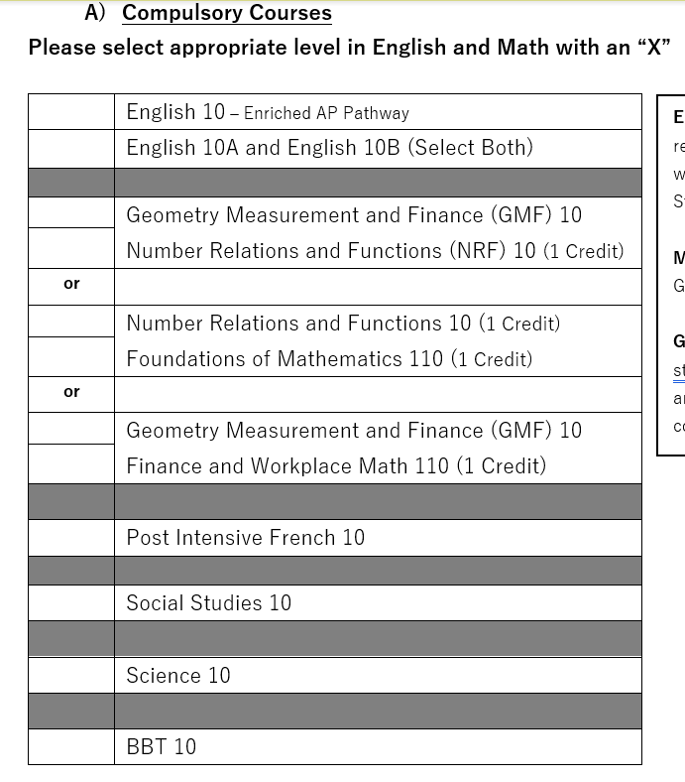
Completing the Course Selection Sheet
Pick an English Option…
3 options available. The first two options keep all post-secondary options open. The third option should only be selected in consultation with guidance or resource.
No choices on the bottom part!
Notes:
Page 24 is the draft and 25 is for their final copy.
They can plan their future year course selections here.
The tables at the bottom of the page are for upper level students only.

Slide 15
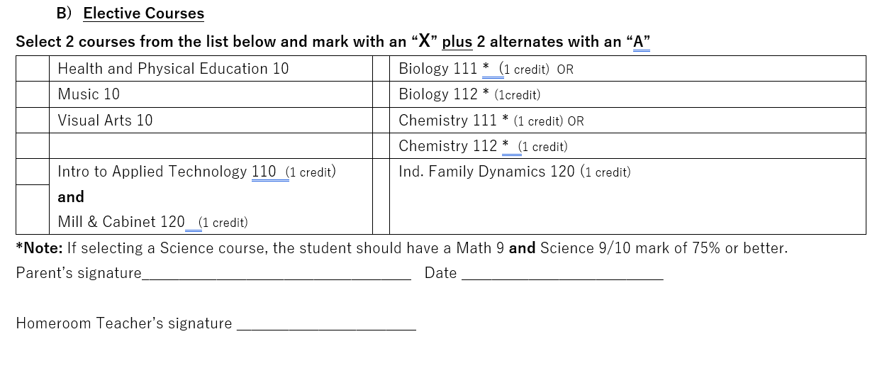
Completing the Course Selection Sheet
3 elective courses
2 Alternates
You can only select one of these!
111 & 112 are virtually the same course with small differences
Notes:
Page 24 is the draft and 25 is for their final copy.
They can plan their future year course selections here.
The tables at the bottom of the page are for upper level students only.

Slide 16
Course Selection online submission must be completed by March 25
Course Registration Forms are to be completely filled out, signed by your parent and handed in to your homeroom teacher by no later than Friday March 25.
You will be inputting this information into PowerSchool with the help of your homeroom teacher Wednesday March 23.
Priority will be given to Grade 10 students who have completed their table properly and submitted selections online by March 25.
Timetabling depends on numbers of students selecting each option and you are not guaranteed all choices in Grade 10. Credit courses are a privilege.

Slide 17
Scholarship Myth Busting
Large, Big Name Scholarships – marks are only a portion of the consideration
University Entrance – they have their own calculation but they only use the 6 or 7 grades of the entrance requirement courses to calculate it – all other courses are ignored.
School Based ones – we drop the low grade and give bonuses for enriched level courses.
Financial Need factors into many of them!

